Slide 1


Slide 2
Task 1: Predication Using Supervised ML
Predict the percentage of an student based on the number of study hours.
This is a simple linear regression task as it involves just two variables.
Data can be found at : https://bit.ly/2HxiGGJ
In this task , we have to predict the score of student if a student studies for 9.25 hrs/day.

Slide 3
Supervised Machine Learning:
Whenever we are solving the problem of supervised machine learning there are one independent feature and one or more than one dependent features.
It is defined by its labelled datasets to train algorithm that to classify data or predict outcomes accurately.
In supervised machine learning, two major problem statement basically solves first is regression and second is classification.
In our case, we will discuss about regression and in regression we solve problem using simple linear regression.
It is a ML task of learning function that maps an input to an output based an example input-output pairs.
Mapping Function
Output
Input
Figure: Supervised Machine Learning

Slide 4
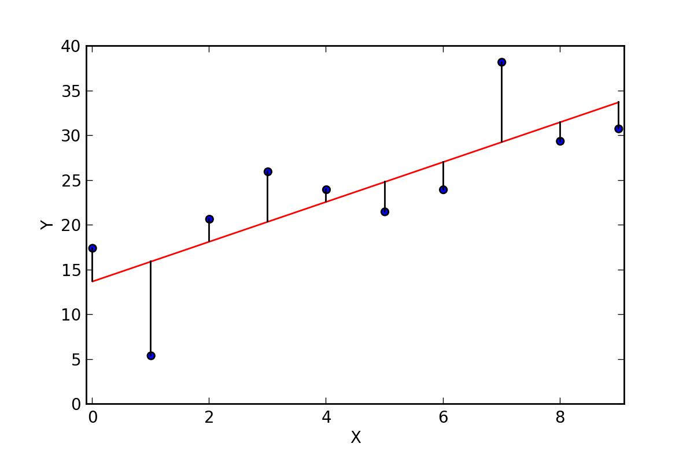
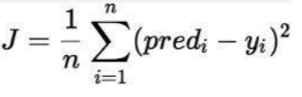
Linear Regression:
In linear regression we are trying to find best fit line which will helps us to do prediction.
To draw best fit line so that the summation of the all the point should be minimal.
The Cost Function of Linear Regression:
The cost function is the average error of n-samples in the data (for the whole training data) and the loss function is the error for individual data points (for one training example). The cost function of a linear regression is root mean squared error or mean squared error.
Y = mx + c

