Slide 1
PREDICTING THE IMPACTS OF BUSINESS ON THE SOCIAL MEDIA

Slide 2
ABSTRACT
Sentiment analysis is a method of determining the emotional state expressed in information or text by categorizing it into three categories: positive, negative and neutral
The proposed model was shown for sentiment analysis via Text Blob and Pattern.
The five small business-oriented companies’ reviews are analyzed and compared to which one is best satisfactory by the sentiment score ratio between total nos. of web scraped sentences and positive words.

Slide 3
Aims & Objectives
The purpose of this project is to look into the potential effects of social media on commercial enterprises, especially those geared towards small businesses like Bettys, The Yorkshire Soap Company, Black Yak, and Masons Yorkshire Gin. The research will make use of machine learning (ML) and artificial intelligence (AI) methodologies to accomplish this.
● To consider how the results of sentiment analysis can be used in practice to raise client satisfaction with a business's operations. Examine the ways in which sentiment insights can aid in the development of customer-centric strategies and serve as a strategic decision-making tool.

Slide 4
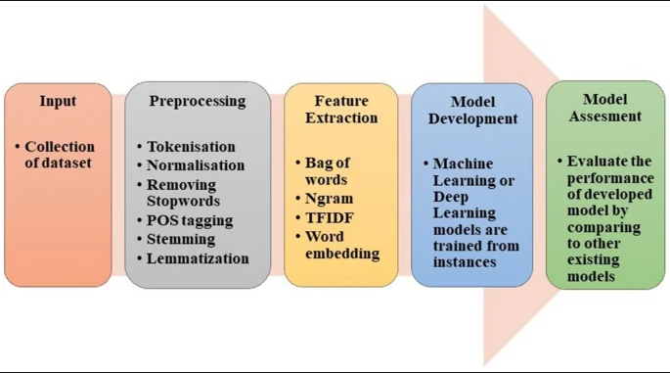
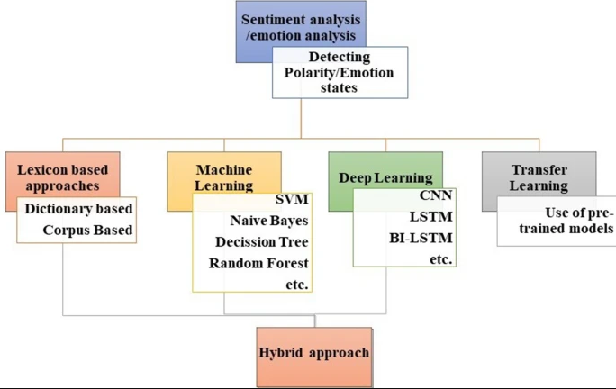
Literature Review
This review of the literature sheds light on the evolving value of social media within the business environment of the modern day through AI.
Transitioning to the methodology of the study and output, the study will examine the usage of social media for promotion and marketing, its effect on key implementation indicators, and practical strategies for enhancing outcomes (Aichner, et al. 2021)(Aljedaani et al. 2022)(Busalim and Ghabban, 2021).

Slide 5
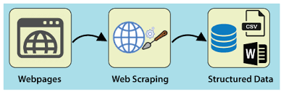
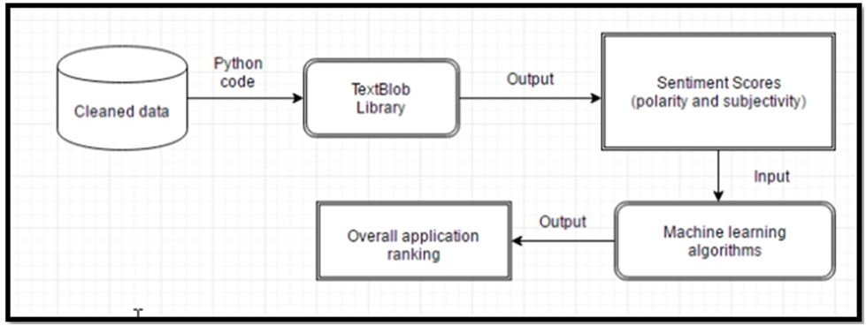
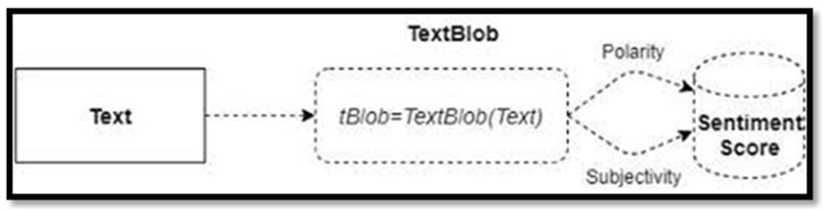
Methodology
Sentiment Analysis by using TextBlob and machine learning
Rule-based sentiment analysis
Embedding-based models
Pattern-based analysis
Sentiment Analyzer

Slide 6
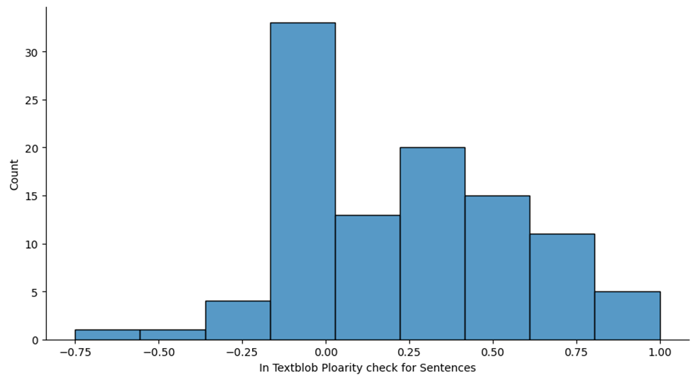
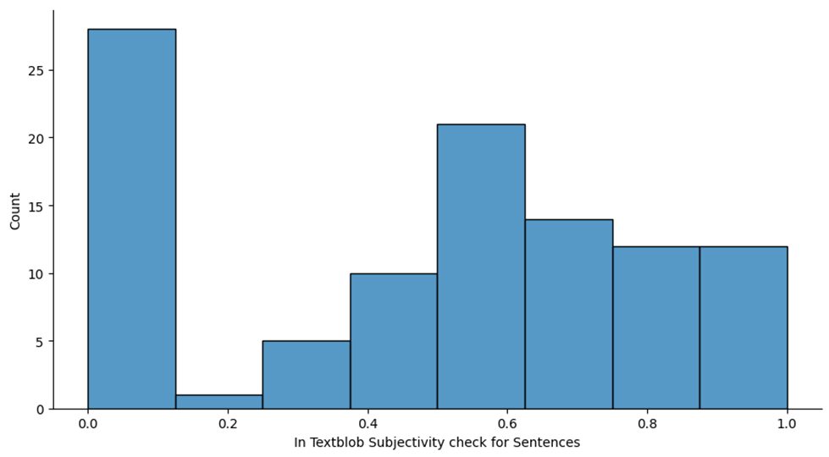
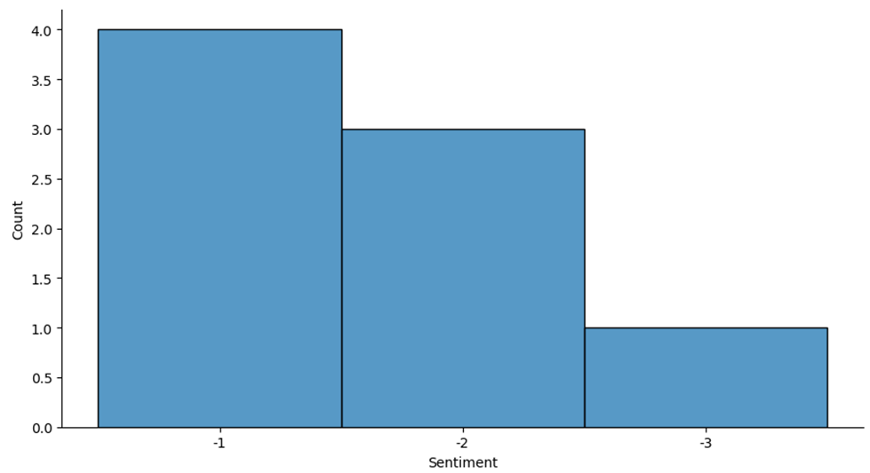
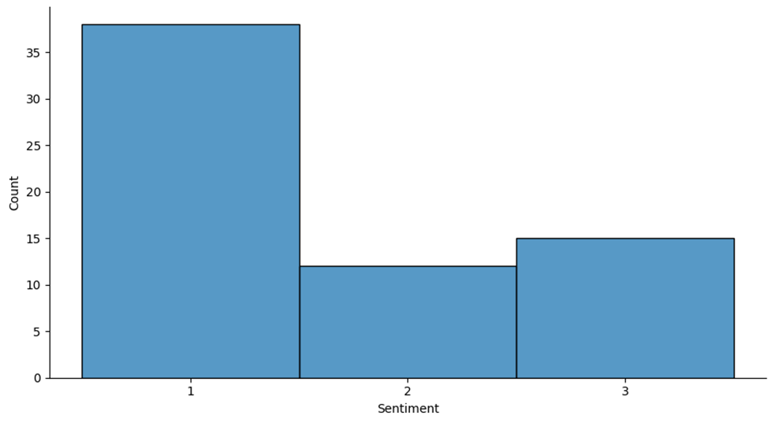
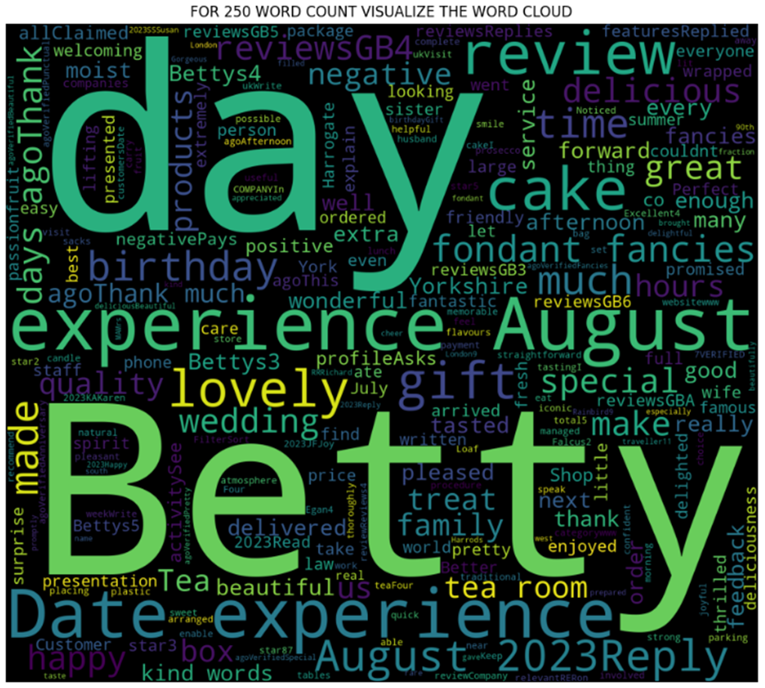
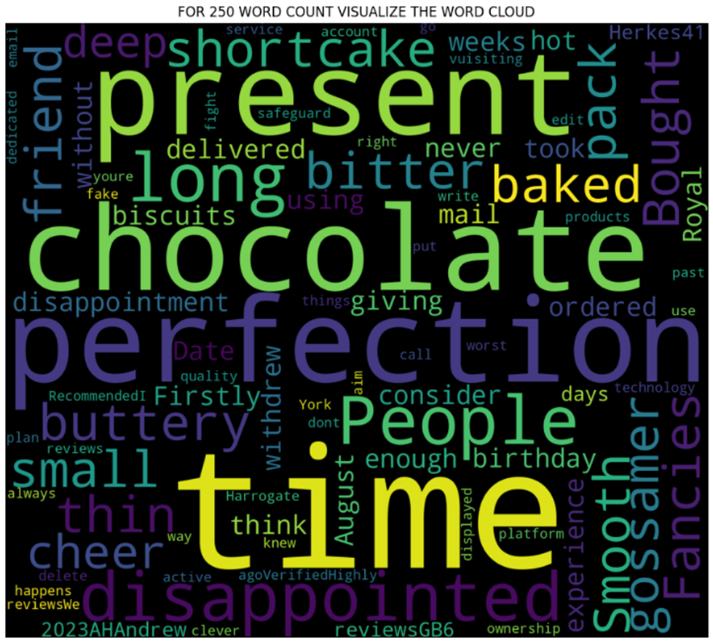
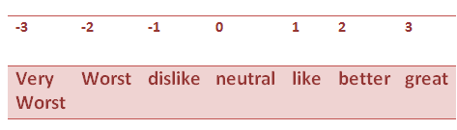
Data Analysis
Webscrapping -> cleaning, tokenization, and visualization -> Sentiment analysis by combined and average methods through the pattern and Textblob ->positive and negative words by Subjectivity {0,3} and Polarity {-3,3} -> Visualization the Word Cloud -> Identify the Customer demands.

Slide 7
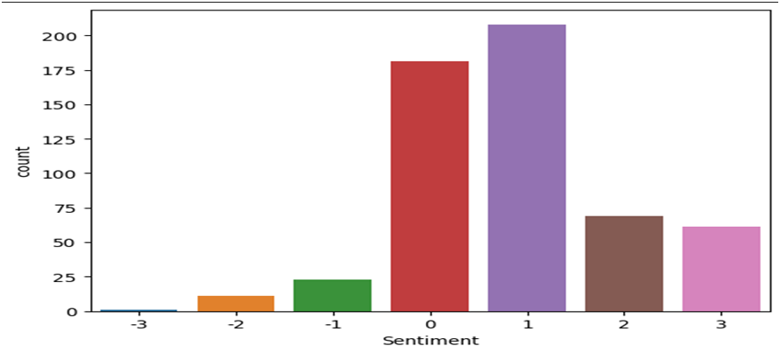
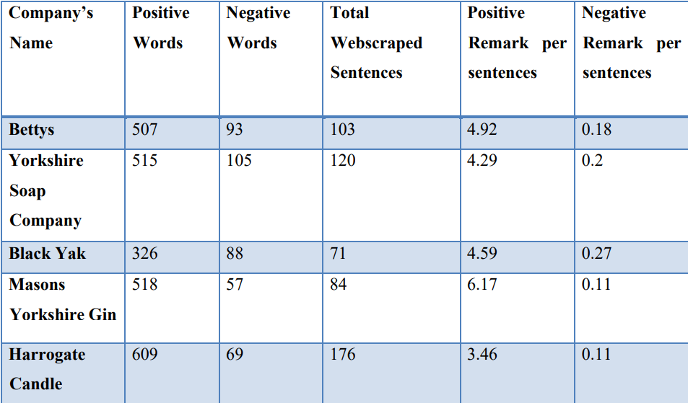
Conclusion
Our experiment is best suitable for sentiment analysis by both combined and average methods from predefined Python libraries i.e. textBlob and pattern. Requirements of fulfillment demands by the customer’s satisfaction can be achieved by text blob and pattern analysis for this dataset.

Slide 8
THANK
YOU
Thank you

