Slide 1

Joint Texas PEM Fellowship Conference · November 11, 2026
Learning with AI:
From Classroom to Bedside
AI in Medical Education
Niharika Goparaju, MD, MPH
Assistant Professor - Pediatric Emergency Medicine Faculty - UT Austin Dell Medical School – Dell Children’s Medical Center

Slide 2
I have no relevant financial relationships to disclose
DISCLOSURES
Financial relationships
None
Products named
Tools are named as examples only, not endorsements.
AI use in this talk
AI assisted with literature search, creating infographics, drafting the slide design. I reviewed and verified all content and references.
2
Notes:
No financial disclosures.

Slide 3

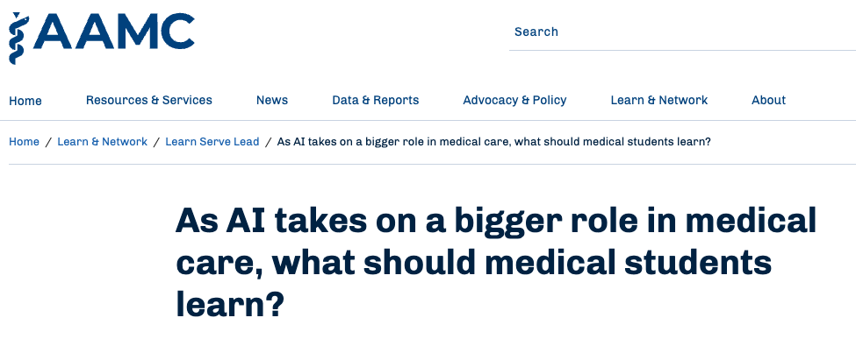
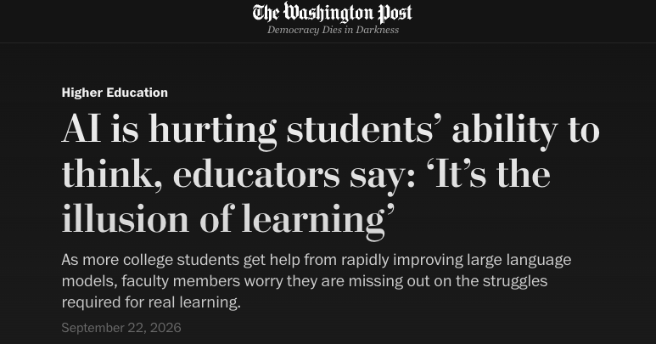
So let’s start with the real debate: AI in education
I KNOW. ANOTHER AI TALK.
HEADLINES
SCHOOL OF THOUGHT 1
Restrict to protect
SCHOOL OF THOUGHT 2
Teach to upskill
Xu AY, et al. JMIR Form Res 2026 · Abdulnour RE, et al. N Engl J Med 2025 · Framing: speaker’s synthesis
3
Notes:
Name the room first. I can hear the sighs: another AI talk. Fair.

Slide 4
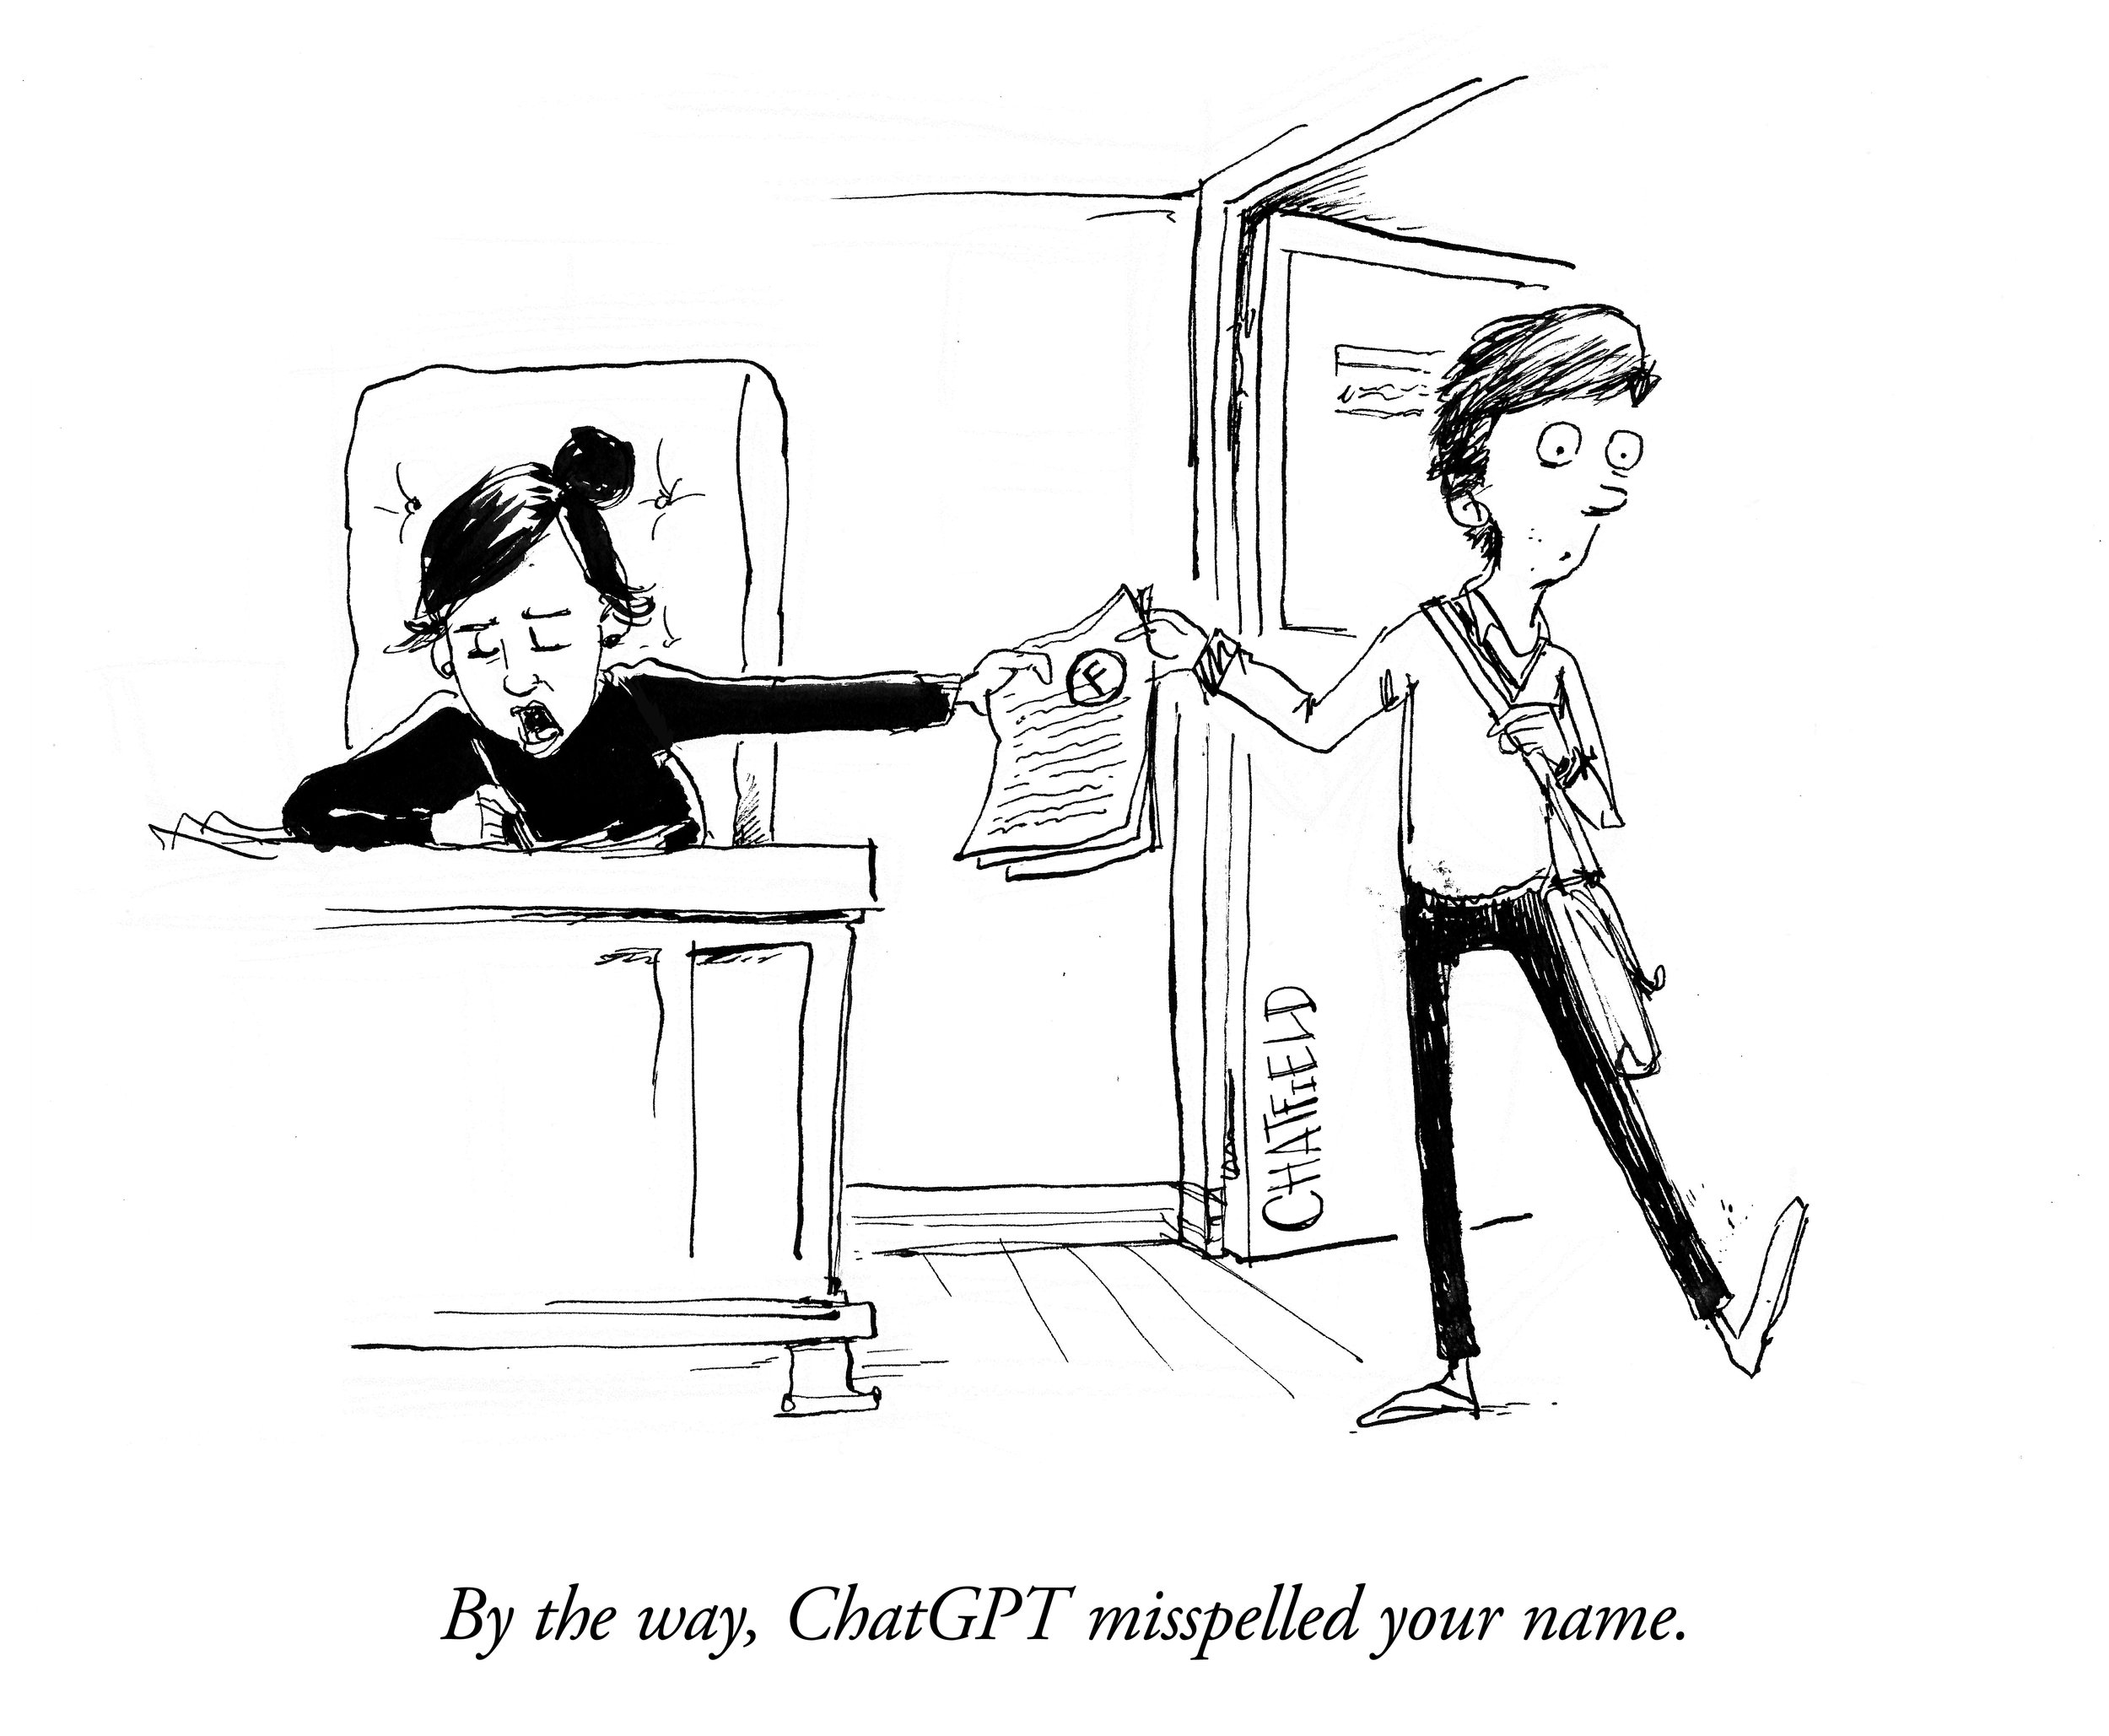
Teaching medicine in an AI era vs. teaching clinicians about using AI.
TWO DISTINCT APPROACHES
Dimension | Teaching medicine in the AI era | Teaching learners about AI
Core question | “What should we teach when AI can diagnose and write prescriptions?” | “How do we safely choose, operate, audit, and govern AI tools?”
Primary goal | Rebalance medical training from recall to human-centric bedside skills and reasoning. | Build AI literacy, error detection, and calibrated skepticism.
Educational focus | AI-free zones, formative clinical struggle, empathy, communication, and executive oversight. | Choosing tools, prompting, hallucination and bias recognition, and data ethics.
4

Slide 5

By the end of this session, you will be able to:
LEARNING OBJECTIVES
Describe how medical students and schools use AI in education today
Section 1 · Current AI use in education
1
Identify the risks and opportunities AI creates for teaching medicine
Section 2 · Teaching medicine in the AI era
2
Outline the AI literacy skills our learners need
Section 3 · Teaching learners about AI
3
Niharika’s website and AI literacy resources
niharikagoparaju.github.io/ai-literacy
Apply AI tools to everyday PEM teaching and learning
Section 4 · Practical applications and demonstrations
4
5
Notes:
niharikagoparaju.github.io/ai-literacy

Slide 6


Current AI Use in Education
SECTION 1
6
Image: Getty Images

Slide 7
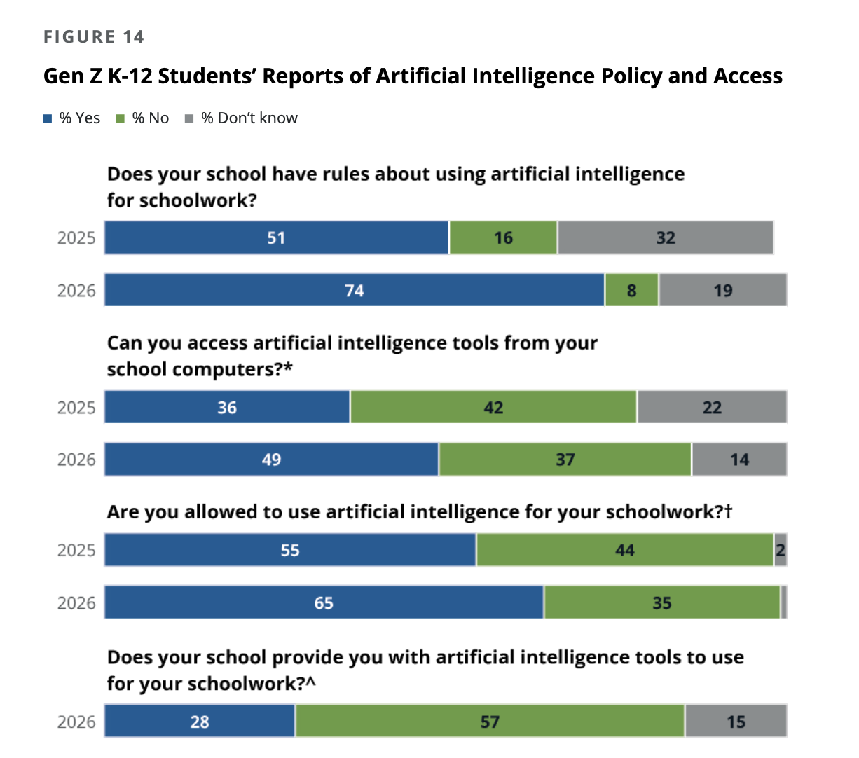
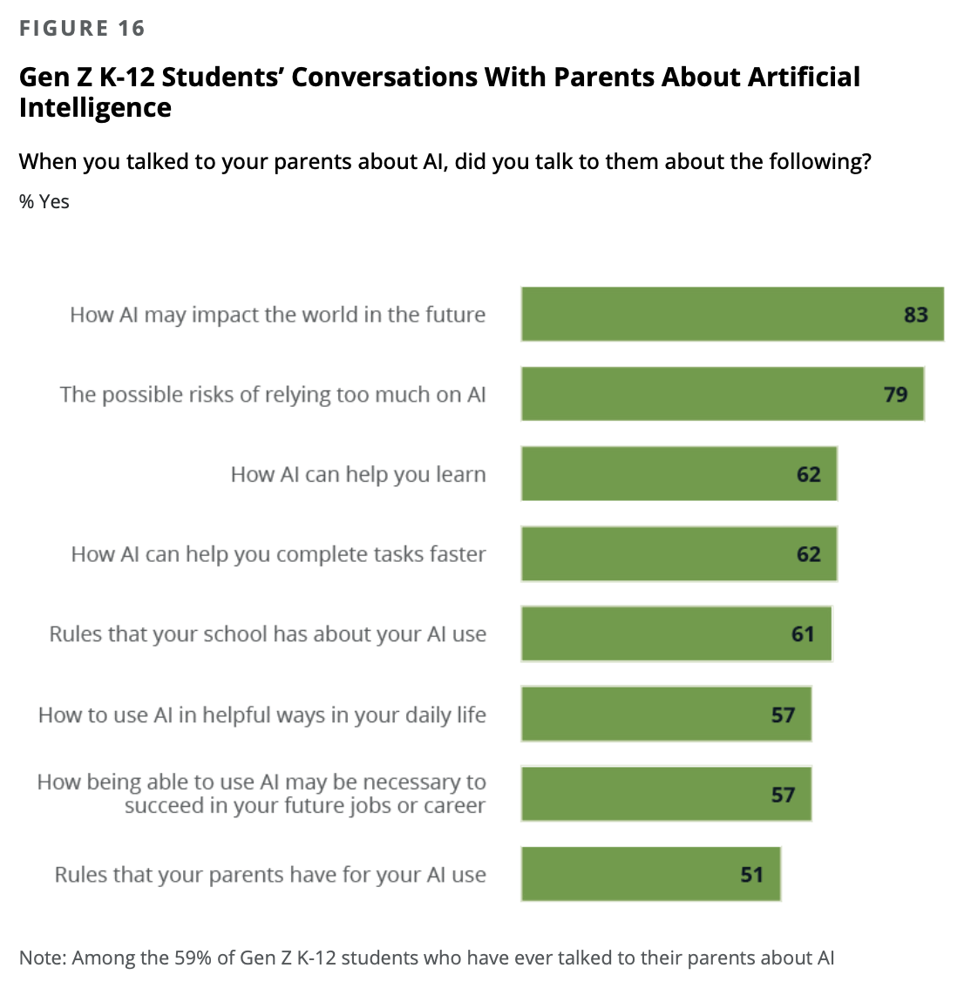
Most K-12 students now say their school has AI rules and allows AI for schoolwork
SECTION 1 · CURRENT AI USE IN EDUCATION
Source: Walton Family Foundation, GSV Ventures, Gallup. Voices of Gen Z: The AI Paradox, More Exposure, Less Confidence Among Gen Z. 2026. Figures 14 and 16.
7

Slide 8
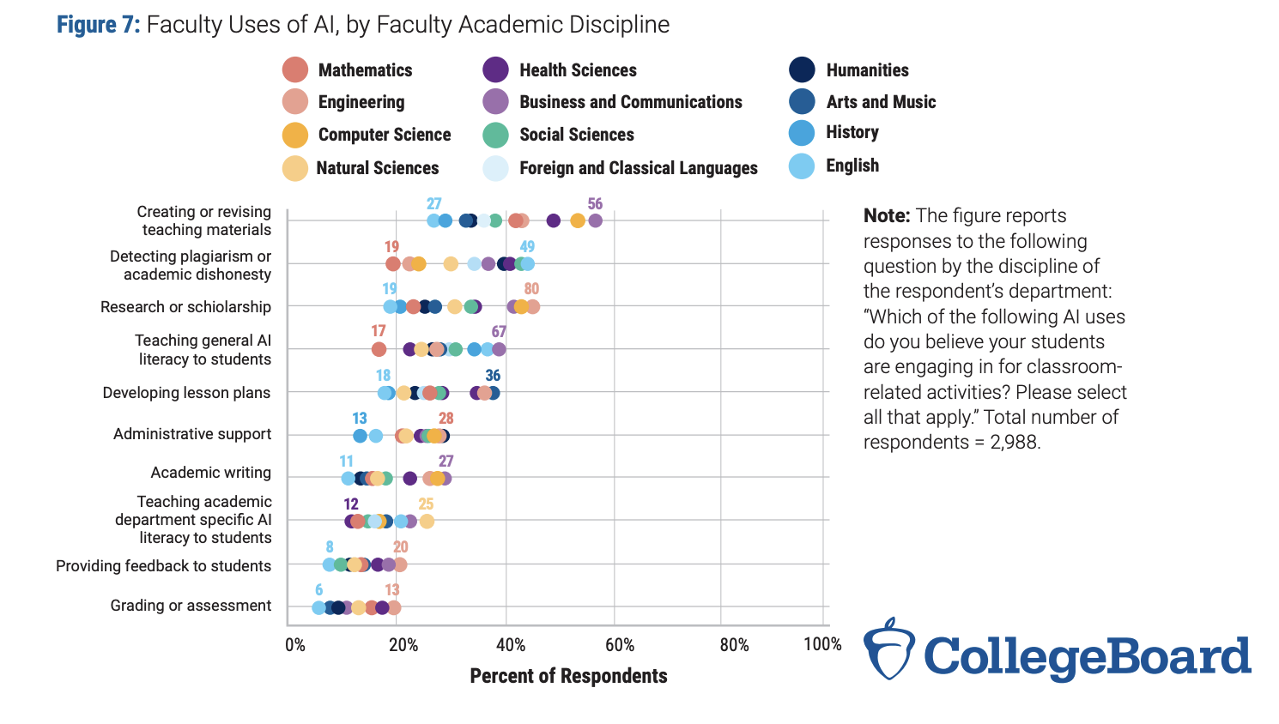

Faculty use of AI varies widely by discipline
SECTION 1 · CURRENT AI USE IN EDUCATION
Source: College Board faculty survey, Figure 7. Faculty reports of AI use for work activities; n=2,988.
8

Slide 9
How medical schools are approaching incorporating AI
MEDICAL SCHOOL
GUARDED
EMBEDDED
School | Approach | What they are doing
Stanford | Embedded | AI literacy modules and workshops, approved study tools and patient sims for rotations.
NYU Grossman | Embedded | Precision education; AI feedback on notes and communication
Harvard | Targeted | AI course for incoming HST students; AI in Medicine PhD track
Mount Sinai · Hopkins · UCSF · Cincinnati | Guided tools | Study tools, secure ChatGPT Edu, note feedback, and a Socratic coach.
Dell Med | Developing | Providing tools, AI in specific lectures, a healthcare AI seminar series, recent UT Real Health AI symposium
Stanford Medicine Magazine 2025 · Mount Sinai 2025 · AAMCNews 2025–26 · HMS 2024 · Jamieson AR, et al. NEJM AI 2024 · Kulkarni-Date M, Bixby J 2026
9

Slide 10
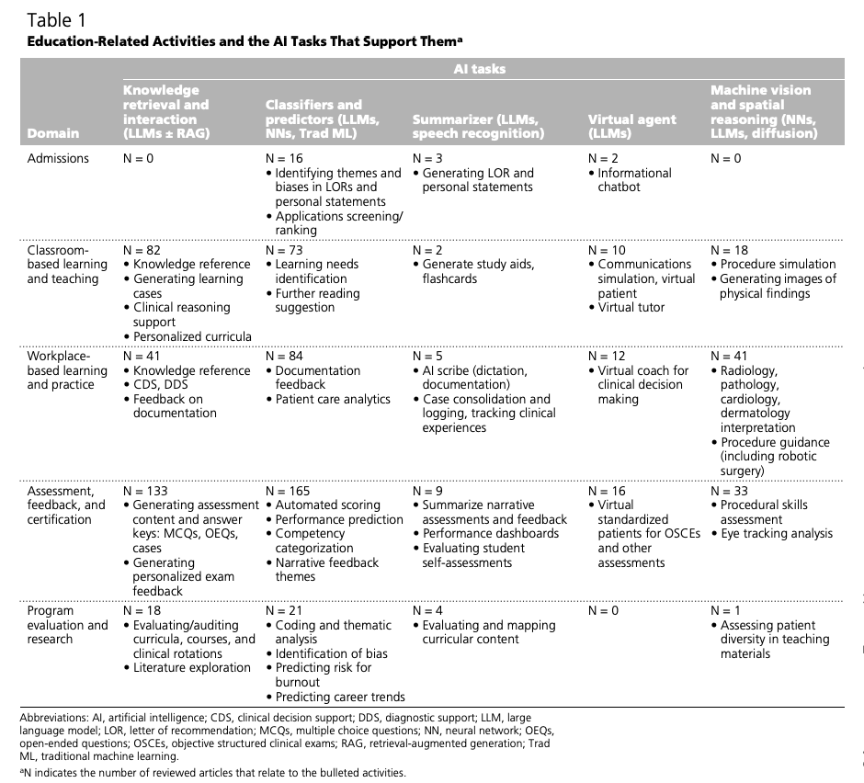
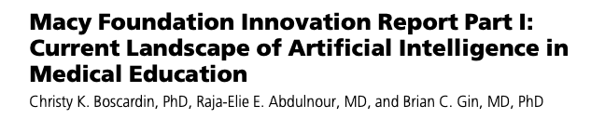

Lots of AI medical education research
MEDICAL SCHOOL
Domains: Boscardin CK, et al. Acad Med 2025 (Macy Foundation report).
10
Notes:
The Josiah Macy Jr. Foundation commissioned a landscape review ahead of its 2025 conference on AI in medical education. Boscardin, Abdulnour and Gin reviewed 455 articles across five domains.

Slide 11
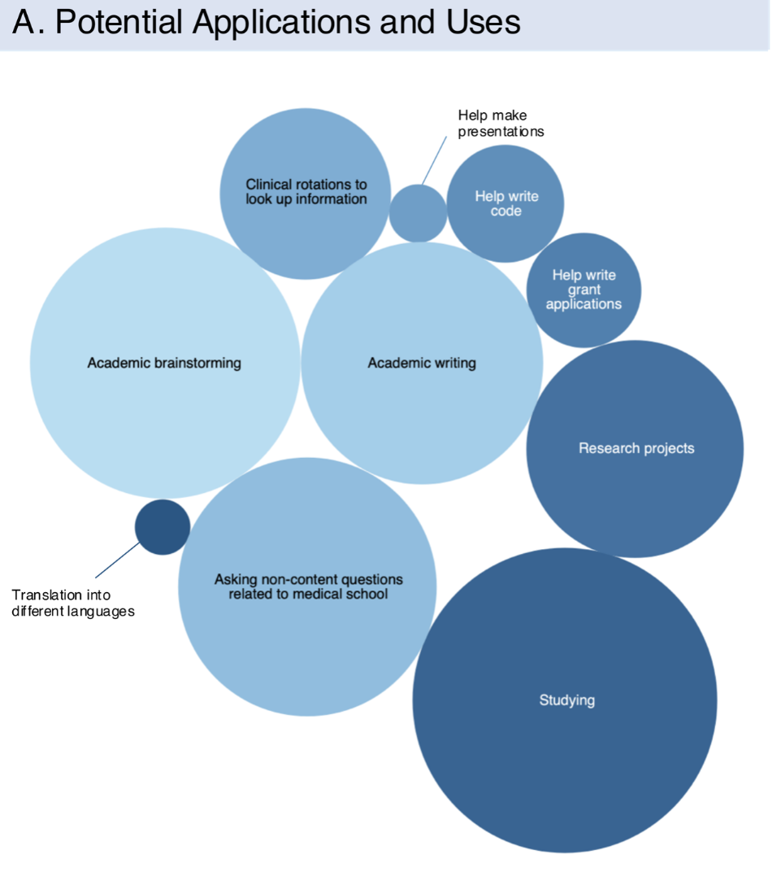
Half of U.S. medical students already use ChatGPT for coursework, most often to study.
MEDICAL SCHOOL
What students used ChatGPT for
How they studied with it, % of that 38%
38%
of students used ChatGPT to study
Academic
brainstorming
Academic
writing
Research
projects
Non-content
questions
Studying
Source: Ganjavi C, et al. PLOS Digital Health, 2024; survey of 415 U.S. medical students at 28+ schools, May 2023.
11

Slide 12




There is no shared AI curriculum; each school is building its own
SECTION 1 · CURRENT AI USE IN EDUCATION
WHAT SCHOOLS ARE DOING
WHAT NATIONAL BODIES OFFER
Required modules + workshops
Clinical Tools
AAMC Principles (2025)
Responsible-use guidance
AAMC AI Competencies (2026)
26 competencies; a target, not a course
Study tools + secure ChatGPT
Lectures, seminars, degrees (optional)
ACGME (residency)
No AI requirements yet
AAP · ACEP · SAEM (2025–26)
Call for AI literacy; no curriculum
Still debated: What belongs in it? How often should it be updated?
Sources: AAMC Principles (2025); AAMC AI Competencies (2026); AAP policy statement, Pediatrics (Nov 2026); ACEP AI Task Force consensus (2025); SAEM AI Consensus Conference (2026); school websites.
12

Slide 13
Teaching Medicine in the AI Era
SECTION 2
13

Slide 14
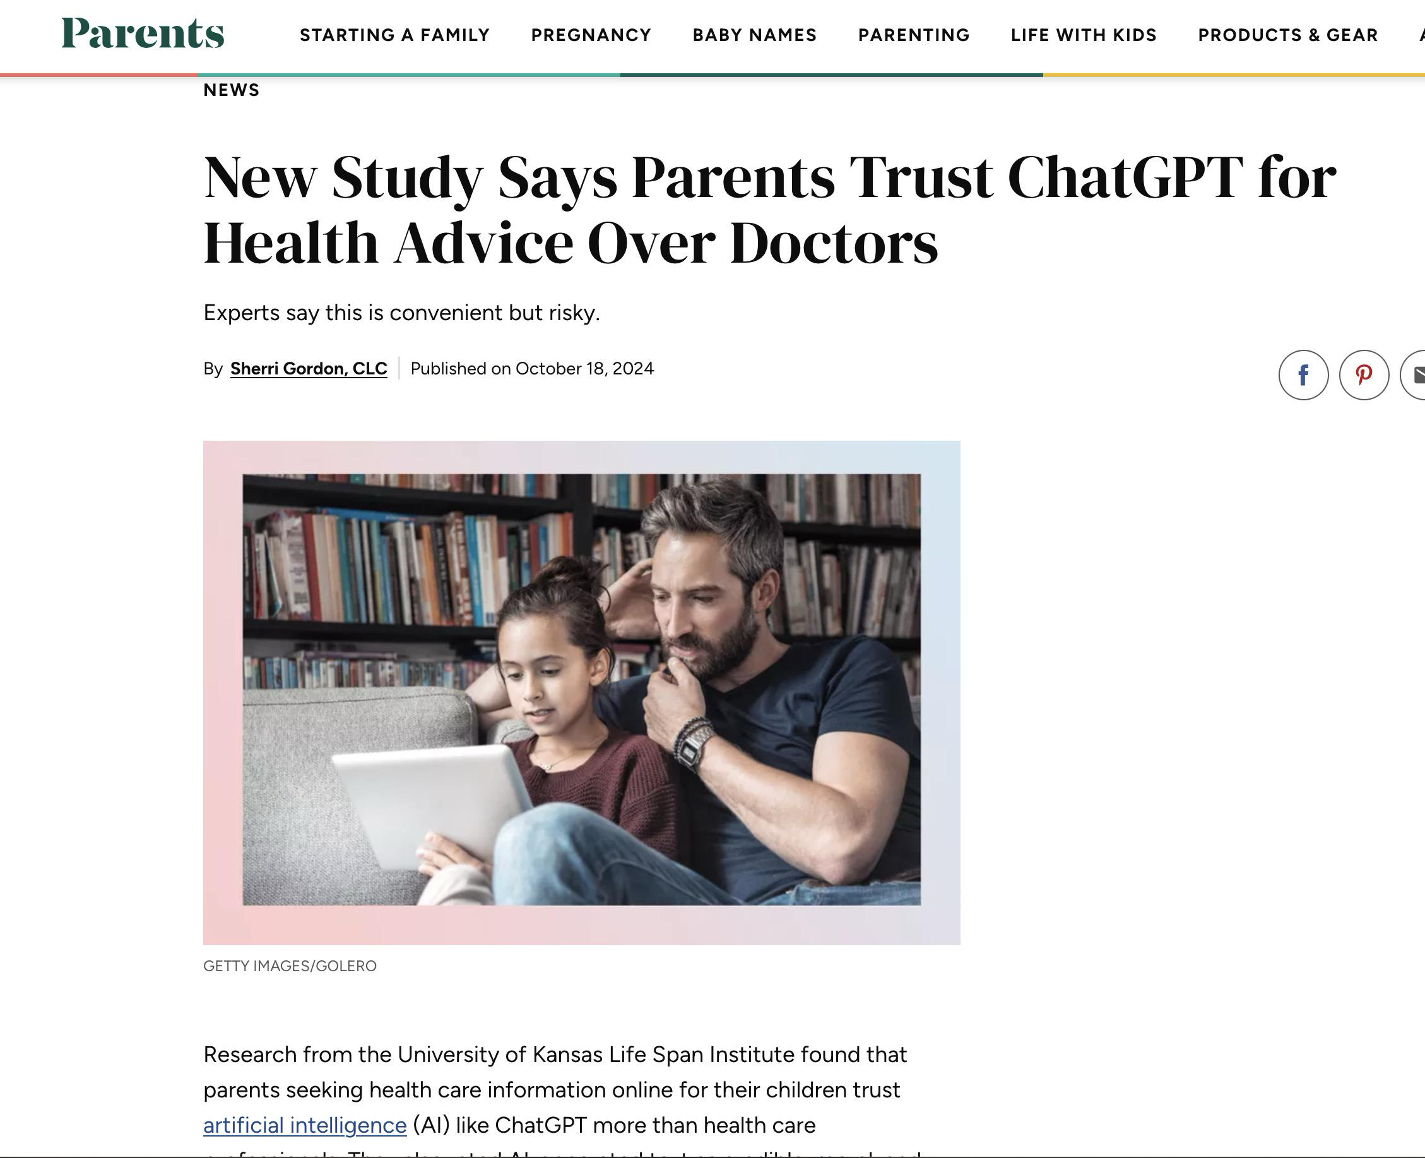
ChatGPT was rated as more trustworthy, accurate, and reliable.
14

Slide 15
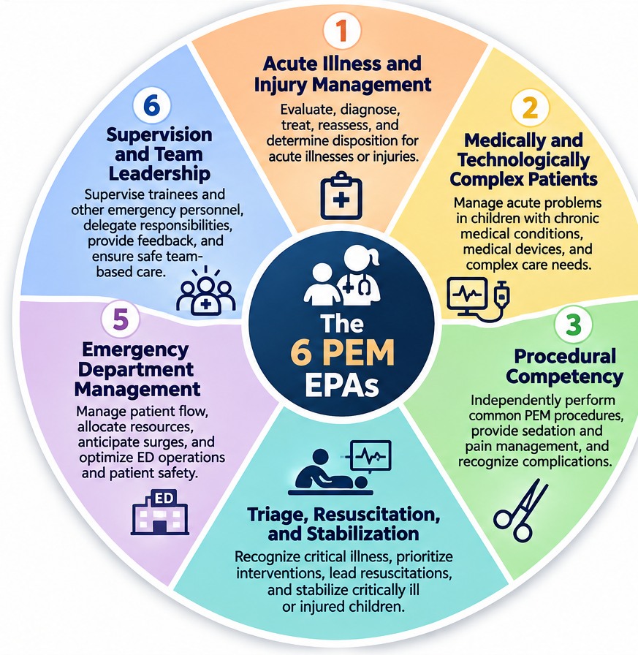
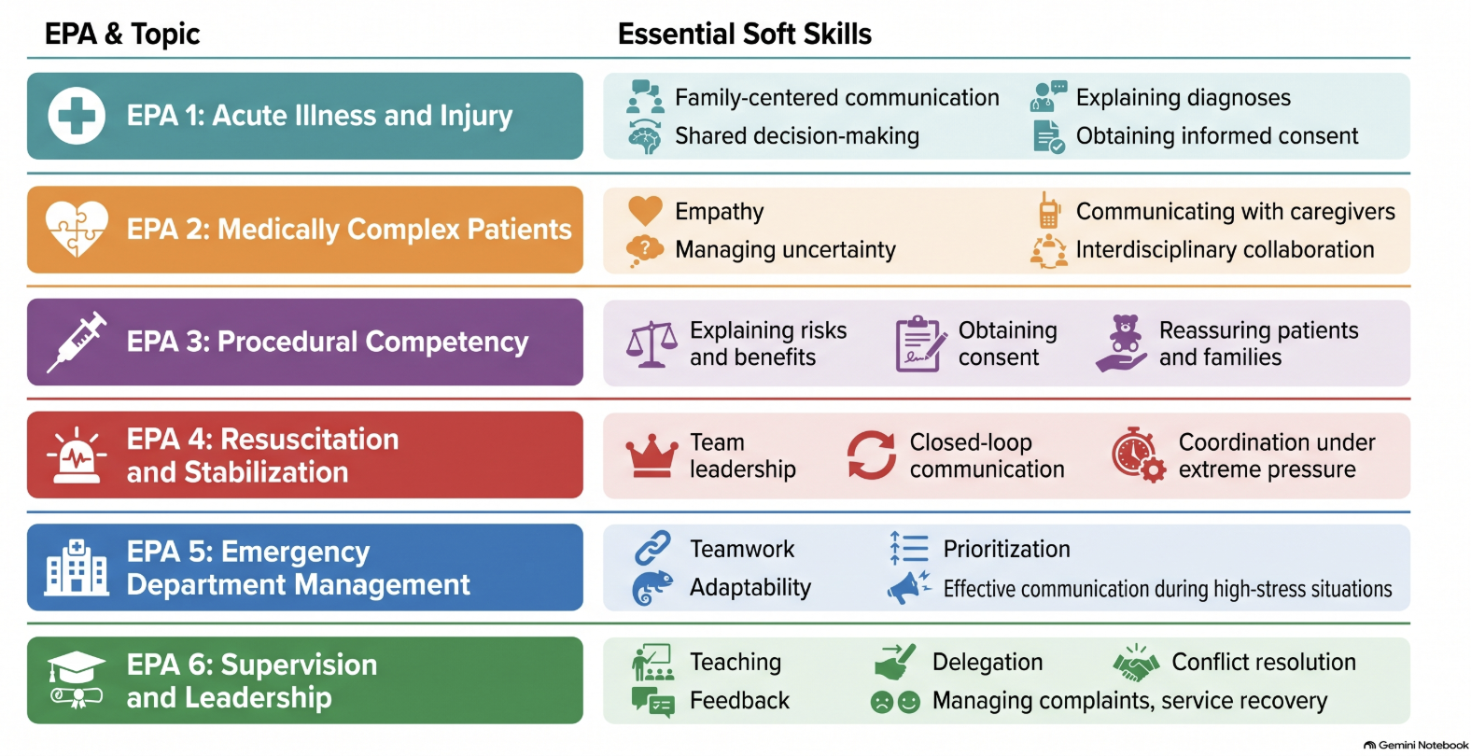
The six PEM EPAs as our framework
SECTION 2 · TEACHING MEDICINE IN THE AI ERA
How can AI help us teach or learn the activities PEM fellows must eventually perform independently?
Underlying these EPAs are skills we need to emphasize even more in the AI era
American Board of Pediatrics, PEM EPAs · Hsu DC, et al. Pediatr Emerg Care 2023;39(8):574-579 · Wheel: speaker’s infographic
15

Slide 16
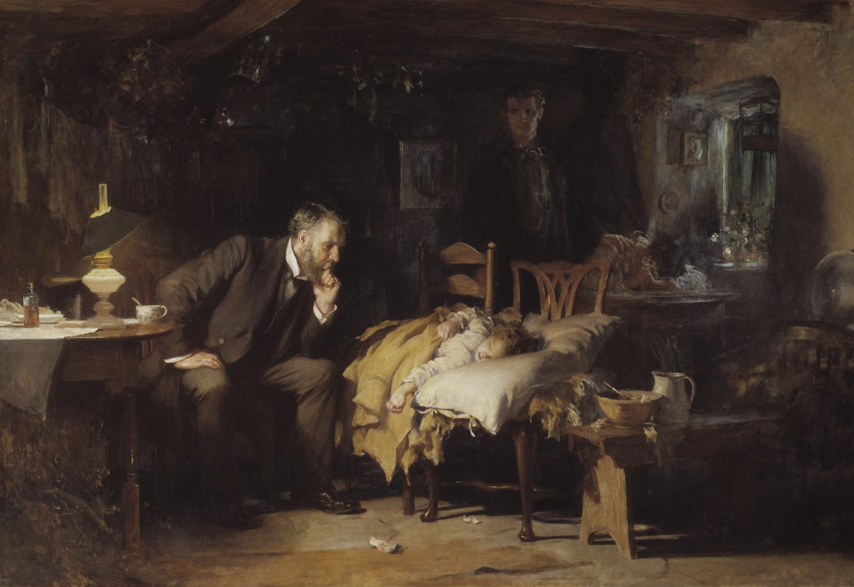
Patients and parents value these as much as competence
SECTION 2 · TEACHING MEDICINE IN THE AI ERA
WHAT PATIENTS AND PARENTS VALUE
Empathy
Communication skills
Partnership
Thoroughness
Luke Fildes, The Doctor, 1891, oil on canvas
1 “People choose to receive human empathy despite rating AI empathy higher” (PMC12872445). 2 Pew Research Center, n=3,488 U.S. adults, June 2026. 3 JAMA Netw Open, Oct 2026; n=1,185 U.S. adults. 4 BMC Health Serv Res 2025 (CCFNI-ED survey of PED parents).
16

Slide 17
The six PEM EPAs as our framework
SECTION 2 · TEACHING MEDICINE IN THE AI ERA
CENTRAL QUESTION
How can AI help us teach or learn the activities PEM fellows must eventually perform independently?
American Board of Pediatrics, PEM EPAs · Hsu DC, et al. Pediatr Emerg Care 2023;39(8):574-579 · Wheel: speaker’s infographic
17
Notes:
Now to teaching medicine with AI, and the framework I want to use is one we all already know: the six PEM EPAs. Acute illness and injury management. Medically and technologically complex patients. Procedural competency. Triage, resuscitation, and stabilization. Emergency department management. And supervision and team leadership. These are the activities a PEM physician has to be able to do independently, and they're how we already teach and assess our fellows. A national survey of PEM fellowship directors by Hsu and colleagues found most do not require level-five independence by graduation for any PEM-specific EPA, so entrustment is a gradual process we already manage carefully. The central question: how can AI help us teach the activities fellows must eventually perform independently? The EPAs show us where AI can strengthen education and where we must protect independent competence. Let's start with a question for you: which EPA would you never let a fellow use AI for during training, and why? Take 60 seconds with your neighbor. If using live polling, put the six EPAs up as options.

Slide 18
AI may help train certain clinical tasks better than others
SECTION 2 · TEACHING MEDICINE IN THE AI ERA
PEM EPA
AI EDUCATIONAL FIT
EXAMPLE USE IN TRAINING
1 Acute Illness and Injury Management
Moderate
Fellowship: didactics - Case practice: differentials, plans, feedback on reasoning.
2 Medically and Technologically Complex Patients
Moderate
Fellowship didactics: review of rare conditions, devices, and care plans
3 Procedural Competency
Limited
Pre-procedure review only; the skill is built by doing
4 Triage, Resuscitation, and Stabilization
Limited
Sim scenario writing; resuscitation is learned hands-on
5 Emergency Department Management
Limited
Tabletop surge and patient-flow scenarios
6 Supervision and Team Leadership
Limited
Rehearse feedback conversations and teaching scripts
EPAs: American Board of Pediatrics; Hsu DC, et al. Pediatr Emerg Care 2023 · Fit ratings: speaker’s assessment
18

Slide 19

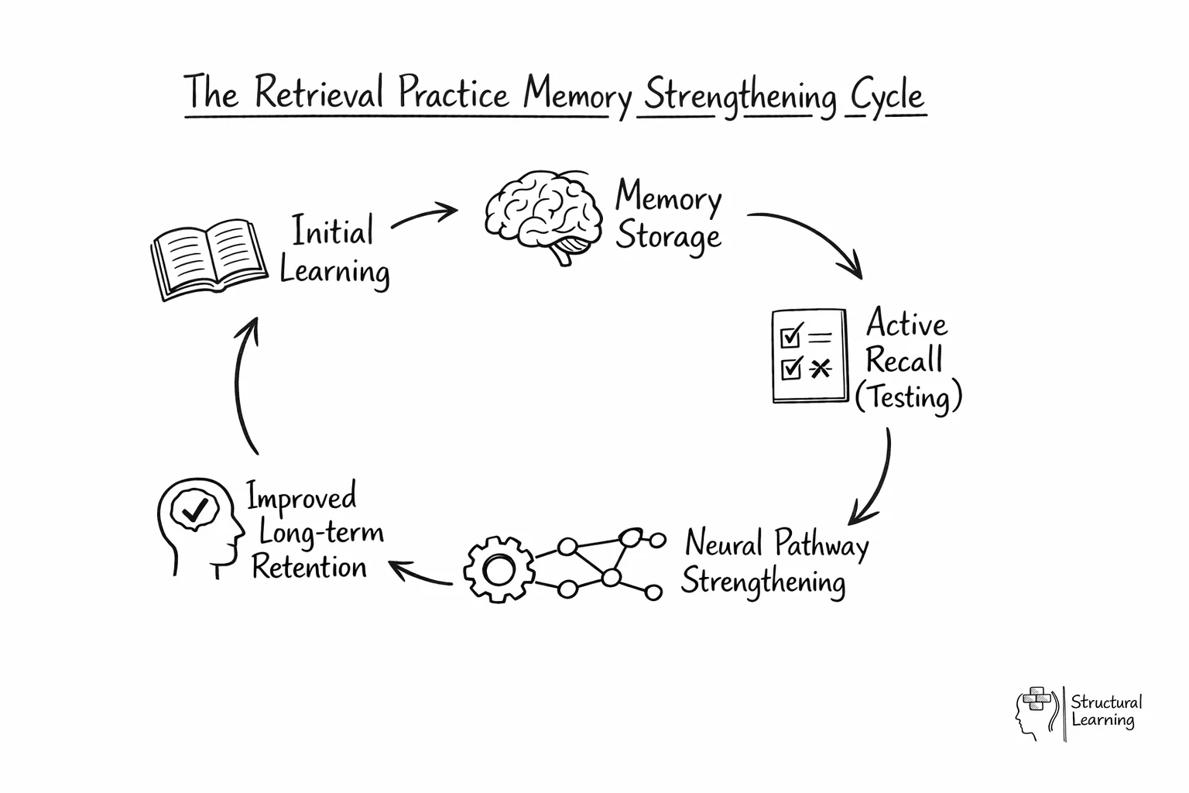


What techniques are proven to help with learning?
SECTION 2 · TEACHING MEDICINE IN THE AI ERA
THREE METHODS WITH STRONG EVIDENCE
Retrieval practice
Pull it from memory instead of rereading it
Spacing
Revisit a topic over days and weeks
Deliberate practice
Targeted reps on weak areas, with feedback
Content outline: American Board of Pediatrics, Pediatric Emergency Medicine content outline. Diagram: Structural Learning.
19
Notes:
You can supercharge your learning by combining all three: use deliberate practice to target specific weak skills, structure that practice using spacing over time, and anchor each session with active retrieval practice instead of passive review.

Slide 20
How Can AI Help?
SECTION 2 · TEACHING MEDICINE IN THE AI ERA
HOW AI SUPPORTS THE EDUCATOR · RECLAIMING FACULTY TIME
AI Can Draft Content and Help With Planning
OUR PROGRAM, FOR EXAMPLE
Curriculum workshop: revamped our fellowship curriculum
Needs assessment survey of fellows
Combined national requirements, our goals, and recent ITE results
Used Gemini to map gaps and draft the new curriculum while having a 2-day in person workshop where faculty verify/add.
Cut low-yield content; added simulation
Board-style question or games
Item drafts mapped to the PEM content outline
Curriculum mapping
Sessions and cases checked against the six PEM EPAs
Simulation case drafts
Scenario, vitals and critical actions for faculty to revise
¹Anthropic Education Report: How educators use Claude, 2025 (74,000 conversations). ²Frontiers in Medicine. 2026;13:1978708 (GPT-5.6, Claude-5, Gemini-3.5 and others). ³medRxiv preprint, 2026 (GPT-5.1/5.2, Gemini 3.0 Pro, Claude Opus 4.5).
20

Slide 21
Two 2026 studies tested current models on teaching content
SECTION 2 · TEACHING MEDICINE IN THE AI ERA
CURRENT-MODEL EVIDENCE · RESEARCH QUESTIONS AND SETTING
Study | Board-style questions | Pediatric OSCE stations
Research question | Can current models write epilepsy multiple-choice questions ready for teaching? | How much do current models differ when writing the same pediatric OSCE station?
Models | GPT-5.6, Claude-5, Gemini-3.5 and four others | GPT-5.1, GPT-5.2, Gemini 3.0 Pro, Claude Opus 4.5, Grok 4.1
What they wrote | 60 questions per model, 420 in total | 6 neonatal jaundice stations per model, 30 in total
Reviewed by | Two blinded clinicians, six areas scored 1–5 | Four blinded experts, including two pediatricians
Published | Frontiers in Medicine, Oct 2026 | medRxiv preprint (not peer reviewed), Aug 2026
Sources: Leveraging LLMs to generate MCQs for epilepsy education. Front Med. 2026;13:1978708. Characterizing LLM variability in OSCE stations. medRxiv. 2026. doi:10.64898/2026.08.04.26359691
21

Slide 22
Current models still make errors and need expert review
SECTION 2 · TEACHING MEDICINE IN THE AI ERA
CURRENT-MODEL EVIDENCE · KEY FINDINGS
Finding | Board-style questions | Pediatric OSCE stations
Looked right | All 420 met the required format after one correction | Followed the prompt; few factual errors
Errors | Wrong answer key in 2–38% of questions, by model | Only 1 of 5 models covered all three types of jaundice
Weakest area | Wrong options too easy to rule out (2–3 of 5) | No model covered every communication skill
Ready to use | 0.5% usable as written; 71% needed major revision | No model ready for unsupervised use in an exam bank
Both author teams: use these models to draft, with clinical review before anything reaches learners.
Sources: Front Med. 2026;13:1978708 (two blinded reviewers). medRxiv preprint, 2026, doi:10.64898/2026.08.04.26359691 (four blinded raters).
22

Slide 23
Teaching Learners About AI
SECTION 3
23

Slide 24
What should we teach?
SECTION 3 · TEACHING LEARNERS ABOUT AI
TRACK 1 · EVERYDAY USE
Use AI without losing clinical skills
Who: Every clinician and trainee
TRACK 2 · EVALUATION AND ADOPTION
Evaluating AI Tools
Who: Clinical leaders, Informatics, AI researchers
Know what the tool does well and poorly
Use AI to review and support your management vs. replace it
Appraise AI research and vendor claims
Check validation, bias and fit for children
Weigh automation risks in the workflow
Know where to keep learning as tools change
24

Slide 25
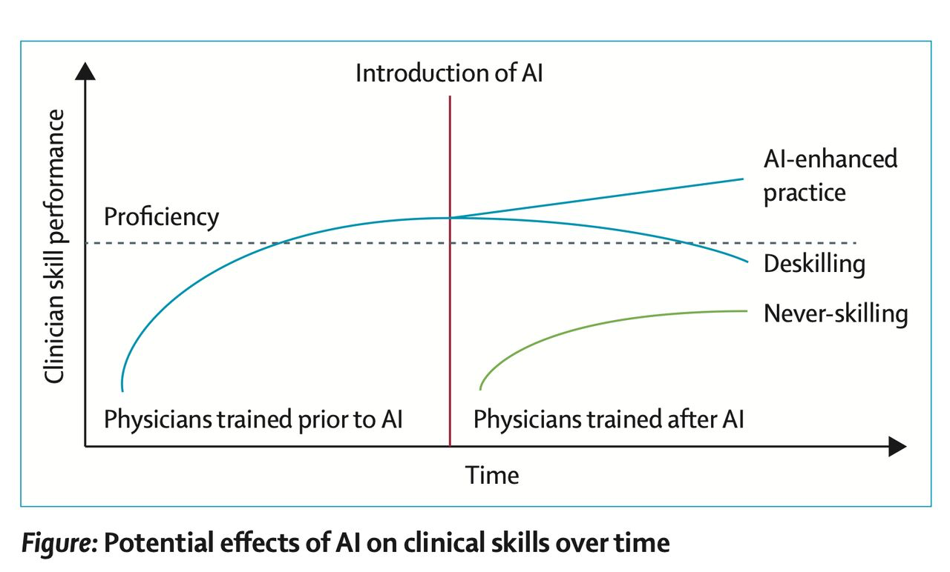
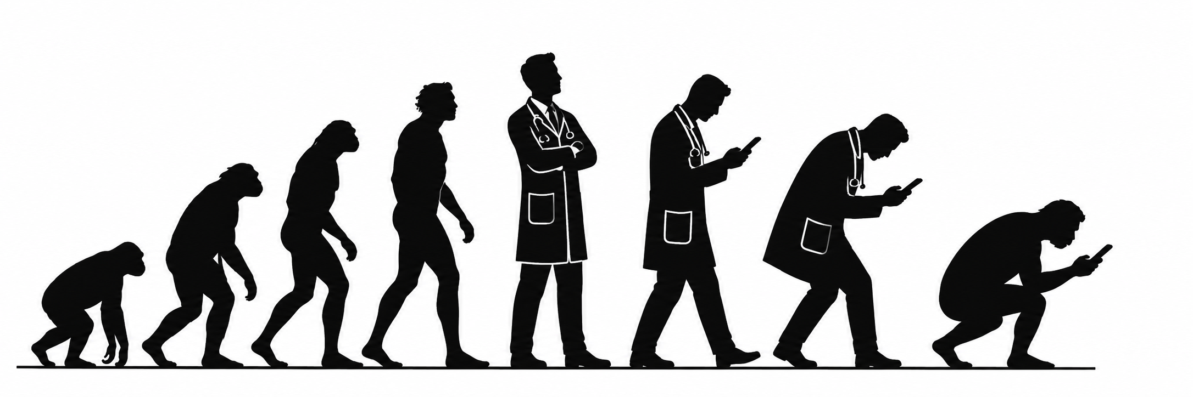
Three ways reliance on AI can shape clinical skill
SECTION 3 · TEACHING LEARNERS ABOUT AI
DEFINITIONS · ABDULNOUR ET AL., NEJM 2025
Deskilling
A skill the clinician already had erodes from disuse.
Never-skilling
A foundational skill never develops because AI did the task first.
Mis-skilling
The learner adopts the AI’s errors or biases as their own reasoning.
Source: Abdulnour REE, Gin B, Boscardin CK. N Engl J Med. 2025;393:786-797. Examples are illustrative.
25

Slide 26
Redesigning clinical reasoning education
SECTION 3 · TEACHING LEARNERS ABOUT AI
SCHAYE ET AL. · ABOUT THE PAPER
The paper
Theory-informed redesign of clinical reasoning education in the era of generative artificial intelligence
Schaye et al. · Academic Medicine, 2026 · Scholarly Perspective
Proposes five cross-cutting strategies
1 | Introduce GAI tools early in the curriculum
2 | Preserve reasoning-first GAI-assisted workflows
3 | Promote graduated autonomy for GAI use in clinical care
4 | Equip faculty to supervise GAI-assisted reasoning
5 | Rethink clinical reasoning assessment
Source: Schaye VE, Parsons AS, Olson APJ, Abdulnour RE, Daniel M. Acad Med. 2026. doi:10.1093/acamed/wvag318
26

Slide 27
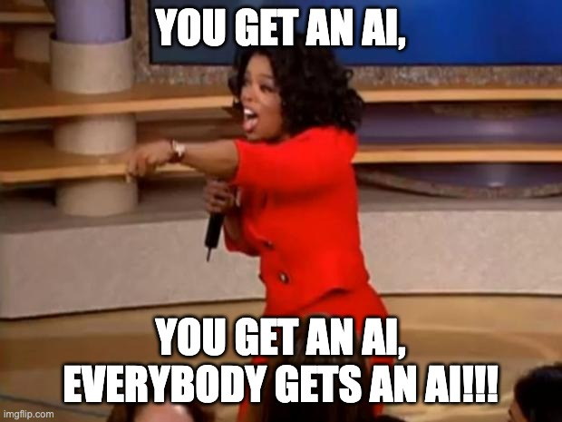
Introduce Generative AI tools early in the curriculum
SECTION 3 · TEACHING LEARNERS ABOUT AI
SCHAYE ET AL. · STRATEGY 1 OF 5
Source: Schaye VE, et al. Acad Med 2026; “Introduce GAI tools early in the curriculum” and Tables 1–2
27

Slide 28
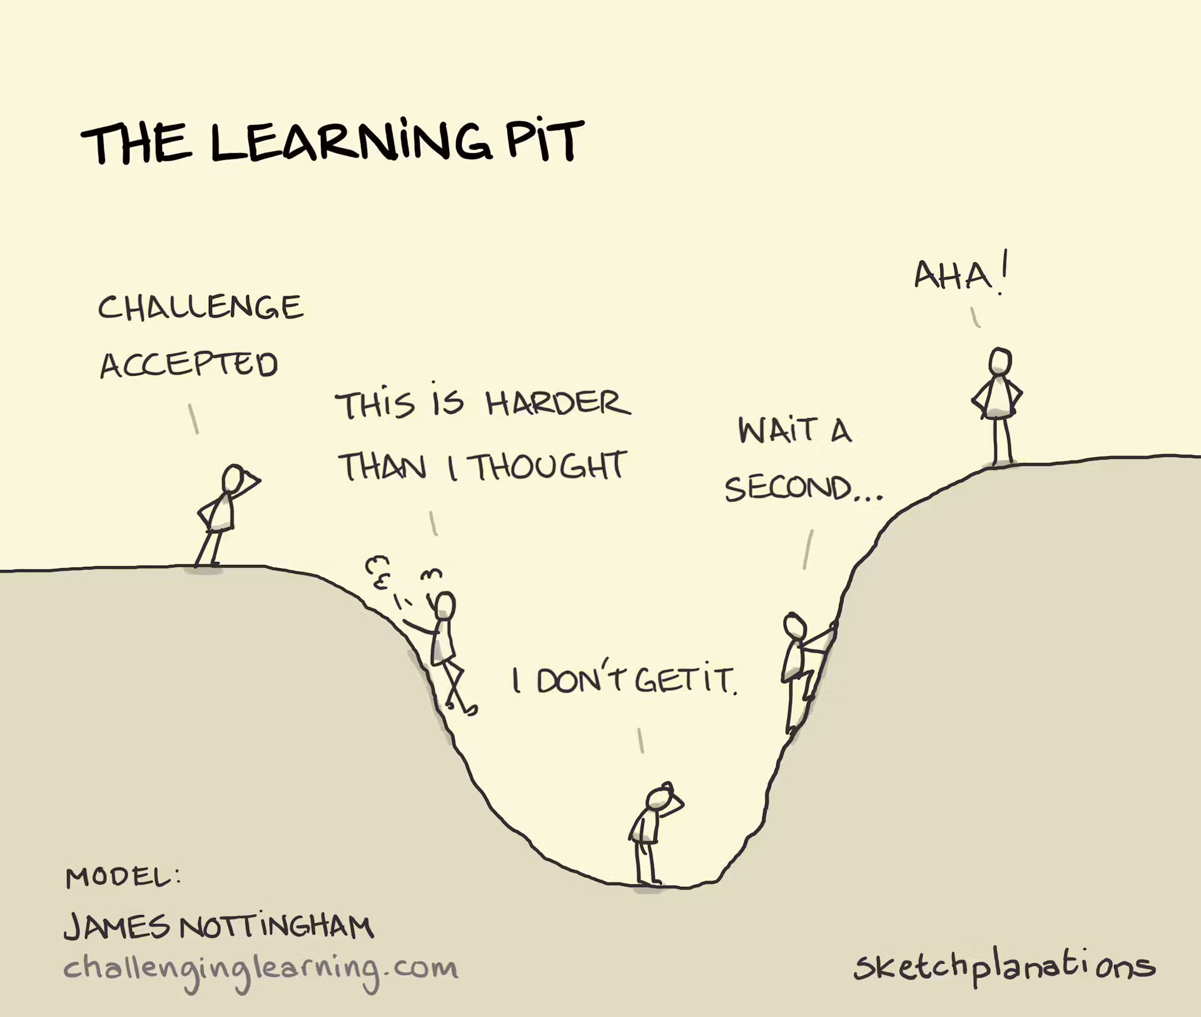
Preserve reasoning-first generative AI-assisted workflows
SECTION 3 · TEACHING LEARNERS ABOUT AI
SCHAYE ET AL. · STRATEGY 2 OF 5
1 Draft alone
Without GAI, write a problem representation, differential and plan.
2 Prompt Generative AI tool
Ask the tool and record its version next to your own.
3 Compare
Set the two versions side by side.
4 Explain
Write a brief rationale for what you revised and what you kept.
5 Synthesize
Produce the final assessment and plan.
Source: Schaye VE, et al. Acad Med 2026; “Preserve reasoning-first GAI-assisted workflows” and Vignette 3
28

Slide 29
Promote graduated autonomy for Generative AI use in clinical care
SECTION 3 · TEACHING LEARNERS ABOUT AI
SCHAYE ET AL. · STRATEGY 3 OF 5
GAI use | Gate the learner passes first
On-demand consult tools | Any stage; learner shows faculty they can frame the clinical question and name the evidence needed
Ambient documentation | Residency, after demonstrated competence writing notes without assistance
GAI for evidence retrieval | Established pattern recognition; plan still contextualized and monitored unaided
Source: Schaye VE, et al. Acad Med 2026; “Promote graduated autonomy for GAI use in clinical care”
29

Slide 30
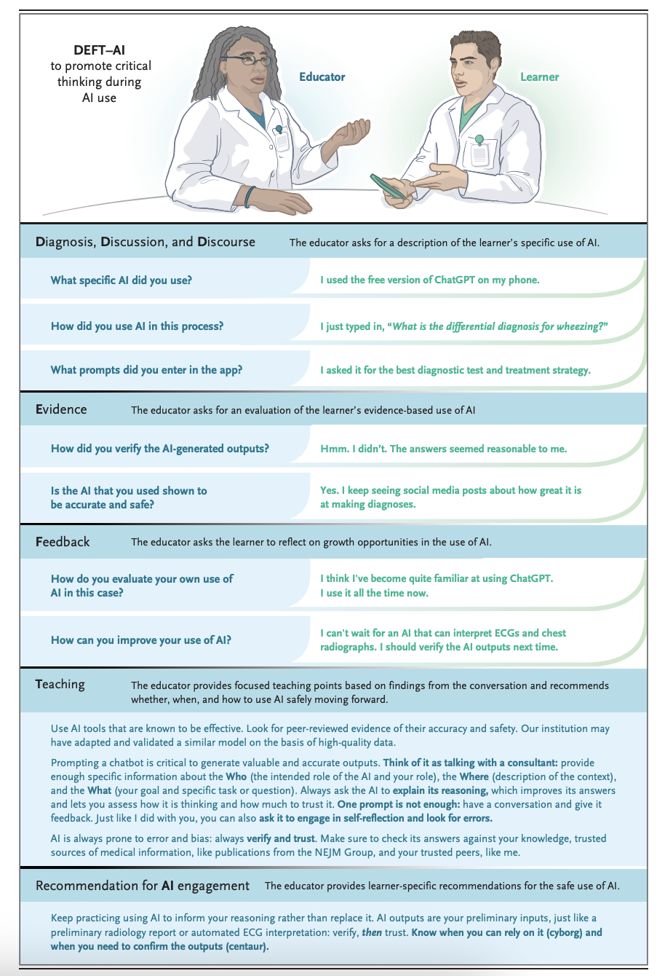
DEFT-AI: a two-minute script for the bedside
SECTION 3 · TEACHING LEARNERS ABOUT AI
SCHAYE ET AL. · STRATEGY 4 OF 5 · EQUIP FACULTY TO SUPERVISE GAI-ASSISTED REASONING
D
Diagnosis and discussion
“Walk me through your thinking. Where did AI come in?”
E
Evidence
“What supports that answer? How did you check it?”
F
Feedback
“Your prompt was well framed. You took the dose without checking.”
T
Teaching
Deliver points on the clinical content, one on AI use.
AI
AI engagement advice
“Next time, build your differential first, then use AI to stress-test it.”
Framework: Abdulnour RE, et al. N Engl J Med 2025
30
Notes:
DEFT-AI adapts the existing DEFT approach (diagnosis, evidence, feedback, teaching) and adds an AI engagement recommendation. The phrases on the slide are mine, so adapt them to your voice. Key move: make AI use discussable. If fellows think using AI will be judged, they will hide it, and you lose the chance to teach. Suggest attendings ask routinely: did you use any tools on this one? Demo: run a 60-second role play with a volunteer fellow who used AI to pick a dose for a febrile infant.

Slide 31
Rethink clinical reasoning assessment
SECTION 3 · TEACHING LEARNERS ABOUT AI
SCHAYE ET AL. · STRATEGY 5 OF 5
 | Without GAI | With GAI present
Purpose | Show learners can reach their own conclusions, well enough to judge GAI output | Show learners use GAI in ways that strengthen their reasoning
When and how | Checkpoints concentrated early and kept later: exams, OSCEs, virtual patients; proctored where it matters | More often as GAI enters routine care: standardized patients, chart-stimulated recall, workplace-based assessment
What is captured | Independent problem representation, differential and plan | The first draft, the prompts used, and why GAI output was accepted or rejected
Source: Schaye VE, et al. Acad Med 2026; “Rethink clinical reasoning assessment”
31

Slide 32
Data-MD Curriculum
SECTION 3 · TEACHING LEARNERS ABOUT AI
SESSION 1
AI Foundations
Pre-survey · 50 min didactic
SESSION 2
Applying AI to Clinical Reasoning
20 min didactic · 40 min small group
SESSION 3
Benchmarking AI for Clinical Reasoning
20 min didactic · 40 min journal club
SESSION 4
Critical Appraisal and the Future
35 min journal club · 15 min didactic · post-survey
AI tools in clinical care today
Key terms: ML, LLMs, generative AI
How models are trained: fine-tuning, RAG
Ethics: privacy, liability
Spot errors and hallucinations
Name sources of bias
Work a vignette with and without AI
Practice prompting techniques
Human-in-the-loop vs on-the-loop
Offloading vs automation bias
Appraise an LLM reasoning benchmark
Appraise a study of LLM-written discharge summaries
Staying current: journals, podcasts, CME
Will AI replace doctors? Tasks first
FOUNDATION
EVALUATE OUTPUTS
EVALUATE RESEARCH
LOOK AHEAD
DATA-MD GenAI curriculum (Data-Augmented, Technology-Assisted Medical Decision-Making) · Appraisal articles: McCoy, et al. NEJM AI 2025; Williams, et al. JAMA Intern Med 2025
32

Slide 33





Data-MD Pilot Sites
SECTION 3 · TEACHING LEARNERS ABOUT AI
OUR MULTICENTER PILOT · FIVE PARTNER INSTITUTIONS · JULY 2025–JUNE 2026
University of Michigan
University of California, Los Angeles
University of Texas at Austin
Washington University in St. Louis
Western Michigan University
Internal Medicine Residency
Internal Medicine Residency
Family Medicine Residency
Pediatric Emergency Medicine Fellowship
Rheumatology Fellowship
Internal Medicine Residency
Same curriculum, adapted locally
Each site updated the curriculum through a nominal group process with its own AI experts, then assessed it with a pre/post knowledge test and a retrospective pre/post survey.
Source: DATA-MD IRB amendment, partner institutions and programs
33

Slide 34
Data-MD Pilot Results
SECTION 3 · TEACHING LEARNERS ABOUT AI
OUR MULTICENTER PILOT · PRELIMINARY RESULTS
Self-rated confidence, retrospective pre to post
Gain on a 5-point scale
5 health systems · 9 programs
Residents, fellows and faculty in internal, family and emergency medicine and psychiatry
KNOWLEDGE · 10 MULTIPLE-CHOICE QUESTIONS
32.8%
pre-survey
→
57.7%
post-survey
Most valued segment: error, bias and prompt engineering (Session 2), chosen by 29%
Goparaju N, et al. AI curriculum for continuing and graduate medical education: a multi-center pilot (abstract). 183 pre-survey and 51 post-survey responses; confidence self-rated on the post-survey
34

Slide 35
Error and bias training was most valued; benchmarking least
SECTION 3 · TEACHING LEARNERS ABOUT AI
PERCEIVED VALUE BY SEGMENT
Most valuable segment
% of 51 post-survey respondents
Least valuable segment
% of 51 post-survey respondents
Every segment was picked as most valuable by at least one learner; 10% named none.
Goparaju N, et al. AI curriculum for continuing and graduate medical education: a multi-center pilot (abstract), Table 3 · Each respondent chose one most and one least valuable segment
35

Slide 36
Practical Applications and Demonstrations
SECTION 4
36

Slide 37
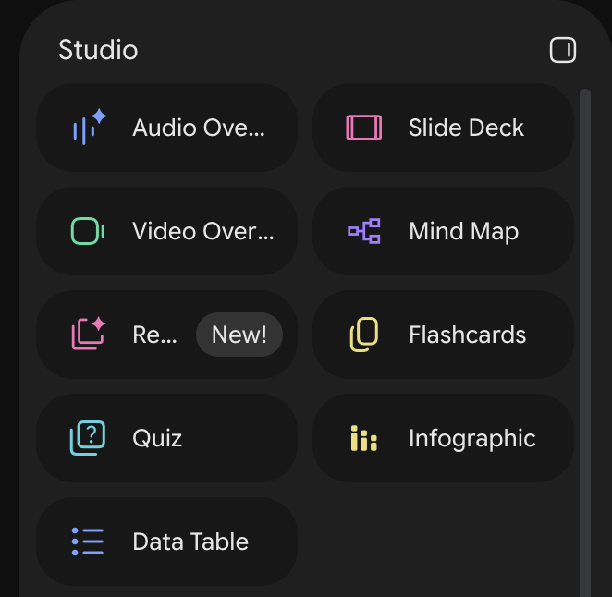

SECTION 4 · PRACTICAL APPLICATIONS AND DEMONSTRATIONS
Turn a lecture into audio
Source: my 24-slide PEM lecture, Toxicology: Bites and Stings.
HOW: NOTEBOOKLM STUDIO
1
Upload the full lecture ppt as the only source or algorithm
2
Customize “Cover every slide in order. Do not condense.”
3
Generate an Audio Overview and download it
Ask for coverage, not a summary. Default audio overviews condense. Steer it to walk through every slide in order, and check it against your deck.
Audio Overview sits first in the Studio panel
Source: Goparaju N, Earp A. Toxicology: Envenomation (lecture) · Workflow: Konsker HB, Stanford 2026 · Wang CG, et al. Prehosp Emerg Care 2026
37
Notes:
Steps one and two, using a real PEM source: my own envenomation lecture, 24 slides on pit vipers, coral snakes, scorpions, brown recluse and black widow. Step one, distill: I uploaded the deck and asked for a one-page comparison table, ID clues, venom, key findings, treatment and disposition, using only my slides, citing the slide for each row, and listing anything that might be outdated. That last instruction matters. It flagged that my slide says coral snake antivenin is no longer manufactured, when limited lots remain available under FDA expiration extensions; that my scorpion slide lists benzodiazepines first, when antivenom resolves severe pediatric neurotoxicity; and that the snakebite algorithm is dated 2021. Grounded is not the same as current. Step two, hear: the same lecture goes into NotebookLM. The Studio panel turns it into an audio overview you can listen to on the drive in, with interactive mode so you can ask the hosts a question, plus a mind map, flashcards, and a quiz. Same caution as always: Wang and colleagues found NotebookLM loaded with EMS protocols got 75% of actions right, and most major misses were in the pediatric arrest case. Never upload PHI.

Slide 38
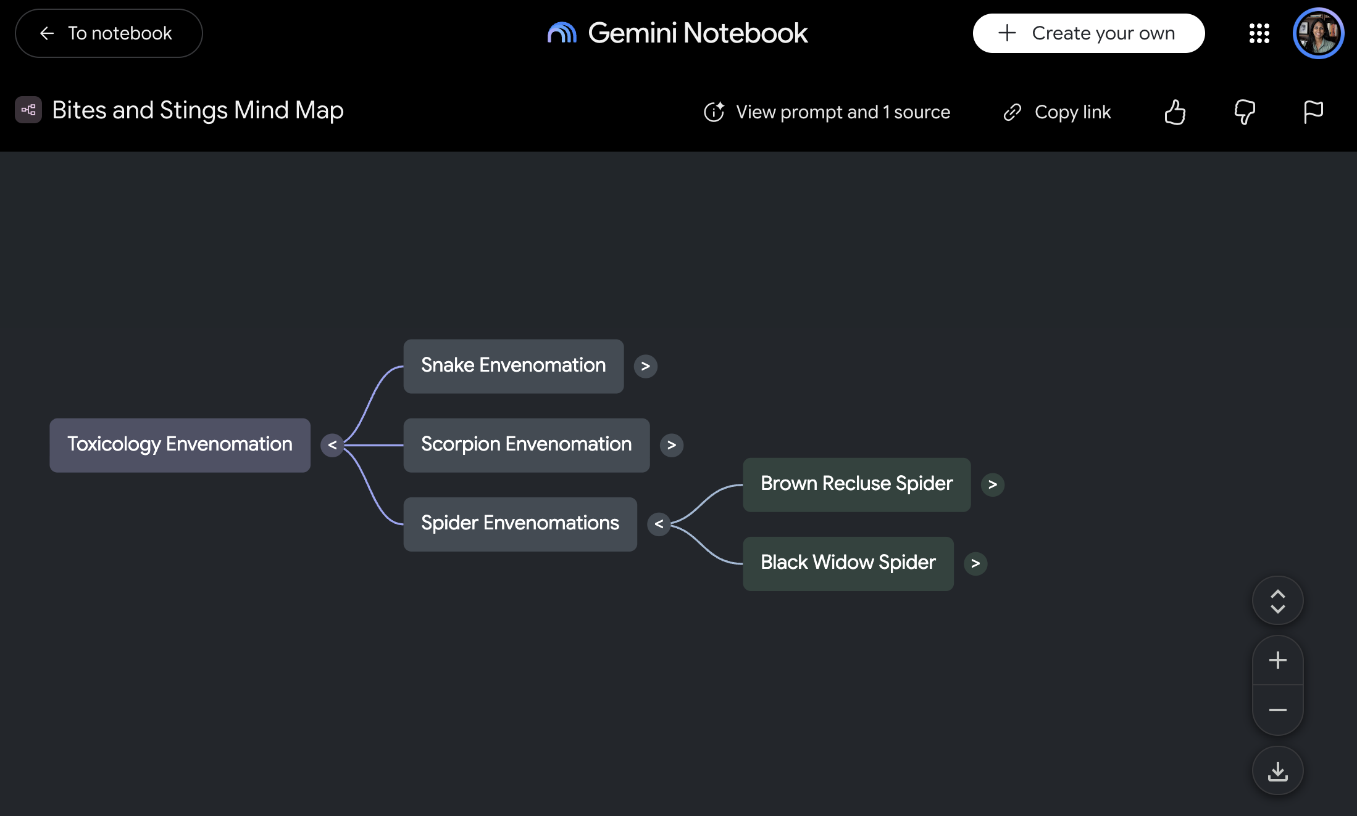
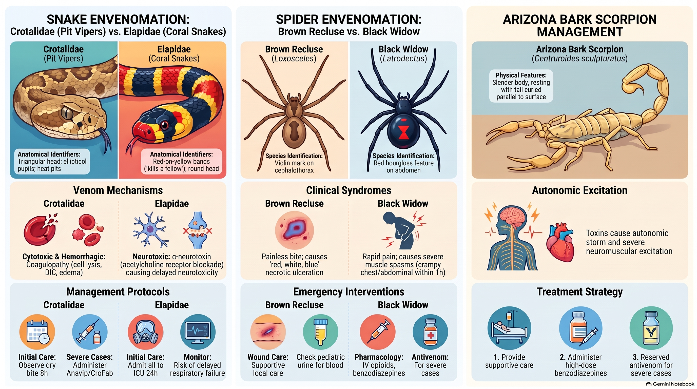
Mind map vs. infographic (NotebookLM)
SECTION 4 · PRACTICAL APPLICATIONS AND DEMONSTRATIONS
Mind map: the structure of a topic
Infographic: one-page visual summary
38

Slide 39
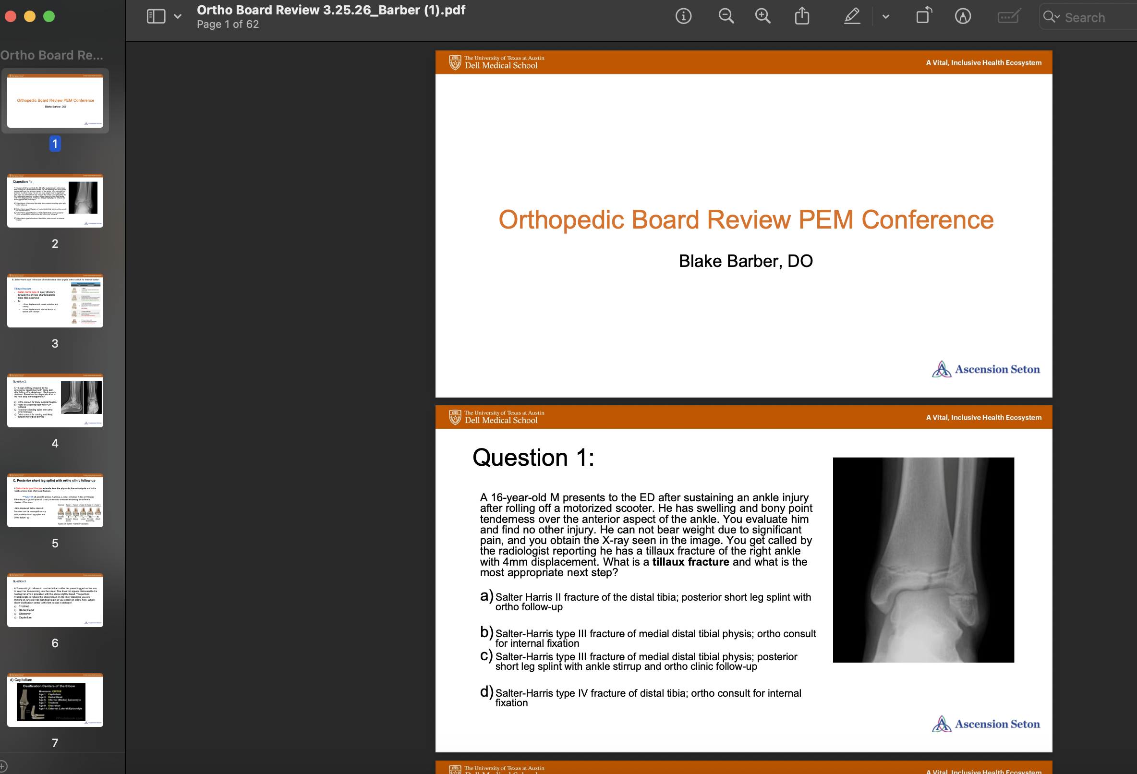
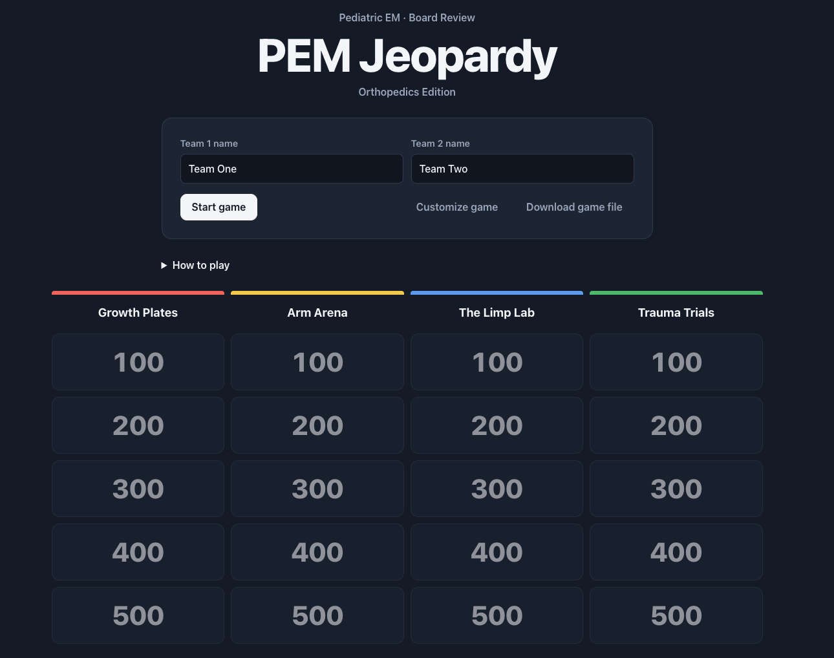
AI-generated Board Review: Jeopardy-style
SECTION 4 · PRACTICAL APPLICATIONS AND DEMONSTRATIONS
Board review PDF
AI-built Jeopardy game
39

Slide 40
AI-generated Anki flashcards for PEM board prep
SECTION 4 · PRACTICAL APPLICATIONS AND DEMONSTRATIONS
Skill will be uploaded soon
40

Slide 41

Simulation: Creating the sim, notes for instructor, one page summary, debrief (Claude skill)
PRACTICAL APPLICATIONS · DEMONSTRATION
1 · YOU TYPE
2 · THE SKILL
3 · YOU GET
One sentence
Same recipe every time
Three Word files
"Build a PEM fellow sim on a 2-month-old in SVT, HR 270."
Checks current guidance and doses against algorithms you place
Follows our sim template and stage table
Keeps patient, doses, and objectives consistent
Flags what it can't confirm: [VERIFY]
Facilitator primer: 2-page brief so any faculty can run it
Sim outline: stages, branches, scripts, labs
Debrief sheet: checklist, takeaways
Defaults: PEM fellows, peds ED, 20 to 30 min case, 15 to 20 min debrief. Add level or emphasis if you want.
The point: topic to ready-to-run case in minutes, so faculty time shifts from writing to reviewing and teaching. You stay the expert: clear every [VERIFY], adapt to local protocol, add real images.
Demo: infant SVT package built with a custom Claude skill (pem-simulation-builder)
41
Notes:
This is the follow-up to the last slide. Instead of a one-off prompt, I saved the whole sim recipe as a reusable Claude skill. I type one sentence, like a 2-month-old in SVT with a heart rate of 300. The skill fills in defaults: PEM fellows, pediatric ED, a 20 to 30 minute case and 15 to 20 minute debrief. Every time, it checks current guidance and doses, uses our existing sim template with the four-column stage table, keeps the patient, doses, and objectives consistent across documents, and flags anything it can't verify. Out come three editable Word files: a two-page facilitator primer so faculty who don't know the topic can still run the case, the simulation outline with branches, confederate scripts, and labs, and a debrief sheet with a checklist and advocacy-inquiry questions. The point is not to replace the sim expert. It moves our time from writing to reviewing, local fit, and teaching. Ask the room: what case have you been meaning to write?

Slide 42
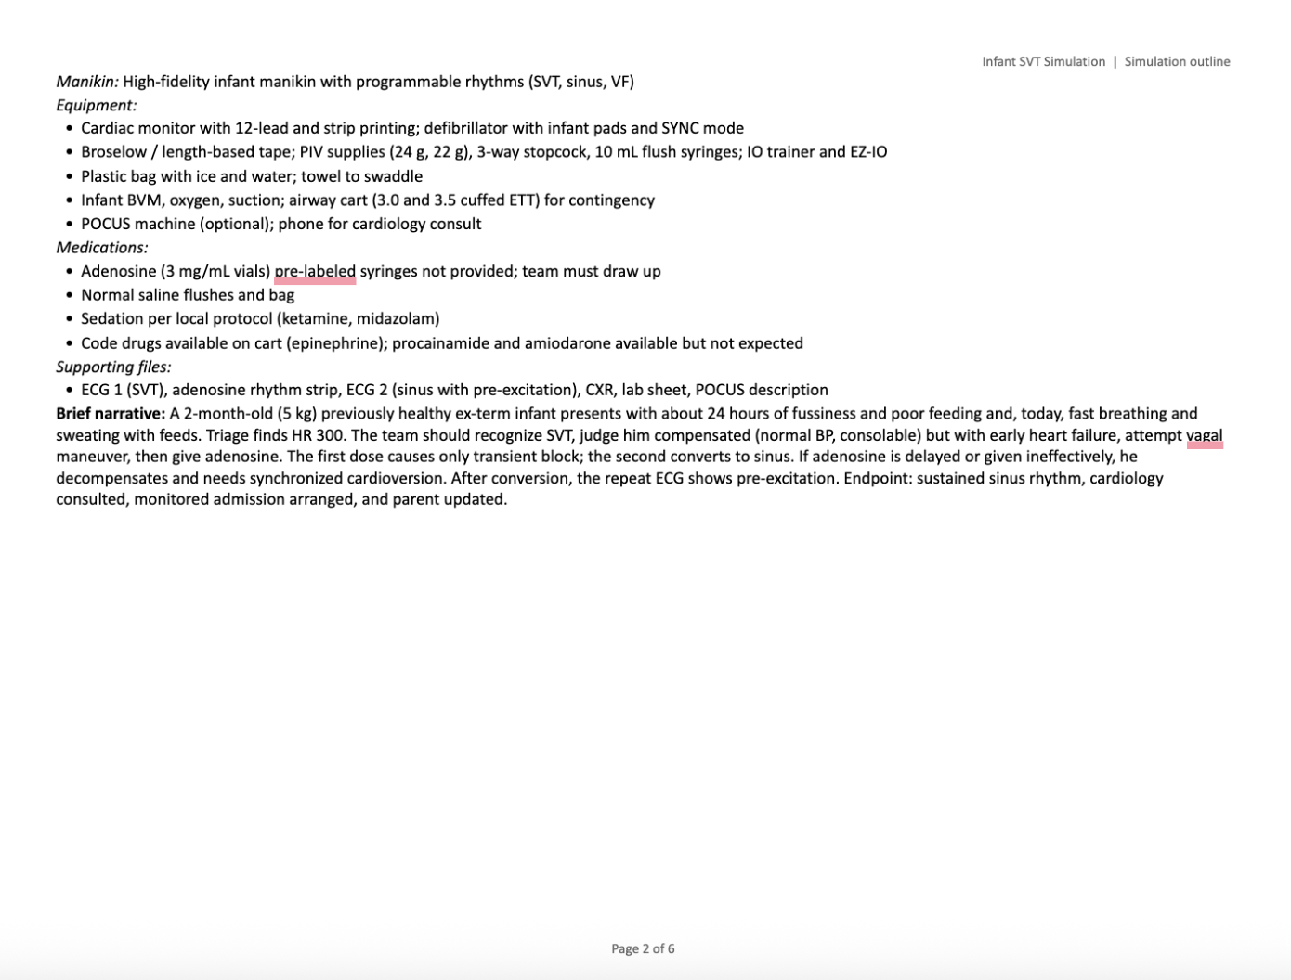
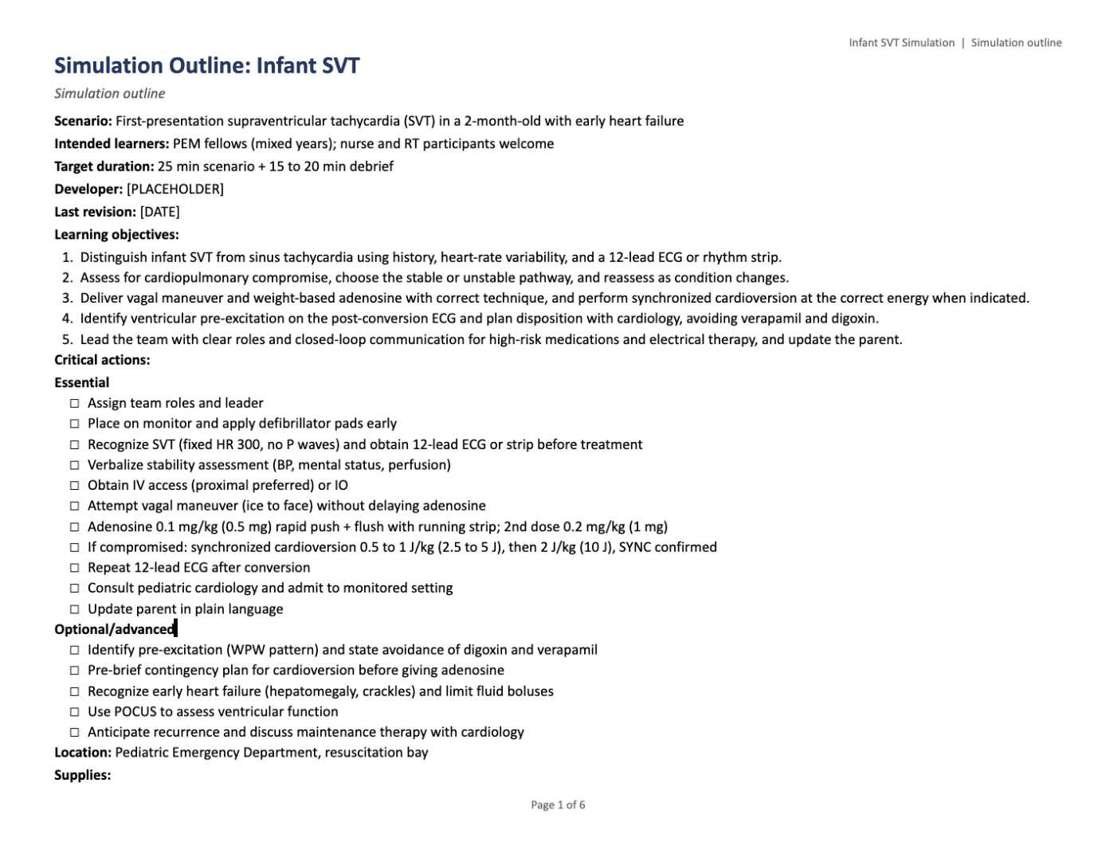
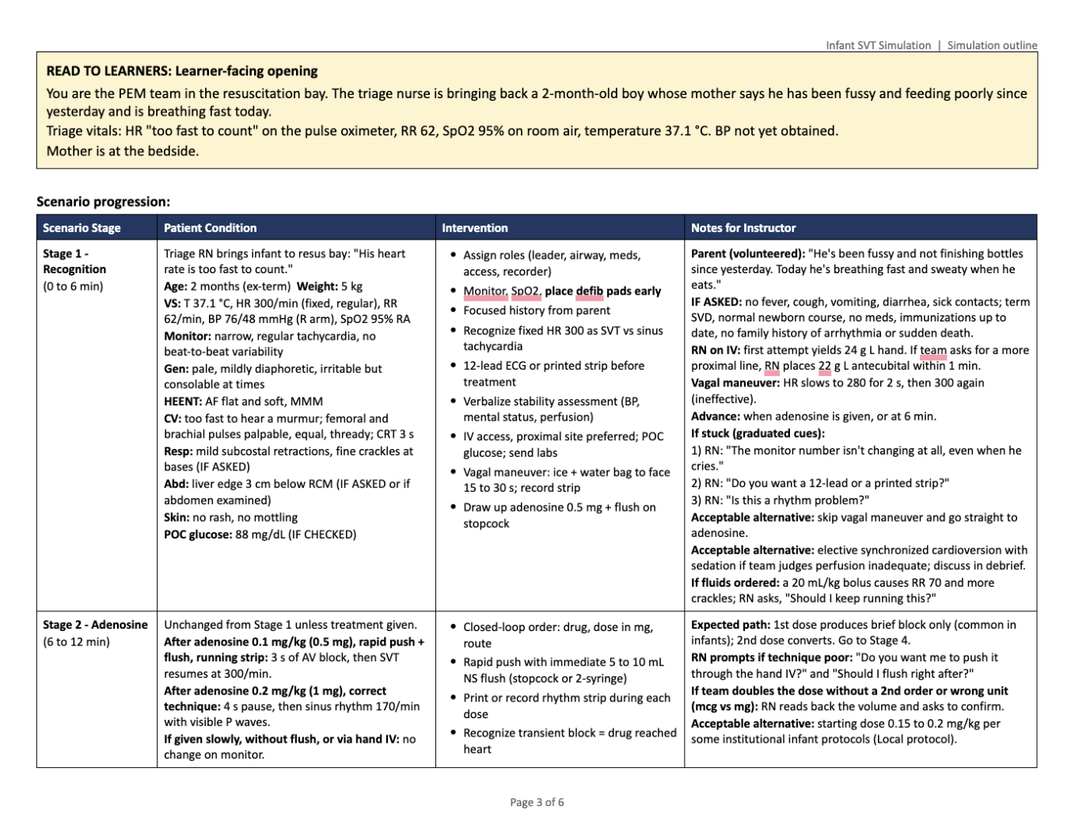
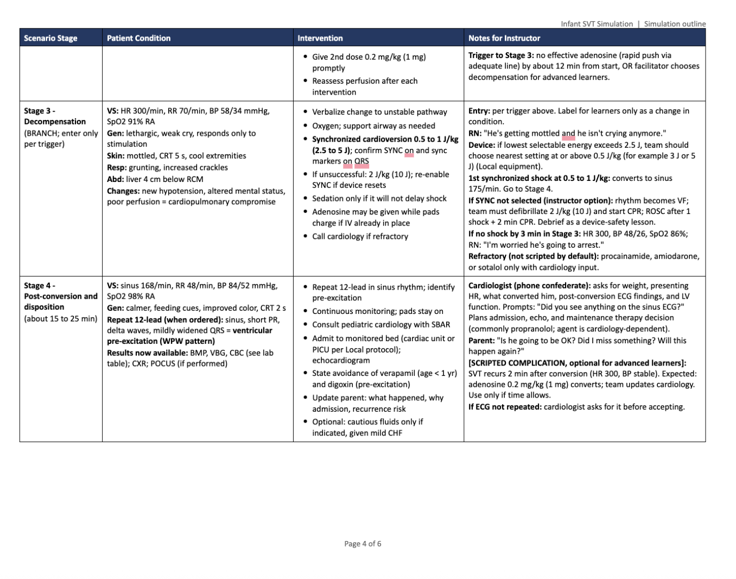
Example: AI-drafted SVT simulation outline
WHAT THE AI DRAFTED
Page 1
Objectives and critical actions
Page 2
Equipment, meds, and case setup
Page 3
Stages 1–2: presentation and first doses
Page 4
Stages 3–4: decompensation and disposition
Open the full outline (Google Doc)
42

Slide 43

Conclusion
1 Protect human skills
2 Think first, then use AI
3 Let AI draft; you verify
AI literacy resources
niharikagoparaju.github.io/ai-literacy
43

Slide 44
References (1 of 2)
REFERENCES
AAMC. AI Competencies Across the Learning Continuum. 2026.
AAMC. Principles for the Responsible Use of Artificial Intelligence in and for Medical Education. 2025.
AAMCNews. AI in medical education coverage. 2025–26.
Abdulnour REE, Gin B, Boscardin CK. N Engl J Med. 2025;393:786-797.
ACEP AI Task Force. Artificial intelligence readiness in emergency medicine: expert consensus opinion. 2025.
American Academy of Pediatrics. Recommendations for the development and implementation of generative AI tools in pediatric clinical care. Pediatrics. 2026.
American Board of Pediatrics. Entrustable professional activities for pediatric emergency medicine.
Anthropic. Education Report: How educators use Claude. 2025.
Boscardin CK, et al. Acad Med. 2025 (Josiah Macy Jr. Foundation report).
Characterizing LLM variability in the production of OSCE stations. medRxiv. 2026. doi:10.64898/2026.08.04.26359691
College Board. Faculty survey of AI use for work activities (n=2,988).
DATA-MD GenAI curriculum (Data-Augmented, Technology-Assisted Medical Decision-Making).
Ganjavi C, et al. ChatGPT and LLMs awareness and use: a survey of U.S. medical students. PLOS Digit Health. 2024;3(9):e0000596.
Goparaju N, Earp A. Toxicology: Envenomation (lecture).
Goparaju N, et al. AI curriculum for continuing and graduate medical education: a multi-center pilot (abstract).
Harvard Medical School. 2024.
Heudel PE, Crochet H, Filori Q, Bachelot T, Blay JY. ESMO Real World Data Digit Oncol. 2026;12:100693.
Hsu DC, et al. Pediatr Emerg Care. 2023;39(8):574-579.
44

Slide 45
References (2 of 2)
REFERENCES
Identifying the needs of parents admitted to the paediatric emergency department. BMC Health Serv Res. 2025.
Jamieson AR, et al. NEJM AI. 2024.
Konsker HB. Stanford Medicine, 2026 (AI study workflow).
Kulkarni-Date M, Bixby J. 2026.
Li C, et al. Leveraging large language models to generate multiple-choice questions for epilepsy education. Front Med. 2026;13:1978708.
McCoy, et al. NEJM AI. 2025.
Mount Sinai. ChatGPT Edu for medical students. 2025.
People choose to receive human empathy despite rating AI empathy higher. 2025. PMC12872445.
Pew Research Center. Survey of U.S. adults on AI in health care (n=3,488). June 2026.
Public perceptions of timeliness for AI use and human oversight. JAMA Netw Open. 2026 (n=1,185).
SAEM. Artificial Intelligence Consensus Conference. 2026.
Schaye VE, Parsons AS, Olson APJ, Abdulnour RE, Daniel M. Acad Med. 2026. doi:10.1093/acamed/wvag318
Stanford Medicine Magazine. 2025.
Structural Learning. Retrieval practice diagram.
Walton Family Foundation, GSV Ventures, Gallup. Voices of Gen Z: The AI Paradox. 2026.
Wang CG, et al. Prehosp Emerg Care. 2026.
Williams, et al. JAMA Intern Med. 2025.
Xu AY, et al. JMIR Form Res. 2026.
45

