Slide 1

Ticket Solve
Streamlining Complaints for Faster Resolutions !

Slide 2
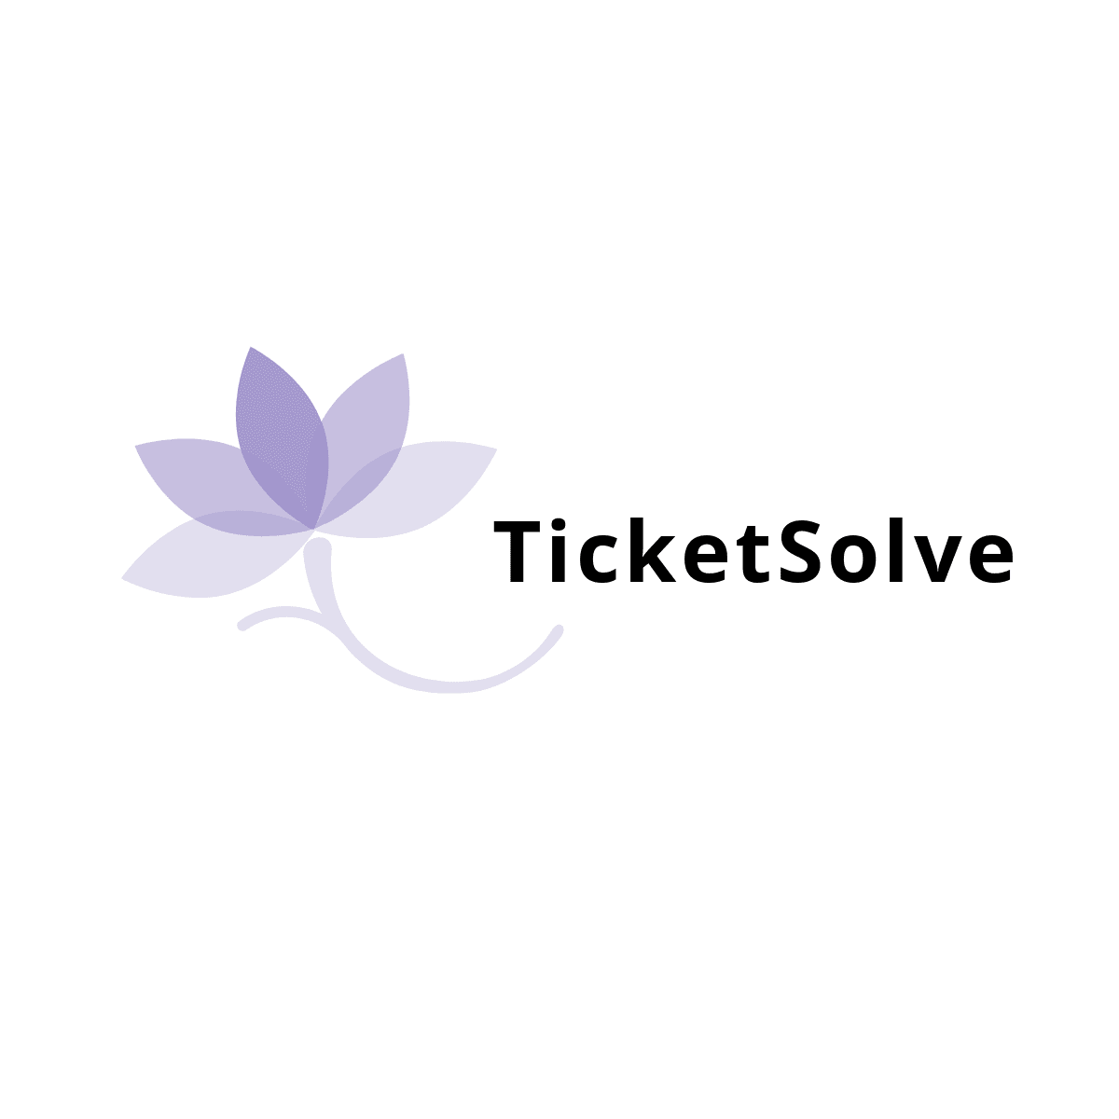
ABOUT TICKET SOLVE?
The Complaint Ticket App is a web-based platform designed to streamline complaint handling by allowing users to submit issues and track resolutions while enabling organizations to manage and respond efficiently. It fosters effective communication and improves customer satisfaction..

Slide 3
WHY TICKET SOLVE?
Simplified complaint submission.
Real-time tracking of statuses.
Efficient resolution with priority handling.
Knowledge Base System.

Slide 4

Actors in the System ?
User
Admin
Organization
Company
Government
Agent

Slide 5
User WorkFlow
User Register & Login
File a Complaint
View all Organizations
Track Status
Knowledge Base
Update Profile
Reset Password
In-app Notification

Slide 6
Organization WorkFlow
User Register & Login
Update Organization Profile
Generate Report
Knowledge Base
View & Update Complaints
In-app Notification

Slide 7
Admin WorkFlow
Admin Register & Login
View all Organizations
Knowledge Base
View all Users
View & Track All Complaint
Create Complaint Category
Admin Rights

Slide 8
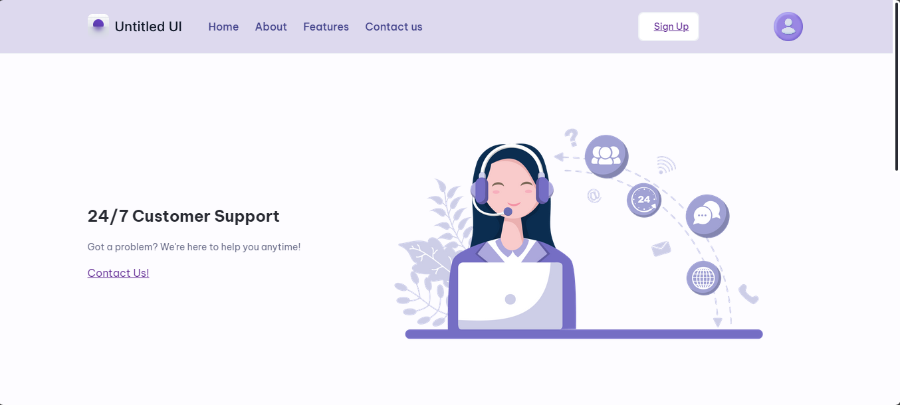
Home Page

Slide 9
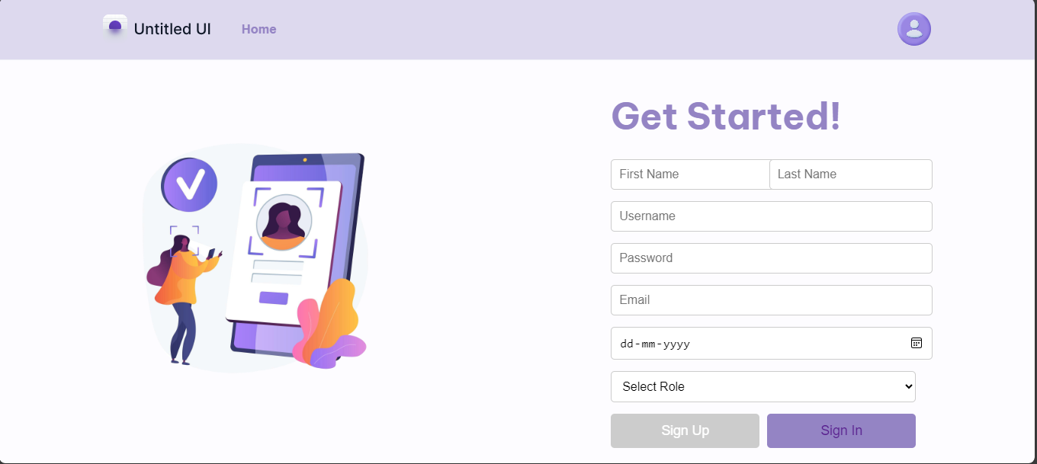
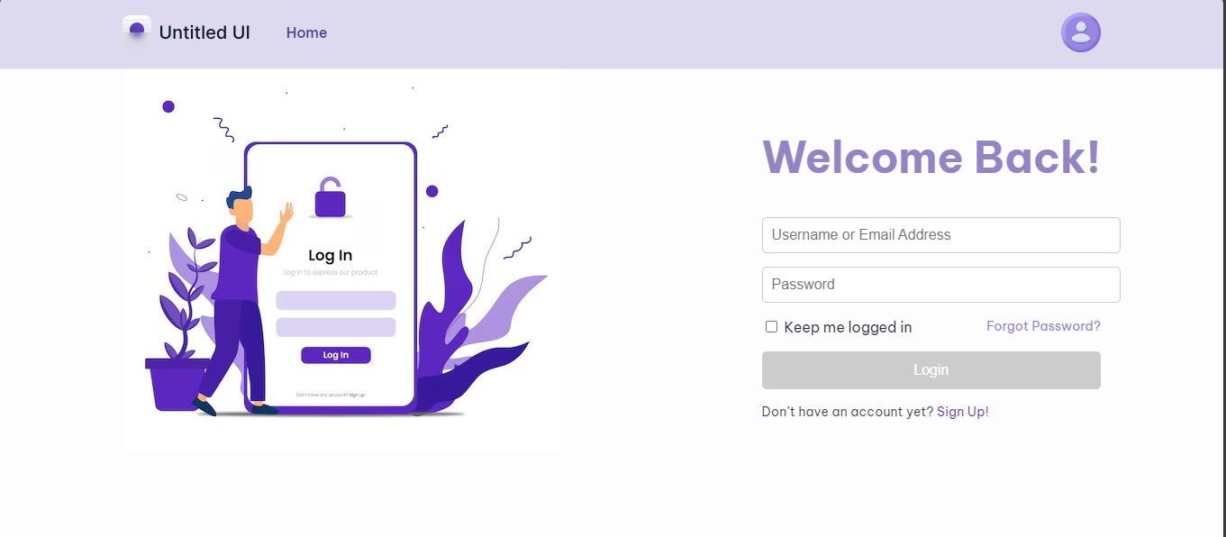
Sign In & Sign Up Page

Slide 10
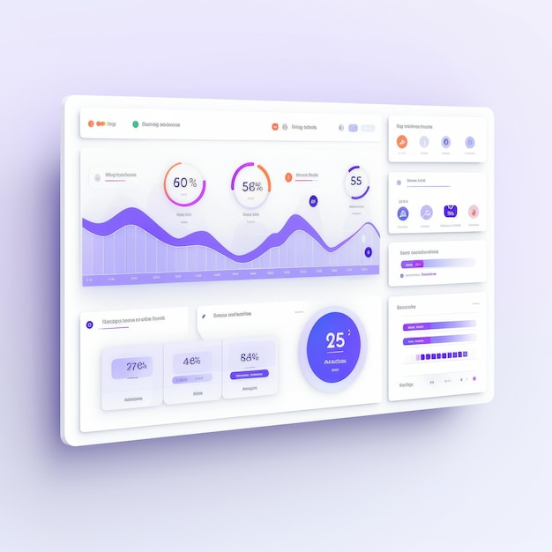
Dashboard
View all complaints
Knowledge Base
Track Status
Admin Rights
Profile Setting
In-app Notification
Help Option

Slide 11

Niharika Garg

