Slide 1
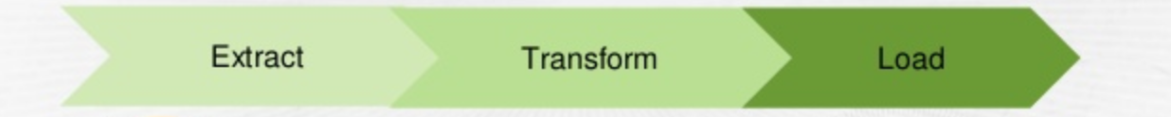
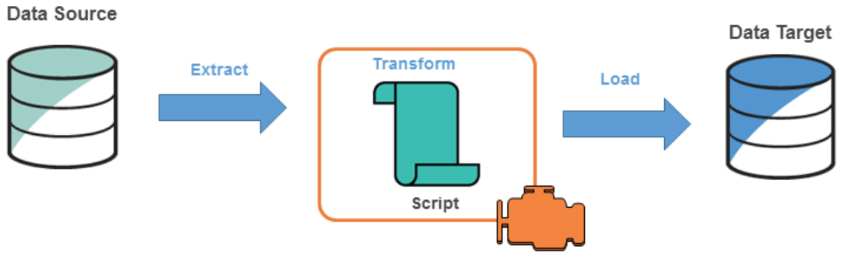
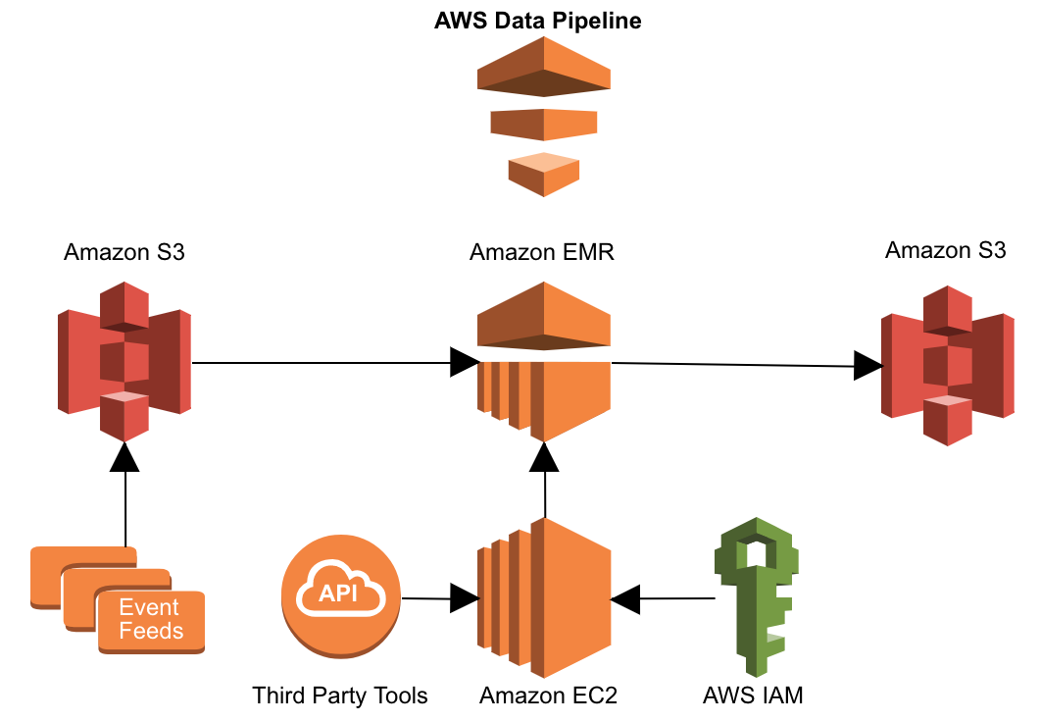


Amplero User Churn Prediction
Khyati Parekh, Niharika Sharma, Rajiv Veeraraghavan | Megan Hazen | University of Washington
Objective
Models
Assessment
Performed a multivariate time series analysis on the data to find the probability of a user churn out.
Motivation of the sponsor - Being able to predict a user’s propensity to churn out of a subscription, and the timing of the churn event, makes marketing more efficient.
Model name | Description
Voting Classifier | Consists of three different models - Logistic Regression, SVC [kernel="rbf], KNN [n=5] Experimented with the feature vector (with & without inactive days) Selected different K size for KNN Experimented with RBF, linear and poly kernel for SVC
Neural Net | A multilayer perceptron network with 1 hidden layer and about 1000 hidden nodes to make the prediction
Voting Classifier (Logistic Regression, SVC [kernel="rbf], KNN [n=5]) including inactive days feature vector
AUC | ACCURACY | RECALL | F1 | PRECISION
0.812 | 0.810 | 0.761 | 0.806 | 0.857
Voting Classifier (Logistic Regression, SVC [kernel="rbf], KNN [n=5]) excluding inactive days feature vector
AUC | ACCURACY | RECALL | F1 | PRECISION
0.637 | 0.635 | 0.598 | 0.631 | 0.667
Input
Voice Call Time Series - Number of calls per day
SMS Time Series – Number of SMS per day
Data Time Series – Data used in KB per day
Recharge Time Series - Amount and time of a pre-paid account recharge
Carrier Reported Subscription State Delta Time Series – Tells whether an entity ID active or inactive. Needed for churn
Neural Network
AUC | ACCURACY | RECALL | F1 | PRECISION
0.7489 | 0.75 | 0.7321 | 0.7446 | 0.7575
Method Pipelines (ETL)
Neural Network (excluding 14 days of timeseries data just before churn)
AUC | ACCURACY | RECALL | F1 | PRECISION
0.658 | 0.658 | 0.644 | 0.653 | 0.663
The best result was using Voting Classifier with Best Models: Logistic Regression, RBF SVC and KNN with soft voting [2, 3, 1] having ~0.80 as the final score.
Neural Network model gave an accuracy of 75% when we consider the time series data till the date of churn
If we ignore 2 weeks of data just before churn, the accuracy of the model drops to 65%.
Feature Selection
Voting Classifier
Features considered for each time series / Entity ID
Mean, Variance
Min, Max
Number of Inactive days
Neural Network
Each time series is broken down into 100 chunks
The average value in each chunk is a feature
Therefore, 100 features are generated from each time series.
S3
51 JSON files
(~ 400 GB compressed data)
3 CSV files
Data for 63960 Entity IDs
Summary
63960
47451
45707
3788
Number of inactive days seems to be a very good predictor of performance. If we ignore number of inactive days as a feature, the predictive power of the model drops.
Voting Classifier and the neural network models can enable mobile networks to identify users that may churn in the future. This information can be used to provide tailor made promotions to users.
Removing NA / Null values
Removing users who have activity after they have churned (from churned users only)
Data Balancing: Data is biased - 96% non churn and 4% churn
Removed the class bias by using 50-50 split
Future Work
Number of entity IDs / Users / Data Points
We believe we can obtain improved performance if we consider convolution neural networks in addition to the current multilayer perceptron.
Considering a much larger dataset to avoid issues with overfitting in a real time environment.
Challenges
Large Compressed files
Read line by line (parallel process also time consuming),
Cannot store Time Series data to a data frame because of memory issues.
Not enough/ satisfactory GZip library documentation

