Slide 1
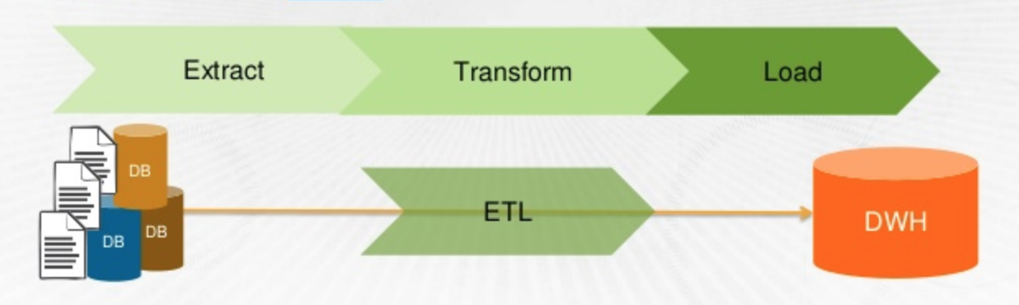
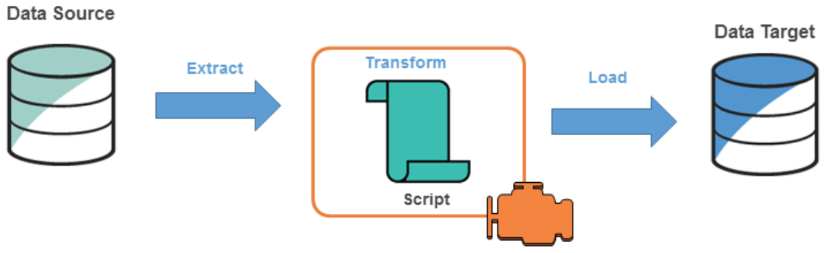
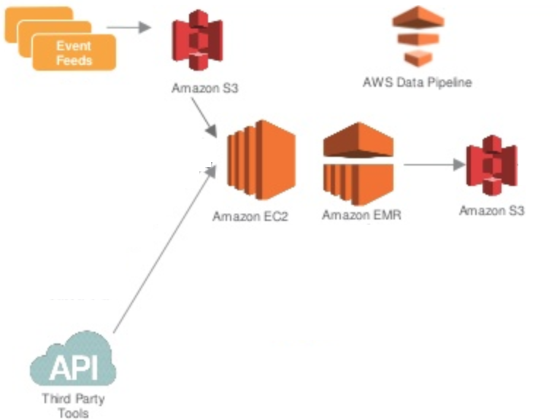
Amplero Time Series Prediction
Khyati Parekh, Niharika Sharma, Rajiv Veeraraghvan | Megan Hazen | University of Washington
Background
Models
Assessment
Being able to predict a user’s propensity to churn out of a subscription, and the timing of the churn event, makes marketing more efficient.
Performed a multivariate time series analysis on the data to find the probability of a user churn out.
Model name | Description
Voting Classifier
Neural Net
Voting Classifier (Logistic Regression, SVC [kernel="rbf], KNN [n=5]) including inactive days feature vector
AUC | ACCURACY | RECALL | F1 | PRECISION
0.812 | 0.810 | 0.761 | 0.806 | 0.857
Voting Classifier (Logistic Regression, SVC [kernel="rbf], KNN [n=5]) excluding inactive days feature vector
AUC | ACCURACY | RECALL | F1 | PRECISION
0.637 | 0.635 | 0.598 | 0.631 | 0.667
Input
Time Series
Voice Call Time Series
SMS Time Series
Data Time Series
Recharge Time Series
Method Pipelines (ETL)
The best result was using Voting Classifier with Best Models: Logistic Regression, RBF SVC and KNN with soft voting [3, 2, 1] having 0.812 as the final score.
Result 2
Result 3
Summary
Feature Selection
S3 51 JSON files (~ 400 GB compressed data)
3 CSV files - data for 63960 entity ids
Brief summary of what you discovered based on results
Indicate and explain whether or not the data supports your hypothesis
Features Considered for each time series
Mean, Variance
Min, Max
Number of Inactive days
63960
47451
45707
3788
Future Work
Removing NA / Null values
Removing users who have activity after they have churned (from churned users only)
Data Balancing: Data is biased - 96% non churn and 4% churn
Removed the class bias by using 50-50 split
Include print and electronic sources in alphabetical order
Number of entity IDs / Users / Data Points

