Slide 1
TravelTide Customer Analytics
Customer Segmentation with RFM analysis
STAR-Approach

Slide 2
01
04
Situation
Exploratory
Data Analysis
03
06
02
05
Actions
Task
Customer Segmentation
Recommendations

Slide 3
01
Situation

Slide 4
Context & Overview
About the client
TravelTide is an E-booking Startup, founded 2021 that offers best-in-class Travel Inventory & Search
Stakeholders
Kevin Talanick (CEO): Improve retention via data-backed marketing
Elena Tarrant (Head of Marketing): Design personalized rewards program
Objective
Kevin Talanick (CEO): Improve retention via data-backed marketing
Elena Tarrant (Head of Marketing): Design personalized rewards program

Slide 5
KPIs
Data Overview
5,998
$1,758
2.6
8.2
Total Customers
Avg Spending
Avg Trips
Avg Sessions
Dataset Composition:
• 17 behavioral, demographic, and transactional features
• Geographic coverage: USA-based customers
• Data collection period: Recent booking activity
• Clean data: 0 missing values, 0 negative values, ready for analysis

Slide 6
01
04
Situation
Exploratory
Data Analysis
03
06
02
05
Actions
Task
Customer Segmentation
Recommendations

Slide 7
02
Task

Slide 8
Analysis Objectives & Methodology
Maximize customer lifetime value
1
Recommend personalized retention perks
2
Develop targeted engagement strategies
3
Identify customer segments to translate into actionable groups
4
Exploratory Data Analysis (EDA)
Behavioral Pattern Analysis
RFM Segmentation Framework
Perks Recommendation Engine
Data exploration & validation
Understanding user behavior
Building the model, assigned customer segments based on RFM scores
Lifetime value analysis, perks allocation, retention strategies

Slide 9
01
04
Situation
Exploratory
Data Analysis
03
06
02
05
Actions
Task
Customer Segmentation
Recommendations

Slide 10
03
Actions

Slide 11
04
Exploratory
Data Analysis

Slide 12
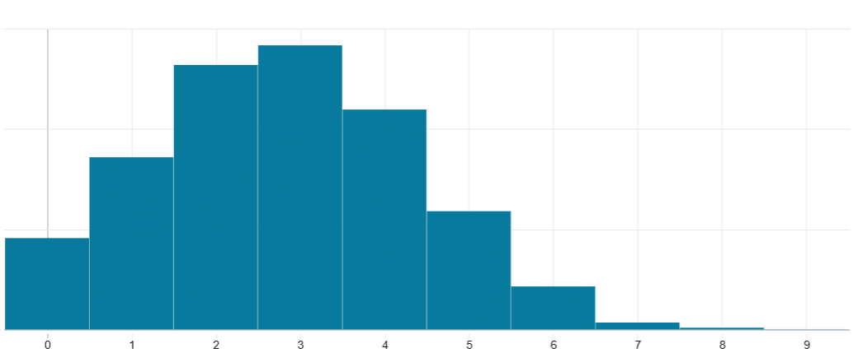
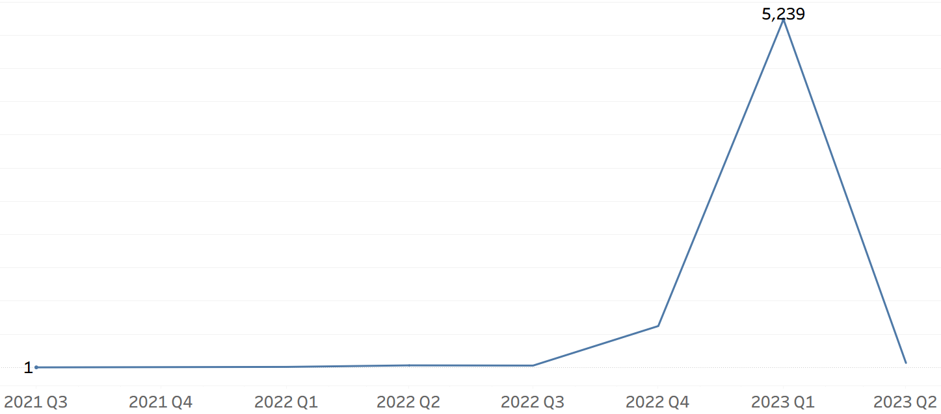
EDA - User data
Total trips booked vs. # of clicks
Sign ups over time

Slide 13
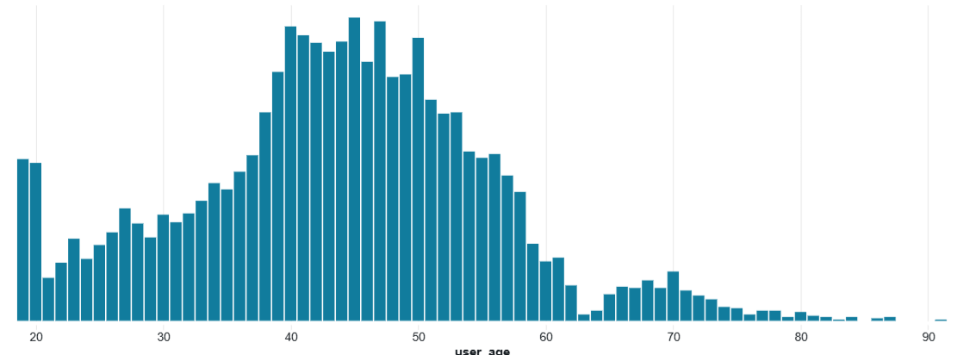
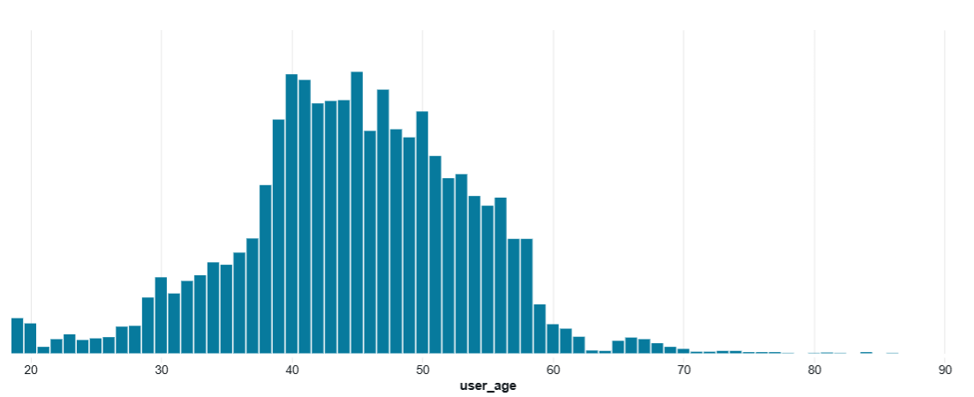
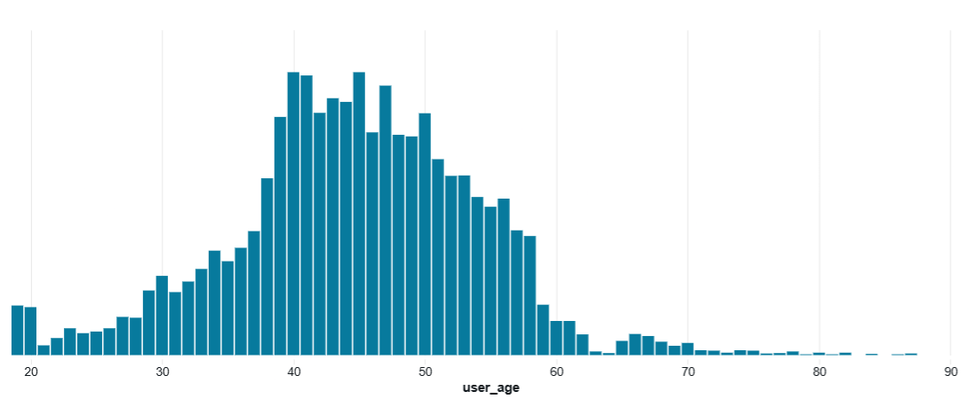
Age distribution
Flights completed
Hotels completed

Slide 14
Business Insights - User Behavior
Bundled Travel Behavior
Flight and hotel booking age profiles are nearly identical, suggesting the same users book both — making package deals and bundled offers a natural upsell opportunity.
Middle-Aged Core Audience
User base peaks between ages 40–50, with thin representation under 30 — pointing to a mature, likely dual-income demographic as the primary customer segment.
Low-Frequency Bookers
Most users book 2–4 trips total, with very few power users — indicating an opportunity to improve retention and repeat booking behavior.
Sign-Up Concentration
Nearly all 5,998 users signed up in a single quarter (2023 Q1), suggesting growth was driven by a one-time campaign rather than organic acquisition.
Notes:
1. Flight and hotel booking age profiles are nearly identical The distributions for flights completed and hotels completed mirror each other almost exactly, both peaking at 40–50. This means the same users are booking both — there's no meaningful segment that flies-but-doesn't-hotel or vice versa. Bundle/package promotions are likely effective across the board for the core age group.
2. Core user base is 35–55, not young adults Age distribution peaks sharply between 40–50 with a long right tail into the 60s–70s. The 20–30 cohort is notably thin. This is a middle-aged, likely dual-income user base — pricing, UX, and perks should be calibrated for that demographic, not millennials or Gen Z.
3. Most users are low-frequency bookers — the sweet spot is 2–4 trips The trips booked histogram is roughly bell-shaped peaking at 3, with very few users at 0 or above 6. The platform has limited power users. Retention strategy should focus on pushing 1–2 trip users toward the 3–4 range, not chasing outliers.
4. Sign-ups are almost entirely a 2023 Q1 phenomenon The platform had near-zero organic growth from mid-2021 through late 2022, then spiked to 5,239 sign-ups in a single quarter before collapsing again in Q2 2023. This isn't gradual growth — it's almost certainly a one-time event (a campaign, partnership, or promotion). The user base is not organically recurring.

Slide 15
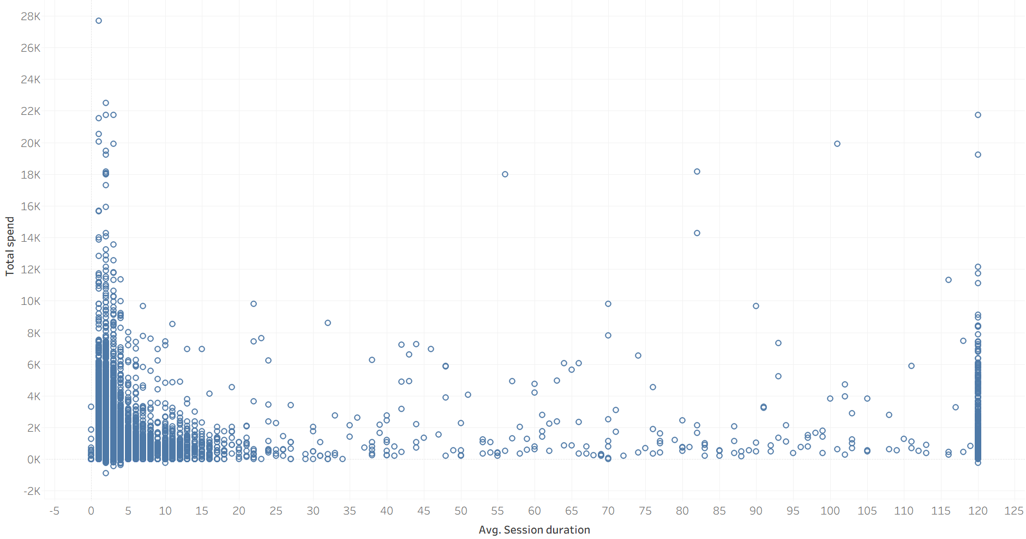
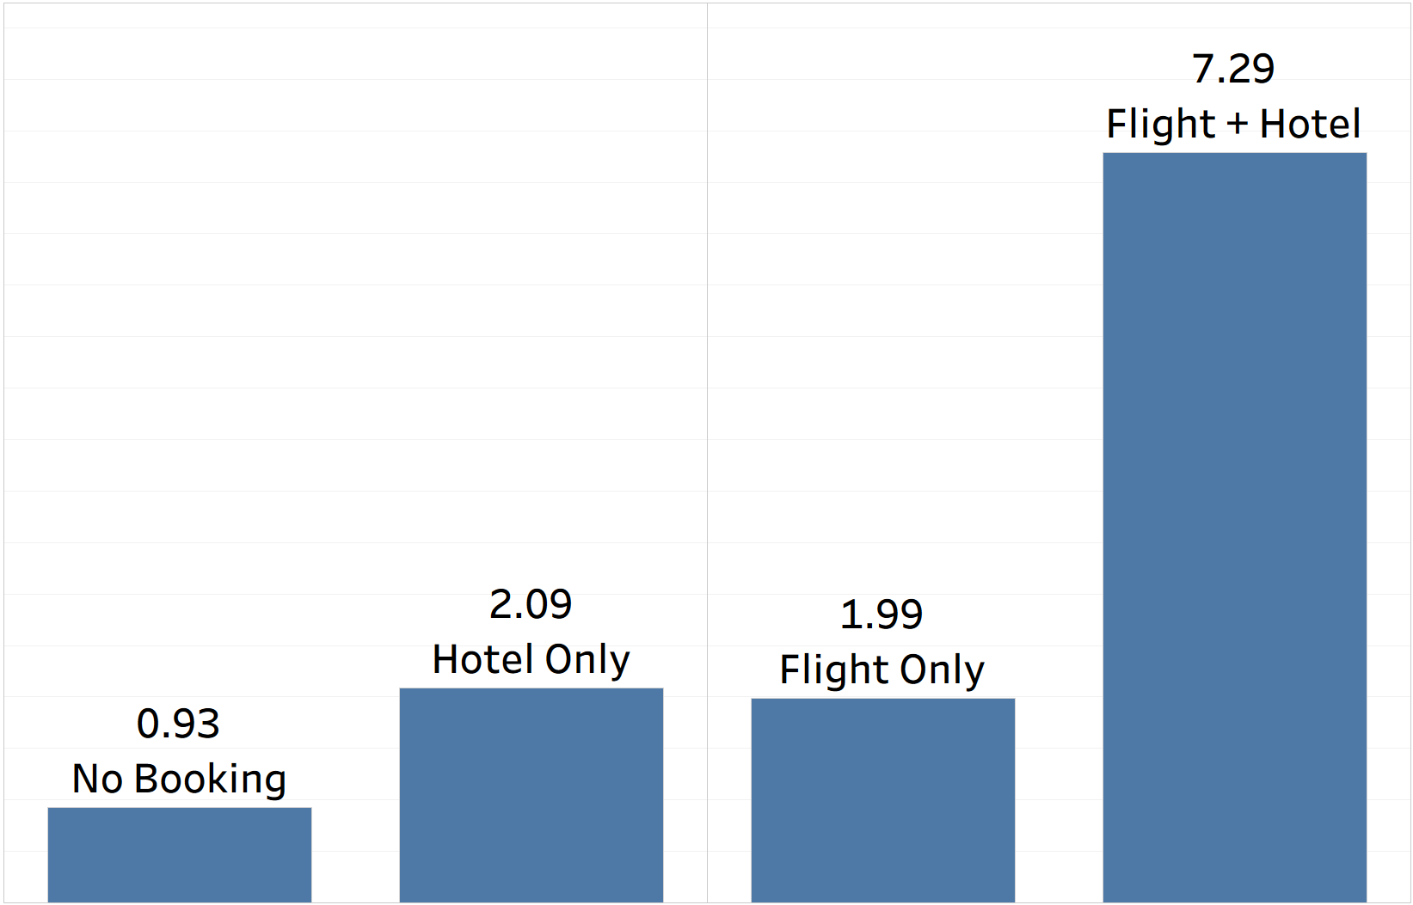
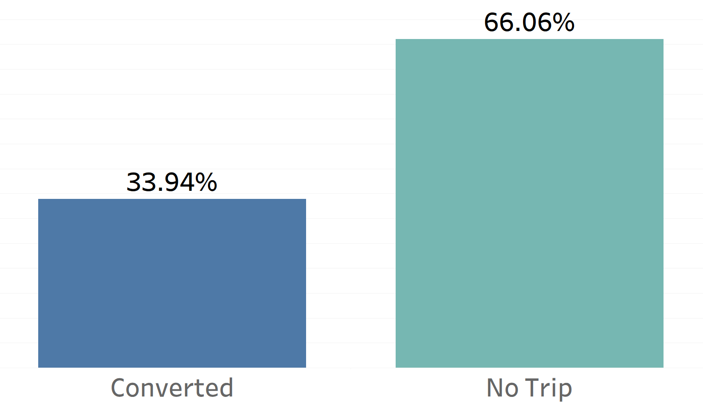
EDA - Sessions data
Total spend by avg session duration
Avg session duration by Outcome
Trip conversions split

Slide 16
Business Insights - Session Behavior
Fast Converters Spend the Most
Under 10 mins account for highest-value bookings - prioritise users with targeted checkout offers
Session-to-Trip Conversion
2/3rds of our sessions don’t convert
Bundled Bookings Require Significantly More Session Time
Users booking both hotels and flights display a high purchase intent
Notes:
Counterintuitively, our biggest spenders aren't the ones browsing the longest. The scatter plot shows that bookings above $10,000 almost exclusively happen in under 10 minutes. Long sessions correlate with indecision. So our priority should be making it as easy as possible for high-intent users to book quickly — reduce friction, not add steps.
When a user books both a flight and a hotel, they spend over 7 minutes in session — far longer than any other group. This isn't just engagement, it's deliberate decision-making. These are our most valuable users, and the data suggests bundled offers are a natural upsell lever worth investing in.
Looking at our session-to-trip conversion, only 1 in 3 sessions results in a booking. That means the majority of our users are leaving without completing a trip — which is actually an opportunity. If we can close even a fraction of that gap through better onboarding or timely prompts, the revenue impact is meaningful.

Slide 17
01
04
Situation
Exploratory
Data Analysis
03
06
02
05
Actions
Task
Customer Segmentation
Recommendations

Slide 18
05
Customer Segmentation

Slide 19
RFM Segmentation Framework
Do Not Lose | Loyal Customers | Champions
At Risk (High Value) : High m score / At Risk : Low m score | Need Attention | Potential Champions
Hibernating | About to Sleep | Promising (High Value) : High m score / Promising (Growth) : Low m score
recency
frequency
monetary
Days since last booking activity
Number of trips booked
Total spending
rfm Score
Average of Recency, Frequency, and Monetary scores (1–3 scale).
Segmentation
Driven by Recency + Frequency combination.
*Monetary score applied selectively to 2 segments - Promising & At Risk, to identify monetary impact based on recency.
f Score (1-3)
r Score (1-3)
Notes:
Why M Score Only for Promising & At Risk
Promising Segment (High Recency, Low Frequency):
"These are my recent visitors who aren't coming back often. They could be new customers or just browsing. By checking their monetary value, I can identify: Are these infrequent visitors actually spending well? If yes—high-value prospects worth investing in retention. If no—emerging customers needing nurturing. The M score tells me where to focus my acquisition and onboarding efforts."
At Risk Segment (Low Recency, Medium Frequency):
"These customers used to visit regularly but haven't been back in a while. This is my churn risk group. By checking their monetary value, I can prioritize: Which at-risk customers are worth saving? The high-value ones get immediate intervention. The lower-value ones—maybe I let them go. The M score lets me predict churn impact and allocate retention budget intelligently."
Why Not Other Segments?
Champions, Loyal, Need Attention, Do Not Lose—their R+F combination already tells the full story. M score adds nothing actionable there. But for these two edge cases, monetary value fundamentally changes your strategy.

Slide 20
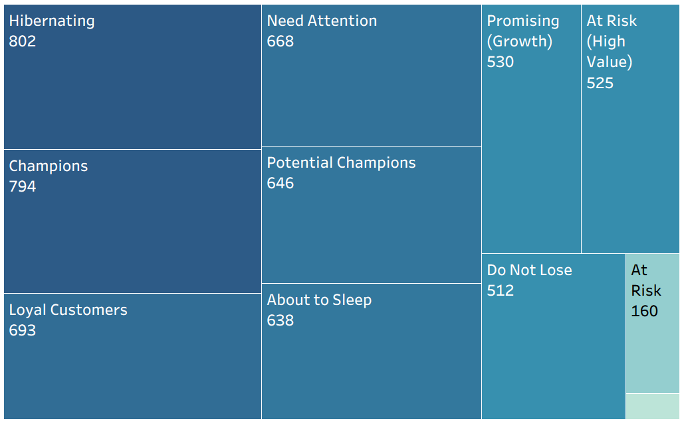
RFM Segments by User Strength
Promising (High Value)
30

Slide 21
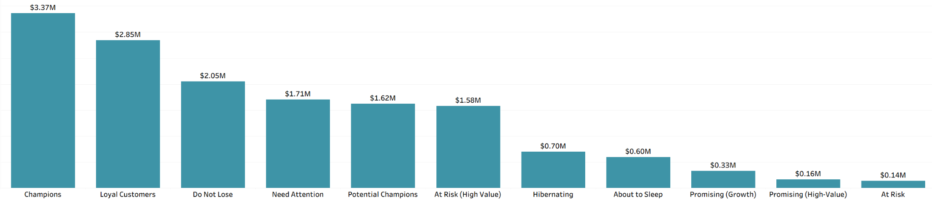
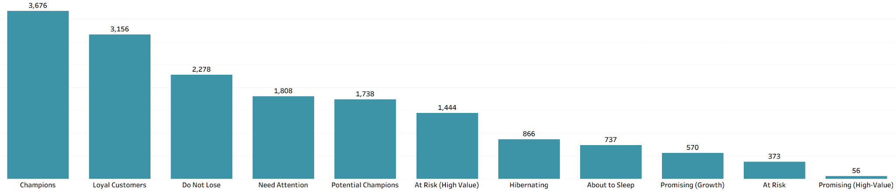
RFM Segmentation Results
Total Revenue by Segment
Purchase Frequency by Segment
Revenue Follows Frequency (Mostly)
At Risk (High Value) is Your Hidden Priority
Do Not Lose = Churn Risk with Revenue Impact
Promising (High-Value) Shows Your Strategy Works
Bottom Tier is Noise
Notes:
Champions, Loyal Customers, and Do Not Lose dominate both charts - high purchase frequency directly correlates with revenue. This validates R+F as your primary segmentation drivers.
At Risk (High Value): Revenue per frequency unit: $1.58M ÷ 1,444 = $1,094 per unit WHILE Loyal Customers:Revenue per frequency unit: $2.85M ÷ 3,156 = $902 per unit
The insight: At Risk (High Value) generates $192 more per frequency unit than Loyal Customers. They're higher-value customers who just happen to visit less frequently. Translation: If you retain one At Risk (High Value) customer, you're protecting more revenue per customer than a typical Loyal Customer. This confirms they deserve priority intervention.
2,278 purchases but declining recency = $2.09M at risk. This is your second-largest revenue pool disappearing. Urgent intervention needed.
Despite only 373 purchases, they're generating $0.16M. This proves your hypothesis: recent + low frequency can still mean value. These are likely high-ticket or new high-value customers—nurture them.
Promising (Growth), At Risk, About to Sleep, Hibernating = $1.07M combined (18% of total). Don't over-invest here; focus on saving Do Not Lose and At Risk (High Value) first.

Slide 22
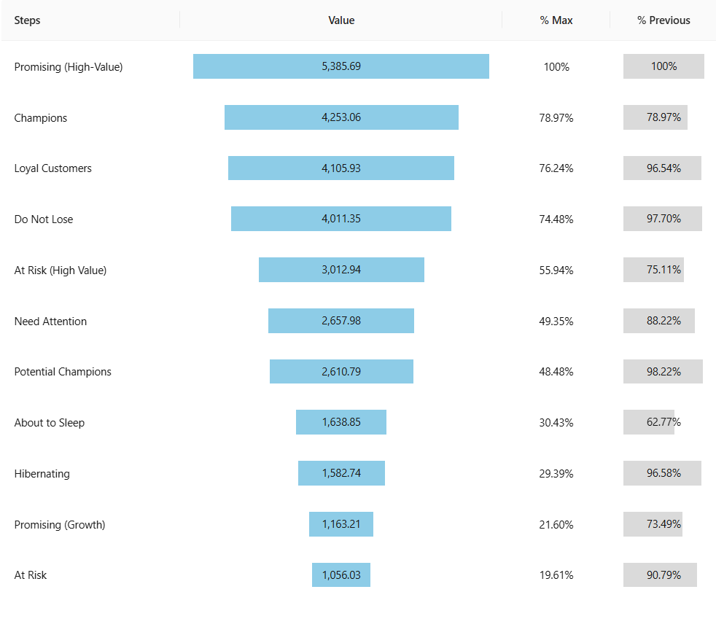
Lifetime Value by Segment
Customer quality (spend/visit) > visit frequency
Promising (High-Value)
Highest avg LTV premium treatment
Do Not Lose High-value customers gone inactive
At Risk (High Value)
Worth aggressive retention spending
Potential Champions
Low spend per visit despite high frequency - focus on monetization
Bottom tier
<$1,600 per customer - minimize investment
Notes:
Thought process
Thought process
PPT Script:
"Looking at lifetime value per customer reveals a completely different story than volume alone. Promising High-Value customers have the highest average value at $5,385 per person—even though they represent the smallest segment. This validates our premium nurturing approach.
Do Not Lose is critical because these customers have nearly the same per-customer value as Champions at $4,011—they're not low-value churn; they're high-value customers who've gone inactive. That's why our 16% win-back discount is justified.
At Risk High-Value shows the same pattern. Despite their low visit frequency, each customer is worth $3,012. Spending 22% to retain them is a smart investment.
However, Potential Champions underperform. They have the same visit frequency as Need Attention but generate less value per customer. This suggests they're visiting without spending—they need a different strategy focused on monetization, not just frequency.
The bottom segments—Hibernating, Promising Growth, and At Risk—all fall below $1,600 per customer, confirming our decision to minimize investment there.
The key lesson: frequency doesn't equal value. Customer quality—how much they spend per visit—is what drives priority."

Slide 23
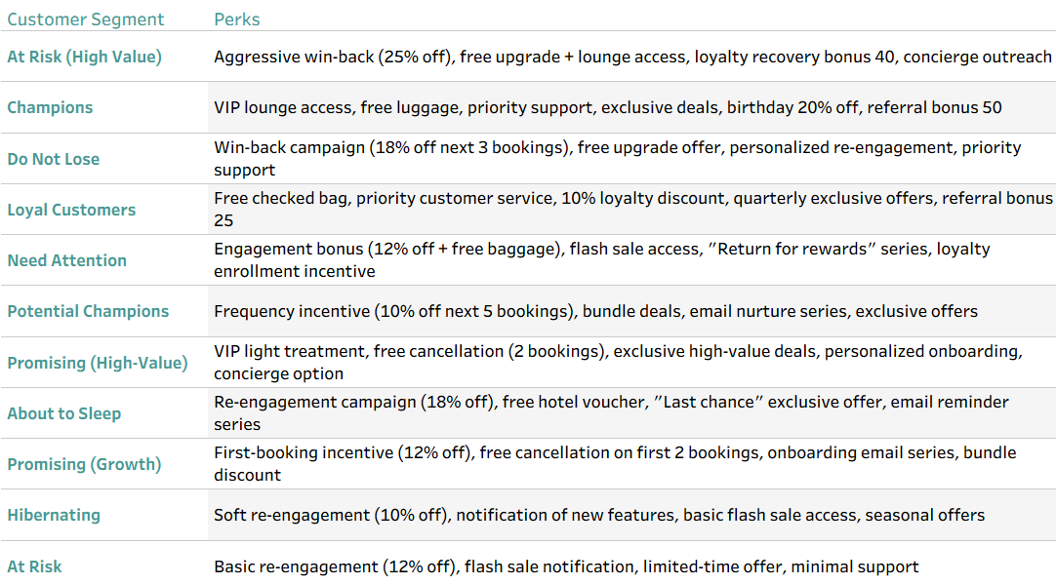
RFM-Based Perks & Engagement Strategy

Slide 24
01
04
Situation
Exploratory
Data Analysis
03
06
02
05
Actions
Task
Customer Segmentation
Recommendations

Slide 25
06
Recommendations

Slide 26
Key Findings & Strategic Implications
Potential Champions
Can be monetised and moved to Champions segment by incentivising frequency - VIP program, discount next 5 services, exclusive previews
Promising (High Value)
High potential, small chunk - Loyalty rewards, tiered benefits, early access to sales
At Risk (High Value)
Immediate risk of churn - Aggressive win-back campaigns, special discounts to increase recency
Need Attention
Center of LTV funnel - Onboarding perks, first-booking incentives, educational content
Next Steps:
Finalise budget for each campaign
Predictive analysis on potential impact of campaigns
A\B Testing to implement segment-based campaigns and track KPIs by cohort
Notes:
Highest LTV, despite fewer purchases generates 10% revenue of At Risk (High Value) segment - These are likely high-ticket or new high-value customers

Slide 27
Thank you

