Slide 1

Humanity
Help with heart

Slide 2
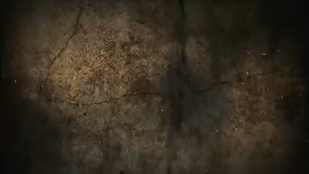
Problem Statement
Humanity is the way to achieve the contribution to humanity. As the third Wave of
COVID-19 is on its way to arrive so, during these circumstances the humans need to
show humanity and help the other beings. The basic idea behind the Web app is to
provide the the user the ability to register to donate and request for the plasma oxygen
cylinder and blood.

Slide 3
FEATURES
Donation of Blood
Donation of plasma
Donation of Oxygen Cylinder
request of Blood donation
request of plasma donation
request of oxygen cylinder
need
search donors and requesters

Slide 4
TECHNOLOGIES FOR CREATING PAGE LAYOUT
for frontend-:
HTML
CSS
JS
for designing-:
CANVA
STUDLOGO

Slide 5
For BACKEND-:
JSON
PHP
AJAX
MY SQL
Jquery

Slide 6
WHAT IS THE WORK METHODOLOGY
1 weeks -:the frontend design
3
1 weeks for backend works
1
2
1 weeks -:creating json files
2 weeks database
4
5
2 weeks combining all modules

Slide 7
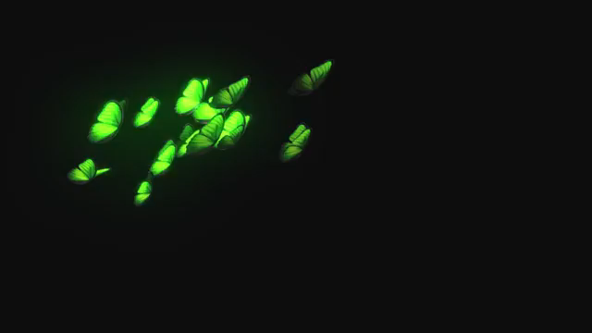
THANK YOU

