Slide 1
ParkSense
AI parking enforcement intelligence for Bengaluru
From reactive patrols to data-ranked enforcement.
Theme: Poor visibility on parking-induced congestion
Gridlock Hackathon 2.0 · Round 2
Participant : Nihar Joshi

Slide 2
THE PROBLEM
Parking chaos is choking our roads
Cars block the road. Illegal and double parking near markets, metro stations and event
venues squeezes traffic into fewer lanes.
Enforcement is guesswork. Teams patrol blindly. There is no map showing which spots
actually hurt traffic the most.
Everything looks equally bad. Officers cannot tell which zone to fix first, so the worst
jams keep coming back.
ParkSense · Gridlock Hackathon 2.0
2

Slide 3
THE INSIGHT
Not every wrong-parked car matters the same
A car blocking a busy main road at 6 PM is a big problem.
The same car on a quiet street at midnight is not.
So we stopped counting cars. We measure how much each spot is actually hurting traffic flow.
ParkSense · Gridlock Hackathon 2.0
3

Slide 4
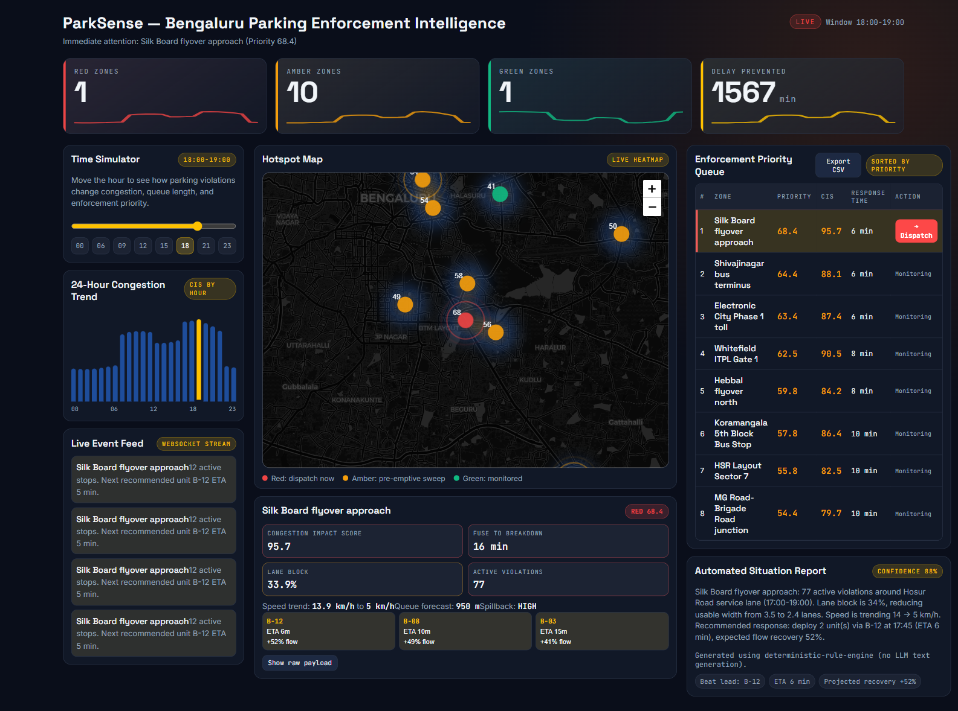
OUR SOLUTION
One live dashboard for the whole city
What you see
Hotspot map
Live red / amber / green zones.
Impact score
0–100 score per spot.
Priority queue
Zones ranked by urgency.
Situation report
Plain-English brief per zone.
ParkSense · Gridlock Hackathon 2.0
4

Slide 5
HOW IT WORKS
The Congestion Impact Score (CIS)
A single 0–100 score that says how badly each spot hurts traffic. It is built from five things:
How many cars are wrongly parked
42%
Why it's better
Every number is shown in
the app — no black box.
Score + how easy it is to
reach the spot decides the
Red / Amber / Green tier.
Time of day (rush hour vs night)
22%
How important the road is
18%
Risk of the jam spilling into junctions
13%
History of repeat offenders
5%
ParkSense · Gridlock Hackathon 2.0
5

Slide 6
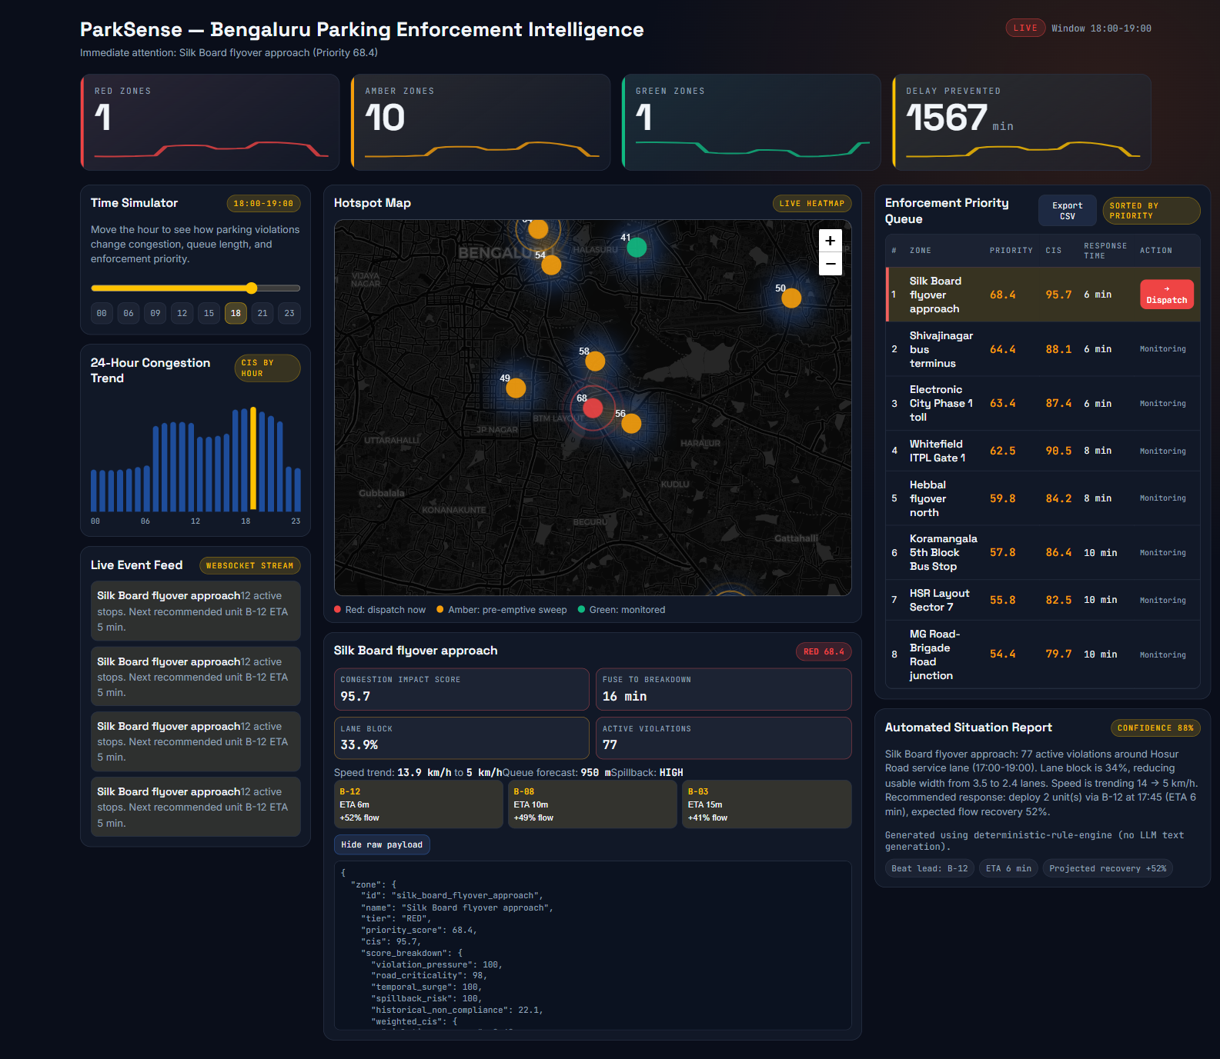
FULLY EXPLAINABLE
No black box — every score is shown
Click “Show raw payload” and you see the full breakdown behind every score.
Judges, officers and engineers can all check exactly how a number was reached.
ParkSense · Gridlock Hackathon 2.0
6

Slide 7
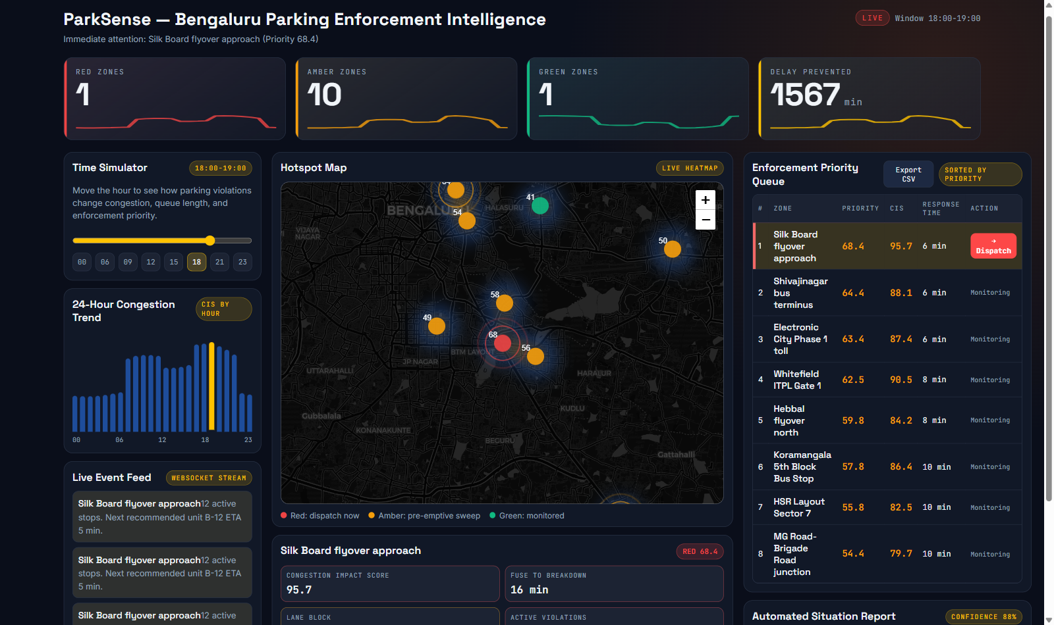
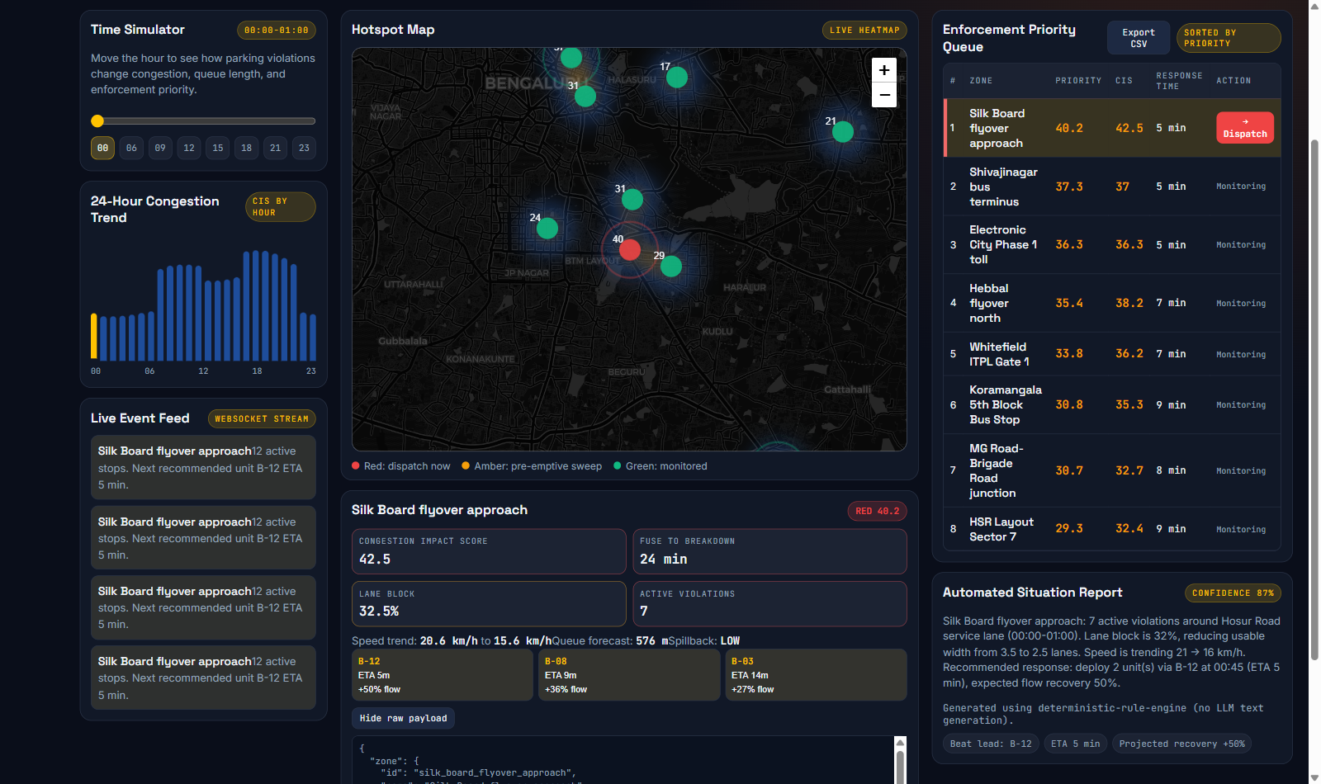
IT REACTS TO REALITY
Busy at 6 PM, calm at midnight
6 PM peak — red zones light up.
Midnight — most zones turn green.
Drag the time slider to any hour. The model is not “always red” — it follows real demand.
ParkSense · Gridlock Hackathon 2.0
7

Slide 8
FROM ALERT TO ACTION
One click closes the loop
1
2
3
See
Decide
Dispatch
Map and queue show the worst zones right now.
Read the plain-English situation report for that zone.
One click sends a patrol and estimates commuter-minutes saved.
Plus: export the queue to CSV for field teams, and a live feed updates the control room in real time.
ParkSense · Gridlock Hackathon 2.0
8

Slide 9
HOW IT'S BUILT
Simple, fast, reproducible
Bengaluru data
→
CIS engine
→
API (REST + live feed)
→
Dashboard
Backend: Python (FastAPI) computes the score and serves a live feed over WebSockets.
Frontend: React + Vite with a Leaflet map and live heatmap.
Data: Seeded synthetic dataset modeling real Bengaluru hotspots — same result every run.
AI: Briefings come from a clear rule engine, so results are explainable and repeatable.
ParkSense · Gridlock Hackathon 2.0
9

Slide 10
IMPACT & WHAT'S NEXT
Smarter enforcement, clear next steps
Impact today
• Fix the worst zones first.
• Measure minutes saved for commuters.
• Every decision is explainable.
What's next
• Plug in real camera / ANPR feeds.
• Mobile app for field officers.
• Link to live traffic-signal data.
ParkSense · Gridlock Hackathon 2.0
10

Slide 11
Thank you
ParkSense - turning parking data into targeted enforcement.
.

