Slide 1
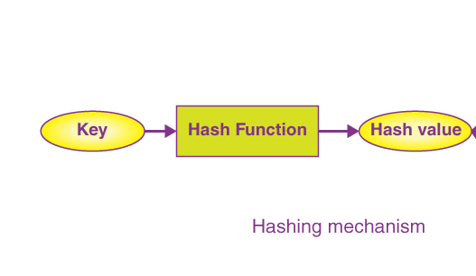
Introduction to Hashing
Hashing is a fundamental data structure that uses a hash function to efficiently store and retrieve data. It is a powerful technique used in various computer science applications, from caching to database indexing.
By
K Nihar
22B81A6231
CSE CS

Slide 2
Collision Resolution Techniques
1
Chaining
Chaining resolves collisions by linking elements that hash to the same index into a linked list.
2
Open Addressing
Open addressing techniques, such as linear probing and quadratic probing, resolve collisions by finding the next available slot in the hash table.
3
Double Hashing
Double hashing uses a second hash function to determine the next probe location, providing a more sophisticated collision resolution mechanism.

Slide 3
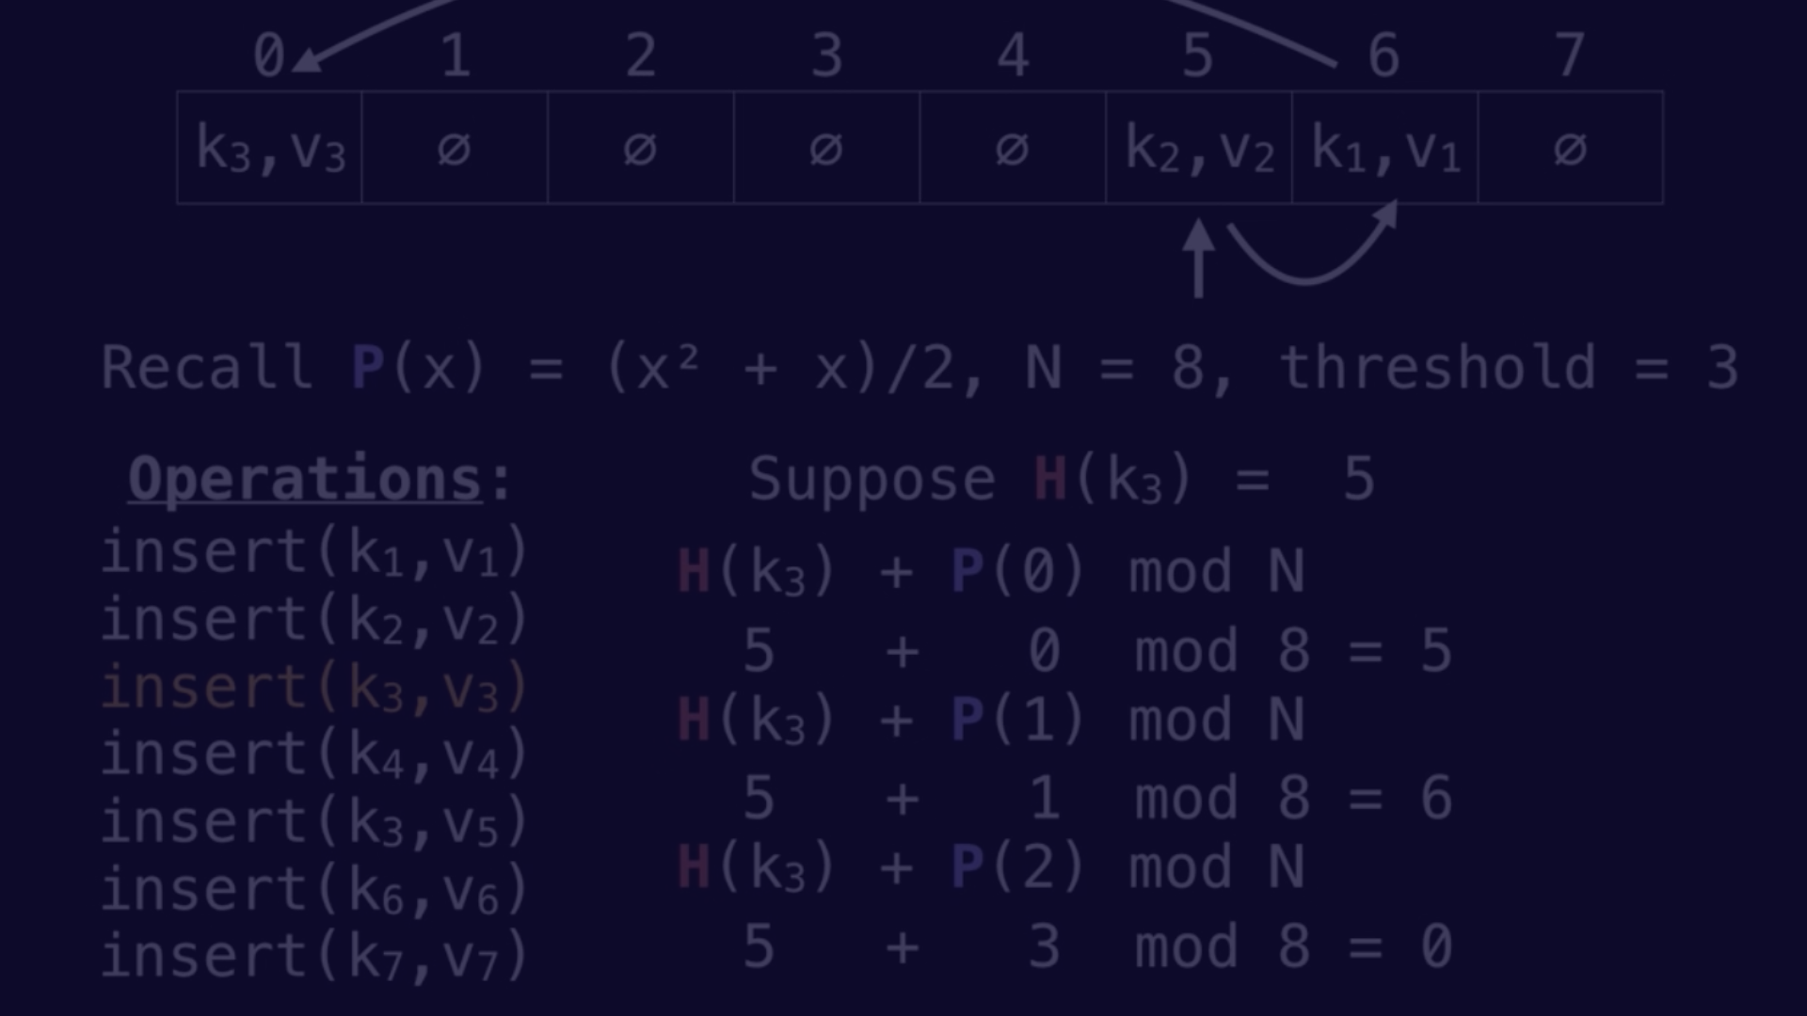
Quadratic Probing Concept
1
Quadratic Probing
2
Probe Sequence
Quadratic probing is an open addressing collision resolution technique that uses a quadratic function to determine the next probe location.
The probe sequence follows a quadratic function, i.e., the offset from the original hash index increases quadratically with each probe.

Slide 4
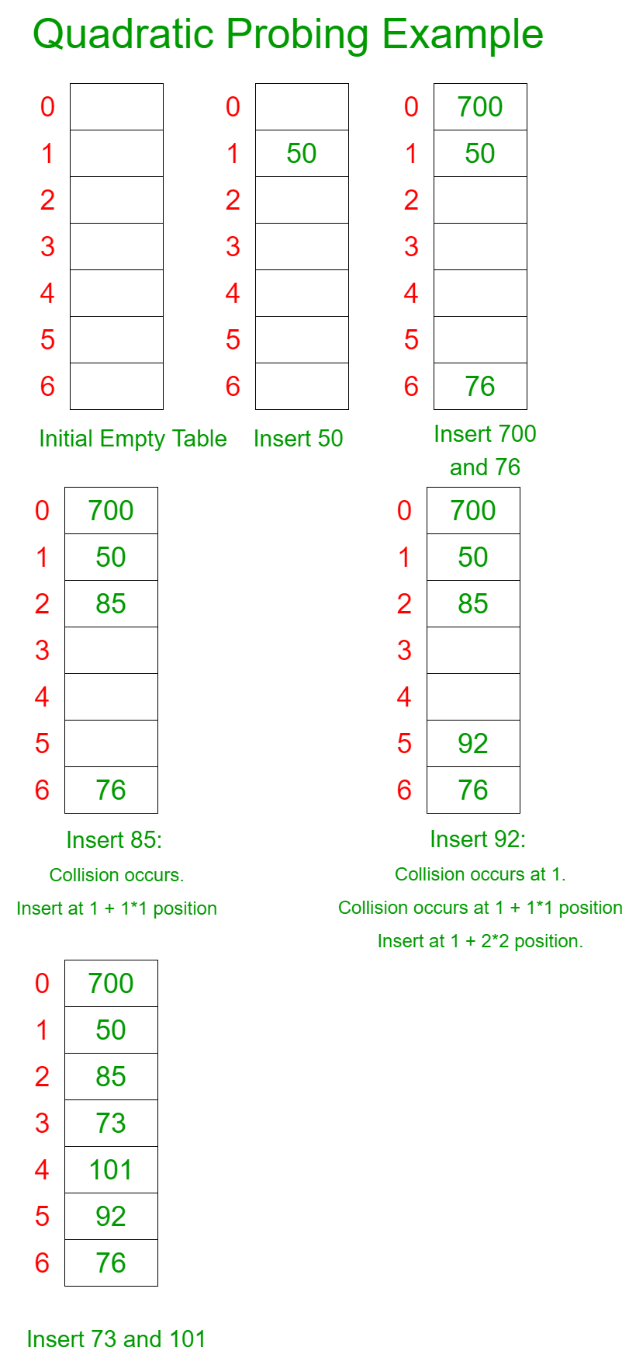
Example : Let us consider a simple hash function as “key mod 7” and sequence of keys as 50, 700, 76, 85, 92, 73, 101
If the slot hash(x) % S is full, then we try (hash(x) + 1*1)% S
If the slot (hash(x) + 1*1)% S is full, then we try (hash(x) + 2*2)% S
If the slot try (hash(x) + 2*2)% S is full, then we try (hash(x) + 3*3)% S
This process is repeated for all the values of i until an empty slot is found

Slide 6
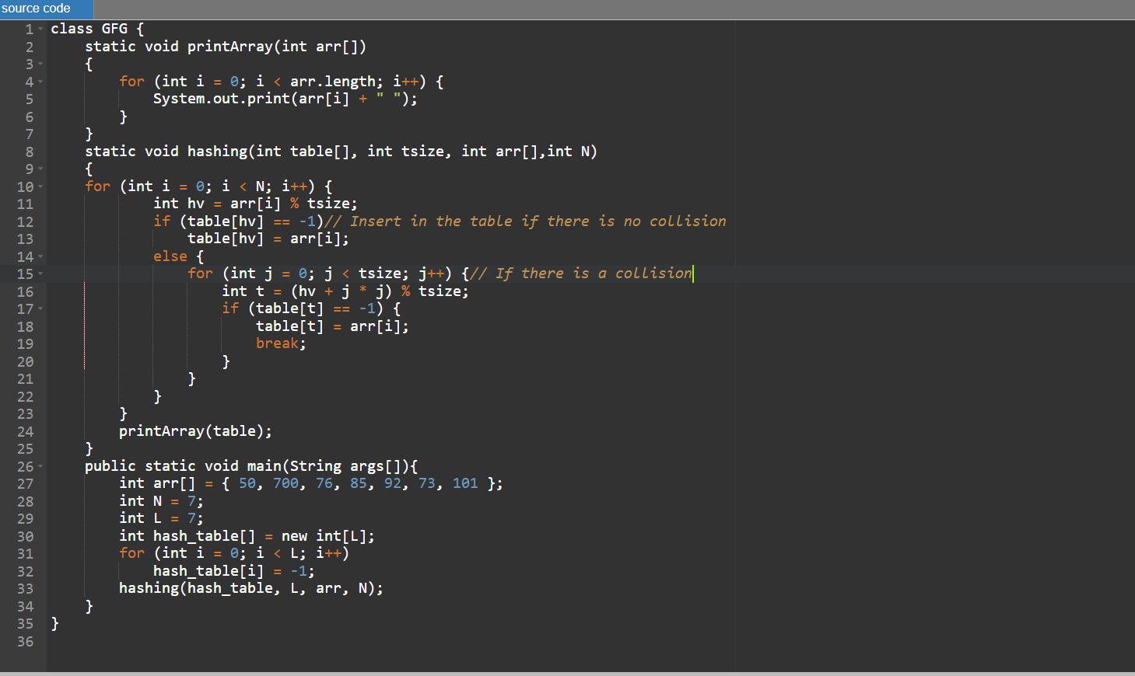
Code for Quadratic Probing

Slide 7
Implementation of Quadratic Probing
Hash Function
Probe Sequence
The hash function maps the key to an index in the hash table.
The probe sequence is determined by a quadratic function, such as i^2, where i is the number of probes.
Collision Handling
Handling Full Tables
When a collision occurs, the next probe location is calculated using the quadratic probe sequence.
If the hash table becomes full, it may need to be resized to maintain efficient performance.

Slide 8
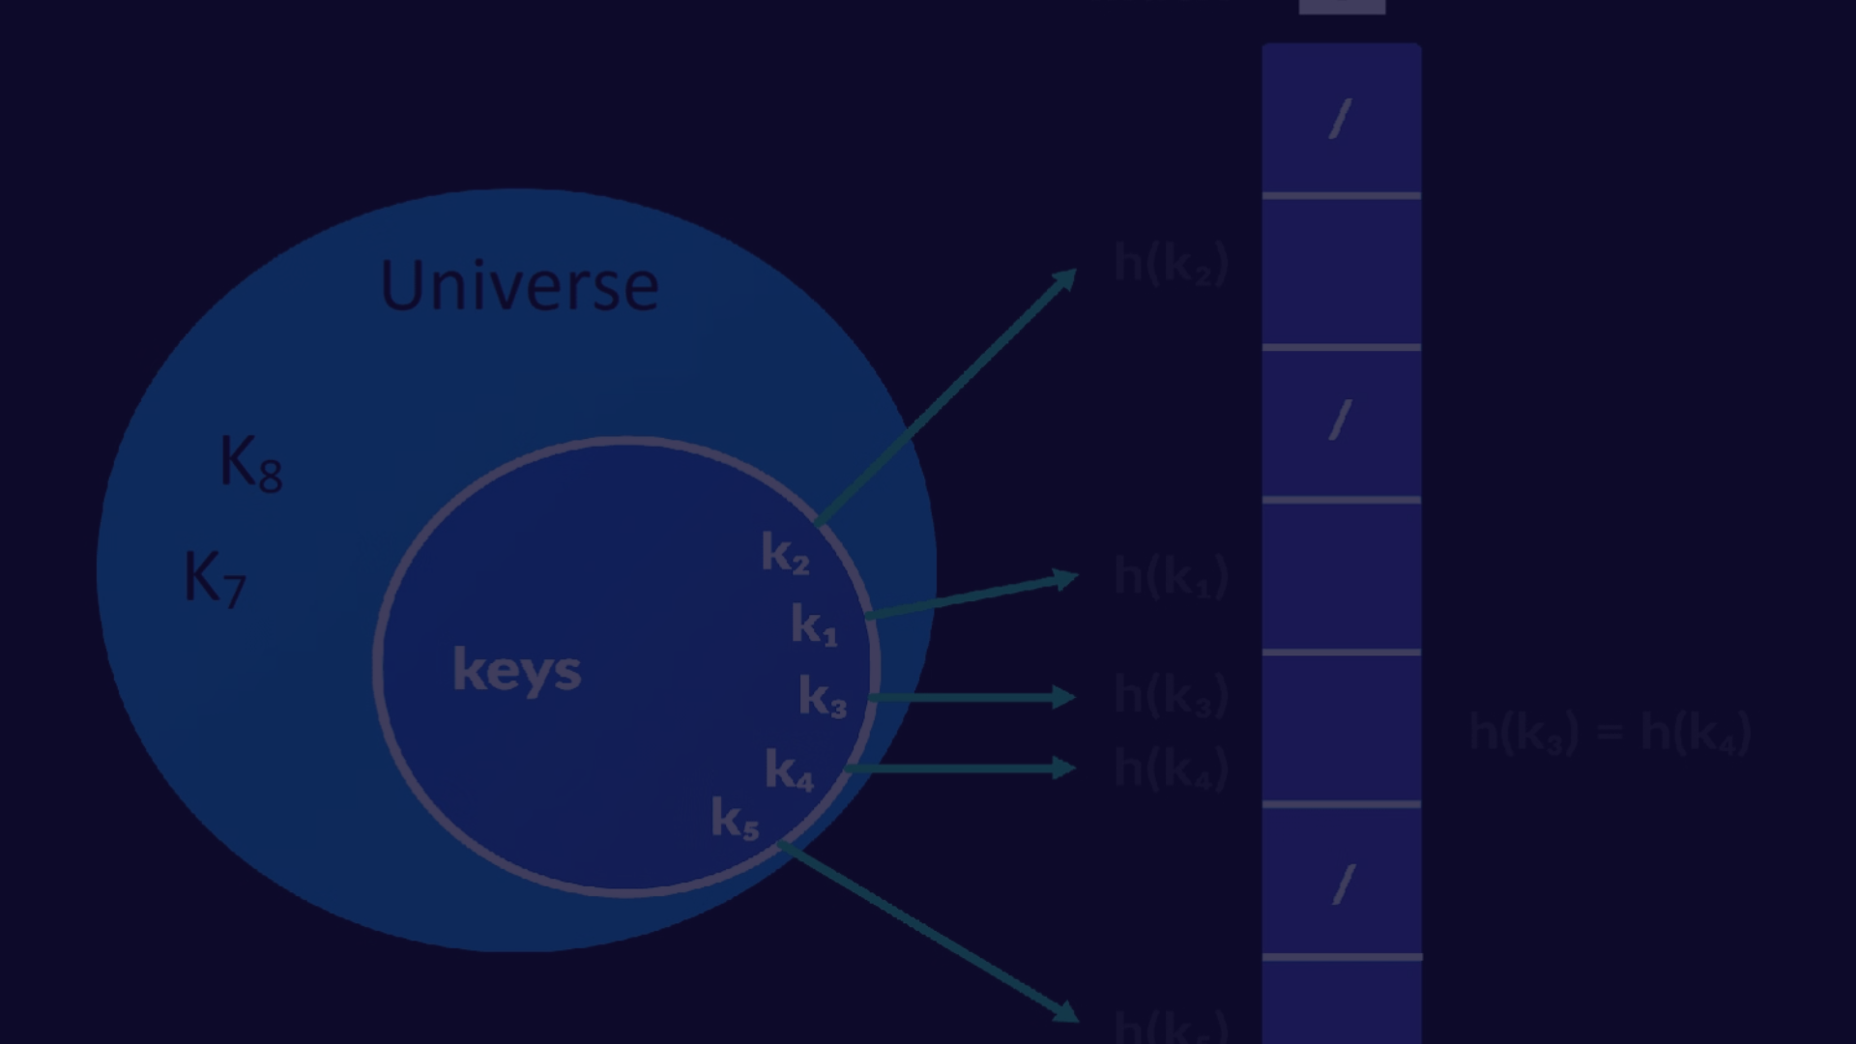
Limitations and Drawbacks
1
Inefficient Deletion
2
Limited Probe Sequence
Deleting elements from a quadratic probing hash table can be complex and inefficient, as it may require restructuring the table.
The quadratic probe sequence may not be sufficient for all hash table sizes, leading to potential performance issues.

Slide 9



Conclusion and Key Takeaways
Performance
Limitations
Alternatives
Quadratic probing provides efficient average-case lookup performance, making it a useful collision resolution technique.
However, it has some limitations, such as inefficient deletion and potential clustering issues at high load factors.
Other collision resolution techniques, like double hashing, may be more suitable in certain scenarios or for specific requirements.

Slide 10
Thank You

