Slide 1
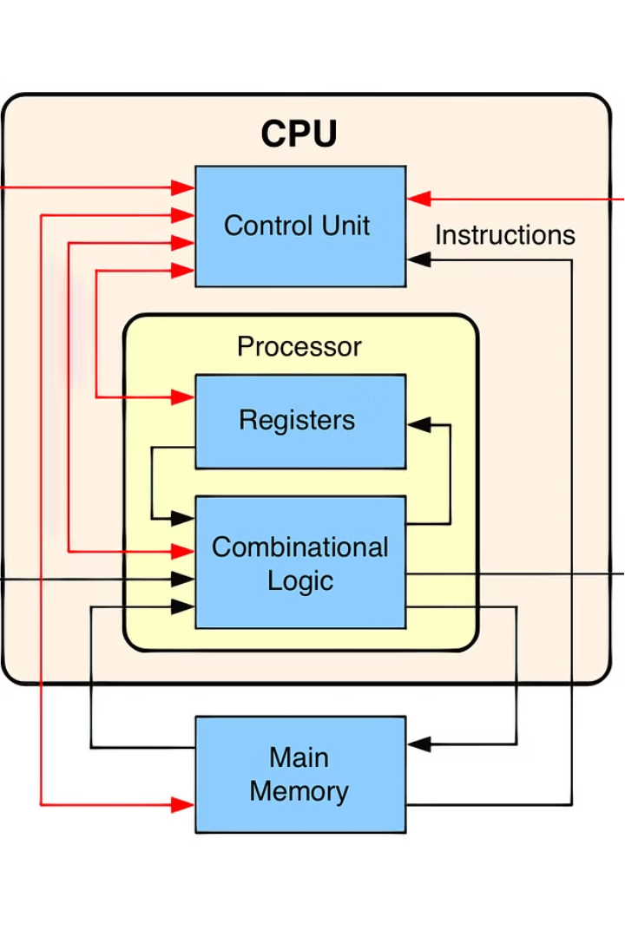


Introduction to Division Algorithm
Division algorithms are fundamental operations in computer architecture, allowing processors to perform essential mathematical calculations. These algorithms enable efficient division of numbers, a crucial step in many computational processes, from simple arithmetic to advanced scientific computing.
by Nihar Konda

Slide 2
Fundamental Concepts of Division
Dividend
Quotient
The number to be divided.
The result of the division operation.
1
2
3
Divisor
The number by which the dividend is divided.

Slide 3
Restoring Division Algorithm
Step-by-Step Process
Advantages
Limitations
The restoring division algorithm involves a systematic approach of subtracting the divisor from the dividend, keeping track of the remainder, and iterating until the desired quotient is obtained.
This algorithm is straightforward to implement in hardware and provides a reliable method for division, making it a common choice in computer architecture.
The restoring division algorithm can be slower than other methods, particularly for large operands, due to the need to restore the dividend after each iteration.

Slide 4
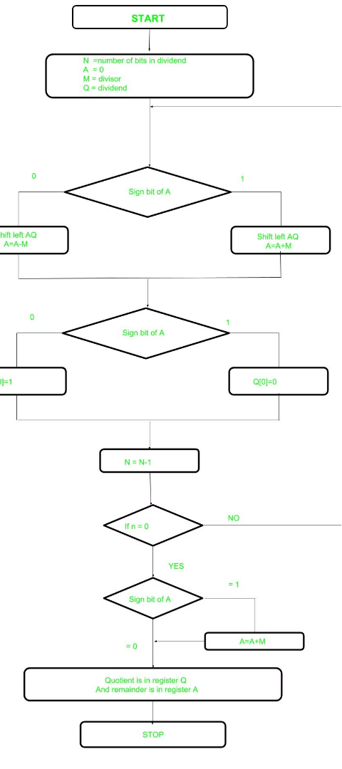



Non-Restoring Division Algorithm
Subtraction
The non-restoring division algorithm subtracts the divisor from the dividend, but does not restore the dividend after each iteration.
Bit Shift
The dividend is then shifted one bit to the right, effectively dividing it by 2.
Iteration
This process is repeated until the desired quotient is obtained, resulting in a more efficient algorithm compared to the restoring method.

Slide 5
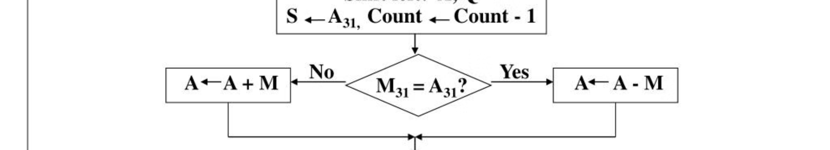
Signed Division Algorithm
1
Handling Negative Numbers
2
Adjusting the Quotient
3
Versatility
This algorithm is essential for a wide range of computational tasks, from simple arithmetic to advanced scientific calculations involving negative numbers.
The signed division algorithm extends the basic division algorithm to handle negative dividends and/or divisors, ensuring accurate results for signed integer operations.
The algorithm determines the sign of the quotient based on the signs of the dividend and divisor, and applies the appropriate adjustments to the final result.

Slide 6
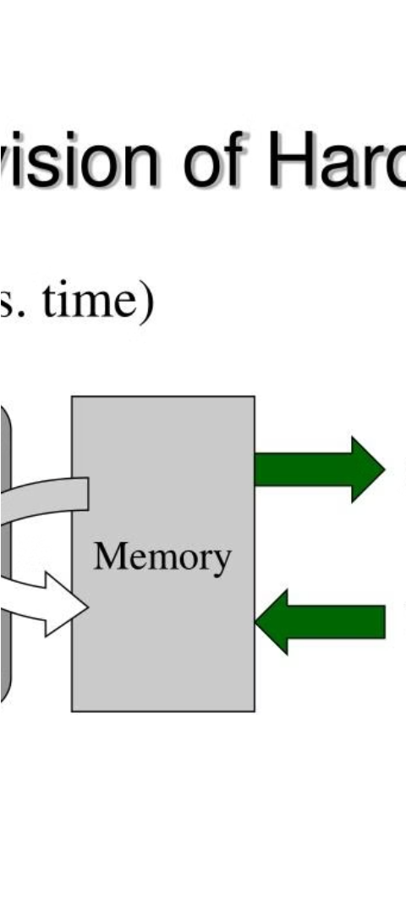
Hardware Implementation of Division
Dedicated Hardware
Microcode Approach
Division operations can be implemented in dedicated hardware, such as arithmetic logic units (ALUs), to improve performance and efficiency.
Alternatively, division can be performed using microcode, a set of low-level instructions that execute the division algorithm step-by-step in software.
Tradeoffs
Hardware implementation offers faster division but requires more chip area, while microcode-based approaches are more flexible but may be slower.

Slide 7



Floating-Point Division Algorithm
Exponent
Mantissa
Sign
The exponent is used to align the operands and determine the exponent of the final result.
The mantissa is the fractional part of the operands, which is divided to obtain the quotient.
The sign of the result is determined by the signs of the dividend and divisor.

Slide 8
Conclusion and Applications
Arithmetic Operations
Division algorithms are essential for performing fundamental arithmetic operations in computer systems.
Scientific Calculations
Accurate division is crucial for scientific and engineering computations, such as those involving fractions and decimals.
Computer Graphics
Division is used in various computer graphics algorithms, such as perspective transformation and texture mapping.

