Slide 1

Expert witness Testimonial
Kidnapping Case of Kim Mills
Nihar Vyas
S5317069
Digital Forensics(7906ICT)

Slide 2
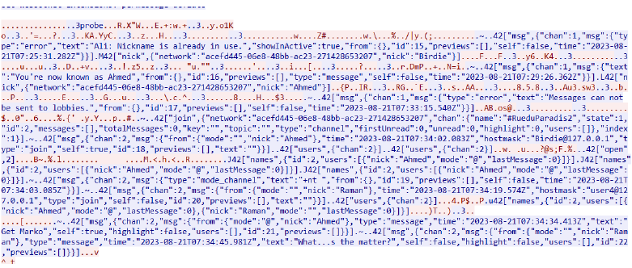
Contents
INTRODUCTION
Evidence A
Evidence B
Evidence C
Evidence D
Final Analysis

Slide 3

INTRODUCTION
Case Overview
Kim and Amanda's abduction is a harrowing case involving the disappearance of two young individuals. Through digital evidence from sources like laptops, network captures, and mobile devices, we can piece together the puzzle and identify the perpetrators, Digital forensics is our guiding light, shedding light on the darkest corners of this case, and providing hope for a resolution.

Slide 4

Results from each evidence
Let’s Dive In

Slide 5
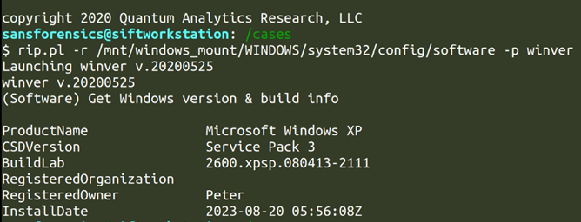
Evidence A (Peter’s Laptop)
Pictures of Kim and Amanda present on the laptop making Peter aware of their whereabouts.
Peter was assigned to pick them up from the airport and take them to a prescribed location.
Address.txt found where the hotel’s location was mentioned which was “Level 5 Hoffman Hotel, 26 Av, Kleber, 75116, Paris, France
Suspicious data extracted from the laptop which mentions “Your reward locker 33 Gare du Nord.“(lesblues2)

Slide 6
Evidence B (Network Capture)
Key pointers
Packet sniffing unleashes the majorly involved individuals that belong to a child trafficking gang
Raman, Marko, and Gregor are the members of the criminal gang
Gives an indication of Raman being the boss who takes account of the current situation and also gives further instructions.
Gives 3 important locations,1 shared by Raman on “THE LOUNGE” chat and the other which is the name of the channel “RUE DU PARADIS” and the image of map “map.jpeg”.

Slide 7
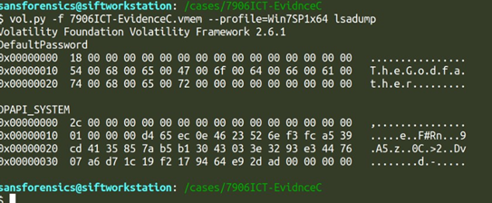
Evidence C (Memory dump)
Key pointers
Introduces a new character named Patrice.
An email conversation showing his interest in the activities of the criminal gang and the abduction.
The channel name used in the LOUNGE chat and a particular search history both coincide to be RUE DU PARADIS
The email conversation and address match showing that Patrice being an outsider is kept in the loop which makes him an important piece of the puzzle
Notes:
Suspected buyer

Slide 8

Evidence D (Kim’s Damaged Phone)
Key pointers
Contacts have just Amanda, Dad, and Mom pointing towards Kim being the owner.
Important texts between Kim and Dad reveal the truth of Peter.
Physical description of the kidnappers which will help in identifying them.
Important details being retrieved from the phone help in connecting the dots from other evidence making the scene and story clearer revealing each character’s involvement

Slide 9
Final Analysis
The evidence found on Peter's laptop, coupled with suspicious mobile messages, strongly suggests foreknowledge of the victims, pointing to a premeditated abduction plan. Raman's pivotal role as the orchestrator is evident through constant communication with Marko, indicating a high level of involvement. Patrice, while lacking detailed communication content, appears linked to the criminal operation, relying on updates from Marko. These factors underscore a complex network of individuals involved in this illicit activity.

Slide 10







Tools Used

Slide 11

Q & A
LOOKING AHEAD

