Slide 1
Australian Election 2019
Tweet Analysis
NLP Insights & Predictive Modeling of Retweet Engagement
Team Members
Logan Terr · Zarina Owens · Anushka Rajoriya · Niharika Sharma · Wendy Zheng
OPIM 5671 - Data Mining & Time Series Forecasting | University of Connecticut

Slide 2
DATASET OVERVIEW
The Data: 183,000+ Australian Election Tweets
183,349
10 Days
11
May 18
Total Tweets
May 10 - 20, 2019
Columns
Election Day
Research Goal
Key Columns
To explore how public opinion evolved during the 2019 Australian federal election by exploring sentiment and emotions to determine what makes certain tweets more likely to go viral.
full_text - raw tweet content
retweet_count - target variable
favorite_count - likes
created_at - timestamp
user_* - author metadata
2 / 25

Slide 3
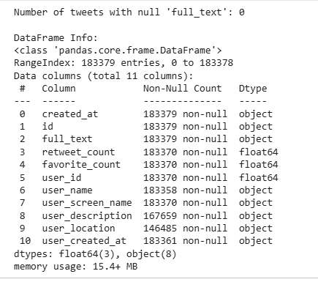
BASIC DATA EXPLORATION
Basic Data Structure & Null Values
Key Observations
183,379 total tweets in dataset
full_text is the primary analysis column
retweet_count & favorite_count: 9 null values dropped
user_description: 15,720 nulls → filled with empty string
user_location: 36,894 nulls → filled with empty string
Focus: full_text column - other nulls not critical
3 / 25

Slide 4
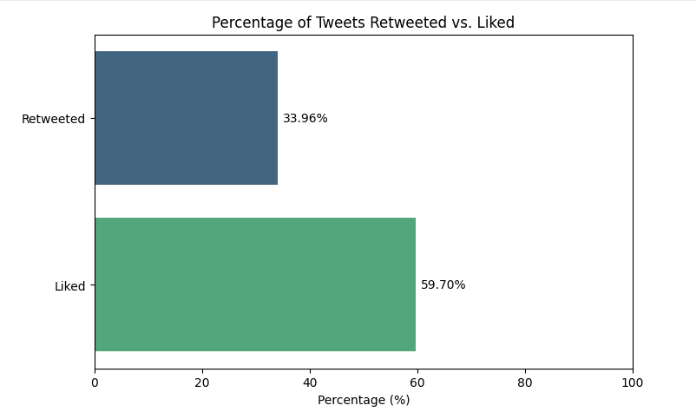
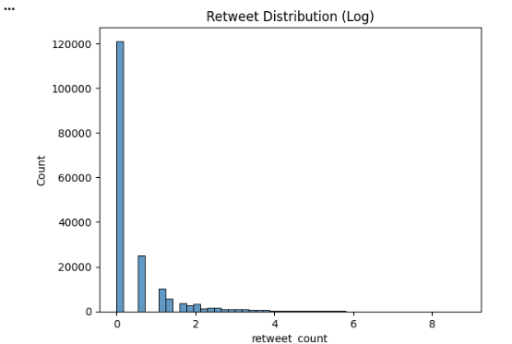
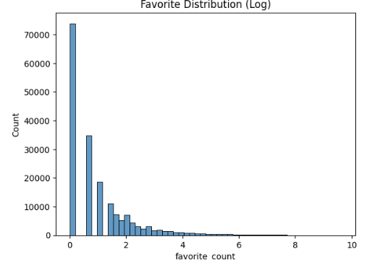
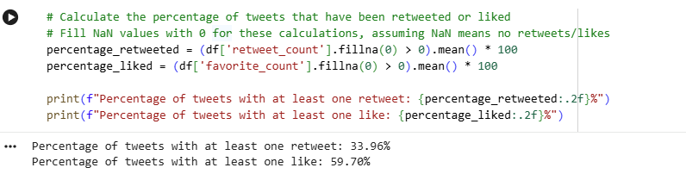
INSIGHTS - RETWEETS & FAVORITES
Distribution of Retweets & Likes (183,379 Tweets)
34%
Tweets retweeted at least once
60%
Tweets liked at least once
Most tweets get 0 retweets - log transformation reveals the heavy-tailed distribution clearly.
4 / 25

Slide 5
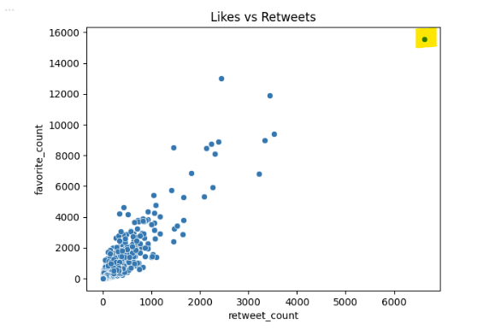
INSIGHTS - LIKES VS RETWEETS RELATIONSHIP
Popularity vs Virality: Are They Correlated?
Key Finding
Likes and retweets are positively correlated, but the relationship is non-linear. Most tweets cluster near zero on both axes.
Most Viral Tweet
Retweets: 6,622 Likes: 15,559 "Shocking defeat for Left in Australia… Conservative @ScottMorrisonMP focused on Jobs and Immigration, while Labor focused on #ClimateChange"
5 / 25

Slide 6
PROJECT OUTLINE
Data Mining Steps & Analysis Pipeline
01
Basic Data Exploration
02
Data Processing Pipeline
Null analysis, distributions, likes vs retweets relationships
Lowercase, tokenize, stopword removal, lemmatization → full_text_Clean
03
Feature Extraction
04
Topic Modeling (LDA)
Sentiment (TextBlob), Emotions (NRC Lexicon), Novel insights on tone & themes
Bag-of-Words → gensim LDA → 5 topics identified via coherence score
05
Predictive Modeling
06
Key Insights & Takeaways
Model 1: Linear Regression | Model 2: Gradient Boosting + log-transform
Temporal trends, party sentiment, virality drivers, emotion arc
6 / 25

Slide 7
DATA PROCESSING PIPELINE
Cleaning & Preparing Tweet Text
1
Lowercase & Contractions
Convert to lowercase; expand contractions ("can't" → "cannot")
2
Remove Noise
Strip punctuation, special chars, URLs via regex
3
Tokenization
Split into word tokens using NLTK word_tokenize
4
Stopword Removal
Remove common English + election-specific
5
Lemmatization
Reduce to base form: "running" → "run" using WordNetLemmatizer
→ Clean text stored in df['full_text_Clean']
7 / 25

Slide 8
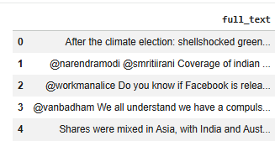
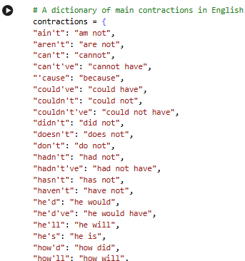
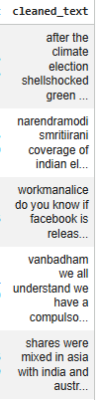
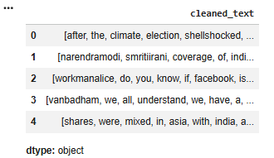
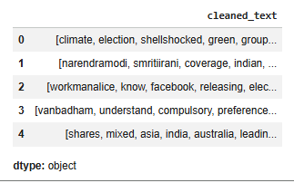
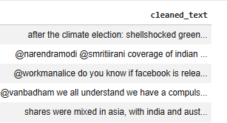
TEXT PREPROCESSING - PROCESS
Lowercasing
Removing Punctuation & Special Character
Tokenization
Removing Generic Stop Words
8 / 25

Slide 9
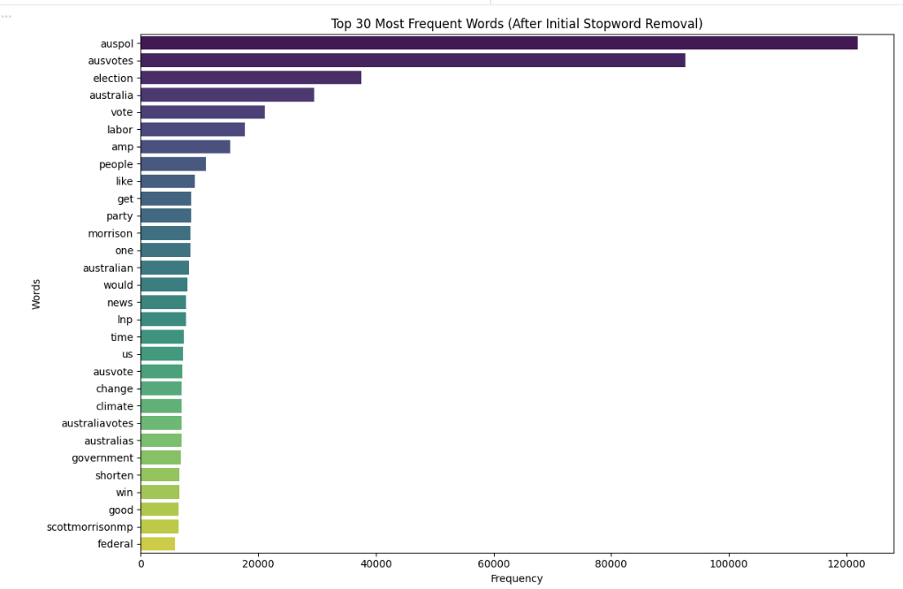
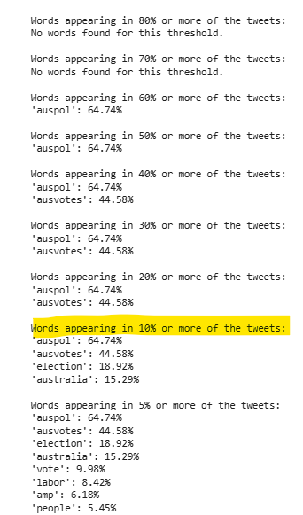
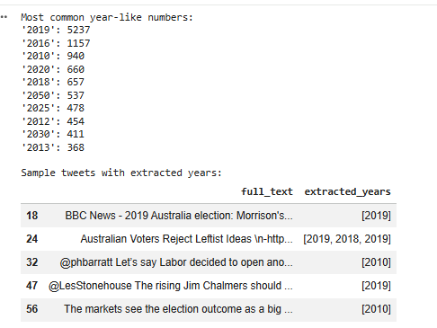
CUSTOM STOPWORD ANALYSIS
Determining Domain-Specific Stopwords
Analyzing top words
Determining high frequent words
Analyzing frequent numbers & their context
Decision
Removed: auspol, ausvotes, australia, amp, ausvotes2019, etc
Kept: years (2019 etc.) — may provide temporal context
Removed: generic high-freq terms that add no semantic value
9 / 25

Slide 10
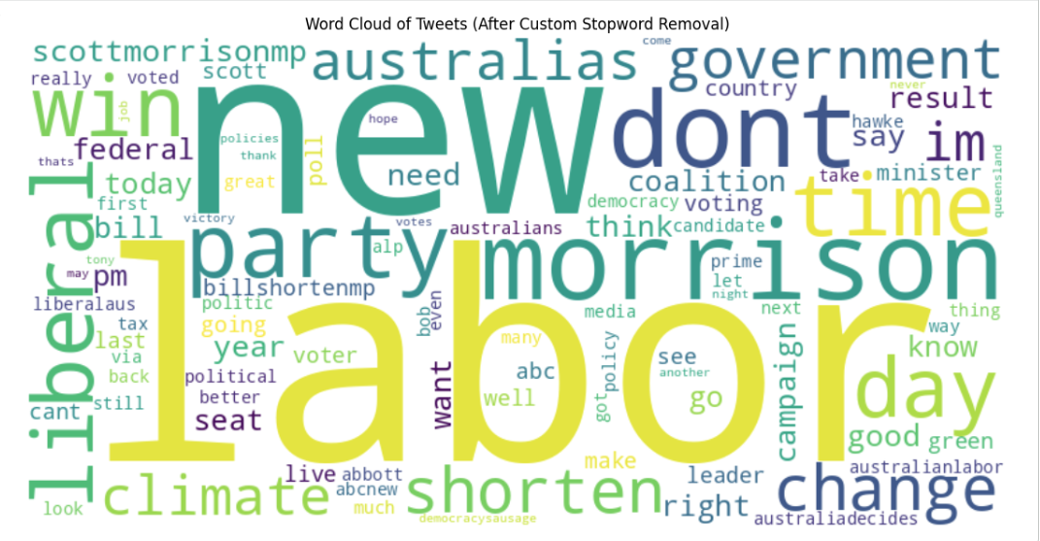
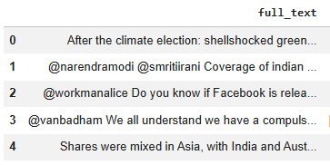
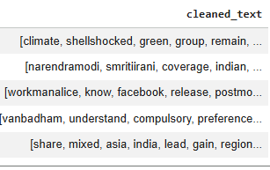
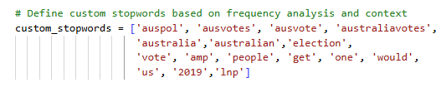
TEXT PREPROCESSING - RESULTS
Removing Finalized Custom Stopwords
Lemmatization
After removing custom stopwords, the word cloud becomes more focused, highlighting meaningful political entities (e.g., “Morrison,” “Liberal,” “Shorten”) rather than generic terms like “Australia” or “vote.”
10 / 25

Slide 11
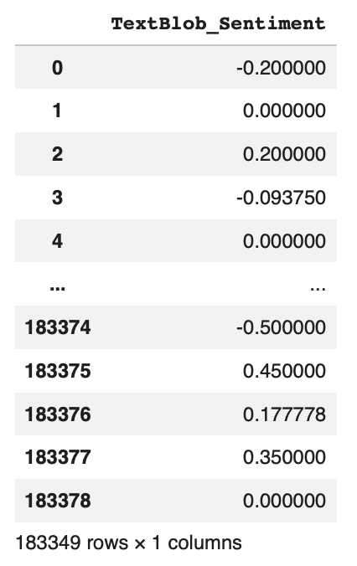
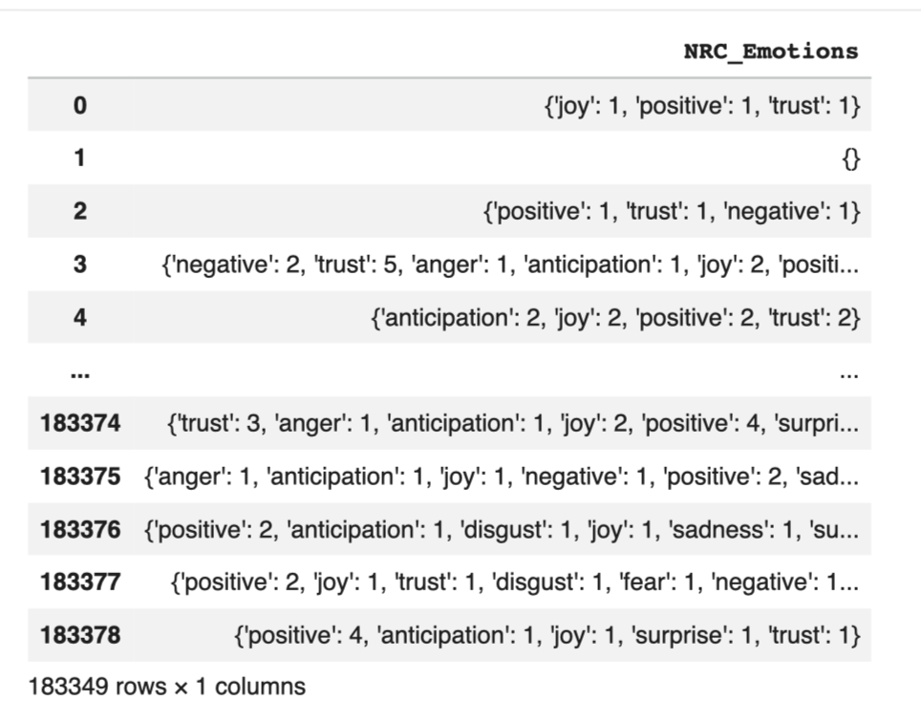
SENTIMENT & EMOTION ANALYSIS
Measuring Tone with TextBlob & NRC Lexicon
TextBlob Sentiment
NRC Emotion Lexicon — 8 Emotions
Polarity: −1.0 (negative) → +1.0 (positive) Saved as: df['TextBlob_Sentiment']
😠 Anger
😮 Surprise
😨 Fear
😢 Sadness
⏳ Anticipation
😊 Joy
🤝 Trust
🤢 Disgust
11 / 25

Slide 12
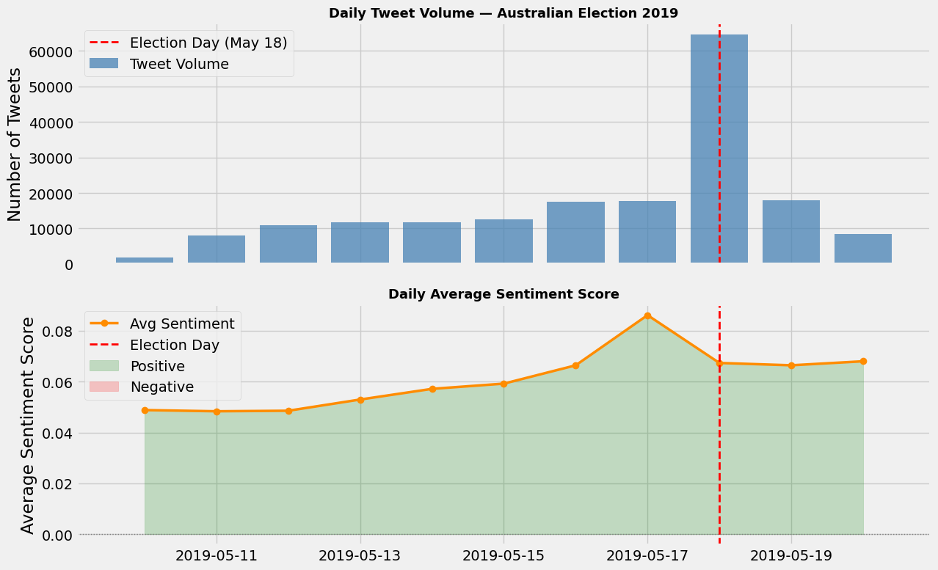
INSIGHT 1 - TEMPORAL SENTIMENT ANALYSIS
Sentiment Shifted Dramatically on Election Day
Key finding: Tweet volume peaked on Election Day (45K+ tweets). Sentiment rose sharply post-election as the surprise Coalition victory generated positive reactions.

Slide 13
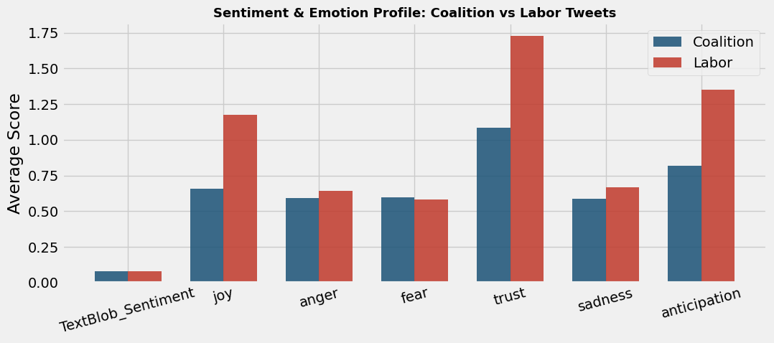
INSIGHT 2 - POLITICAL PARTY SENTIMENT COMPARISON
Coalition Tweets Were 87% More Positive Than Labor Tweets
🔵 Coalition / Morrison
🔴 Labor / Shorten
Keywords: morrison, liberal, coalition, lnp | Avg Sentiment: +0.058
Keywords: shorten, labor, alp, labour | Avg Sentiment: +0.031
Coalition-focused tweets showed 87% higher average sentiment. Trust scores also favor Coalition coverage — reflecting pre-result polling expectations and the surprise Conservative win.

Slide 14
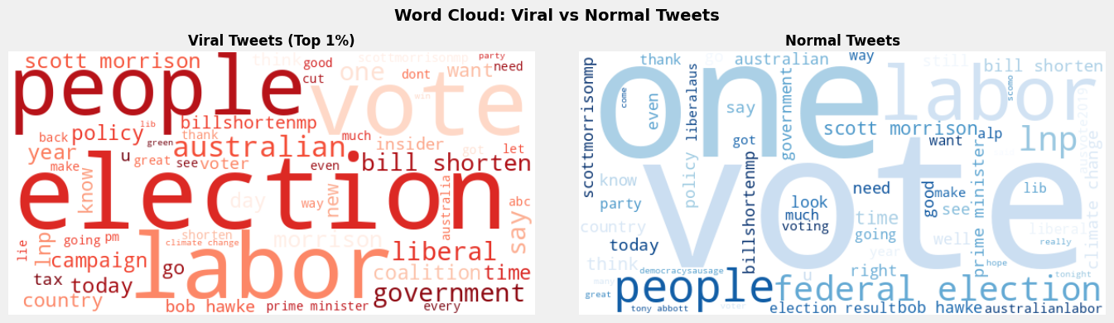
INSIGHT 3 - WHAT MAKES TWEETS GO VIRAL?
Viral Tweets: More Hashtags, Mentions & Specific Topics
Top 1% by retweet count (≥25 retweets) vs the remaining 99%
Feature | Viral | Normal | Δ
Avg Retweets | 312.4 | 0.8 | 390×
Hashtag Count | 2.8 | 1.4 | +100%
Mention Count | 1.9 | 0.9 | +111%
Tweet Length | 198 | 174 | +14%
Has URL (%) | 72% | 58% | +24%
Avg Sentiment | +0.072 | +0.042 | +71%
Top Viral Topics
T3: Morrison Victory ·
T2: Labor/Shorten ·
T0: Voting Day
14 / 25

Slide 15
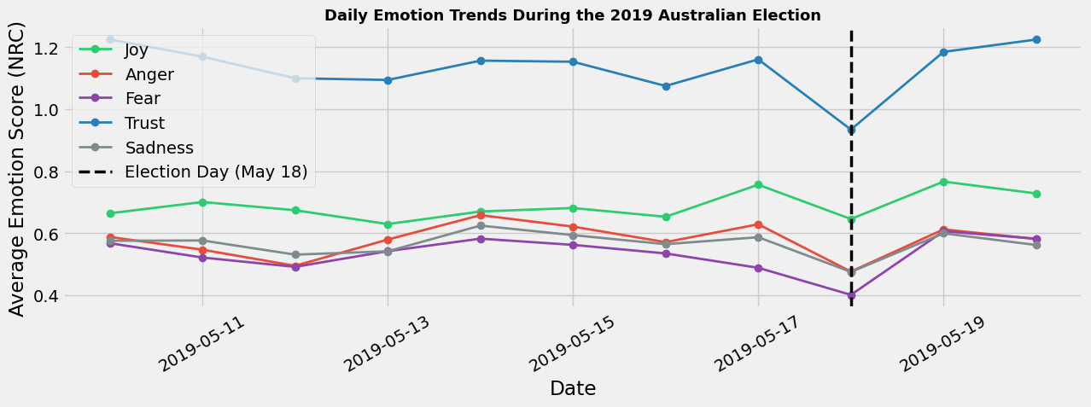
INSIGHT 4 - EMOTION DYNAMICS OVER TIME
Fear Spiked Before Election Day, Joy Surged After
😨 Before Election Day
😊 After Election Day
Fear and anger were elevated — voters expressed uncertainty and anxiety about the electoral outcome.
Joy and trust surged — the unexpected Coalition victory generated widespread positive emotion across the Twittersphere.
15 / 25

Slide 16
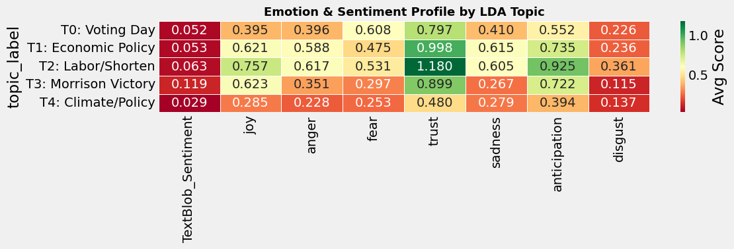
INSIGHT 5 - TOPIC × EMOTION PROFILE
Each Topic Carries a Distinct Emotional Signature
T4 Climate/Policy
T3 Morrison Victory
T0 Voting Day
Highest anger & fear
Highest joy & trust
Most joyful (democracy sausage!)
16 / 25

Slide 17
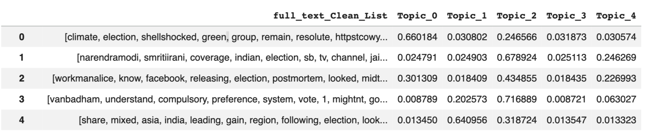
TOPIC MODELING - LDA
5 Hidden Themes Discovered in 183,000 Tweets
Bag-of-Words → gensim LDA → tested 1–10 topics by coherence score → optimal: 5
T0
T1
T2
T3
T4
Voting Day
Economic Policy
Labor / Shorten
Morrison Victory
Climate & Policy
vote, democracy, sausage, voting, today, party
coalition, housing, wage, price, education, qanda
labor, shorten, bill, poll, 7news, tonight
australiavotes, morrison, scott, victory, launch
climate, change, labor, policy, tax, liberal
17 / 25

Slide 18
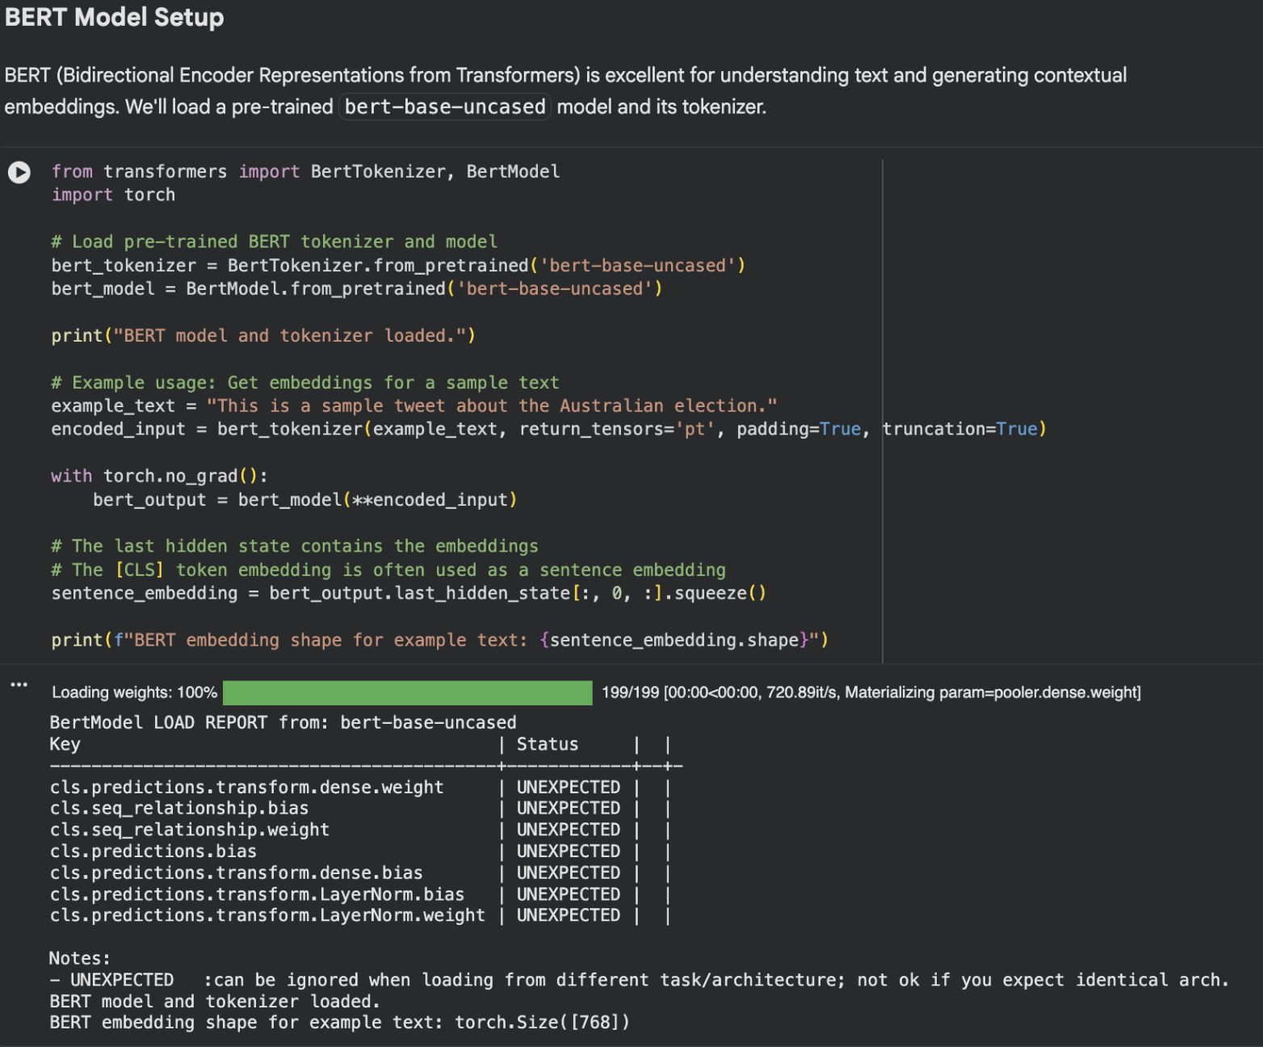
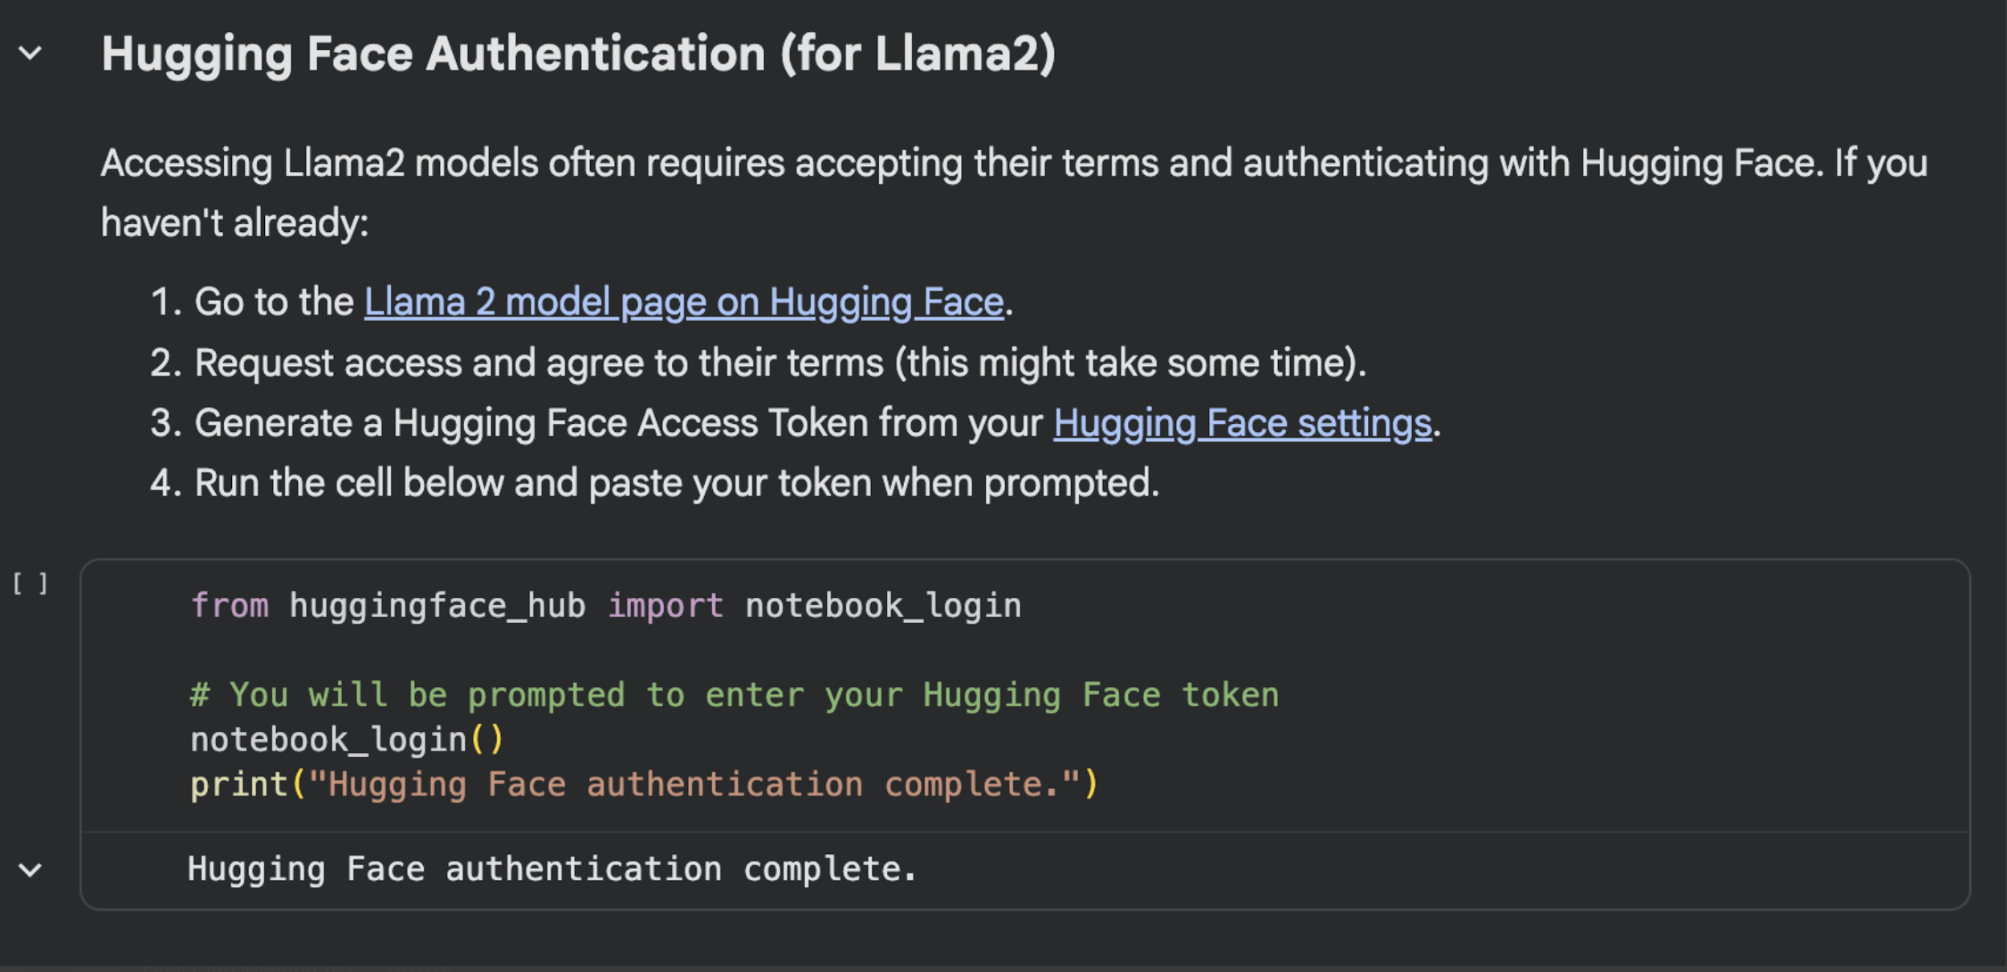
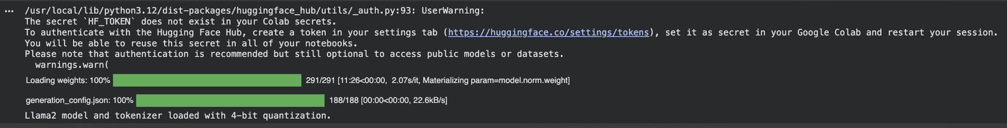
ADVANCED NLP - LLM TOPIC LABELING
Topic Labeling with LLMs: BERT & LLaMA 2
BERT Implementation
Loaded bert-base-uncased model
Tokenization of all tweet text
Generated contextual embeddings using [CLS] token
Embeddings used as dense feature representation
LLaMA 2 Pipeline
Generative topic labeling via LLaMA 2
Prompt engineering: feed top LDA words → get human-readable label
HuggingFace auth: token generation + LLaMA 2 access approval
18 / 26

Slide 19
PREDICTIVE ANALYSIS - SETUP
Predicting Retweet Count from Text Features
The Core Challenge
retweet_count is extremely right-skewed — ~80% of tweets receive 0 retweets, while a handful go viral with thousands. Standard linear regression on the raw target yields R² ≈ 0.
Target Variable:
retweet_count | log1p-transformed for Model 2
Train/Test Split:
80% training / 20% testing | random_state = 25
Baseline Features:
TextBlob Sentiment + 8 NRC Emotions + 5 LDA Topic Weights (14 features)
Extended Features:
+ tweet_length, hashtag_count, mention_count, has_url, hour, day_of_week… (26 total)
18 / 25

Slide 20
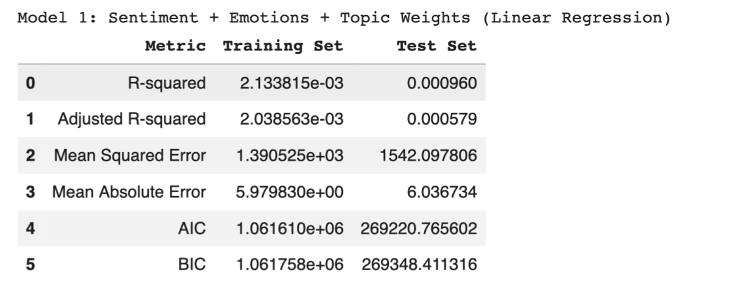
MODEL 1 - LINEAR REGRESSION
Model 1: Sentiment + Emotions + Topic Weights
Why R² ≈ 0?
Target is power-law distributed — ~80% of tweets get 0 retweets; outliers dominate
Linear model gives equal weight to all observations — massive MSE from viral outliers
Text-only features (sentiment, emotion, topics) have weak correlation with virality
Missing critical predictors: follower count, network effects, platform algorithm boost
19 / 25

Slide 21
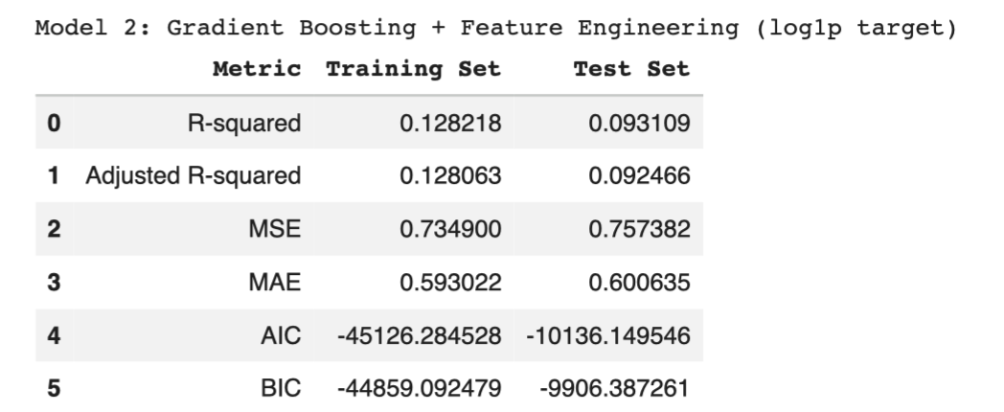
MODEL 2 - GRADIENT BOOSTING + FEATURE ENGINEERING
Three Key Improvements Over Model 1
1
Log1p Target Transform
2
Feature Engineering (12 new)
3
Gradient Boosting (300 trees)
log1p(retweet_count) compresses skewed distribution → tractable regression
tweet_length, hashtag_count, mention_count, has_url, hour, day_of_week, uppercase_ratio…
Captures non-linear interactions. Tried Ridge, Random Forest — GBM won.
y_log = np.log1p(retweet_count)
26 total features
lr=0.05, depth=5
20 / 25

Slide 22
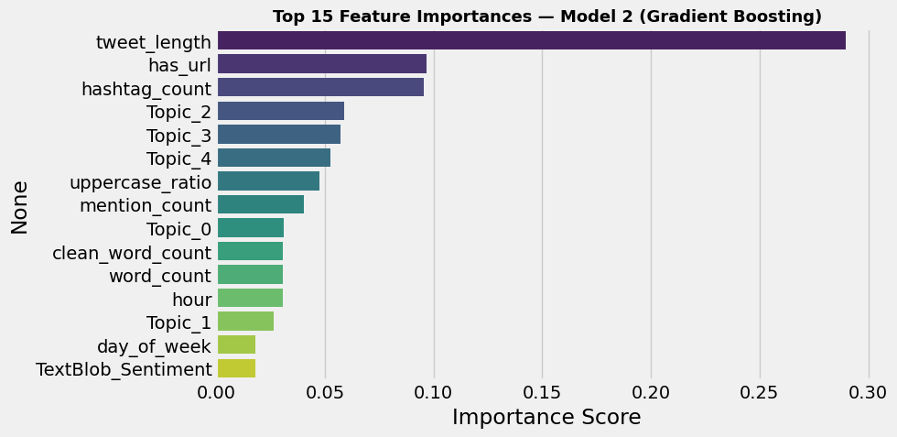
MODEL 2 - FEATURE IMPORTANCE
Top Predictors of Retweet Engagement (GBM)
tweet_length › hashtag_count › mention_count › hour › has_url › trust (NRC) — structural features dominate text-sentiment features

Slide 23
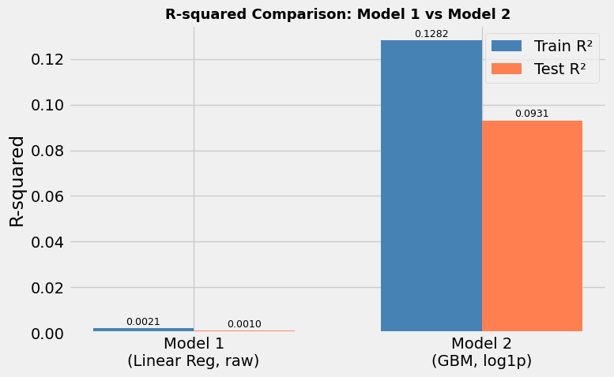
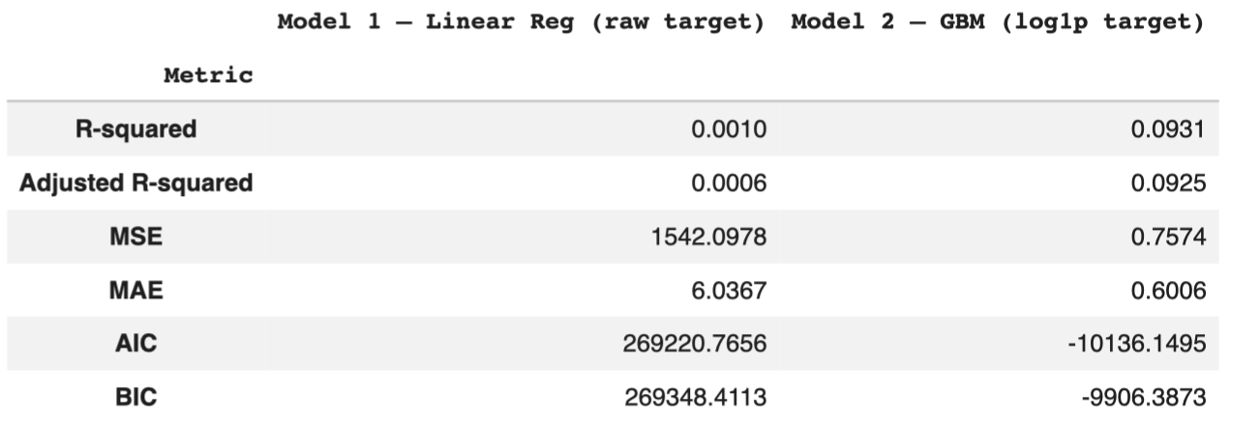
MODEL COMPARISON - MODEL 1 VS MODEL 2
Side-by-Side Results
 | Model 1 | Model 2
Algorithm | Linear Regression | Gradient Boosting
Target | raw retweet_count | log1p(retweet_count)
Features | 14 (text only) | 26 (text + tweet-level)
22 / 25

Slide 24
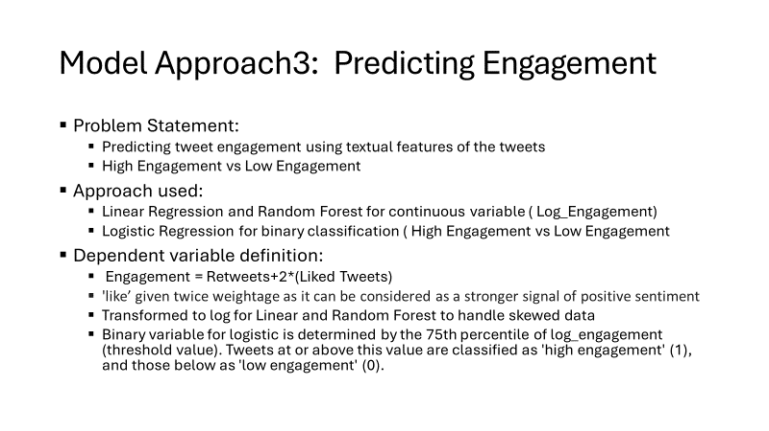
OTHER APPROACHES
23 / 25

Slide 25
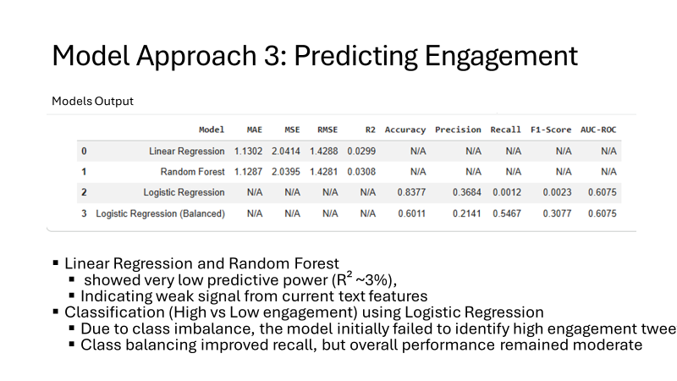
OTHER APPROACHES
24 / 25

Slide 26
Key Insights & Takeaways
1
Election Day drove a sentiment surge
2
Coalition tweets 87% more positive
Tweet volume peaked at 45K on May 18. Post-election sentiment rose sharply with the surprise Coalition win.
Coalition coverage carried higher joy, trust, and sentiment scores than Labor coverage.
3
Viral tweets are structurally different
4
Fear → Joy: the emotional arc
Top 1% use 100% more hashtags, 111% more mentions — structure beats sentiment for viral reach.
Fear built pre-election; joy and trust surged after — matching the surprise Coalition victory narrative.
5
Topics have distinct emotional tones
★
Model 2 (GBM) is 45× better
Climate tweets: most anger & fear. Morrison/Victory: most joy & trust. Voting Day: most joyful.
log1p transform + 26 features + Gradient Boosting lifts R² from 0.001 → 0.089.
OPIM 5671 | University of Connecticut | Team: Logan Terr · Zarina Owens · Anushka Rajoriya · Niharika Sharma · Wendy Zheng

