Slide 1
AZ-Eval: A Parallel Azerbaijani–English Benchmark Reveals
Negative Cross-Lingual Transfer from Kazakh Fine-Tuning
Nihat Garibli
Baku State University, Azerbaijan
CMAI 2026 · Nazarbayev University, Astana

Slide 2
Open multilingual models are measured on high-resource languages
Kazakh has open evaluation sets - freshqa_kazakh, defan_kazakh, BeyneleBench
Azerbaijani, to our knowledge, has none
Both are Turkic. Kazakh is written in Cyrillic, Azerbaijani in Latin.
AZ-Eval · CMAI 2026 · 2
Notes:
One sentence only: this is the host institute's own methodology, extended to another Turkic language. Do not linger.

Slide 3
The question
Does fine-tuning on Kazakh transfer to Azerbaijani?
Kazakh is the closest well-resourced Turkic relative of Azerbaijani.
Adapting to a related language is the intuitive move for a low-resource language.
AZ-Eval · CMAI 2026 · 3
Notes:
Stress the script difference now. It detonates on slide 8.

Slide 4
AZ-Eval - an open parallel benchmark
verified_by is a gate, not metadata: unverified rows never enter the set.
356 parallel AZ/EN short-answer items | 255 hand-written by a native speaker
Every item human-verified | 101 from templated Wikidata queries
7 categories | math, history, geography, science, culture, language, world
Accepted answers expanded | rule-based Azerbaijani morphology
AZ-Eval · CMAI 2026 · 4
Notes:
Say in one sentence why the questions are not about Azerbaijan: we need facts the model demonstrably knows in English, otherwise the gap collapses to zero and measures nothing. Otherwise it comes back in Q&A.

Slide 5
Four nested normalizations
STRICT → MORPH → LENIENT → TRANSLIT
suffix stripping · diacritic folding · Cyrillic→Latin
Each stage adds exactly one transformation, applied symmetrically to
prediction and reference - so each score increment attributes error mass
to that single surface phenomenon.
Paired comparisons · 1000-resample bootstrap · permutation test · Holm correction
AZ-Eval · CMAI 2026 · 5
Notes:
This is a mathematics conference. Showing bare percentages looks weak; showing that the measurement is trustworthy looks strong. Do not claim a theorem.

Slide 6
Result 1 - the gap is universal
Majority-class baseline: 1.1%
Model | AZ | EN | Gap | p (Holm)
Qwen3-1.7B | 5.9% | 23.6% | 17.7 | 0.0020
Qwen3-VL-4B-Instruct | 16.6% | 30.6% | 14.0 | 0.0020
Qwen3-VL-4B-Thinking | 12.6% | 29.5% | 16.9 | 0.0020
issai/Qolda-AVL-5B | 3.1% | 29.5% | 26.4 | 0.0020
AZ-Eval · CMAI 2026 · 6
Notes:
'Every model is bad at Azerbaijani' is the expected result - do not dwell. Point at the last row and move on: something is wrong there.

Slide 7
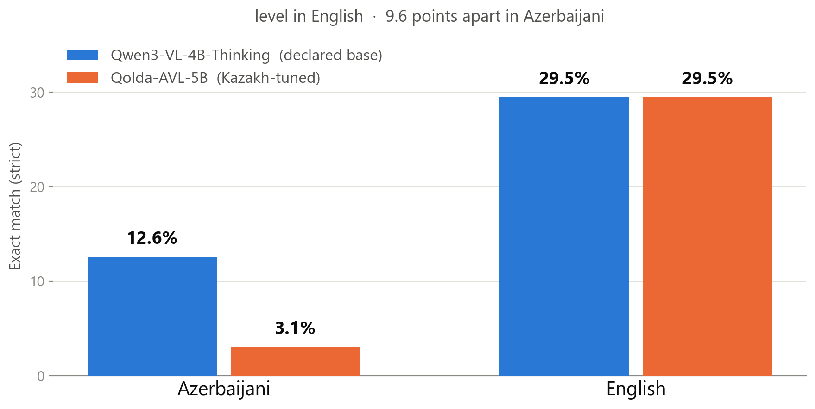
Result 2: transfer is NEGATIVE
Holm-corrected p = 0.0040 · its own declared base, same quantization, same prompt
AZ-Eval · CMAI 2026 · 7
Notes:
Stop here. This is the centre of the talk. Do not rush. The only difference between the two models is the Kazakh fine-tune.

Slide 8
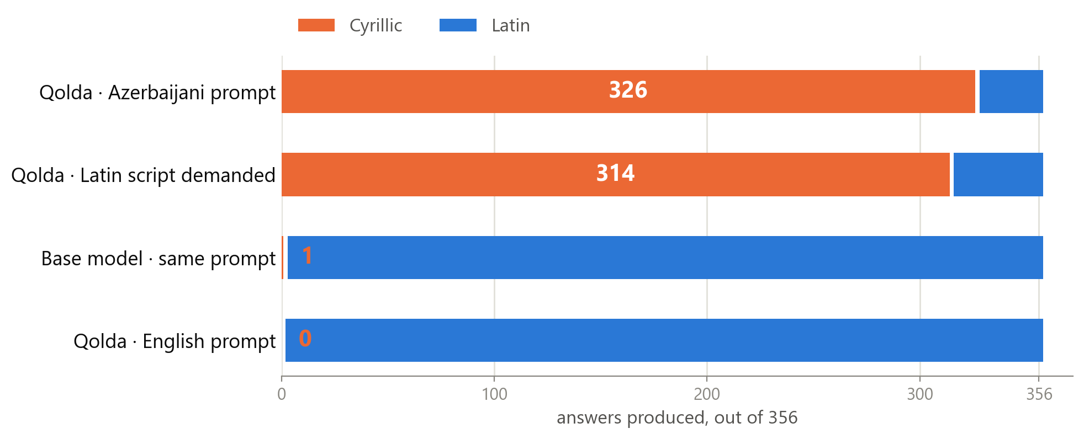
The mechanism is orthographic
Understands the question, finds the answer, writes it in the wrong alphabet.
AZ-Eval · CMAI 2026 · 8
Notes:
The memorable moment of the talk. Slow down. Two sentences: 326 vs 0 is a direct count, it depends on no statistical test. And demanding the Latin alphabet in the prompt moves only 12 of the 326.

Slide 9
Is it simply a weaker model?
Indistinguishable in English. 27.1 points apart in Azerbaijani - and transliteration closes it.
Language | Base model | Kazakh-tuned | Gap | p (Holm)
English | 62.5% | 59.4% | 3.1 | 1.0000
Azerbaijani (STRICT) | 37.5% | 10.4% | 27.1 | 0.0050
Azerbaijani (TRANSLIT) | 38.5% | 33.3% | 5.2 | 1.0000
96 world + science items - facts every model demonstrably knows in English
AZ-Eval · CMAI 2026 · 9
Notes:
A weaker model would be weaker in both languages. This one is weaker only in Azerbaijani. Raise the objection before the audience does.

Slide 10
Takeaway
Dataset CC BY 4.0 · Code MIT · github.com/nihatgaribli/AZ-Eval
1. Fine-tuning on a closely related language can HARM rather than help
- when the writing systems differ.
2. Most of the damage is orthographic, not semantic
- transliteration removes 56% of the deficit.
3. Which means it is in principle fixable
- e.g. by constraining the output script at decoding time.
AZ-Eval · CMAI 2026 · 10
Notes:
End on the practical sentence. Someone building a low-resource model is in this room.

Slide 11
Backup - where the gap is widest
Mathematics: knowledge is present in English, the language blocks it.
Category | n | Qwen3-VL-4B (AZ / EN) | Qolda-AVL-5B (AZ / EN)
mathematics | 28 | 3.6% / 25.0% | 3.6% / 28.6%
world | 45 | 51.1% / 57.8% | 0.0% / 60.0%
history | 45 | 4.4% / 0.0% | 0.0% / 2.2%
AZ-Eval · CMAI 2026 · 11
Notes:
Keep this ready - it is a mathematics conference and this is the widest gap. History sits near zero in BOTH languages: that is ignorance, not a script problem.

Slide 12
Backup - what survives transliteration
Transliteration removes 56% of the deficit - but not all of it.
Residual after TRANSLIT: 5.9 points, Holm p = 0.0364 - still significant.
So the claim is: the damage is LARGELY orthographic, not purely orthographic.
AZ-Eval · CMAI 2026 · 12
Notes:
Honest framing. At n=96 this residual was not detectable; at n=356 it is.

Slide 13
Backup - how the dataset was built
255 items hand-written by a native Azerbaijani speaker
101 from 8 templated SPARQL queries × 4 syntactic variants (round-robin)
No LLM authored, translated, or answered any dataset item.
Rejected candidates are retained, so the acceptance rate stays auditable.
Items whose gold answer depends on a contested position are excluded (6 removed).
AZ-Eval · CMAI 2026 · 13

Slide 14
Backup - limitations
n = 356. Confidence intervals are ±2–5 points; every reported comparison
survives Holm correction.
One model pair. The 9B/8B pair did not fit in 8 GB of VRAM.
Two knowledge regimes are mixed on purpose - and kept in separate categories
so the distinction stays visible instead of averaging away.
AZ-Eval · CMAI 2026 · 14

Slide 15
Backup - answer extraction
Identical rules for both languages:
first line only · strip 'Cavab:' / 'Answer:' prefixes
strip markdown emphasis and trailing punctuation · remove thinking blocks
Raw model outputs are kept untouched (8 runs), so the scoring rule can be
changed and the analysis re-run without spending another GPU-hour.
AZ-Eval · CMAI 2026 · 15

