Slide 1

Final project
Niha yadav

Slide 2
Research topic
What are the future research trends in data mining research

Slide 3
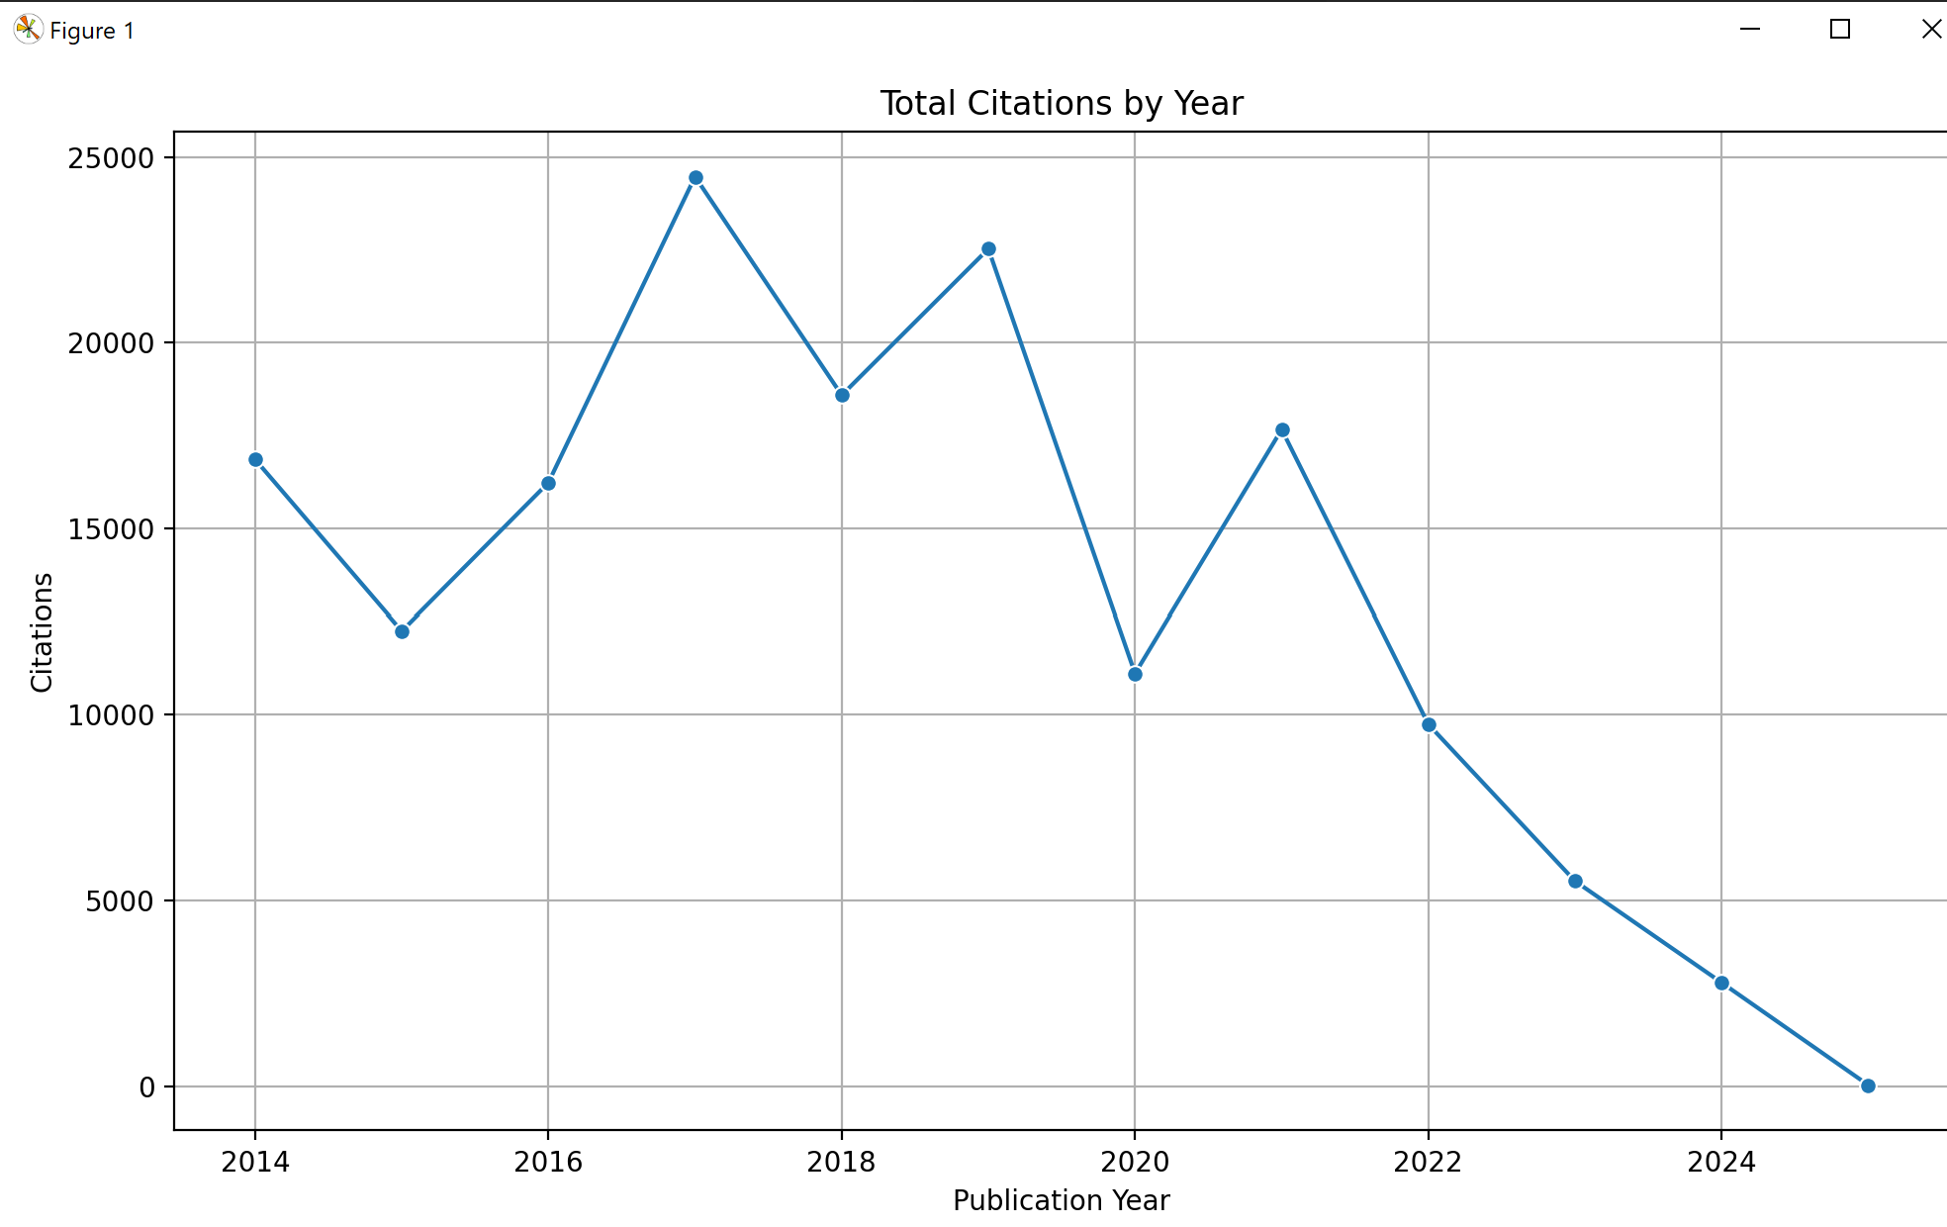
Citation trends

Slide 4
Most cited papers
Paper Topics | Times Cited
Web server for cancer and gene mutation | 7407
Image Data augmentation for deep learning | 6761
Graph neural networks | 6523
Data perspectives | 2187
Data mining with big data | 1962
Big data’s disparate impact | 1772
Data mining and machine learning models for cybersecurity intrusion detection | 1627
Meta server for automated enzyme annotation | 1607
Data-driven approximation | 1351
Trajectory data mining | 1347

Slide 5
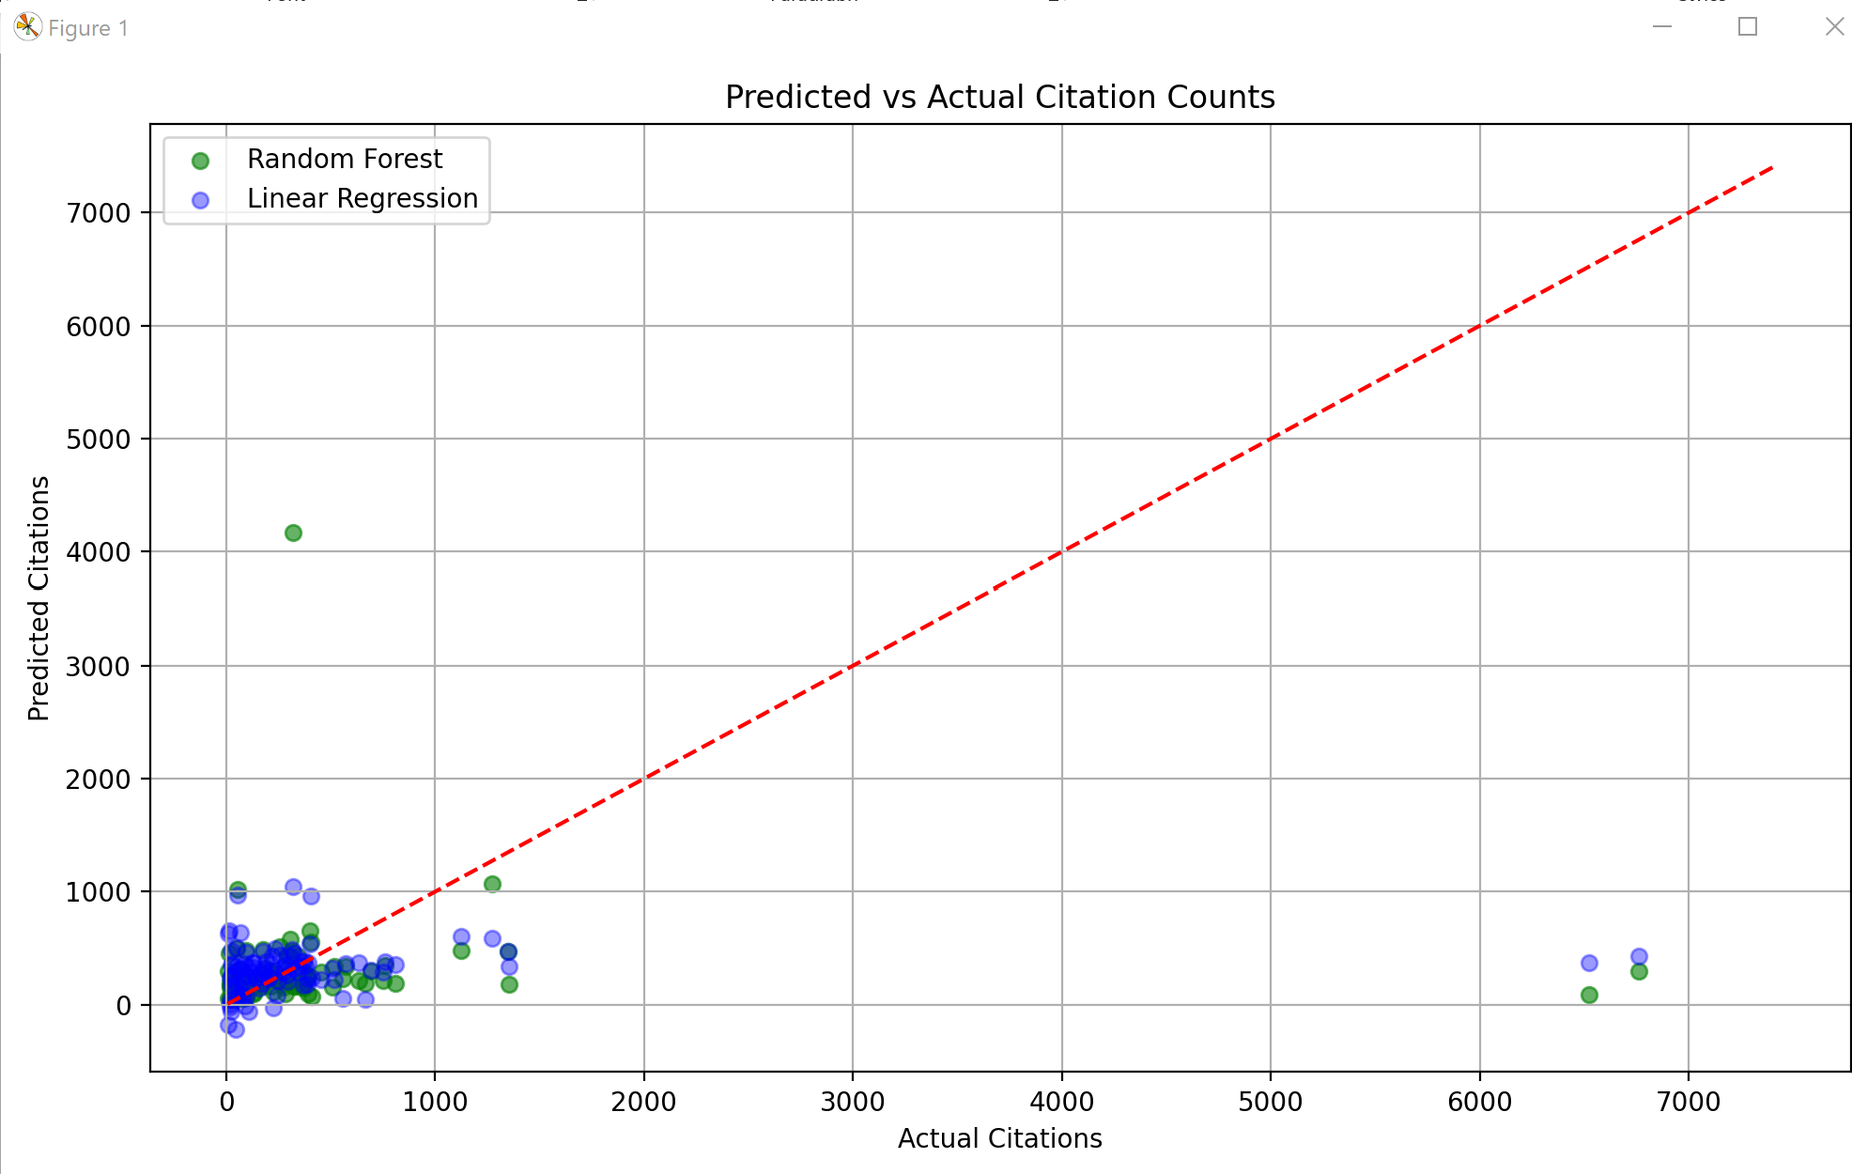
Predicted v.s. actual citation counts

Slide 6
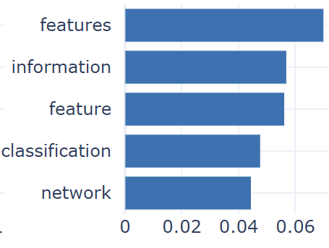
future trends
Feature engineering or deep learning for hyperspectral image classification (HSI)
Used in remote sensing and image analysis

Slide 7
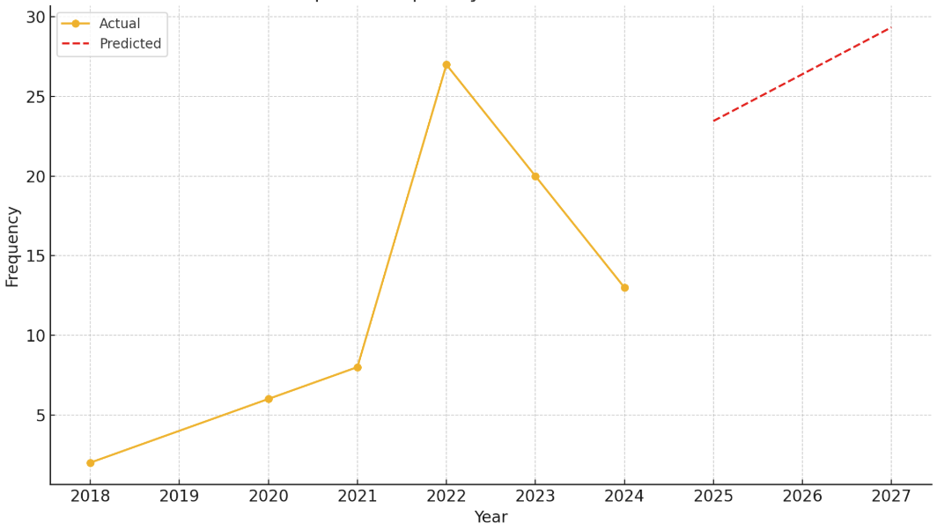
Predicted trend of hsi

