Slide 1
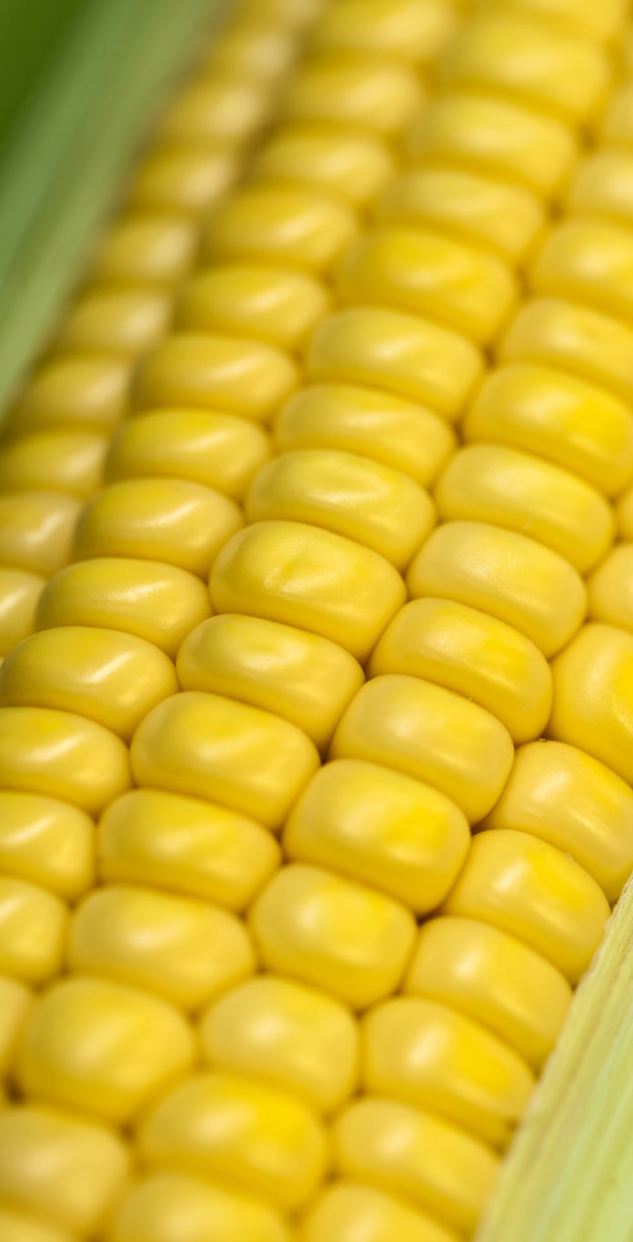
Hybrid Breeding in Maize
From Commercial Seed to Biological Foundation
2 Hours

Slide 2
Course Overview
Session 1: Commercial hybrid seed (10 min)
Session 2: Biological Foundation (30 min)
Break (10 min)
Session 3: Parent creation & pools (30 min)
Session 4: Production Realities (30 min)
Learning Goal: Understand how each breeding decision connects to farmer ROI
Session 4: How do we test? (20 min)

Slide 3
Why do farmers buy hybrid seed every year?

Slide 4
Session 1: The End Goal
Commercial Hybrid Seed (10 min)
  What is the market for hybrids?
  Considerations, Pros/Cons
  Production specifications
  Cost of Goods, Legal Protections

Slide 5
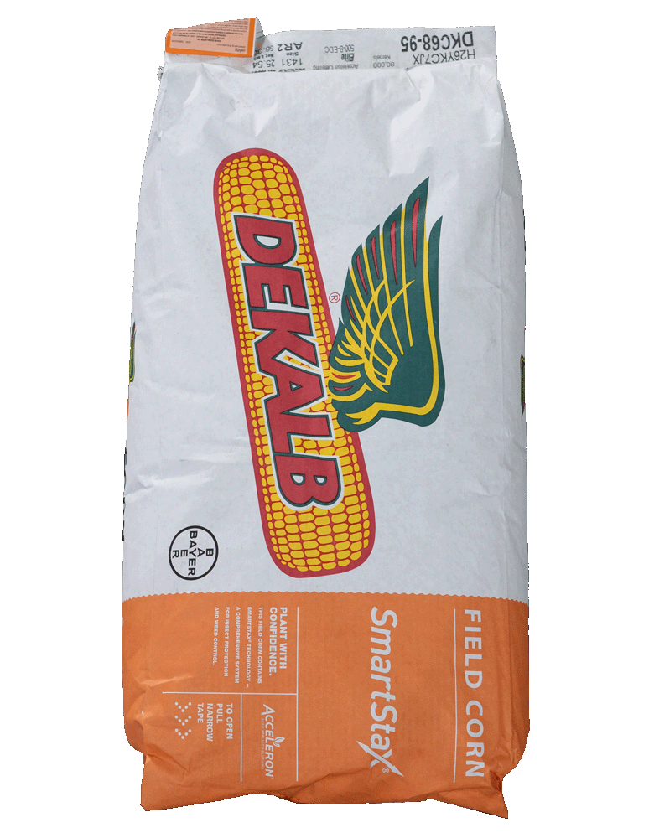
What Success Looks Like
Uniform
High-performing
Consistent
Worth the premium?

Slide 6
Farmer ROI: Why Buy Hybrids?
Yield heterosis: 15-30% advantage over open-pollinated
Uniformity: Easier management, predictable harvest
Stress resilience: Better performance in variable conditions
Quality traits: Grain quality, silage digestibility
Trade-off: Cannot save seed (F2 loses vigor and uniformity)

Slide 7
Seed Company ROI
Market differentiation: Unique genetics, trait packages
Production efficiency: Seed yield in production fields
Built-in IP protection: F1 hybrid biology prevents seed saving
Margins justify R&D: Premium pricing for performance
Brand loyalty: Consistent winners build farmer trust
Long-term investment: 10-15 years to first commercial product

Slide 8
Session 2: Biological Foundation
Why Hybrids Work (20 min)

Slide 9
Heterosis: F1 Outperforms Parents
DEFINITIONS
Mid-parent heterosis: F1 > average of parents
MPH% = [(F1 − midparent) / midparent] × 100%
Better-parent heterosis: F1 > better parent
BPH% = [(F1 − better parent) / better parent] × 100%
EXAMPLE
Yield Comparison (bu/ac)
130
Parents: 85 and 95 bu/ac
F1 hybrid: 130 bu/ac
MPH = 44% BPH = 37%
90
95
85
Parent A
Parent B
F1 Hybrid

Slide 10
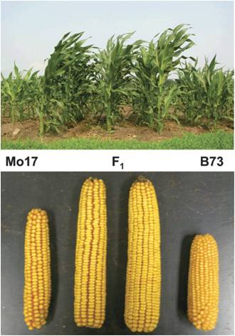
Heterosis Magnitude in Maize

Slide 11
Genetic Basis: Dominance Hypothesis
MOST LIKELY PRIMARY MECHANISM
Each parent has deleterious recessives at different loci
F1 masks bad alleles with good dominant alleles
COMPLEMENTATION EXAMPLE
Parent A: aa|BB (bad at locus 1, good at locus 2)
Parent B: AA|bb (good at locus 1, bad at locus 2)
F1 hybrid: Aa|Bb (good dominant alleles at both loci!)
Result: F1 has fewer exposed deleterious alleles than either parent

Slide 12
Genetic Basis (Cont)
OVERDOMINANCE
Heterozygote (Aa) superior to either homozygote (AA or aa)
Some documented examples exist
Controversial, probably minor contribution
EPISTASIS (GENETIC INTERACTIONS)
Favorable allele combinations in F1
Complex gene networks interact favorably
Reality: All three mechanisms likely contribute
Dominance is probably the primary driver

Slide 13
General Combining Ability (GCA)
GCA = Average performance of a parent across many crosses
Reflects breeding value (additive genetic effects)
Example:
Inbred A: GCA = +8 bu/ac
Inbred B: GCA = +2 bu/ac
Prediction: Crosses with A will yield ~6 bu/ac more than crosses with B

Slide 14
Specific Combining Ability (SCA)
SCA = Performance of a specific cross A×B
Good parent A + Good parent B = ???
• Could be: Amazing hybrid (+SCA)
• Could be: Disappointing hybrid (-SCA)

Slide 15
GCA + SCA Relationship
Expected hybrid performance:
Expected = GCA_A + GCA_B
SCA = Deviation from expectation:
SCA = Observed - Expected
Example:
• Inbred A: GCA = +10 bu/ac
• Inbred B: GCA = +8 bu/ac
• Expected A×B: +18 bu/ac
• Observed A×B: +25 bu/ac
• SCA_AB = +7 (excellent specific combination!)

Slide 16
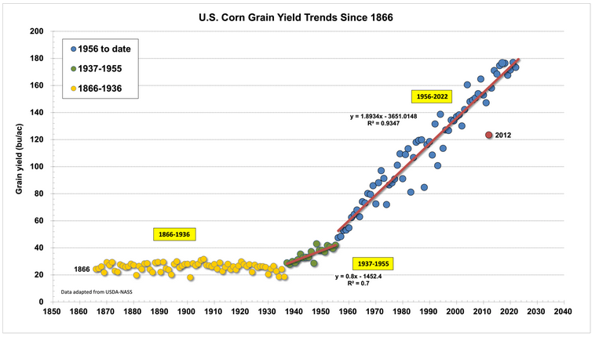
Historical Impact: US Maize Yield 1930-2020
https://extension.entm.purdue.edu/newsletters/pestandcrop/article/historical-corn-grain-yields-in-the-u-s-4/

Slide 17
Session 3: Parent Creation
Inbreds & Pool Management (30 min)

Slide 18
Where do these inbred parents come from?

Slide 19
What is an Inbred Line?
DEFINITION
Homozygous at most loci (achieved through selfing)
‘Pure breeding’ − produces uniform progeny when selfed
SELFING GENERATIONS
Typically S6–S7 (6–7 generations of selfing)
S6 = 98.4% homozygous
S7 = 99.2% homozygous
PERFORMANCE DECLINES DURING SELFING
Inbreeding depression
Exposure of deleterious recessive alleles

Slide 20
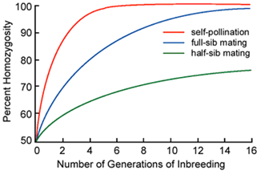
Selfing Process: S0 → S6
https://iastate.pressbooks.pub/plantbreedingmethods/chapter/inbreeding/

Slide 21
Inbreeding Depression
Performance decline as heterozygosity is lost:
• Yield drops dramatically
• Shorter plants, smaller ears
• Reduced vigor and fitness
Genetic basis:
• Exposure of deleterious recessive alleles
• Loss of heterozygote advantage
Why it matters for breeding:
• Can't select purely on per se performance of inbreds
• Must rely on testcross/GCA data
• Some promising crosses come from weak-looking inbreds!

Slide 22
Selection Strategy: What to Select When
Generation | Population Size | Selection Criteria
S0-S2 | Large (1000s) | Major traits, cull defects
S3-S4 | Moderate (100s) | Begin testcrossing, uniformity
S5-S6 | Small (dozens) | GCA-based selection

Slide 23
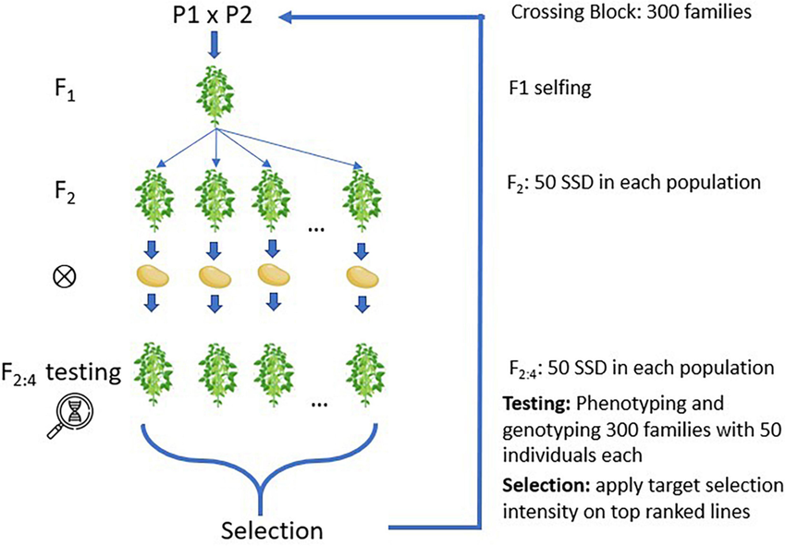
Conventional Inbred Development: 6-7 Years
https://www.researchgate.net/figure/Simulated-families-created-and-inbreeding-using-single-seed-descent-SSD_fig1_354359495

Slide 24
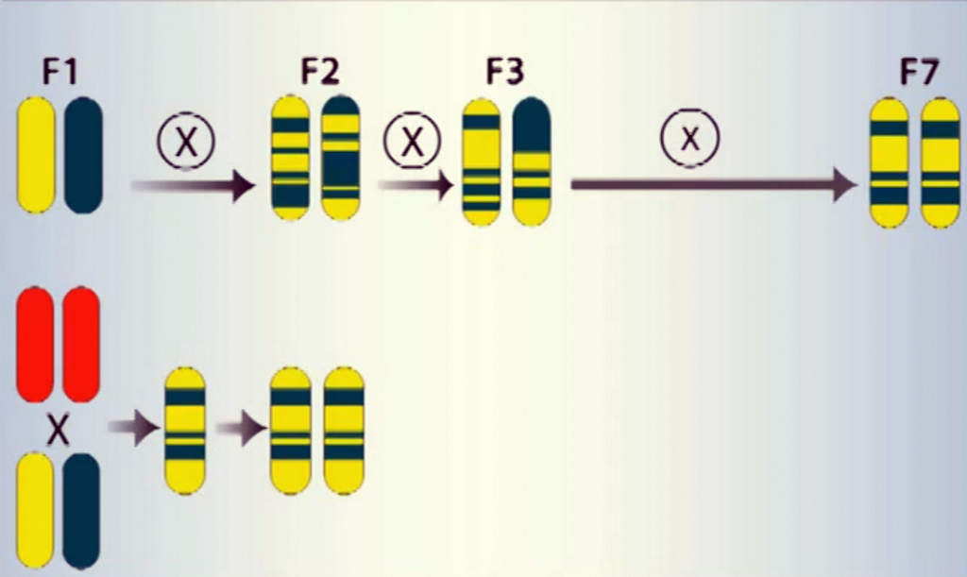
Doubled Haploid (DH): 1-2 Years
https://en.wikipedia.org/wiki/Doubled_haploidy#/media/File:Double_haploidy.jpg

Slide 25
DH vs. Conventional: Cost-Benefit Analysis
 | Conventional | Doubled Haploid
Timeline | 6-7 years | 1-2 years
Cost per line | $400-800 | $15-30
Selection | Gradual (S0-S6) | Only at S0
Infrastructure | Low | $200K-500K
Break-even | Any scale | 500-1000+ lines/year

Slide 26
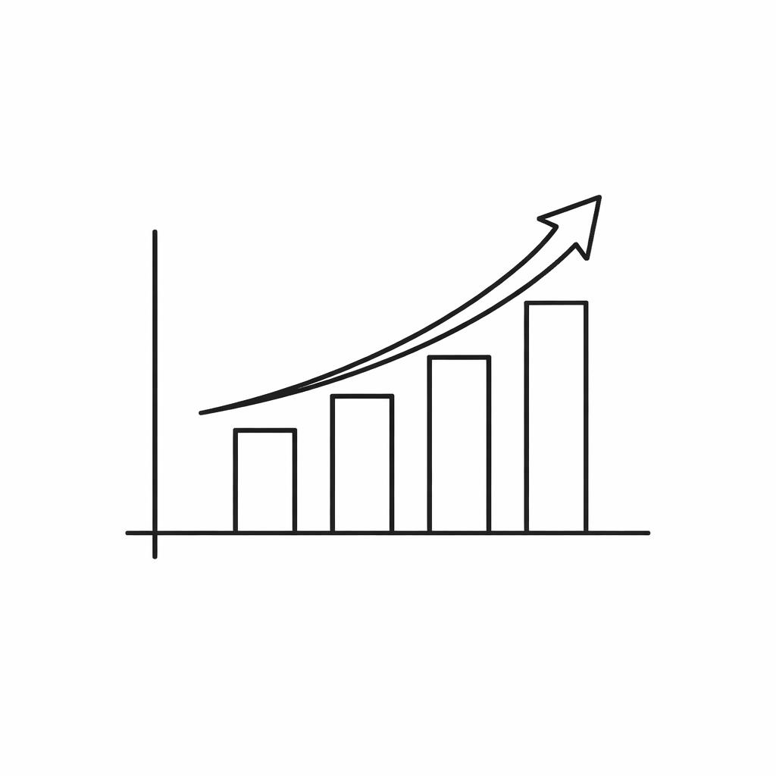




What Makes a Good Inbred?
High GCA for Yield
Adequate Per Se Performance
Good Seed Production
Primary selection criterion
Not so weak it can’t be maintained
Fertility, kernel size, germination
Combines Well with Partners
Complements Germplasm
Broad GCA vs. narrow specific niche
Fills gaps in heterotic pattern

Slide 27
Why don't all inbreds work well together?
Why separate breeding pools?

Slide 28
Heterotic Groups in Maize
Pool A: Stiff Stalk Synthetic (SSS)
• Origin: Iowa Stiff Stalk Synthetic population
• Classic lines: B73, PH207, LH82
• Often used as female parent
Pool B: Non-Stiff Stalk (NSS)
• Subgroups: Lancaster, Iodent, Reid Yellow Dent
• Classic lines: Mo17, PH595, LH123
• Often used as male parent
Other pools: Tropical, Popcorn, Sweet corn (distinct patterns)

Slide 29
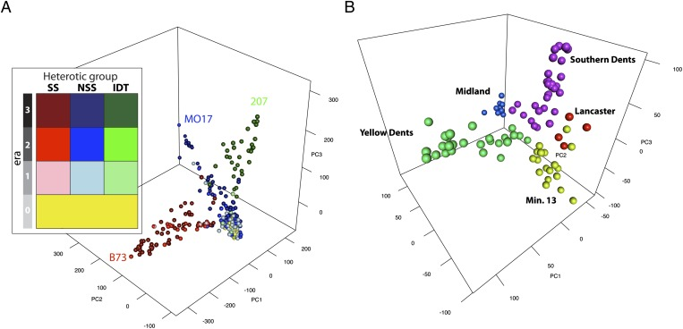
https://pmc.ncbi.nlm.nih.gov/articles/PMC3412004/

Slide 30
Heterotic Pattern: Distance = Heterosis
Within pool crosses:
• SSS × SSS = Moderate heterosis (~10-15%)
• NSS × NSS = Moderate heterosis (~10-15%)
Between pool crosses:
• SSS × NSS = Maximum heterosis (~25-35%)!
Why?
• Genetic distance correlates with heterosis
• More divergent = more complementary loci
• But not too distant (genomic incompatibilities possible)
Sweet spot: Divergent but compatible (like SSS × NSS)

Slide 31
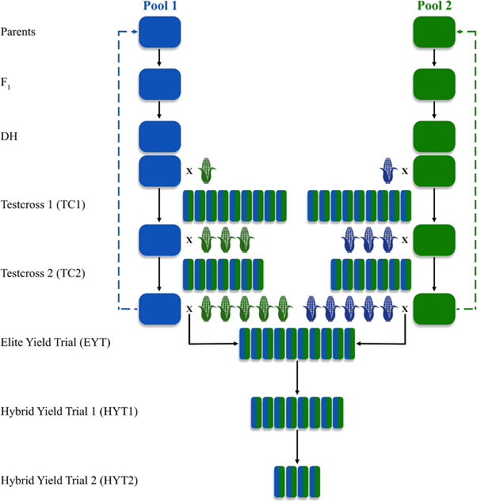
https://www.researchgate.net/figure/Overview-of-maize-hybrid-breeding-pipeline-for-the-conventional-program-used-in-burn-in_fig2_374532916
Two-Pool Breeding Program Structure

Slide 32
Maintaining Pool Divergence
Don't cross between pools during inbred development
• Keep Pool A and Pool B separate
Reciprocal Recurrent Selection (RRS):
• Improve Pool A by selecting for performance with Pool B
• Improve Pool B by selecting for performance with Pool A
• Maintains divergence while improving combining ability
What if pools merge?
• Genetic distance erodes over time
• Heterosis declines in future crosses
• Historical examples show pattern erosion when pools intermixed

Slide 33
Session 4: How do we test what should be a product?

Slide 34
Two-Pool Breeding Program Structure

Slide 35
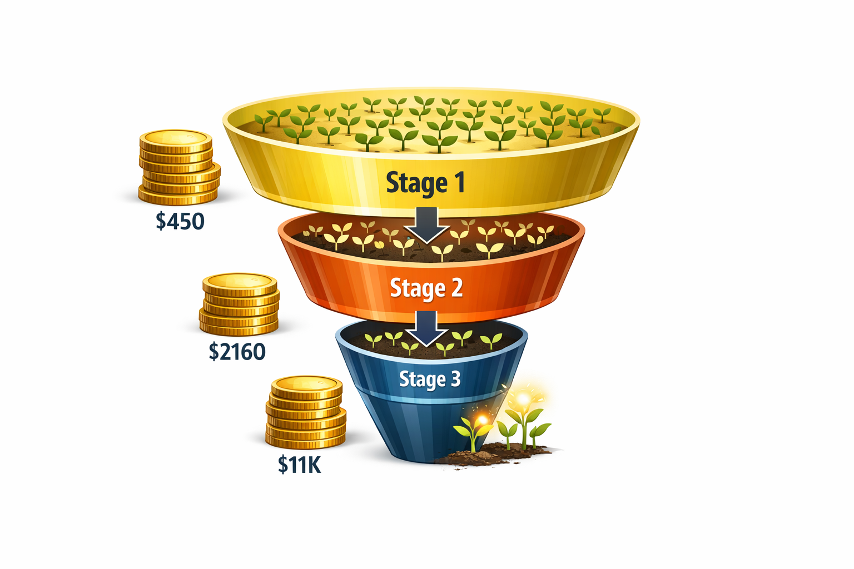
Stage-Gate Testing Funnel
500-2000 hybrids
Top 10-20%
100-300 hybrids
Top 10-20%
20-50 hybrids
Top 10-20%

Slide 36
Stage 1: Preliminary Yield Trials (PYT)
PURPOSE
Eliminate poor performers quickly
SCALE
Many hybrids tested: 500–2,000 new crosses/year
Few locations: 2–5
Limited replication: 2–3 reps, sometimes unreplicated
KEY FACTS
Selection: Keep top 10–20%
Cost: ~$150/hybrid/location
Example: 1,000 hybrids × 3 locations = $450,000

Slide 37
Stage 2: Advanced Yield Trials (AYT)
PURPOSE
More advanced traits and regional adaptation
SCALE
Fewer hybrids: 100–300
More locations: 8–15
Better replication: 3–4 reps
Multiple years ideally (at least 1 full year)
KEY FACTS
Selection: Keep top 20–30%
Cost: ~$180/hybrid/location
Example: 200 hybrids × 12 locations = $432,000

Slide 38
Stage 3: Elite/Regional Trials
PURPOSE
Final commercial decision
SCALE
Top candidates: 20–50 hybrids
Many locations: 15–50+
Proper replication: 4+ reps
Multiple years REQUIRED: 2–3 years
Additional stress/disease nurseries
KEY FACTS
Selection: Keep top 5 hybrids
Cost: ~$220/hybrid/location
Example: 200 hybrids × 12 locations = $432,000

Slide 39
Advances in Genomic Prediction
TRADITIONAL APPROACH
MODERN ALTERNATIVE
Test all crosses in PYT
Advance best to AYT
Pros:
Real field data on all candidates
Cons:
Expensive: $500K–1M
Slow: +1 year to pipeline
Predict from GCA + genomic data
Skip straight to AYT
Pros:
Save $500K+ annually
Accelerate by 1 year
Cons:
Model accuracy critical
Risk missing winners

Slide 40
How good does your model need to be?
• 70% accuracy: Will you capture most top performers?
• Cost of false negatives: Miss a commercial-quality hybrid
• Cost of false positives: Waste AYT resources on poor hybrids
• Net savings: ~$435K but did you miss the best hybrid?

Slide 41
POLL: Your GCA model is 30% accurate
Skip PYT and go straight to AYT?
Show of hands:
• YES - Skip PYT
• NO - Keep PYT
(2-3 min discussion)

Slide 42
What Drives the Skip-PYT Decision?
Program maturity:
• Established programs with good GCA data predict better
• Years of testcross and hybrid trials improve models
Genetic architecture:
• Traits with high GCA component predict better
Risk tolerance:
• Can you afford to miss a potential winner?
Budget constraints:
• If testing budget is tight, prediction becomes attractive
Industry trend: Large programs increasingly skip PYT for routine crosses

Slide 43
But we can't test all possible crosses...
1000 inbreds per pool = 1,000,000 possible crosses!
How do we choose which crosses to make?

Slide 44
INTERACTIVE: GCA Prediction Exercise
Pool A (SSS) | GCA | Pool B (NSS) | GCA
A-104 | +15.1 | B-202 | +13.2
A-101 | +12.3 | B-204 | +11.0
A-107 | +10.5 | B-201 | +9.8
A-102 | +8.7 | B-207 | +7.6
 |  | B-203 | +5.5
Which 5 crosses would you make?

Slide 45
Session 5: Seed Production

Slide 46
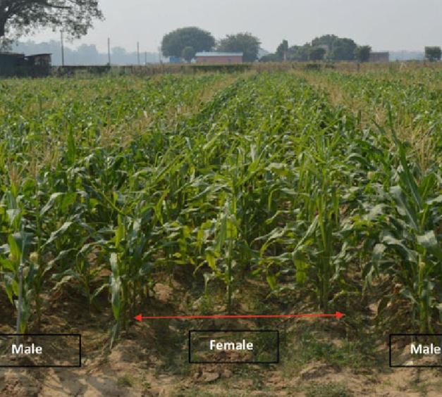
How Hybrid Seed is Made: F1 Production
Isolation: 660+ feet from other corn
Female rows: Detasseled or male-sterile
Male rows: Pollen donors

Slide 47
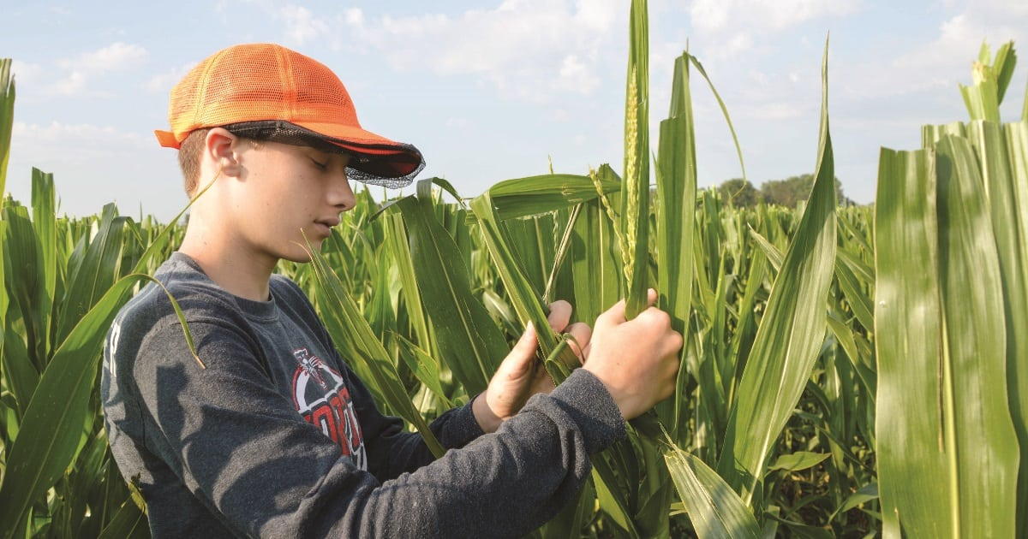
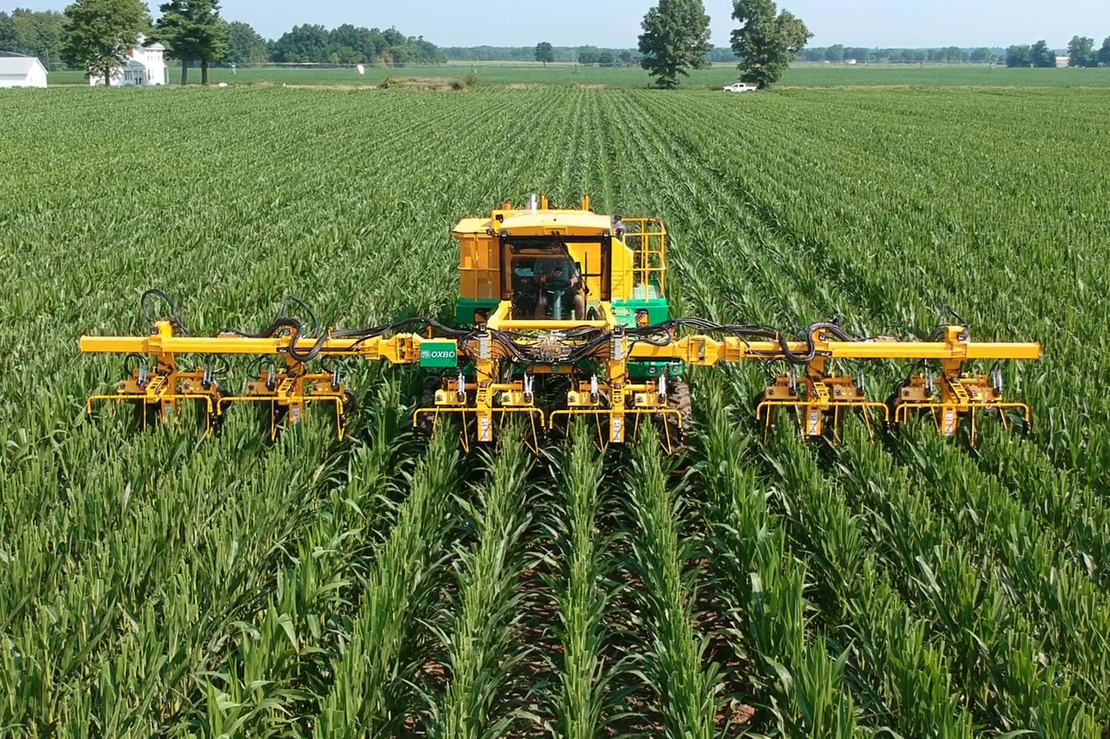
Preventing Female Self-Pollination: Three Methods
1. Manual Detasseling:
• Student crews walking rows, pulling tassels
• Labor-intensive, timing critical (before pollen shed)
• Significant cost, requires seasonal workforce
2. Mechanical Detasseling:
• Modern machines 'sweep' fields with cutting bars
• Tractor-mounted, GPS-guided systems
• Still requires manual follow-up for escapees
3. CMS Systems (next slide):

Slide 48
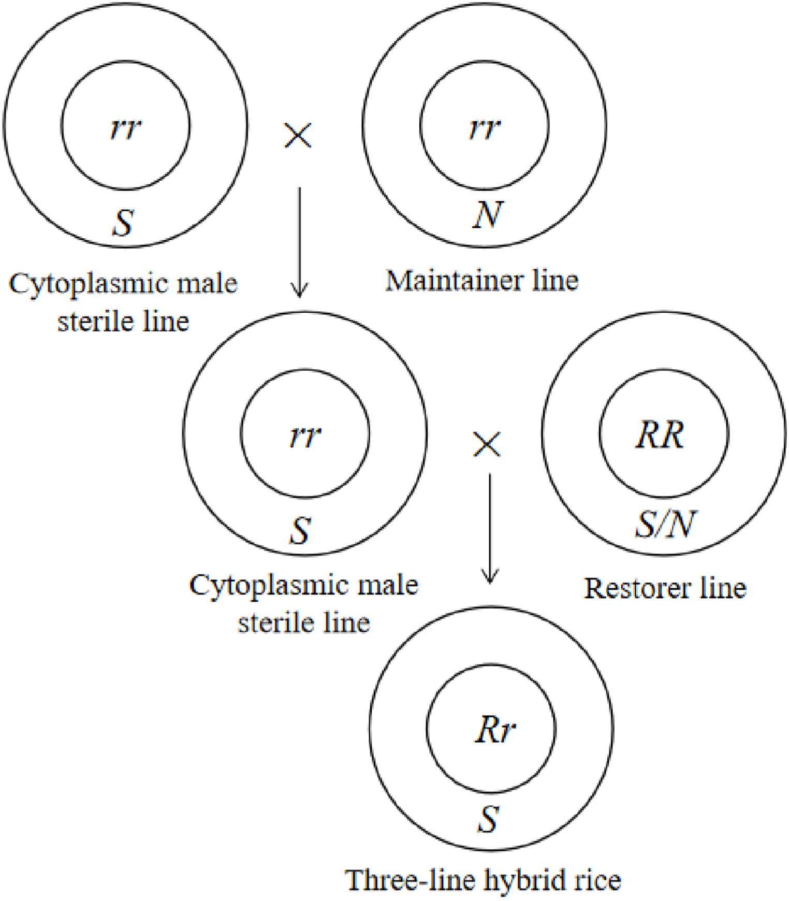
Cytoplasmic Male Sterility (CMS) Systems
Genetic solution: No detasseling needed
How it works:
• CMS cytoplasm → male-sterile female parent (no pollen)
• Restorer (Rf) genes → restore fertility in F1 hybrid
• Three-line breeding system required:
- CMS line (female in production)
- Maintainer line (to propagate CMS line)
- Restorer line (male in production)
Advantages: Cost savings, no labor/timing risk
Trade-offs: Genetic complexity, maintaining three lines
https://www.cell.com/heliyon/fulltext/S2405-8440%2823%2905412-9

Slide 49
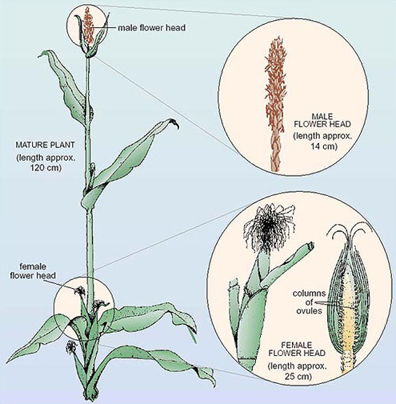
Monoecious but Role-Focused
Production plants serve different ROLES:
• Female-focused: Good seed set (primary) + pollen competency for maintenance
• Male-focused: Good pollen (primary) + seed set for Male×Male crosses
https://www.open.edu/openlearn/science-maths-technology/biology/meiosis-and-mitosis/content-section-4.1

Slide 50
Production Constraints Affect Breeding Decisions
Parent seed availability:
• Need enough inbred seed of both parents annually
• Some inbreds are poor seed producers → limits commercial viability
Flowering synchrony:
• Male/female timing must align (ASI - anthesis-silking interval)
• Male pollen shed duration must cover female silk receptivity
Other factors:
• Geographic constraints: Where can we produce seed?
• CMS/Rf genetics: Planning for fertility restoration
• Seed quality: Kernel size, vigor, germination

Slide 51
Which Hybrid Goes to Production?
Performance requirements:
• Yield advantage: 3-5+ bu/ac minimum over competition
• Agronomic package: Standability, maturity, stress tolerance
• Stability: Consistent performance across environments (low G×E)
• Production feasibility: Parent seed availability
Data requirements:
• 3+ years of testing
• 10-50+ locations
• Multi-environment performance

Slide 52
INTERACTIVE: Which Hybrid Would You Commercialize?
Hybrid | Yield (bu/ac) | vs. Check | Standability | Stability (CV%)
PH-2401 | 187.3 | +5.2 | 6/9 | 18%
PH-2402 | 183.8 | +1.7 | 8/9 | 12%
PH-2403 | 191.5 | +9.4 | 5/9 | 22%
PH-2404 | 185.2 | +3.1 | 7/9 | 14%

Slide 53
The Complete System:
Biology to ROI
1. Heterosis exists → Justifies hybrid breeding system
2. Heterotic pools → Maximize crossing potential
3. Inbred development → Create homozygous parents
4. GCA testing → Identify valuable parents
5. SCA testing → Find specific winning crosses
6. Production seed → Deliver uniform product
7. Farmer ROI → Yield advantage, consistency
8. Company ROI → Sustainable business model

Slide 54
Bottlenecks in Hybrid Breeding
Time: Inbred development takes years
Money: Testing is expensive
• Medium program: $5-15M/year
• No revenue for 10+ years
Personnel: Skilled breeders scarce (40-60% of budget)
Scale: Small programs face high per-hybrid costs
Prediction: SCA is hard to predict
Market dynamics: Target keeps moving

Slide 55
Modern Tools: Where to Invest?
Tool | Benefit | Cost | Savings/Gain
Genomic prediction | Skip PYT stage | $30-80K/year | Save $500K/year
DH technology | Save 4-5 years | $200-500K infra | Faster cycles
Precision phenotyping | Better data, less labor | $50-200K equip | 30-50% labor
Speed breeding | 2-3 gen/year | $100-500K/year | Double gain rate

Slide 56
If you had to design a hybrid breeding program from scratch, what would you prioritize?

Slide 57
Resources for Further Learning
Classic Papers:
• Shull (1908), East (1908), Jones (1918) - Historical foundation
• Crow (1948) - Dominance vs. overdominance
Modern Reviews:
• Birchler et al. (2006) - Genetic basis of heterosis
• Schnable & Springer (2013) - Molecular insights
Textbooks:
• Hallauer et al. - Quantitative Genetics in Maize Breeding
• Bernardo - Breeding for Quantitative Traits in Plants
Datasets: NCSU variety trials, CIMMYT data

