Slide 1
Catchup Visual Design

Slide 2
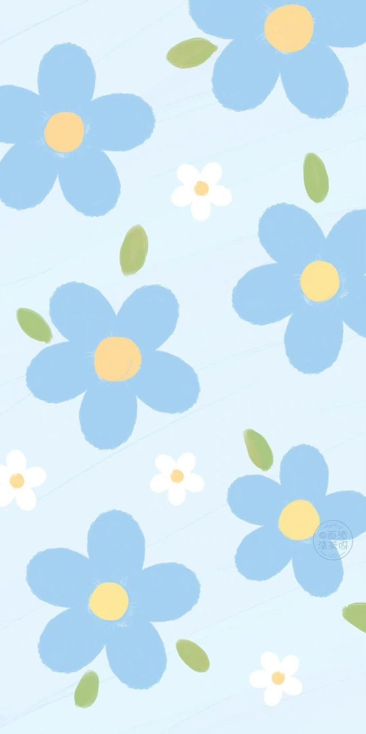
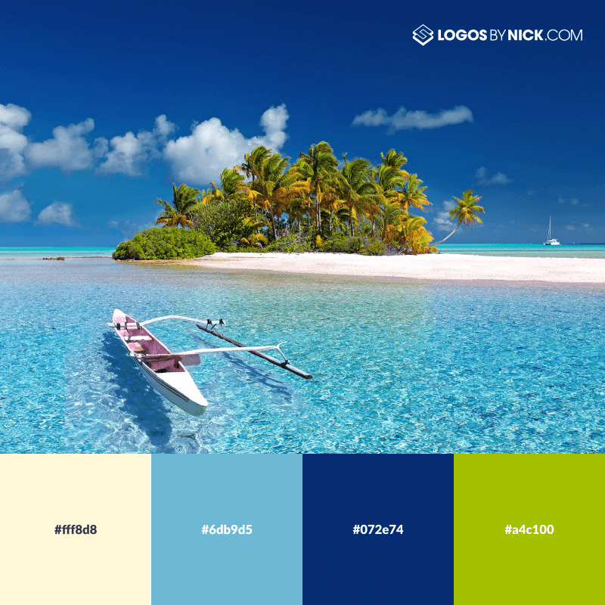

Relaxing color palettes
Sky blue and bright yellow, each with different shades.

Slide 3
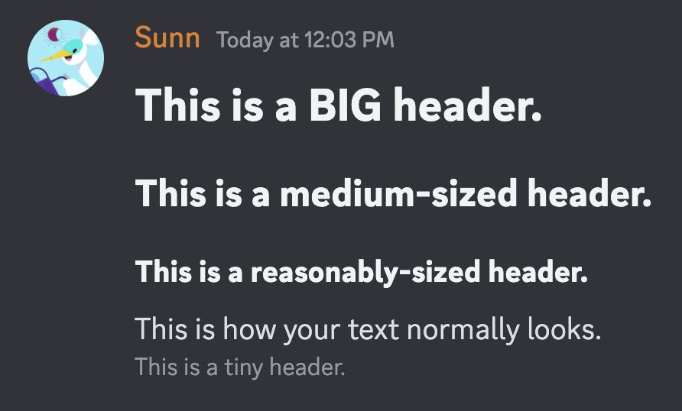
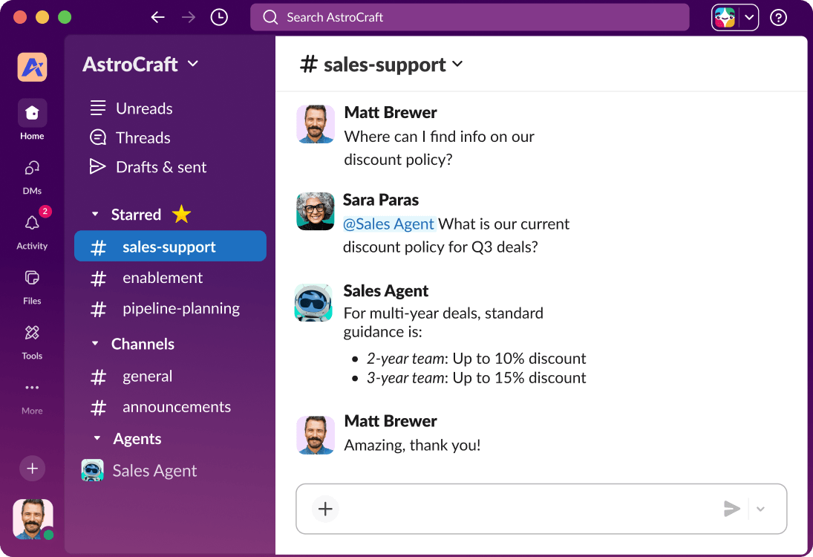
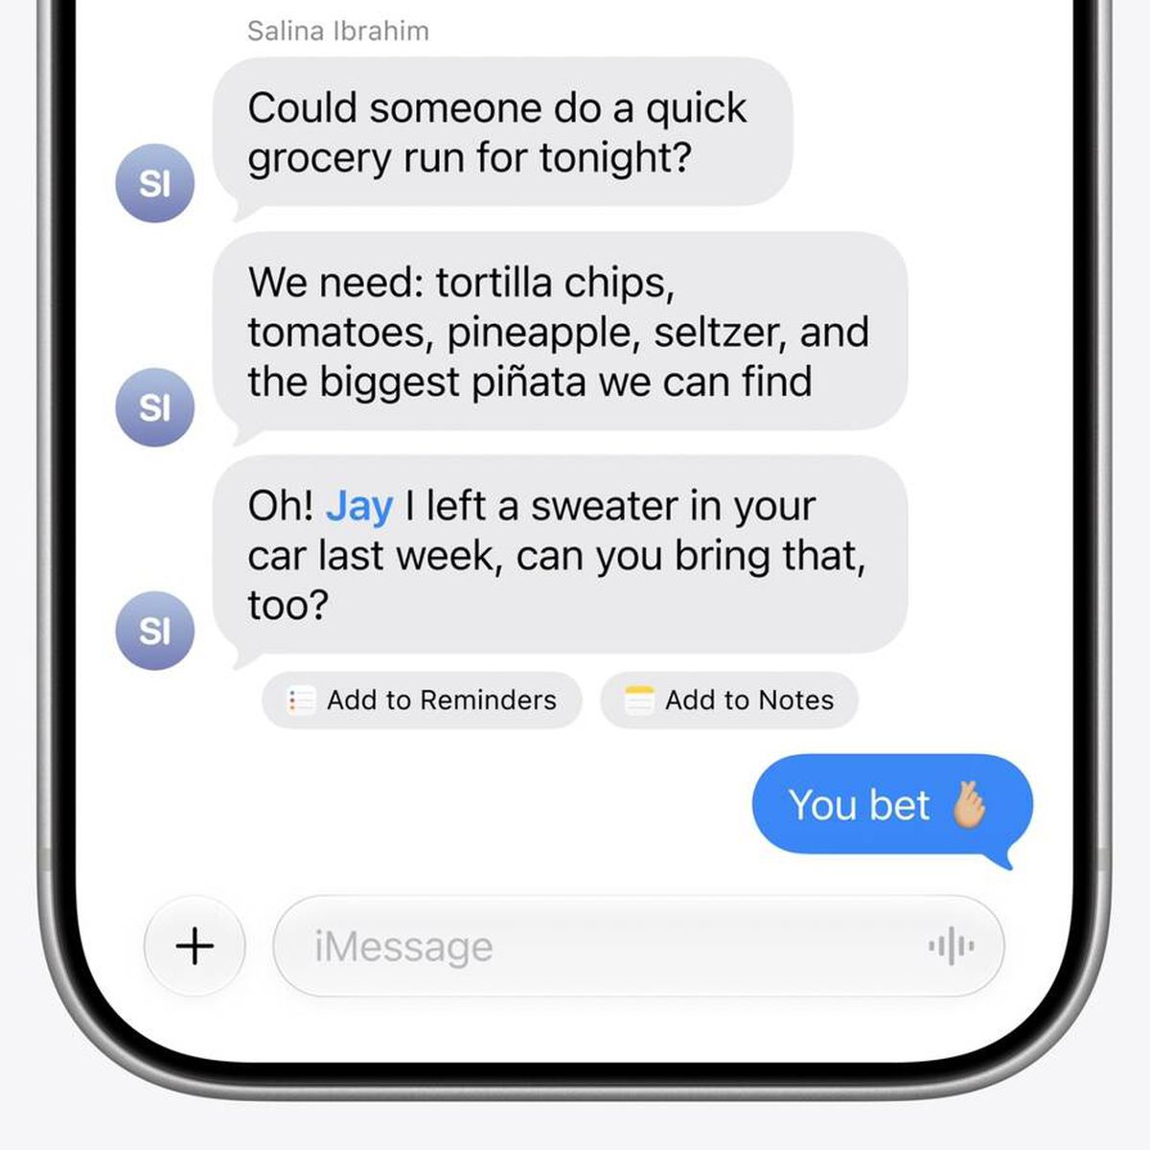
Casual Font Choices
Serif will feel too formal, like a magazine.
All chat apps I investigated use Sans-serif.
Discord: GG Sans
Apple Messages: San Francisco
Slack: Lato
My choice: Nunito Sans

