Slide 1
Basic Block grouper & GraphSlick
By:
Ali Rahbar
Elias Bachaalany
Ali Pezeshk

Slide 2
Presentation outline
Motivation and problems we are solving
Basic Block grouper
What is BBGrouper?
How it works
GraphSlick plugin
What is GS?
How it works
Demo time!

Slide 3
Motivation and problems we are solving
Have you ever seen the disassembly of the following:
Long force-inlined functions?
Lines of code that are copied/pasted repeatedly in the same function or throughout the source code
Debugging / Reverse engineering repeated blocks of code is tedious and can be boring/tiring
Such programming and code generation practices are legitimate in some cases and used as anti-reverse engineering in some other cases
What can reversers do to facilitate their work?

Slide 4
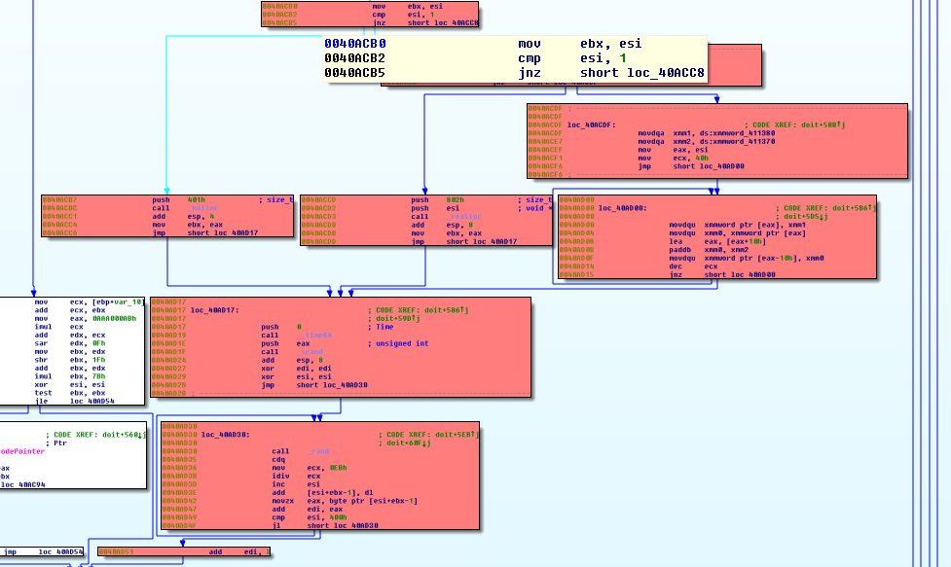
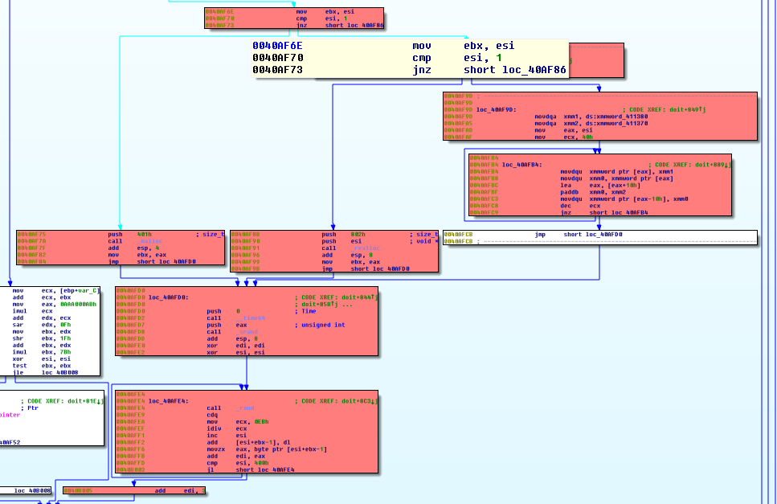
Motivation and problems we are solving /2
Instance of code @ 0x40aCB0
Instance of same code @ 0x40aF6E
Here we same two sets of basic blocks at different locations in the same function
This is an indication of either:
Copy/paste (macros)
Or force-inlined function call

Slide 5
Motivation and problems we are solving /3
What if there was a way to:
Find all similar basic blocks and group them?
Keep track of similar blocks and find them across the program and not just one function or program
Extract the inlined or copied/pasted code into their own functions
Debug over similar basic blocks and skip them
The solution to this is:
BBGrouper and GraphSlick

Slide 6
BBGrouper – What is it?
Python library that contains a set of algorithms
Basic Block abstraction layer (BB_types.py)
BBDef class:
Id: basic block Id
Start/End: basic block boundaries
Context: arbitrary user context
A set of utility functions (BB_util.py)
An IDA support library (BB_ida.py):
A set of hashing functions that transforms IDA basic block into BBDefs
The context of each BBDef is a set of hashes
When BB_ida code runs, the result is independent from IDA
It can be used with any other matching or visualization support code

Slide 7
BBGrouper – Supported hashing
Hash type1:
Take the “cmd.itype” of all instructions in a basic block and builds an array of command instruction numbers
The array is then hashed
Operands are totally ignored
Good for:
Almost exact basic block matching
Ignores the operands
Weakness:
Fails if instruction ordering is different
Fails if basic block length is different

Slide 8
BBGrouper – Supported hashing /2
Hash type2:
For each instruction in the basic block:
Take the “cmd.itype” and assign to it a unique prime number from ITYPE_PRIME_POOL[]
For each operand in the instruction, assign a unique prime number to the operand type (register, memory, immediate, etc…) from the OPND_PRIME_POOL[]
Multiply the two prime numbers to generate a prime number that uniquely represent the instruction
Any other similar instruction should have the same resulting number
Good for:
Out of order instructions -> survives code re-ordering
Takes the operand types into consideration but not the value -> survives relocations
Weakness:
Fails if the same source code is emitted differently (different instructions) in each inline function instance
If basic block lengths are not the same

Slide 9
BBGrouper – Basic block matching percentage
Instead of hashing the block, let us compute a characteristic for each instruction in the basic block:
Prepare a dictionary ‘D’
Key = instruction characteristics
Value = match count
For each instruction, store how many types we have same characteristics
D[get_characteristics(cmd)] ++
Give two basic blocks B1 and B2, we have two characteristics tables D1 and D2
Check how much D1 and D2 have in common.
A high % of similarity between D1 and D2 classifies two BBs as identical

Slide 10
BBGrouper – Basic block matching algorithm
TODO
Talk about the algorithm
Show what are complete blocks
Etc…

Slide 11
BBGrouper – Basic block matching algorithm /2
TODO
Talk about the algorithm
Screenshots, etc….

Slide 12
BBGrouper – Basic block matching algorithm
Implemented in bb_match.py
Exports method calls used by the GraphSlick plugin
Analyze(func_ea) -> analyzes the function and returns a result to be visualized
Load/SaveState(): Load an existing result set OR save an existing result set after it has been modified (interactively) by the user via the GS plugin
The result of the matching algorithm is a three-dimensional array:
Result = Array[Parent Groups]
Parent group = Array[Groups]
Groups = Array[Similar Basic Block]

Slide 13
GraphSlick – What is it?
GraphSlick is an IDA Pro plugin
Takes the result of running Analyze() in the BB Matcher routine and visualizes it
Result can be interactively modified by the user
The algorithm is processor agnostic
Works on ARM 32/64
Works on X86/AMD64
Any other processor supported by IDA Pro

Slide 14
GraphSlick – What is it? /2
The UI represents the results using:
A chooser window (aka “GS Panel”): displays the BB Analyze() function call results in a list
A user graph window (aka “GS View”):
displays a user graph containing the matching results
Allows interactivity to manipulate the grouping results
Allows coloring and navigating through the results

Slide 15
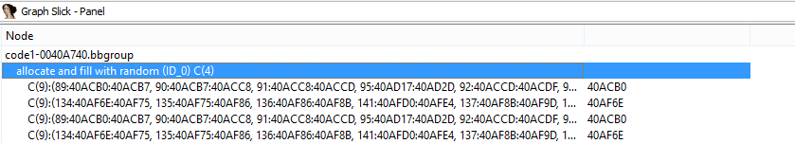
GraphSlick – Panel
The GS panel shows all the nodes and under which parent group they fall
Each parent group contains various group each containing a set of nodes that make up similar code pattern in various program location
“allocate and fill with random” parent group has four groups
Each group is composed of 9 basic blocks

Slide 16
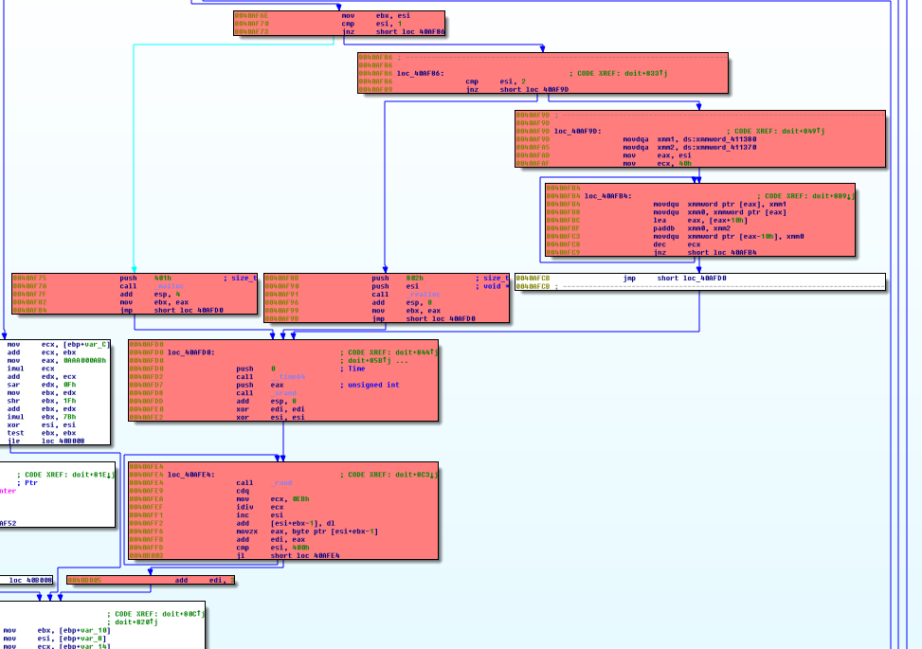
GraphSlick – Panel /2
These are the 9 nodes that make up “allocate and fill with random” code logic
It is composed of 9 basic blocks
These 9 blocks could have been an inlined function
Or code that has been copied and pasted

Slide 17
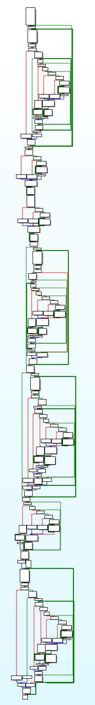
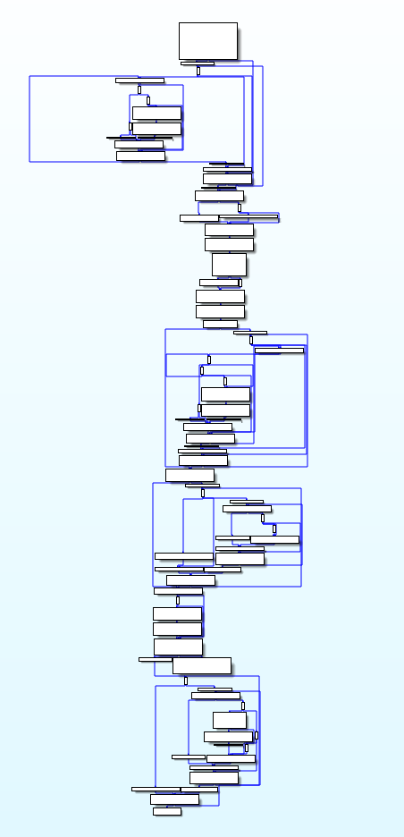
GraphSlick – Before and after
Before
After
In this example, we automatically identified similar basic block instances and grouped them under a single parent group
Note how the graph is much more simpler

Slide 18
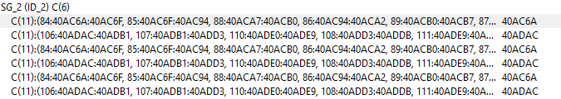
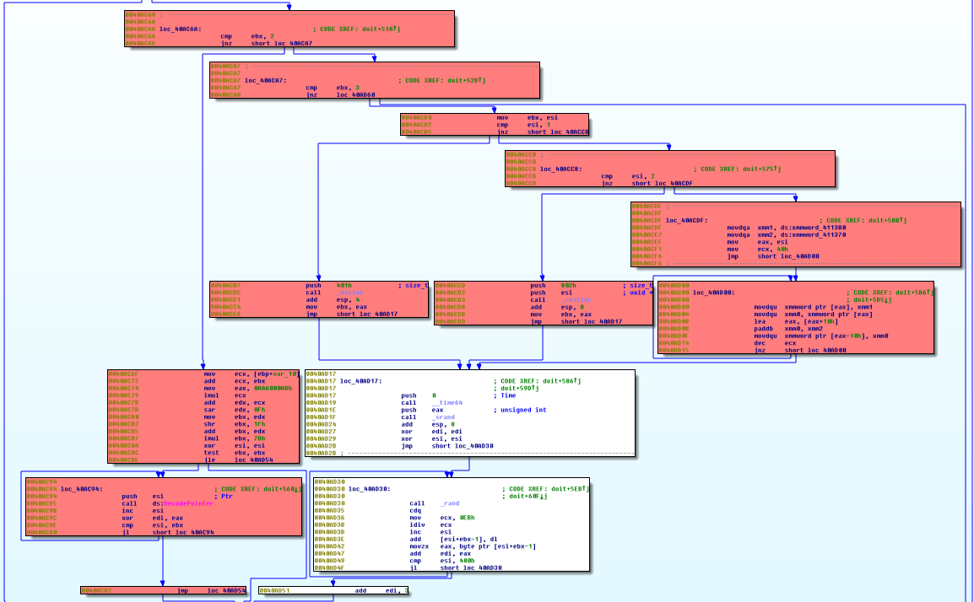
GraphSlick – Automatic grouping on x86
In this example, we can see how the GraphSlick panel:
Created one parent group with 6 sub groups
Each sub-group is composed of 11 basic blocks

Slide 19
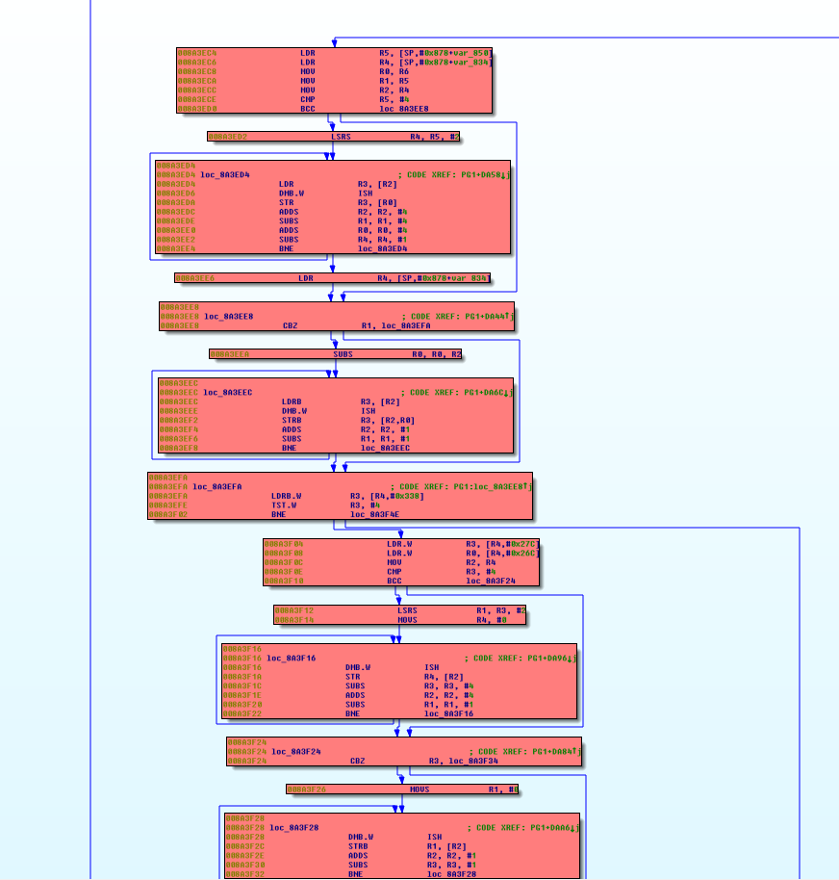
GraphSlick – Automatic group on ARM 32

Slide 20
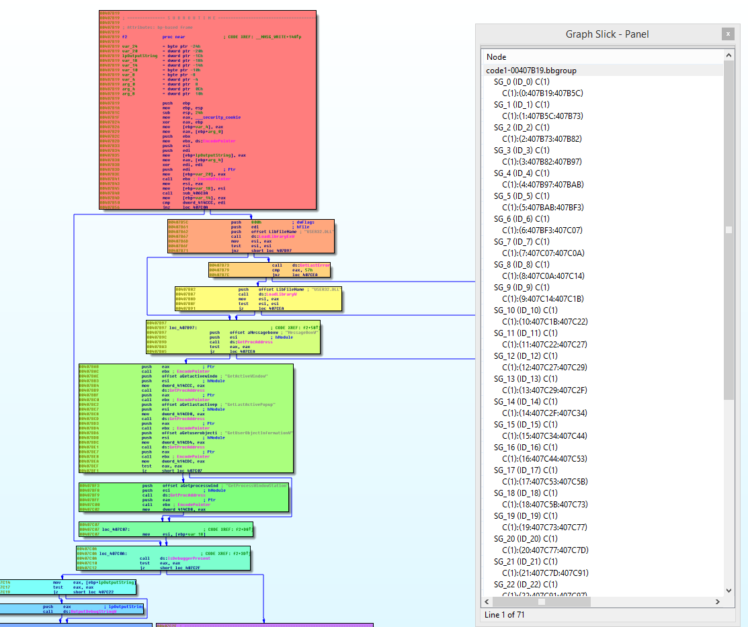
GraphSlick – Automatic coloring
Here we see a function with no similar basic blocks
Each basic block is its own parent block
Each parent block is automatically assigned a distinct color

Slide 21
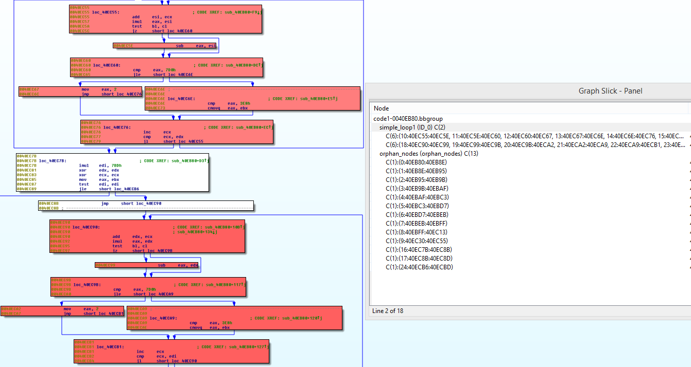
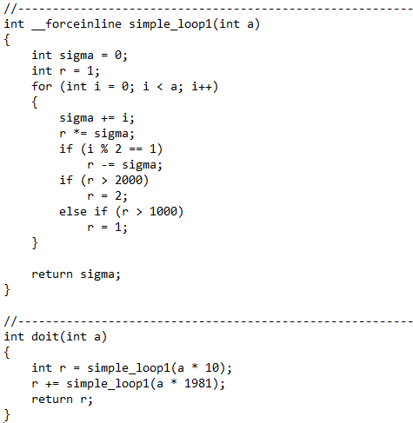
GraphSlick – Automatic color shades
The “doit” function has the body of “simple_loop1” inserted twice
The GS panel detected 6 basic blocks per inlined function call
All the groups belonging to the same parent group have the same color but with different shade
The other “Orphan nodes” are just regular blocks

Slide 22
GraphSlick – Automatic color shades
Demo time!

