Slide 1

NATIONAL CONFERENCE ON
Machine Learning, Artificial Intelligence, Recent Advancement & Security: Opportunities & Challenges
(17th – 18th April, 2026)
organized by
KCC INSTITUTE OF LEGAL & HIGHER EDUCATION, GREATER NOIDA
Affiliated to GGSIPU (Guru Gobind Singh Indraprastha University), Dwarka, New Delhi
Hourly Multi-Pollutant Air Quality Forecasting using BiLSTM-GRU Based Deep Learning Model on Chandni Chowk and R.K. Puram, Delhi
Presented By: Nihira Dubey
00927402023
BCA “6”sem
1

Slide 2
Introduction
Air pollution is a major environmental and health issue caused by urbanization, industrial growth, and vehicle emissions, affecting human health and ecosystems..
Rapid urbanization and industrialization, especially in cities like Delhi, have worsened air pollution levels.
The project considers multiple pollutants (PM2.5, PM10, NO2, CO, O3) along with weather factors to provide a more realistic and accurate analysis.
Use of Deep Learning Models: Advanced models like BiLSTM and GRU are used to capture complex, non-linear relationships in time-series air quality data and improve prediction accuracy.
A multi-pollutant approach with deep learning helps improve forecasting and supports effective environmental management
The main goal is to compare different models and identify the most effective one for accurate hourly air quality forecasting in Delhi locations.
NATIONAL CONFERENCE ON MACHINE LEARNING, ARTIFICIAL INTELLIGENCE, RECENT ADVANCEMENT & SECURITY: OPPORTUNITIES & CHALLENGES
(17 – 18 April, 2026)
2

Slide 3
Research Gaps & Research Aim
The existing studies on air quality prediction mainly focus on single pollutants and often fail to capture the complex interactions among multiple pollutants and meteorological factors.
Traditional statistical models are limited in handling nonlinear and dynamic relationships present in air pollution data.
Although deep learning models improve prediction accuracy, many studies do not effectively integrate spatial and temporal dependencies together .
There is limited research on hybrid models that combine multiple deep learning architectures for better performance.
Additionally, issues like model interpretability and handling of real-time multi-pollutant data are still not fully addressed.
NATIONAL CONFERENCE ON MACHINE LEARNING, ARTIFICIAL INTELLIGENCE, RECENT ADVANCEMENT & SECURITY: OPPORTUNITIES & CHALLENGES
(17 – 18 April, 2026)
3

Slide 4
Literature review
Air pollution is a major environmental and public health concern caused by rapid urbanization, industrialization, and vehicular emissions, with pollutants like PM2.5, PM10, NO₂, CO, and O₃ severely impacting human health. Traditional air quality monitoring systems and statistical models are limited in coverage and fail to capture complex, non-linear relationships, often focusing on single-pollutant analysis. Recent research emphasizes multi-pollutant analysis along with meteorological factors for more realistic predictions. Advanced deep learning models such as CNN, LSTM, GRU, and Bi-LSTM have shown better performance in handling time-series data, while hybrid models like BiLSTM-GRU further enhance prediction accuracy. However, challenges such as high computational cost, need for large datasets, and lack of interpretability still remain.
NATIONAL CONFERENCE ON MACHINE LEARNING, ARTIFICIAL INTELLIGENCE, RECENT ADVANCEMENT & SECURITY: OPPORTUNITIES & CHALLENGES
(17 – 18 April, 2026)
4

Slide 5
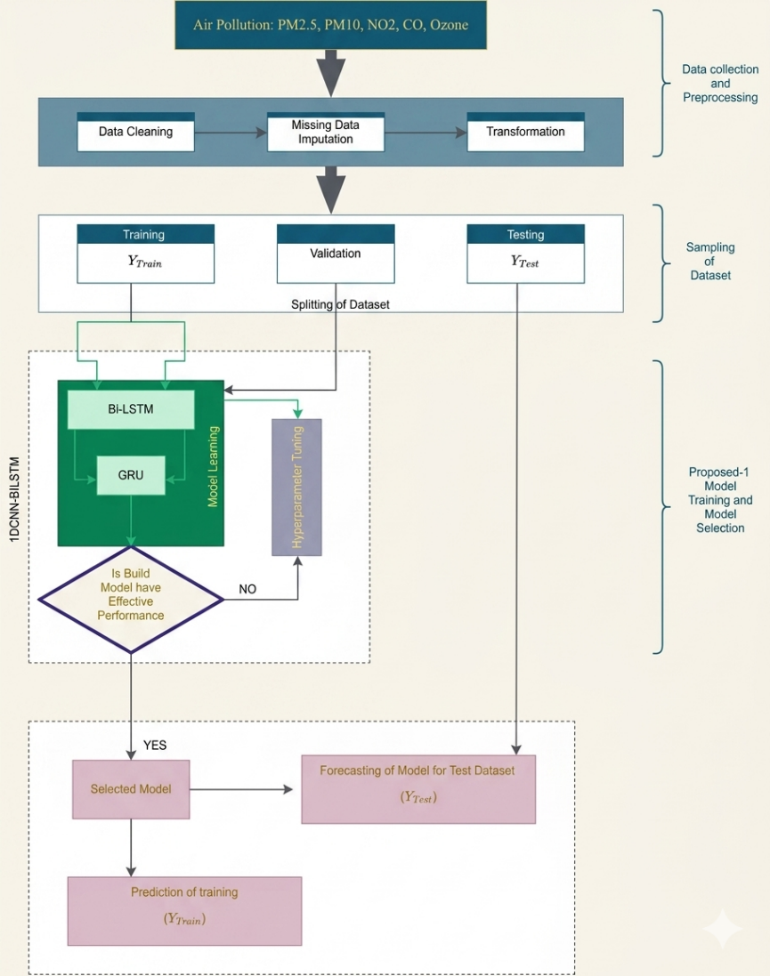
Research Methodology
The research methodology is based on collecting multi-pollutant air quality data, including PM2.5, PM10, NO₂, CO, and O₃ along with meteorological parameters. The collected data is preprocessed through cleaning, handling missing values, and normalization to improve data quality. The dataset is then divided into training, validation, and testing sets. A hybrid deep learning model combining BiLSTM and GRU is developed to capture temporal dependencies and complex patterns in the data. The model is trained and optimized using iterative learning and evaluated using performance metrics such as MAE, RMSE, and R² to ensure accurate air quality prediction.
NATIONAL CONFERENCE ON MACHINE LEARNING, ARTIFICIAL INTELLIGENCE, RECENT ADVANCEMENT & SECURITY: OPPORTUNITIES & CHALLENGES
(17 – 18 April, 2026)
5

Slide 6
Research Finding
Hybrid BiLSTM-GRU model achieved higher accuracy compared to traditional and single deep learning models..
Multi-pollutant approach provided more realistic and reliable predictions than single pollutant models.
Strong correlation was observed between PM2.5 and PM10, indicating common pollution sources.
Inclusion of meteorological factors (temperature, humidity, wind) improved prediction performance.
Chandni Chowk showed higher pollution levels compared to R.K. Puram due to traffic and congestion.
GRU shows strong performance, particularly for PM10 prediction.
Evaluation metrics like MAE, RMSE, and R² confirmed the robustness and efficiency of the proposed model.
NATIONAL CONFERENCE ON MACHINE LEARNING, ARTIFICIAL INTELLIGENCE, RECENT ADVANCEMENT & SECURITY: OPPORTUNITIES & CHALLENGES
(17 – 18 April, 2026)
6

Slide 7
Conclusion
The study concludes that air pollution prediction can be significantly improved using advanced deep learning techniques. The proposed hybrid BiLSTM-GRU model effectively captures complex, non-linear, and temporal patterns in multi-pollutant air quality data, resulting in higher accuracy compared to traditional models. The integration of multiple pollutants along with meteorological factors provides a more realistic understanding of air quality variations. The results also highlight that highly congested areas like Chandni Chowk experience more severe pollution than residential areas like R.K. Puram. Overall, the proposed approach proves to be reliable for accurate air quality forecasting and can support better environmental management and decision-making.
NATIONAL CONFERENCE ON MACHINE LEARNING, ARTIFICIAL INTELLIGENCE, RECENT ADVANCEMENT & SECURITY: OPPORTUNITIES & CHALLENGES
(17 – 18 April, 2026)
7

Slide 8
References
Central Pollution Control Board (CPCB), National Air Quality Monitoring Programme (NAMP) Report, India.
Hochreiter, S., & Schmidhuber, J., Long Short-Term Memory, Neural Computation, 1997.
Cho, K. et al., Learning Phrase Representations using RNN Encoder–Decoder for Statistical Machine Translation, 2014.
S. Son and J. Seok, “Optimal activation function selection for enhanced model perfor mance,” Information Sciences, p. 123300, 2026.
T. Talaei Khoei and H. Slimane, “Deep learning: systematic review, models, challenges,” Neural Computing and Applications, vol. 35, no. 31, pp. 23103–23124, 2023.
Zhang, Y., et al., Air Quality Prediction using Deep Learning: A Review, IEEE Access, 2018.
NATIONAL CONFERENCE ON MACHINE LEARNING, ARTIFICIAL INTELLIGENCE, RECENT ADVANCEMENT & SECURITY: OPPORTUNITIES & CHALLENGES
(17 – 18 April, 2026)
8

