Slide 1
Multiple Regression and Model Building
By-Nihit Jain
Utkarsh Rai
Anujay Jain

Slide 2
Objective
Build the best multiple regression model that you can for the purpose of predicting head injury severity, using all the other variables as the predictors.
Determine which variables must be made into indicator variables.
Determine which variables might be superfluous.
Build two parallel models, one where we account for multicollinearity, and another where we don't consider multicollinearity.
Continuing with the Crash data set, combine the four injury measurement variables into a single variable, defending your choice of combination function. Build the best multiple regression model you can for the purpose of predicting injury severity, using all the variables as the predictors. Build two parallel models, one where you account for multicollinearity, and another where you don't consider multicollinearity. For which purpose may each of these models be used?

Slide 3
Description
Resource →Crash.dat
Technology → Anaconda
Jupyter notebook
Data mining success criteria→ Multiple regression

Slide 4
Resources Description
Crash.dat
It includes the excerpt of the data of the car model from 1987 to 1991
It includes the data for unique car model of a company
It stores record for the number of head injury, left leg injury,etc.

Slide 5
Columns in the file
MAKE →It tells the company of the car.
MODEL →It tells the model of the car.
CARID →It is the unique name by which we can know the company and the model of the company. It uniquely identifies a certain type of car from another.
CARID_YR→It also contains the CARID, but along with it also tells the year in which it was released.
HEAD_INJ→Number of head injuries in an accident in a certain type of car.
CHEST_IN→ Number of chest injuries in an accident in a certain type of car.
LLEG_INJ→ Number of injuries in left leg in an accident in a certain type of car.

Slide 6
Continued…
RLEG_INJ→ Number of injuries in right leg in an accident in a certain type of car.
DRIV_PAS→ Whether the passenger got hurt or the driver.
PROTECT→ What type of protection was available in the vehicle.
DOORS→Number of doors in the vehicle.
YEAR→In what year the car was launched.
WEIGHT→ Tells the weight of the car.
SIZE→ Categorize the cars by their size.
SIZE2→ Size in numeric value for the category of size to which the car belongs.
PROTECT2→Numeric value for the protection in the car.

Slide 7

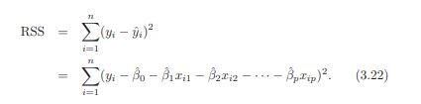
Multiple Linear Regression
Its used when there are more than one predictor.
Formula used→
H0 : β1 = β2 = ··· = βp = 0 versus the alternative
Ha : at least one βj is non-zero.
Notes:
Ho h1 are

Slide 8
Why use Multiple Linear Regression and not Linear Regression ?
Its simple as that like ,is it better to cook 10 different ingredients in 10 different utensils or all of them in 1 utensil to get the food

Slide 9
Multicollinearity
It is a phenomenon in which one predictor variable in a multiple regression model can be linearly predicted from the others with a substantial degree of accuracy.

Slide 10
Effects of Multicollinearity
A multivariate regression model with collinear predictors can indicate how well the entire bundle of predictors predicts the outcome variable, but it may not give valid results about any individual predictor, or about which predictors are redundant with respect to others.

Slide 11
How to perform Multicollinearity
Find out the level of dependence between all the columns
Remove those columns which are very highly dependent
Then again perform multiple regression

Slide 12
Some terminology→
Superfluous→ unnecessary, especially through being more than enough.
Indicator variables→The variables which are influencing the target
Feature Selection→Having too many variables could potentially cause your model to become less accurate.

Slide 13
Steps Taken
Data Cleaning→
Fill empty columns with values
Value used→ mean for that column

Slide 14
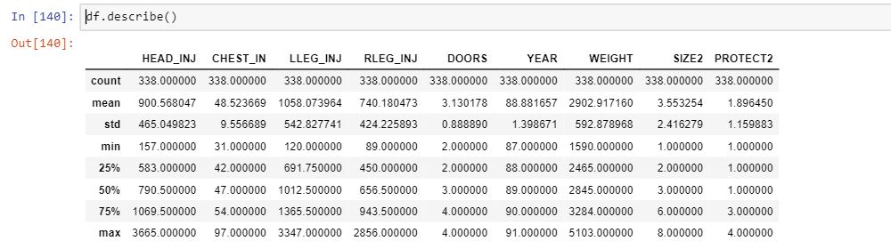
Data Understanding

Slide 16
Certain Insights
# Which company make had highest head injury count
a = df.groupby(['MAKE'],as_index=False).sum()
m = (a["HEAD_INJ"].max())
a[a['HEAD_INJ']>=m]
# Which company make had lowest head injury count
a = df.groupby(['MAKE'],as_index=False).sum()
m = (a["HEAD_INJ"].min())
a[a['HEAD_INJ']<=m]

Slide 17
# Which year car make had the highest head injury
a = df.groupby(['YEAR'],as_index=False).sum()
m = (a["HEAD_INJ"].max())
a[a['HEAD_INJ']>=m]
# Which year car make had the lowest head injury
a = df.groupby(['YEAR'],as_index=False).sum()
m = (a["HEAD_INJ"].min())
a[a['HEAD_INJ']<=m]

Slide 18
# Which Type of protection has highest influence on head injury
a = df.groupby(['PROTECT2'],as_index=False).sum()
m = (a["HEAD_INJ"].max())
a[a['HEAD_INJ']>=m]

Slide 19
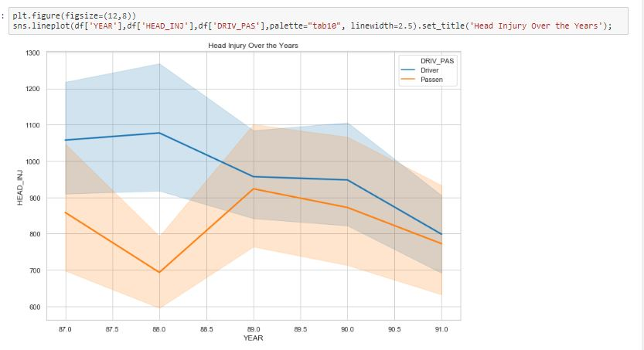
Graph for head injury to driver and passenger over the year

Slide 20
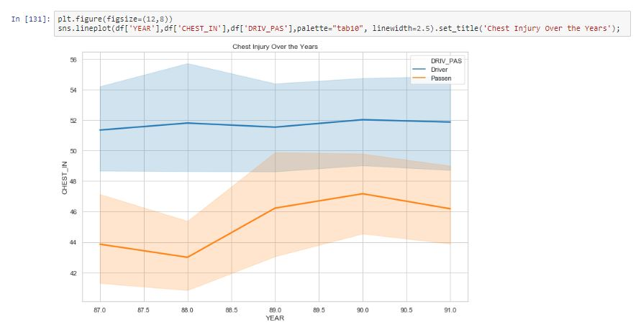
Graph for chest injury to driver and passenger over the year

Slide 21
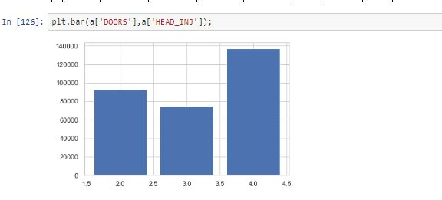
Graph of head injury Vs no. of doors in the vehicle

Slide 22
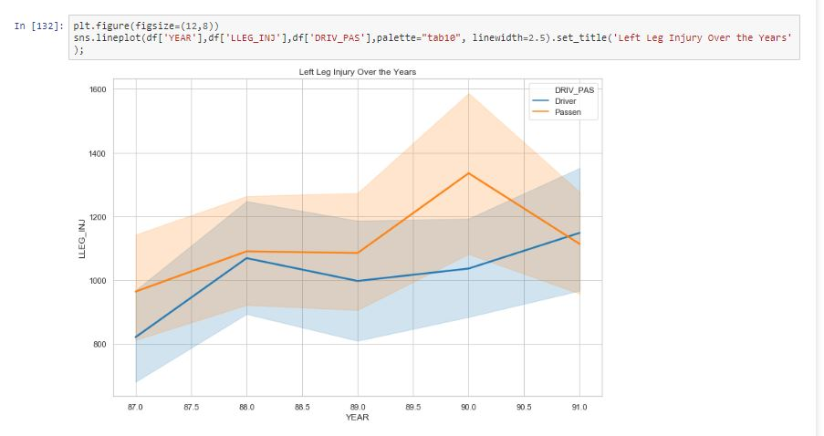
Graph for left leg injury to driver and passenger over the year

Slide 23
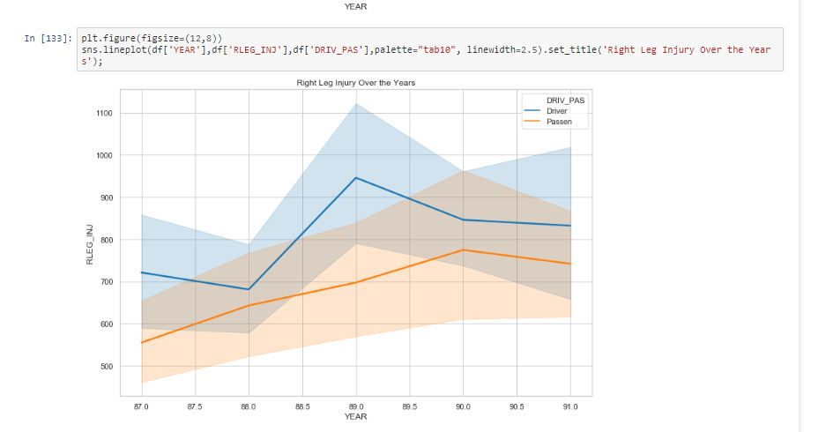
Graph for right leg injury to driver and passenger over the year

Slide 24
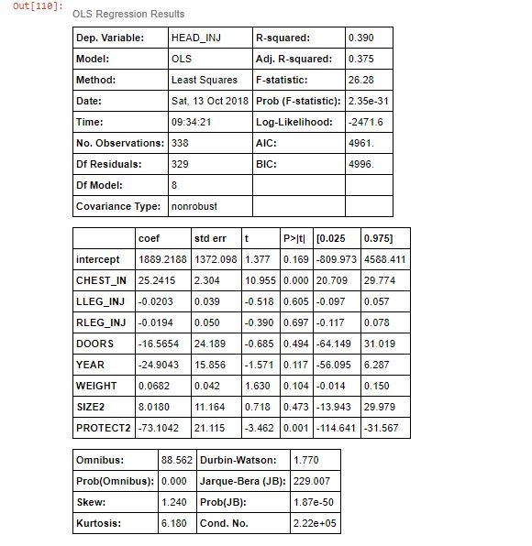
OLS Regression Result

