Slide 1

KIDS HIPPODROME
BY
RIHAN’S PROJECTIONS PVT.LTD
COFOUNDERS
Ms. J Niha Laxmi : 15251A1234 Ms. P Aparna Reddy : 15251A1251
Ms. Indu Reddy Pati : 15251A1252 Ms. P C Haritha : 15251A1254
Ms. L Shivani : 15251A1256 Ms. S Rishitha : 15251A1257

Slide 2

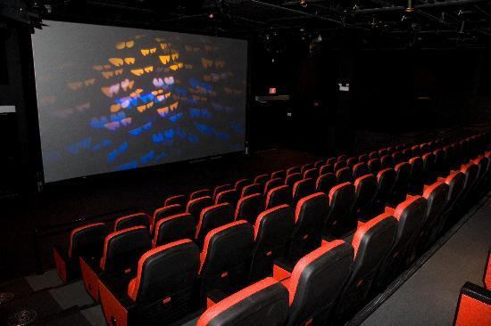
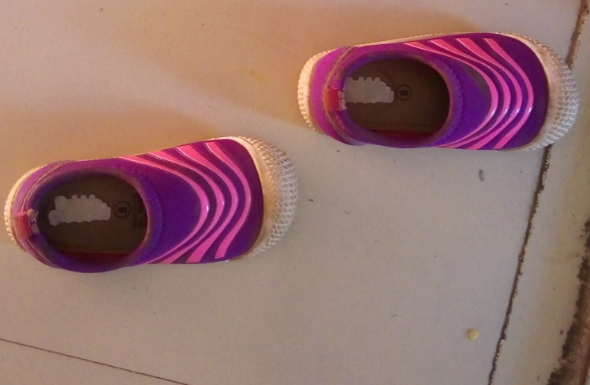
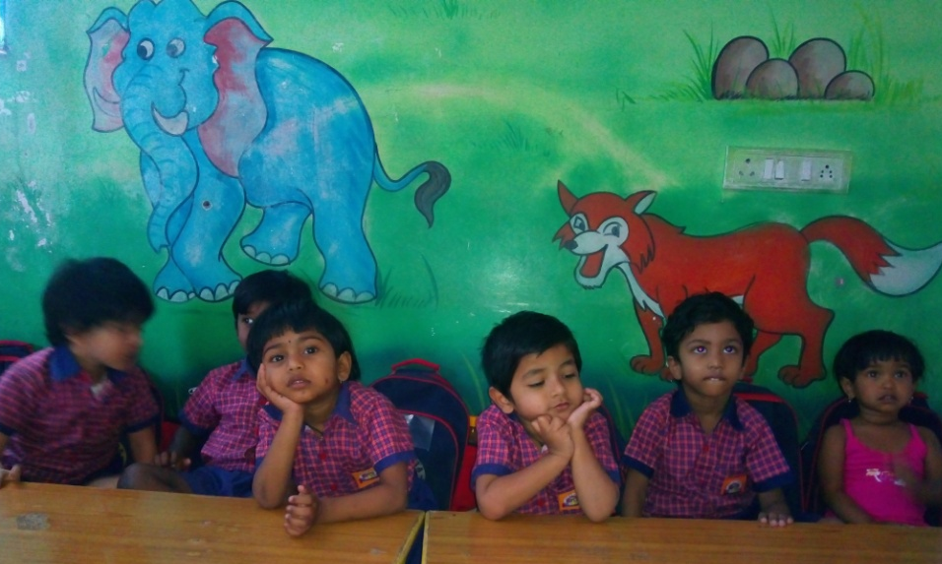
WHY KIDS HIPPODROME?
‘Be Job Creators Rather Than Job Seekers’
Fascinated towards kids.
Interest in animations.
Booming business.
Only few existing.
Plenty of scope for
development.

Slide 3
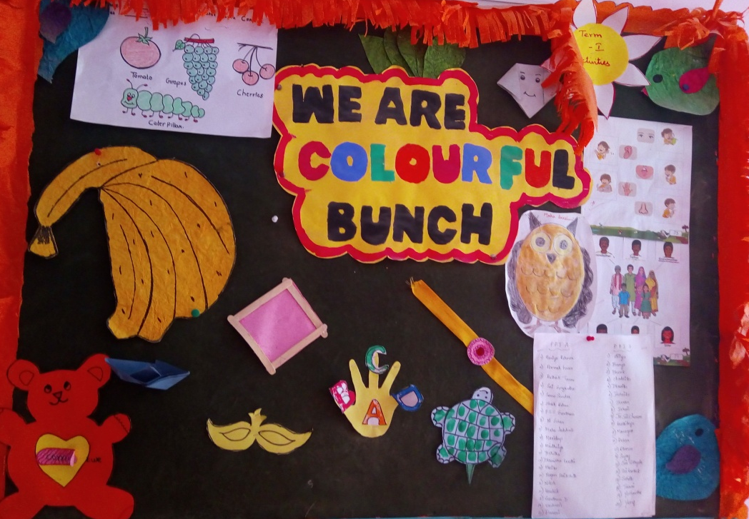
WHAT IS “KIDS HIPPODROME”?
A theatre or concert hall.
Draw the attention of play group kids.
Cultivate the imagination skills.
Ensures parents with the safe environment.

Slide 4
WHAT ARE OUR AIMS & OBJECTIVES?
To be seen for our superior management skills, professionalism, integrity and personal management involvement in all of our shows.
To treat every child with same level of commitment and attention.
To meet all the objectives the team members should have an appreciably high level of rapport with each other.
To be as eco friendly and energy efficient as possible.

Slide 5
WORK FLOW OF ORGANIZATION:-
Hiring of site layout for running theatre.
Preparation of theatre layout as per design and requirements.
Preparation of animated screenings as per behavior of kids.
Estimation of labor cost and contingencies.
Approval of animated screenings from Sensor Board of Film Certification.
Protection of Intellectual property (IP) rights to foster innovation

Slide 6
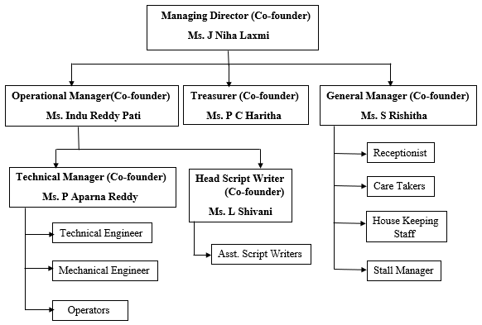
ORGANIZATION STRUCTURE:-

Slide 7
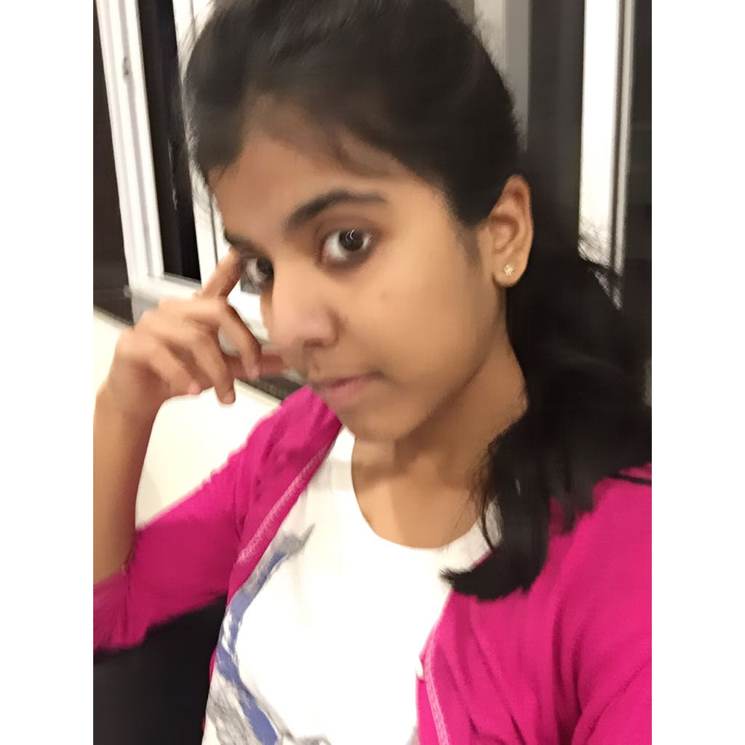
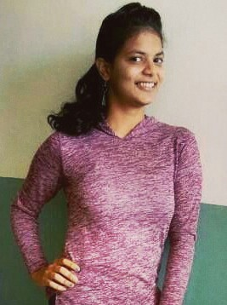
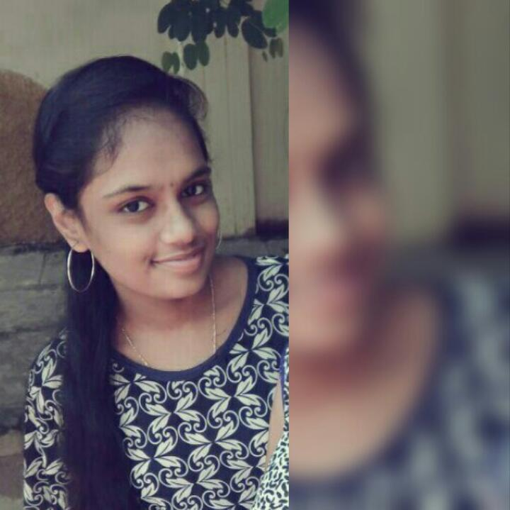
ROLES IN ORGANIZATION:-
Ms. J Niha Laxmi
Managing Director
Ms. S Rishitha
General Manager
Ms. P C Haritha
Treasurer
The MD is the most senior role in any company. Holds ultimate responsibility for the company's performance
Key partner in the development and implementation of Theatre's strategic plan.
The Treasurer has a watchdog role over all aspects of financial management, working closely with other members of the management committee to safeguard the organization’s finance.

Slide 8
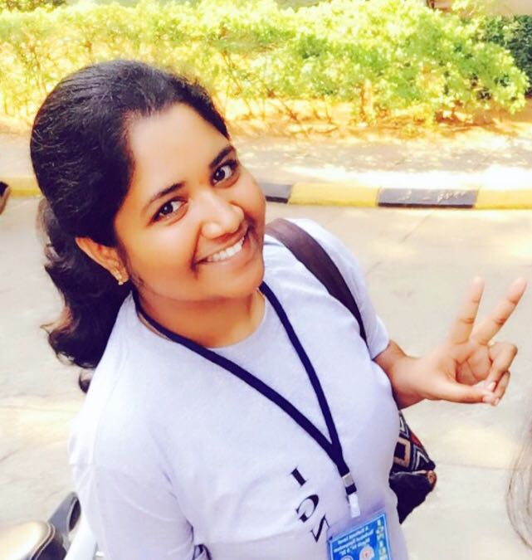
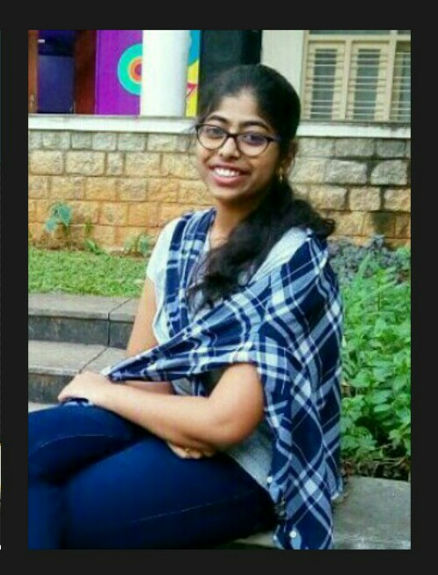
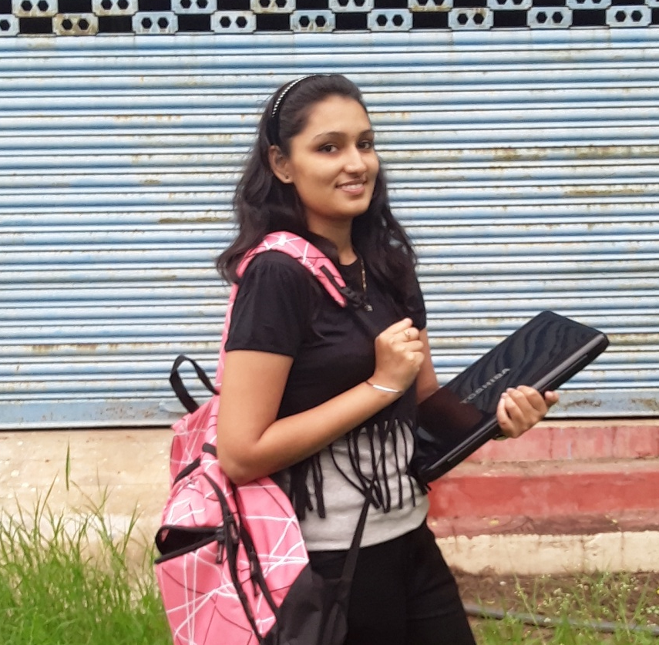
Ms. Indu Reddy Pati
Operational Manager
Ms. Aparna Reddy P
Technical Manager
Ms. Shivani L
Head Script Writer
Plays a senior role which involves overseeing the projection. Ensure efficient service that meets the needs of clients.
Plays Work closely with operational manager during all phases of development cycle. Also review all the work produced by development team.
Provides script for our own personalized story line for animated films. Selection of story. What will be the characters?

Slide 9



ACHIVEMENTS
Achieved recognition as
YOUNG ENTREPERNEURS.
Animated screening that are approved by GHMC to be screened at FORUM Mall is under progress.
There is no Third-party involvement in script writing.
“Unity is our Strength”.

Slide 10
CONCLUSION
Defines clear perception of capturing the mindset of kids.
Provides them with an amicable environment - both fun and learning .
Serves procreative approach of learning-visualizing is rendered for long-term.

Slide 11
CONCLUSION
Serves procreative approach of learning - visualizing is rendered for long-term.
Paves way transformative approach in educating the fragile minds of kids.

Slide 12
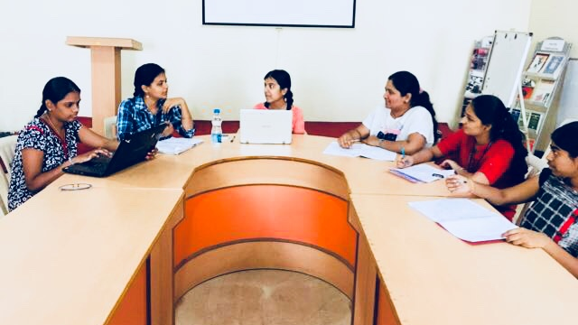
THANK YOU
FROM OUR TEAM
“RIHAN’S PROJECTIONS”

