Slide 1
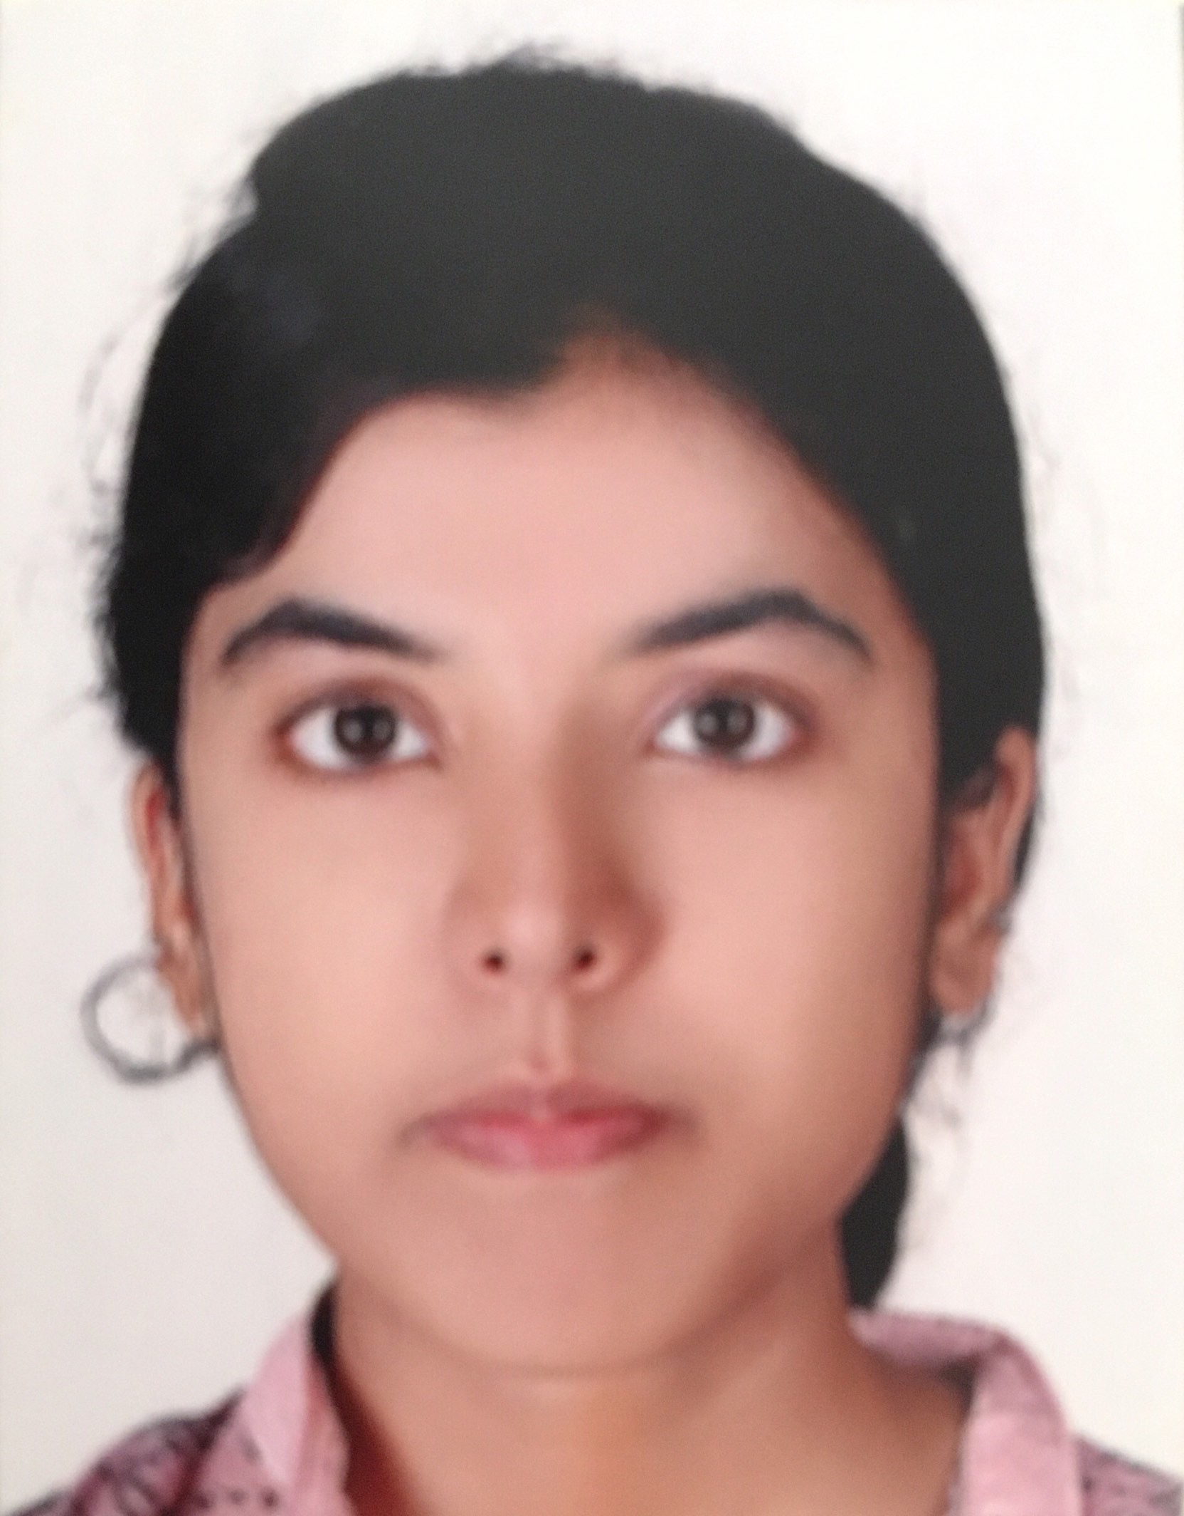
NIHALAXMI JAKKIDI
Analyst/software engineer
Email ID: nihalaxmi.j@capgemini.com
Mobile No: 9704982893
Grade: A4
EDUCATION & CERTIFICATES
Bachelor of Technology
Computer Science : 2015-19
PRACTISING DEVOPS
SKILLS
docker
kubernates
ansible
Terraform
Jenkins
Github actions
scripting[SHELL,YAML,PWSH]
AddOns
Maven
AWS
Additional Details
Excellent Communication Skills
Team player
PROJECTS
Implemented Ansible Server and triggered playbooks thru Jenkins and sent the build artifact to deploy on TOMCAT SERVER .
ANSIBLE PLAYBOOKS to ssh connections with remote hosts and triggering Jenkins jobs on them.
STRENGTHS:
Self driven learner with Front-End and Back-End knowledge. Passionate about implementing and launching new projects.
Ready to learn new technologies/Frameworks and implement them to further improve my knowledge.
A team player with good communication skill always ready to work for the enrichment of knowledge.

