Slide 1
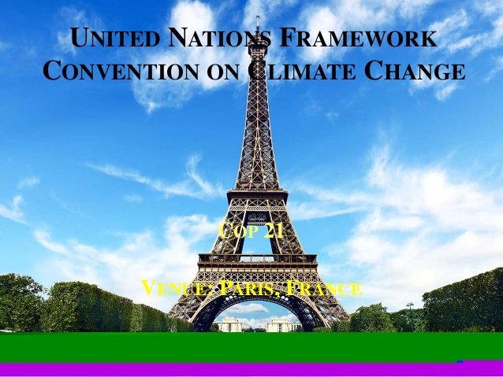

Slide 2
Recently the conference of Paris took place on outskirts of city at Le Bourget.
It was held on 30th december 205 to 2th december 2015.
Its held under UN body UNFCCC.

Slide 3
Due to concern of fate of mankind 196 countries had come together for global consensus to combat the menence of CLIMATIC CHANGE restricting the rise of temperature.

Slide 4
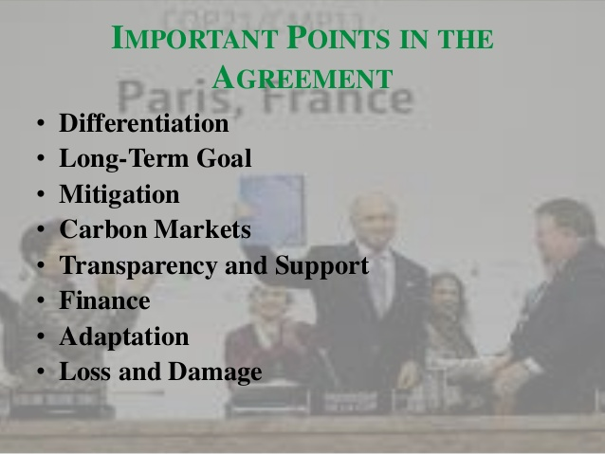

Slide 5
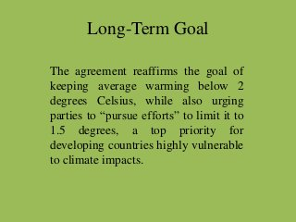

Slide 6
MITIGATION
To prepare, communicate and maintain a NDC(National Determined Contributions)
To provide information necessary for clarity and transparency and to communicate a new NDC every 5 years.

Slide 7
It sets the expectation that each successive NDC will represent a progression beyond its previous years and will represent a country’s highest ambitions.
The developed countries should strive against absolute reduction of economy-wide targets while developing countries are encouraged towards an economy-wide targets

Slide 8
FINANCE
The agreement commits the developed countries to provide mitigation and adaption for developing countries
The COP descision extends towards a 100-billion-$-year by 2025.

Slide 9
Biennially the developed countries should provide report on their support and adaption to help developing countries in terms of climatic finance.
In context of plans of least developed or developing countries,The Financial Mechanism of convention provide and support ready approvals.

Slide 10
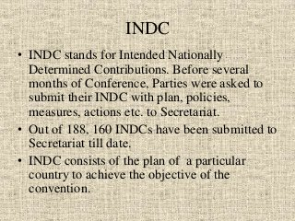

Slide 11
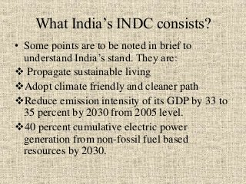

Slide 12
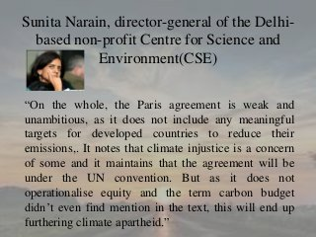

Slide 13
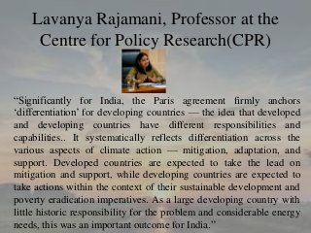

Slide 14
THANK YOU!

