Slide 1
Phonebook
Nick Rose
Michael Dessureault

Slide 2
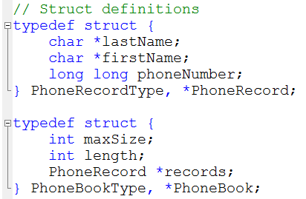
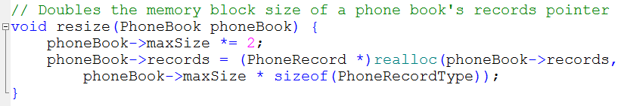
Data structure used
Array (Resizable)

Slide 3
Data structure used (cont’d)
Advantages
Fast O(1) insert at end during application start
As the number of records in the phonebook increases, this will likely be the most common operation of the program
Sorts in place
Simple memory requirement compared to a BST/Linked List (no node pointers necessary)
Disadvantages
Insert and delete (O(n)) at arbitrary locations is more expensive than a BST (O(logn)) or a Hash Table (O(1))

Slide 4
Data structure used (cont’d)
Operation | Time complexity
Insert at end | O(1)
Insert at arbitrary index | O(n)
Delete from end | O(1)
Delete from arbitrary index | O(n)
Sort | O(n logn)
Search for exact record | O(logn)
Search for partial record | O(n)

