Slide 1
NLP@IDC – Final Course Project, Spring 2013
By Ziv Levy & Shachar Langbehiem

Slide 2
Songs Genres Classification
Today, we usually define a song’s genre by its vocal elemnts – melody, instruments, etc.
We intend to find if we can define a genre simply through the lyrics – whether the written elements of songs contain significant genre information.

Slide 3
Why ?
Because its AWESOME!
Also, this is important to the study of literature & poetry – it could hint at a cognitive connection between melodies and ideas, and help us define the term “genre” and its meanings, thus grounding the study of literature & poetry in something a bit more robust than just personal taste & opinion.

Slide 4
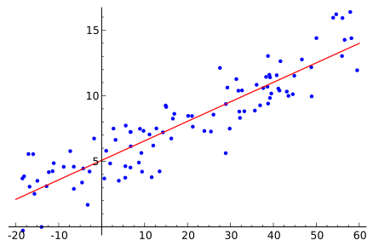
How? Logistic Regression
Logistic regression is a type of regression analysis used for predicting the outcome of a categorical dependent variable based on one or more predictor variables.

Slide 5
Variables
Words – we’ll examine how distinct is the vocabulary of each genre.
Structure – if time constraints will allow, we’ll examine whether genres also imply a certain structure on the lyrics.
Diversity – even if genres use the same words, do they repeat themselves (“Baby, baby, baby oooh”), or does each song contain a wider selection of words?

Slide 6
Limitations and Future Enhancements
Lyrics databases aren’t quality-controlled, don’t carry the same formats between songs (especially obvious with “censored” words, which can be written in different ways – S-it, Sh*t, *%#$, etc.)
No existing tree-banks on song lyrics, which limits us to low-level analysis.
No efficient data-mining tools – either we create them, or we hand-create all of our data-sets.

Slide 7
Thank You!

