Slide 1
NLP@IDC – Final Course Project, Spring 2013
By Ziv Levy & Shachar Langbehiem

Slide 2
Songs Genres Classification
The Problem:
While we’re given some song, we would like to analyze its lyrics in order to determine and classify its genre
And in more simple form:
Input: Song lyrics
Output: The song’s genre

Slide 3
Why ?
Because its AWSOME!

Slide 4
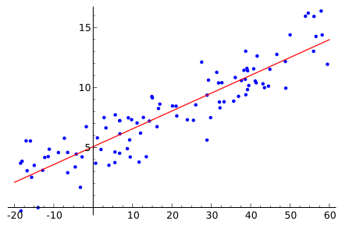
How? Logistic Regression
Logistic regression is a type of regression analysis used for predicting the outcome of a categorical dependent variable based on one or more predictor variables.

Slide 5
Limitations and Future Enhancements
Sometimes words are rated (censored). Unfortunate, words will be rated with different annotations such as: - sh*t sh–t or maybe… s*it What can we do?

Slide 6
Thank You!

