Slide 1
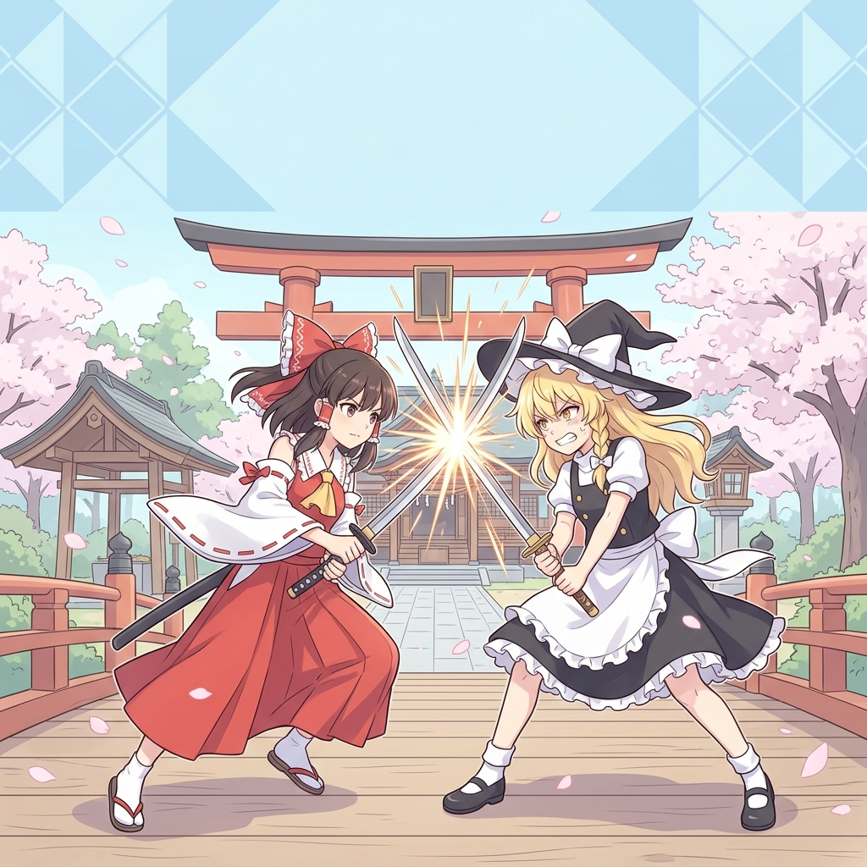
Arcane Souls: Rebirth
Group: AIGEN | Lee Chun Kit & Lam Chi Him Advisor: Jussi Pekka Holopainen | SM4712B (LA2) City University of Hong Kong — School of Creative Media
Phase II Final Presentation | April 2026
* Background artwork: AI-generated

Slide 2

Agenda
01 Introduction & Problem Statement
02 Objectives
03 What We Built (Deliverables)
04 System Architecture
05 Boss AI & Perilous Attack System
06 VRM Character Pipeline
07 Results & Evaluation
08 Challenges & Solutions
09 Conclusion

Slide 3
Introduction
Why does this game matter?
The Problem
Our Solution
• Souls-like genre is growing but few combine: anime visuals + deep posture combat • Small indie teams lack scalable pipelines for VRM anime characters in UE5 • No existing project merges Sekiro-style posture mechanics with stylized UE5 workflow
• Arcane Souls: Rebirth — Sekiro-inspired 3D action game • Built in Unreal Engine 5.5 with C++ • Touhou Project anime characters (Reimu, Patchouli) via VRM4U plugin • Full posture / parry / perilous attack loop

Slide 4
Objectives
🎨 Creative
⚙️ Technical
🎯 Performance
▶ Cohesive anime aesthetic
▶ 4-frame (67ms) parry window
▶ 60 FPS @ 1080p (GTX 1660S)
▶ Cinematic stylized visuals
▶ Lumen global illumination
▶ Input latency < 100 ms
▶ Touhou character designs
▶ Behavior Tree boss AI
▶ p95 frame time < 20 ms
▶ Niagara VFX for combat

Slide 5
What We Built
Phase II Deliverables — all ✅ delivered
✅ Playable Vertical Slice
✅ Player Character (Reimu)
Full game: player + boss + arena environment
VRM model, IK-retargeted combat animations
✅ Boss (BP_SekiroEnemy)
✅ Combat System (C++)
4 standard attacks + 2 perilous attacks
Posture, deflection, deathblow execution
✅ Boss AI
✅ Boss Arena Level
Behavior Tree + randomized attack selection
Shrine-themed with Lumen lighting
✅ HUD/UI System
✅ Source Code
Health, posture, lock-on, perilous warning
C++ + Blueprints + Python automation

Slide 6
System Architecture
Component-based C++ design shared by player & boss
ASekiroCharacter (C++ Base Class)
USekiroPostureComponent
→ Posture accumulation & break
USekiroDeflectComponent
→ Parry window timing (4 frames)
USekiroCombatComponent
→ Attack combos & hit detection
USekiroAttributeComponent
→ Health, damage, death
USekiroEnemyAttributeComponent
→ Boss: montage pools & perilous
Behavior Tree + AI Controller
→ Boss decision-making

Slide 7
Boss AI & Perilous Attack System
Behavior Tree Structure
⚠ Perilous Attack: Unblockable
Root (Selector)
• 「危」kanji warning displayed on screen • Cannot be blocked — must DODGE • Two types: Great Sword Slash + Upward Thrust • Probability: PerilousChance (default 25%)
├── [IsAlerted=true]
│ └── Sequence: Combat
│ ├── Move To Player
│ └── Select Attack
│ ├── 75%: Standard Combo
│ │ (4 montages, random)
Standard Attacks
│ └── 25%: Perilous Attack
│ (2 montages, random)
▸ Heavy Slam — High dmg, long windup, blockable
└── Sequence: Idle/Patrol
├── Wait (2–4 sec)
▸ Quick Sweep — Medium dmg, short windup, dodge
└── Random move
▸ Forward Thrust — Medium dmg, parryable
▸ Two-Hit Combo — Delayed second hit

Slide 8
VRM Anime Character Pipeline
How we put Reimu and Patchouli into UE5
VRM File
VRM4U Plugin
IK Retargeter
AnimBlueprint
In-Game
Touhou Project Reimu / Patchouli (.vrm model)
Import into UE5 Auto-generates Skeleton + Materials
RTG__魔_博麗_霊夢 Mannequin → VRM bone mapping
ABP_reimu_C Realtime animation transfer
Full combat anims on anime character at 60 FPS
→
→
→
→
Key Challenges:
Rest pose mismatch (VRM A-pose vs Mannequin T-pose) → Fixed Retarget Pose in IK Retargeter Weapon attached to Mannequin bone → Runtime re-attachment to VRM 「右手首」bone at BeginPlay

Slide 9
Combat System Deep Dive
Posture · Deflect · Deathblow
🛡 PARRY / DEFLECT
💀 POSTURE BREAK
⚔ COMBAT LOOP
• Fixed 4-frame window (≈67 ms @ 60 FPS)
• Posture accumulates when blocking attacks
• Engage → Attack pattern (BT selects)
• Perfect Parry → posture dmg to ATTACKER
• Posture breaks → stagger state
• Player parries → builds boss posture
• Late block → posture dmg to DEFENDER
• Staggered boss: DEATHBLOW prompt appears
• Posture break → execute deathblow
• No input → direct health damage
• Posture recovers slowly when not hit
• Repeat (boss has multiple HP bars)

Slide 10
Results & Evaluation
Performance Metrics
Playtest Results (n=5)
Metric
Target
Achieved
Level
Parry%
Deaths
Feedback
FPS @ 1080p (GTX 1660S)
≥ 60 FPS
✅ Stable 60 FPS
Souls beginner
28%
8
Warning clear
p95 Frame Time
< 20 ms
✅ ~17 ms
Souls beginner
35%
6
Blocking responsive
Input Latency (parry)
< 100 ms
✅ ~67 ms (4 frames)
Casual gamer
22%
12
Visual feedback helps
Asset Load Time
< 5 sec
✅ ~3 sec
Sekiro veteran
58%
2
Parry feels fair
Sekiro veteran
65%
1
Perilous adds variety

Slide 11
Challenges & Solutions
VRM Forward Lean
REST POSE
✅ Fix: Edited Retarget Pose in IK Retargeter to correct spine/pelvis rotations
Problem: Rest pose mismatch: VRM A-pose vs UE5 T-pose
Weapon Wrong Position
BONE MAPPING
✅ Fix: Runtime re-attachment to 「右手首」 (right hand) VRM bone at BeginPlay
Problem: Weapon on Mannequin hand_r, not VRM hand bone
Boss T-Pose Attack
CDO vs INSTANCE
✅ Fix: Re-assigned ABP_SekiroEnemy_New and re-spawned actor to inherit updated CDO
Problem: AnimBP class assignment lost on Blueprint instance
Perilous Not Firing
CDO MISMATCH
✅ Fix: Deleted and re-spawned boss to inherit correct default values
Problem: CDO vs Instance data mismatch after Blueprint edit
FBX Import Hijacked
PLUGIN CONFLICT
✅ Fix: Temporarily disabled VRM4U plugin for animation imports only
Problem: VRM4U intercepted ALL FBX imports globally

Slide 12
Live Demo / Video
▶ GAME DEMO
① Player movement + lock-on system
④ Perilous attack: 「危」warning appears
② Boss attack patterns (4 standard)
⑤ Dodge dodges the unblockable hit
③ Parry → Posture break → Deathblow

Slide 13
Conclusion & Lessons Learned
✅ What Went Well
⚠ What Could Be Better
• Modular C++ component architecture — reusable between player & boss
• IK retargeting quality — minor artefacts in extreme poses
• VRM4U → IK Retargeter pipeline — reproducible for future projects
• Content scope — planned 2 levels, delivered 1 boss arena
• Behavior Tree + probability attack — easy designer tuning
• No automated unit tests for combat calculations
• 60 FPS stable — met all performance targets
• Stricter branch/PR workflow to avoid merge conflicts
🔑 Key Contributions
1. Reproducible VRM → UE5 character integration pipeline
2. Modular C++ posture-based combat architecture applicable to other projects
3. Practical patterns for combining anime visuals with responsive action combat in UE5

Slide 14
Thank You · References & AI Ethics
Questions & Discussion Welcome 🙏
Lee Chun Kit (57306141) · Lam Chi Him (57185861) · SM4712B | AIGEN | April 2026
📚 References
[1] Epic Games. (2024). Unreal Engine 5 Documentation. docs.unrealengine.com
[2] FromSoftware. (2019). Sekiro: Shadows Die Twice. Activision Blizzard.
[3] Team Shanghai Alice (ZUN). (1996–2024). Touhou Project. Self-published.
[4] ruyo. (2024). VRM4U: VRM importer plugin for UE5. github.com/ruyo/VRM4U
[5] Gregory, J. (2018). Game Engine Architecture (3rd ed.). CRC Press.
⚙ AI Ethical Usage Statement
• AI was used as a learning consultant only — never as a code generator or blueprint drafter.
• Blueprint nodes: We never let AI drag or wire connections. We asked AI to explain the concept,
then implemented every node and connection ourselves inside the UE5 editor.
• Hard bugs: e.g. skeletal mesh IK mismatch & AnimNotify timing — AI explained the root cause;
all fixes were designed and applied manually in C++ and the UE5 editor by team members.
• All source code, asset pipelines, and design decisions are fully original team work.
leechunkit01255210.wixsite.com/e-portfolio | nihonjin864.wixsite.com/lamchihim

