Slide 1
Predicting PM2.5 in Karaganda, Kazakhstan
Eleven machine-learning algorithms, ten-fold validation, four years of daily data
Course: Artificial Intelligence and Machine Learning, Astana IT University
Case Study Task 1 and the research article, combined into one project
Data: Kazhydromet bulletins 2021-2026, CAMS and ERA5 reanalysis, 1503 modelled days

Slide 2
The problem
- Karaganda is first among 70 monitored settlements of Kazakhstan, and recorded 244 of the country's 337 high-pollution episodes in the first half of 2026
- Two competing explanations, with very different policy consequences:
- Emissions - respond with fuel substitution and industrial regulation, over a decade
- Dispersion - respond with episode forecasting and heating-load management, within a season
- Separating them needs daily data and a model, not annual averages
- Complication: the whole national ranking rests on two instruments in one district
- The calendar alone barely helps: the repeatable annual cycle is only 6.3 % of daily variance, against 89 % synoptic weather

Slide 3
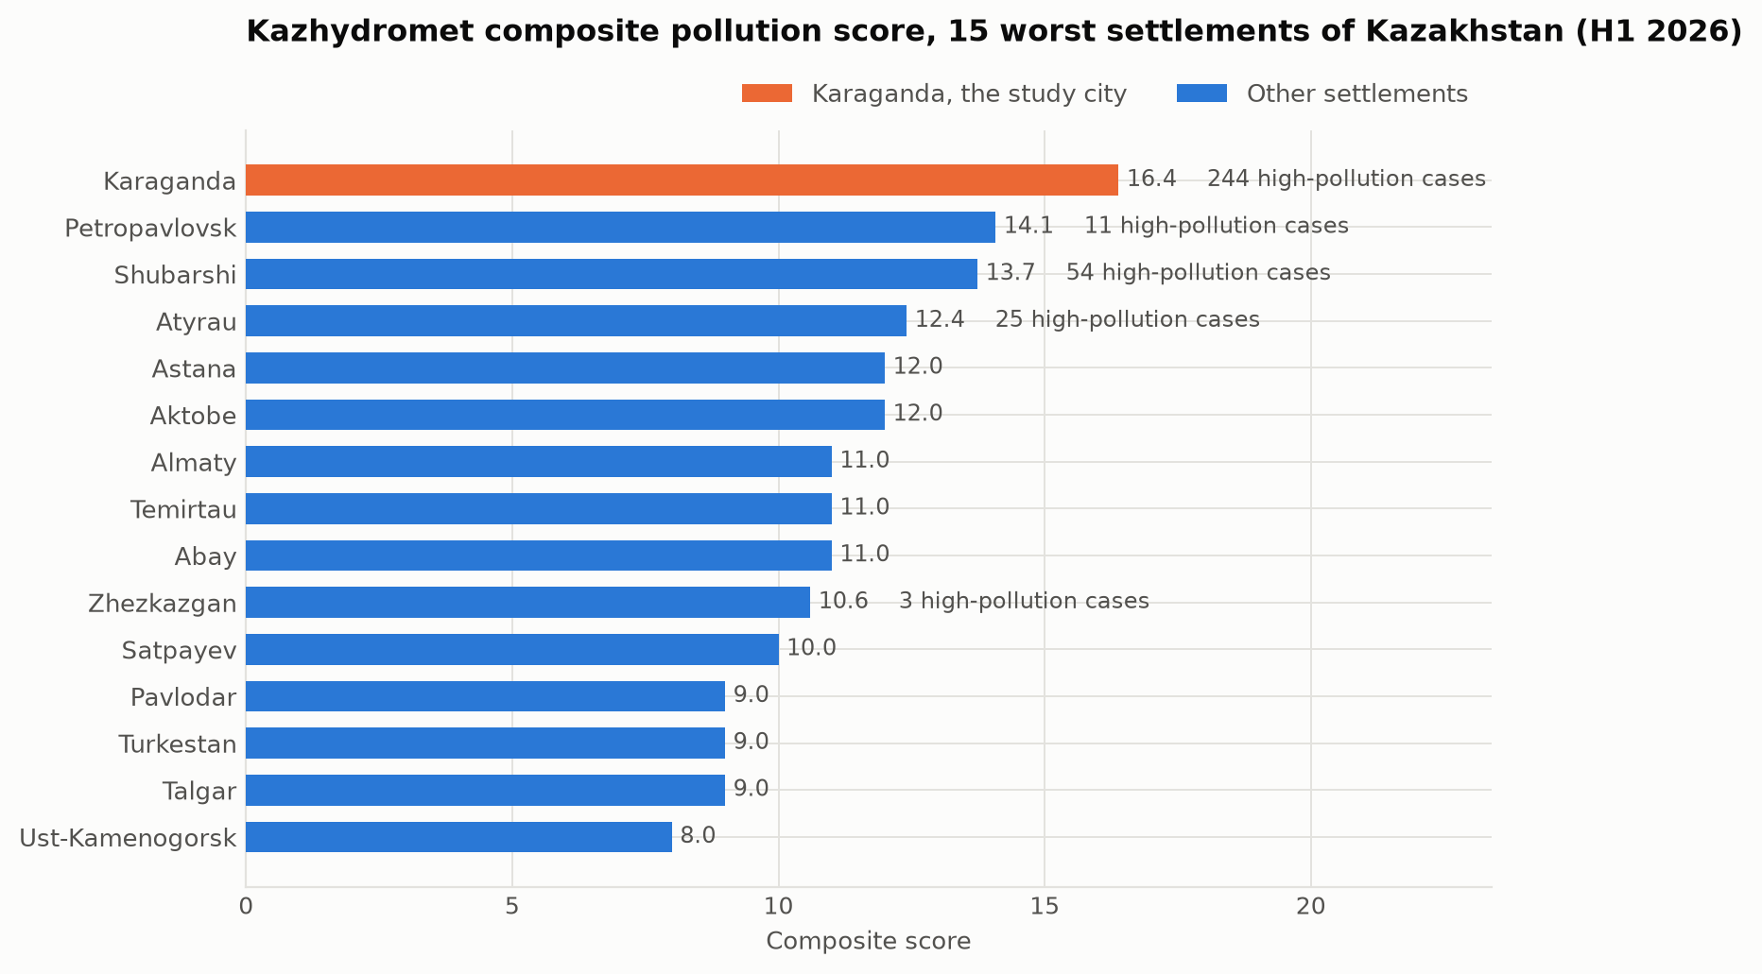
Karaganda leads the national ranking
Kazhydromet composite score, first half of 2026. Four of the fifteen worst settlements are in the Karaganda region; Almaty ranks seventh.

Slide 4
Literature: what is already established
- Coal combustion dominates Kazakh winter emissions - confirmed by the COVID-19 lockdown natural experiment, where winter peaks survived a collapse in traffic (Baimatova et al., 2022)
- Mixing depth is a first-order control on surface PM2.5 in Almaty (Tursumbayeva et al., 2022) - but Almaty is a mountain basin, Karaganda is flat steppe
- Source apportionment resolves coal, secondary aerosol and industry as leading contributors across Kazakh cities (Tursun et al., 2025)
- Boosted tree ensembles consistently outperform alternatives for PM2.5 prediction (Aman et al., 2025; Makhdoomi et al., 2025)
- Gap: no study covers Karaganda, the worst-ranked settlement in the country

Slide 5
Data and features
Source | What it gives | Coverage
Kazhydromet bulletins | 15 substances, 169 episode days, 105 emitters | 24 periods, 2021-2026
CAMS reanalysis | Daily PM2.5, PM10, NO2, SO2, CO, O3 | 1503 days, 40 km cell
ERA5 reanalysis | Temperature, wind, pressure, mixing depth | 2083 days
National bulletins | Composite ranking of 70 settlements | 2025-2026
Target: daily mean PM2.5. 21 predictors, no pollutant among them.
Engineered: ventilation index (wind x mixing depth), heating degree days, circular sine/cosine encodings of wind direction and day of year.

Slide 6
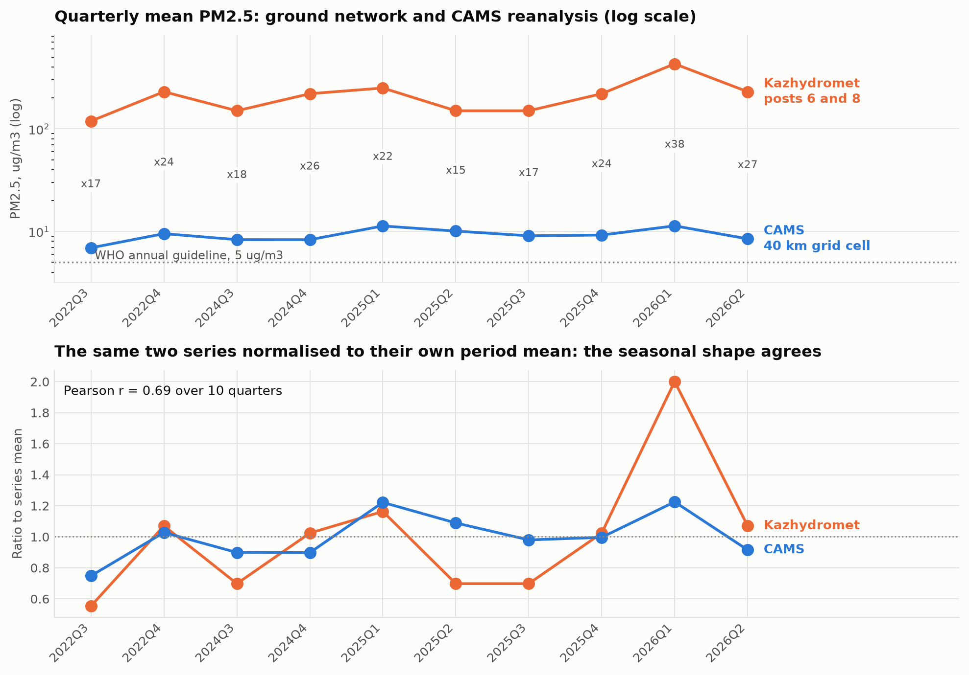
The two data sources disagree by 20x
Ground network 119-430 ug/m3, reanalysis 6.9-11.3 for the same quarters. Normalised, they track each other at r = 0.69.

Slide 7
Reconciling them
- The 40 km reanalysis cell averages the city with open steppe - it must underestimate an urban plume
- The ground posts sit in Prishakhtinsk next to coal-burning housing, and report a PM2.5/PM10 ratio of 0.90-1.00 against a normal urban 0.5-0.7 - the instrument is not resolving the fractions
- An independent commercial estimate for 2024 sits near 105 ug/m3, midway on a log scale
- Conclusion: the true annual mean is between roughly 30 and 150 ug/m3, that is 6 to 30 times the WHO guideline
- Timing is trustworthy, absolute level is not - so every claim about level is stated as a range

Slide 8
Table 1: eleven algorithms, ten-fold validation
Algorithm | RMSE, ug/m3 | R2
Ridge / Lasso / Elastic Net | 4.64 - 4.66 | 0.32
KNN Regression | 4.39 | 0.40
Adaptive Boosting (AdaBoost) | 4.89 | 0.22
Gradient Boosting | 3.79 | 0.53
HistGradientBoosting | 3.75 | 0.54
LightGBM | 3.73 | 0.54
Extra Trees | 3.72 | 0.55
XGBoost | 3.66 | 0.56
**CatBoost** | **3.59** | **0.587**
Mean baseline | 5.74 | -0.01

Slide 9
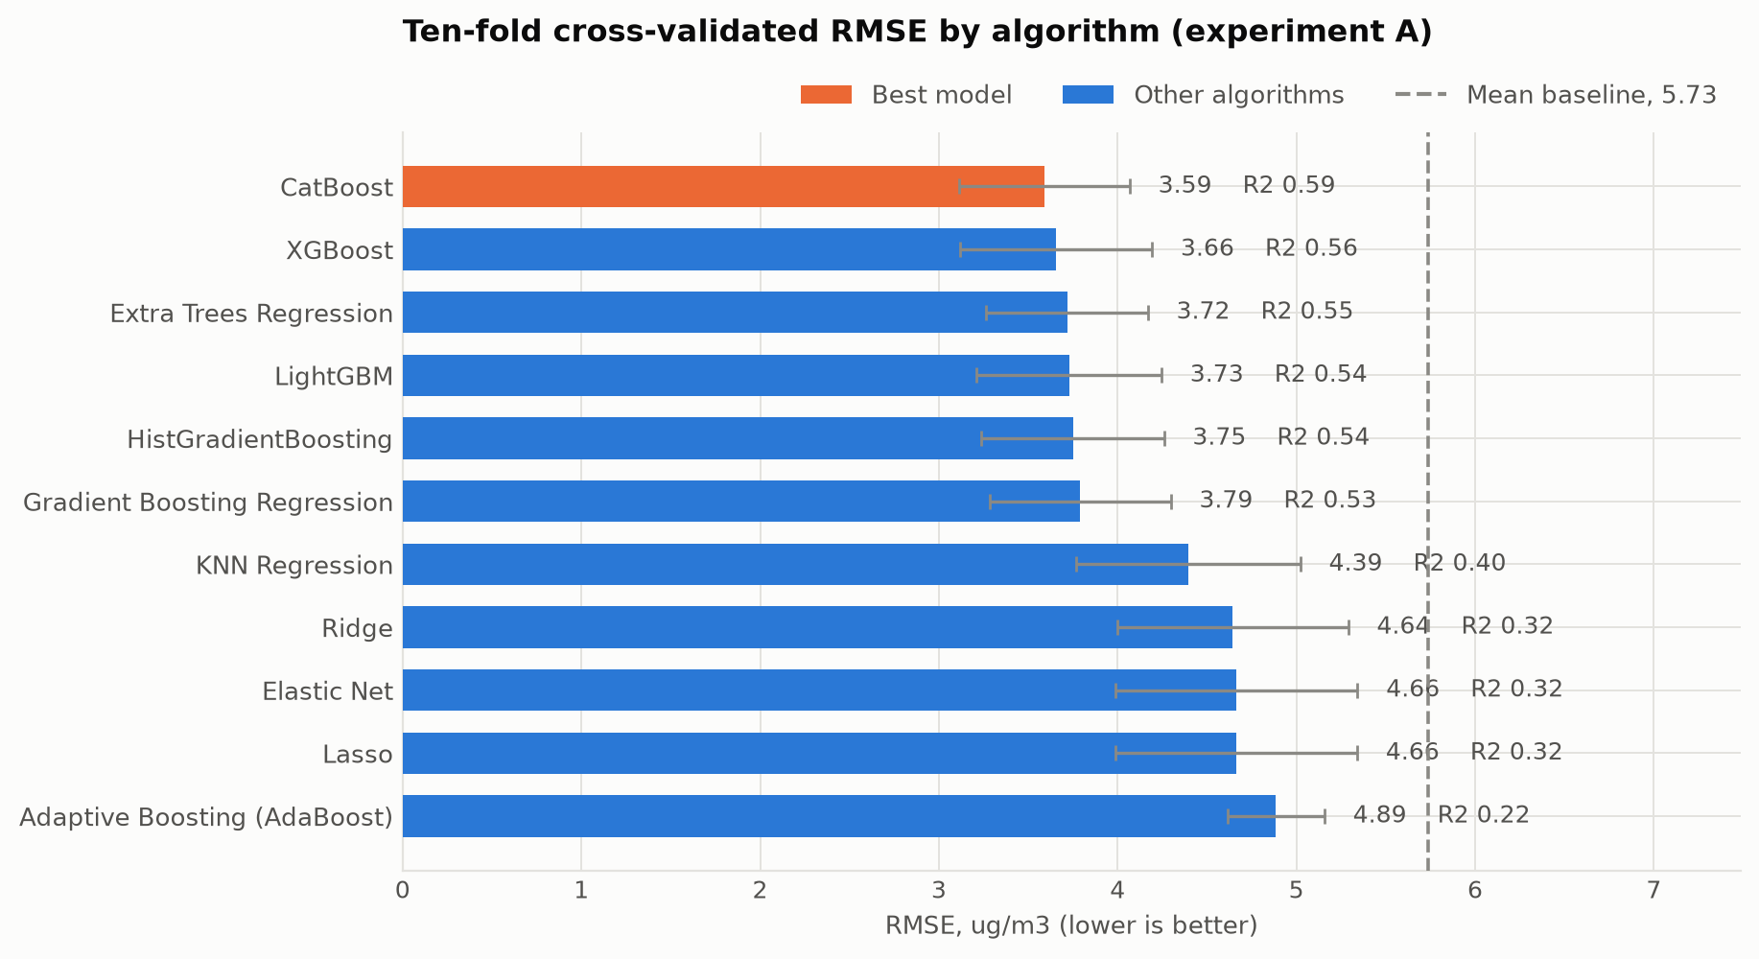
Ensembles beat linear models by 0.26 in R2
Ten-fold cross-validated RMSE. The gap between the tree ensembles and the linear models is the quantitative statement that the relationship is non-linear.

Slide 10
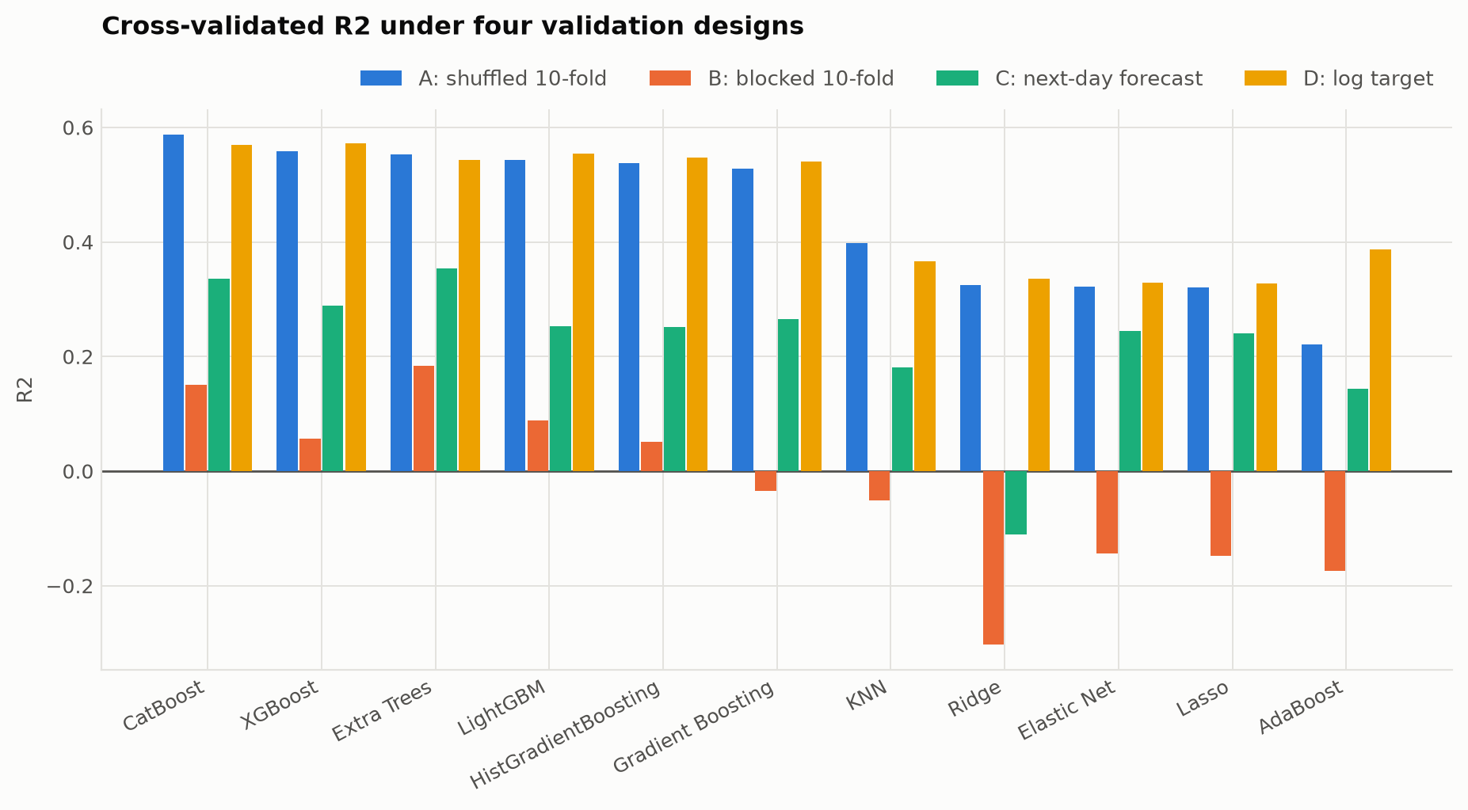
The methodological finding: shuffling inflates the score
Four validation designs. Blocked chronological validation cuts the best R2 from 0.587 to 0.184.

Slide 11
Why that matters
- A shuffled 10-fold split puts days from the same weather episode on both sides of the partition - the target has a lag-1 autocorrelation of 0.609
- Measured against the matching baseline, skill falls from a 37.4% error reduction to 21.3%
- About two fifths of the apparent skill is an artefact of the validation design
- Adding lagged pollutant history restores it to 29.5% in a genuine next-day forecast
- Fitting on log(PM2.5) barely changes the ranking, so the result is not an artefact of target skew
- Takeaway: report the shuffled score as an upper bound; the blocked check costs one extra run

Slide 12
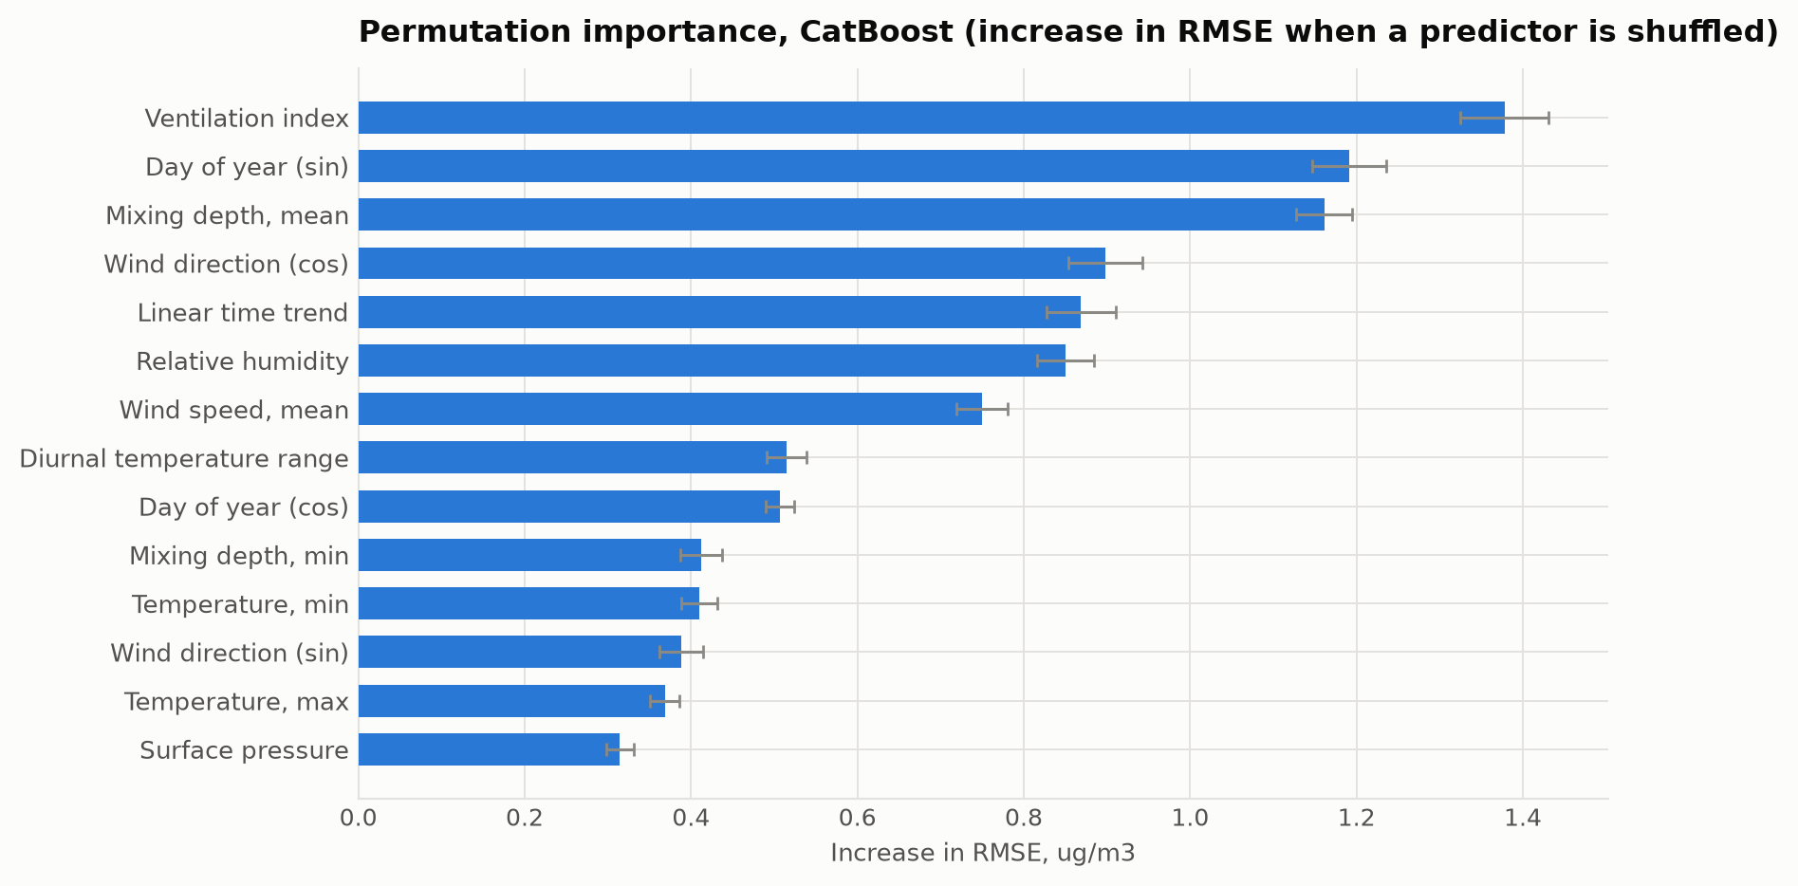
What the model learned - and an independent check
Permutation importance: the ventilation index outranks both of its own constituents.

Slide 13
Measured episodes confirm the mechanism
Heating-season median | Ordinary days | High-pollution days
Mean temperature, C | -4.5 | -11.1
Mean wind speed, km/h | 16.4 | 8.3
Minimum mixing depth, m | 135 | 30
Surface pressure, hPa | 956.8 | 961.8
The two variables the model relies on most are the two that separate 169 instrument-measured episodes from ordinary days.
High pressure, hard frost, calm, a mixing layer tens of metres deep: a textbook surface inversion. Flat steppe traps pollution as effectively as Almaty's mountain basin.

Slide 14
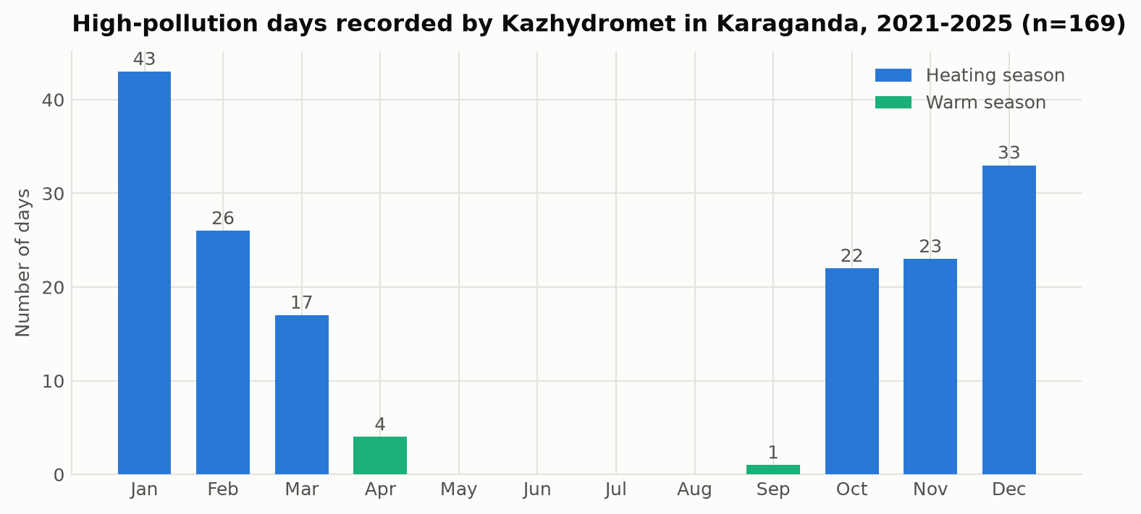
The season sets the level, the weather picks the day
169 measured high-pollution days by month, 2021-2025. Sixty per cent fall in December, January and February, none at all between May and August - yet within the cold season the annual cycle explains only 6.3 % of daily variance and the weather 89 %.

Slide 15
Recommendations
- Now: build an episode forecasting service - free data, open-source tools, roughly 30% error reduction. Trigger: forecast wind below 8 km/h with mixing depth below 50 m in the heating season
- Now: deploy 20 calibrated low-cost sensors. Karaganda has 2, Almaty has 153. This resolves more uncertainty than any further analysis of the existing record
- Now: fix the reference instruments - the PM2.5/PM10 ratio anomaly undermines the numbers the national ranking rests on
- 3-5 years: target domestic coal burning in Prishakhtinsk; regulate ash and volatile content of household coal; require continuous stack monitoring at the largest emitters
- 5-10 years: decarbonise heat supply, preserve ventilation corridors, converge national limits towards the WHO guidelines

Slide 16
Conclusions and future work
- Meteorology and season explain 58.7% of daily PM2.5 variance; CatBoost is best at RMSE 3.59 ug/m3
- The calendar alone explains 8%, so nearly all of that signal is weather, not season
- Karaganda has an emission problem expressed through a dispersion bottleneck - emissions run year-round, the winter anticyclone converts them into episodes
- The ventilation index is the dominant predictor, confirmed independently by 169 measured episodes
- Validation design is not a detail: shuffled 10-fold overstates generalisation by roughly two fifths on this data
- Limitations: the target is a reanalysis, not a measurement; the model underpredicts above 20 ug/m3
- Future work: kilometre-scale satellite PM2.5 to resolve the urban plume; a quantile objective calibrated on the upper tail that an early-warning system actually needs
- Reproducible end to end: four scripts, no API keys, no manual steps, each ending in assertion-based self-checks that fail loudly rather than emitting wrong numbers silently
- One data defect found and documented in KNOWN_ISSUES.md rather than quietly worked around
Thank you. Questions?

