Slide 1
Air Pollution in Karaganda, Kazakhstan
Case Study Task 1
Data: Kazhydromet bulletins 2021-2026, ERA5 and CAMS reanalysis 2021-2026
Question: why is Karaganda the most polluted city in Kazakhstan, and what can be done about it?

Slide 2
Problem statement
- Karaganda is first among 70 monitored settlements of Kazakhstan by the official Kazhydromet score
- It recorded 244 of the country's 337 high-pollution episodes in the first half of 2026, that is 72 %
- Coal mining, coal chemistry, ferroalloys, and half a million people heating their homes with coal
- Two competing explanations, with very different price tags:
- Too much is emitted - fix with fuel substitution and industrial regulation, over a decade
- It does not disperse - fix with episode forecasting and heating-day restrictions, within a season
- This study separates the two using five years of official data

Slide 3
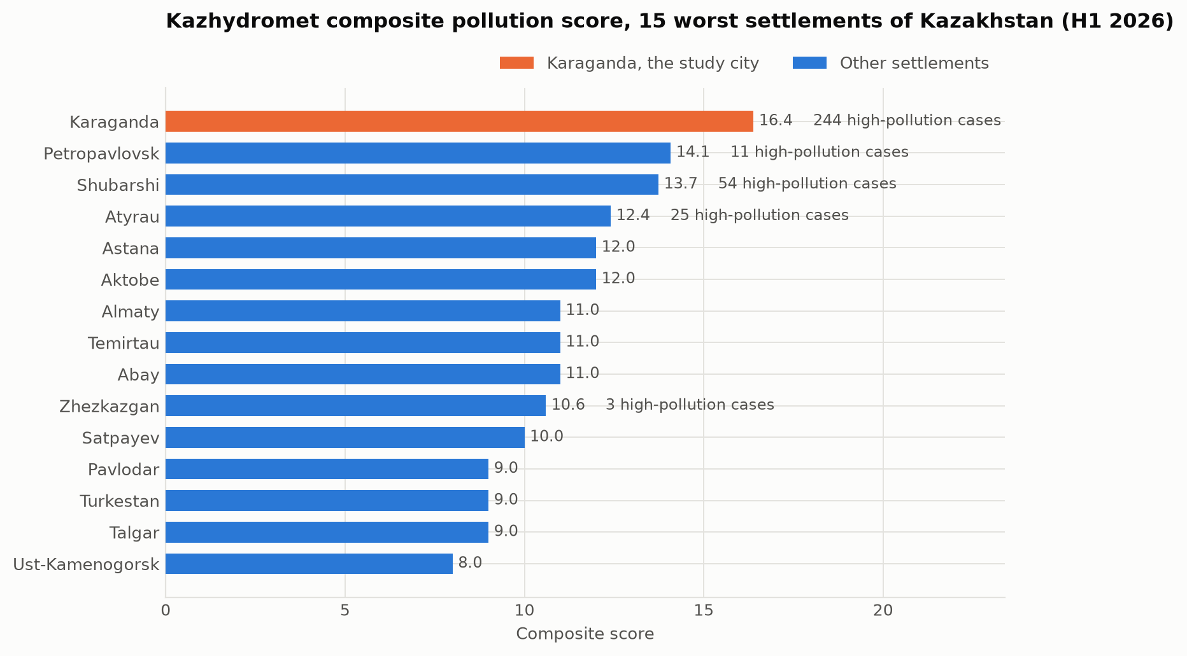
Karaganda leads the national ranking
Composite pollution score, Kazhydromet, first half of 2026. Almaty, which gets most of the public attention, is only seventh.

Slide 4
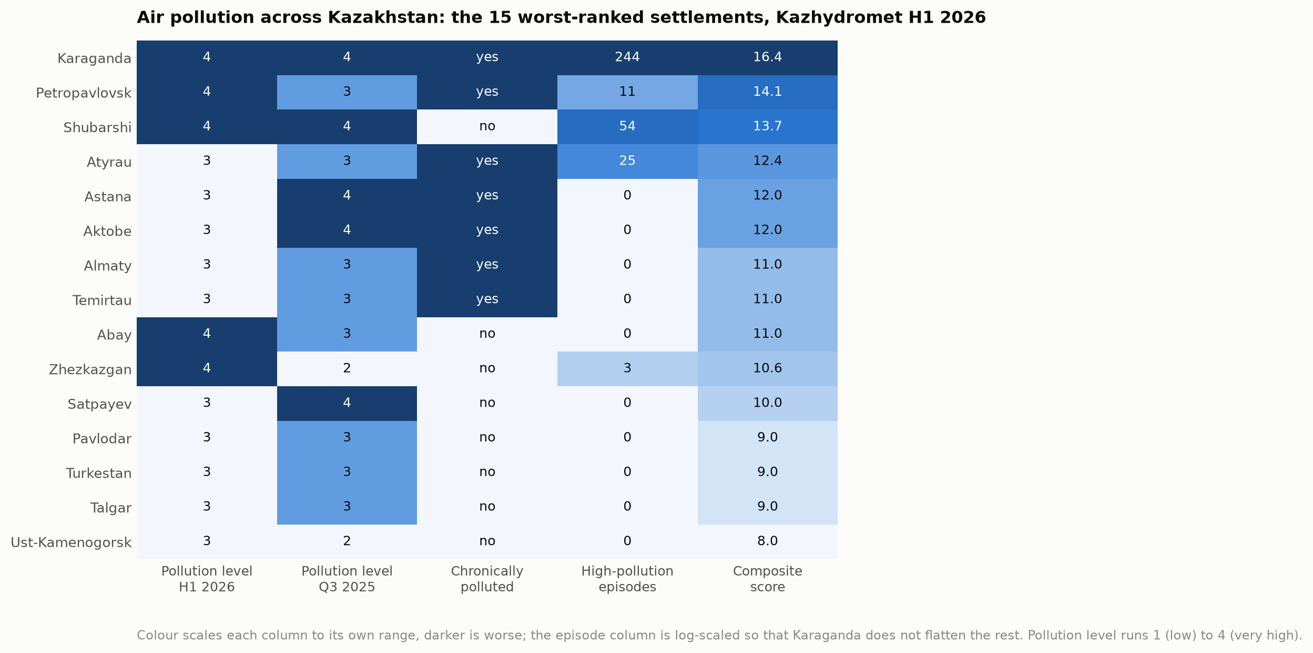
It is worst on every indicator at once
Fifteen worst settlements across five indicators. Several cities match Karaganda on one; none matches it on all five.

Slide 5
Data used
Source | What it gives | Coverage
Kazhydromet regional bulletins | 15 substances, 169 episode days, 105 emitters | 24 periods, 2021-2026
Kazhydromet national bulletins | Ranking of 70 settlements | H1 2026
ERA5 reanalysis | Temperature, wind, pressure, mixing depth | 2083 days
CAMS reanalysis | PM2.5, PM10, NO2, SO2, CO, O3 | 1503 days
All four are public and free. Bulletins were parsed from PDF; the reanalysis came from the Open-Meteo API.
Caveat stated up front: ground posts report 119-430 ug/m3 where the reanalysis reports 6.9-11.3. Normalised, the two agree at r = 0.69. Timing is reliable, absolute level is not - so every level in this report is given as a range.

Slide 6
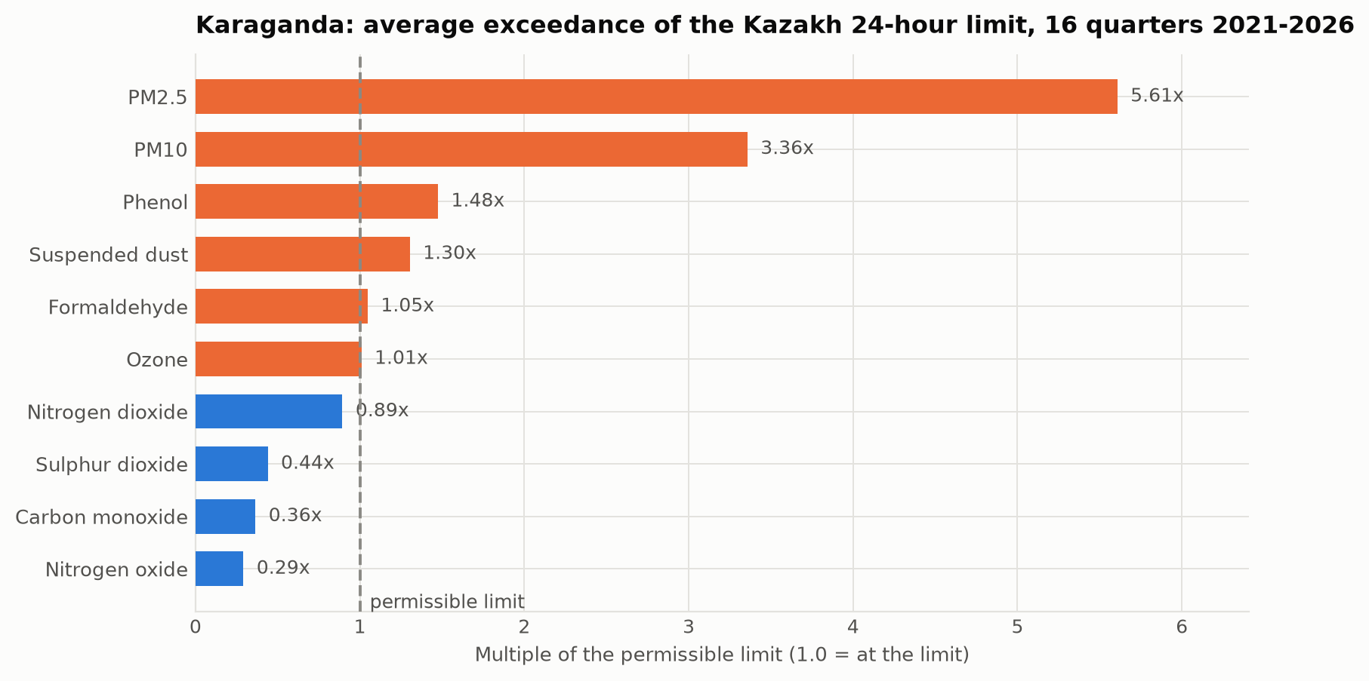
Key finding 1: it is a particulate problem
Average exceedance of the Kazakh 24-hour limit, 16 quarters. PM2.5 is 5.6 times over; the tall-stack gases are under.

Slide 7
Key finding 1, in numbers
- PM2.5 averages 5.6x the Kazakh 24-hour limit, one measurement hit 40.9x the short-term limit
- 100 % of samples have been above the limit since 2022
- PM10 follows at 3.4x; phenol is the only gas with a constant exceedance, pointing at coal chemistry
- SO2, NO2 and CO stay below their limits - that is the signature of low-level sources, not tall stacks
- Against the WHO guideline of 5 ug/m3 a year, Karaganda runs at 6 to 30 times over, depending on which of the two badly reconciled sources you trust

Slide 8
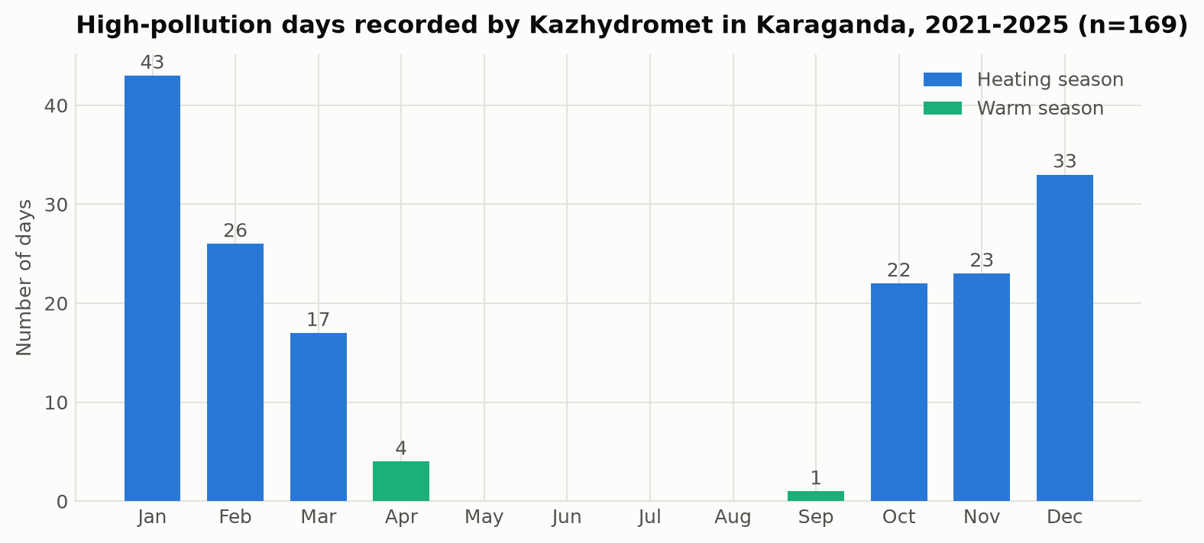
Key finding 2: all the risk is in the cold season
169 measured high-pollution days by month, 2021-2025. Sixty per cent fall in December to February; none at all between May and August.

Slide 9
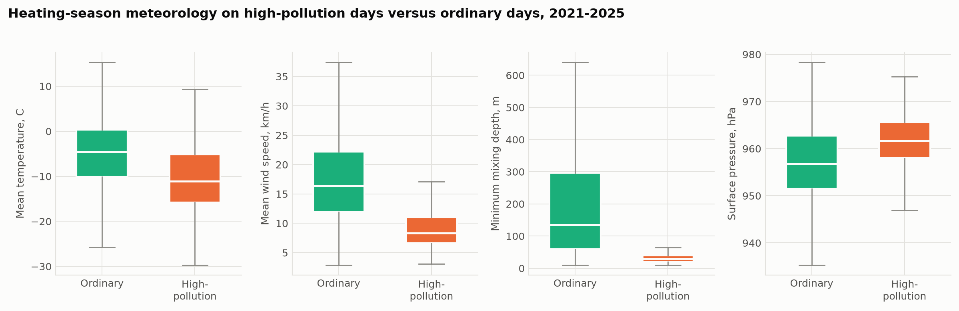
Key finding 3: the weather decides the day
Weather on episode days against ordinary heating-season days.

Slide 10
Key finding 3, in numbers
Heating-season median | Ordinary day | Episode day
Temperature | -4.5 C | -11.1 C
Wind speed | 16.4 km/h | 8.3 km/h
Minimum mixing depth | 135 m | 30 m
Surface pressure | 956.8 hPa | 961.8 hPa
High pressure, hard frost, calm air, a mixing layer tens of metres deep: a textbook temperature inversion.
Flat steppe traps pollution just as effectively as the mountain basin usually blamed for Almaty's smog.

Slide 11
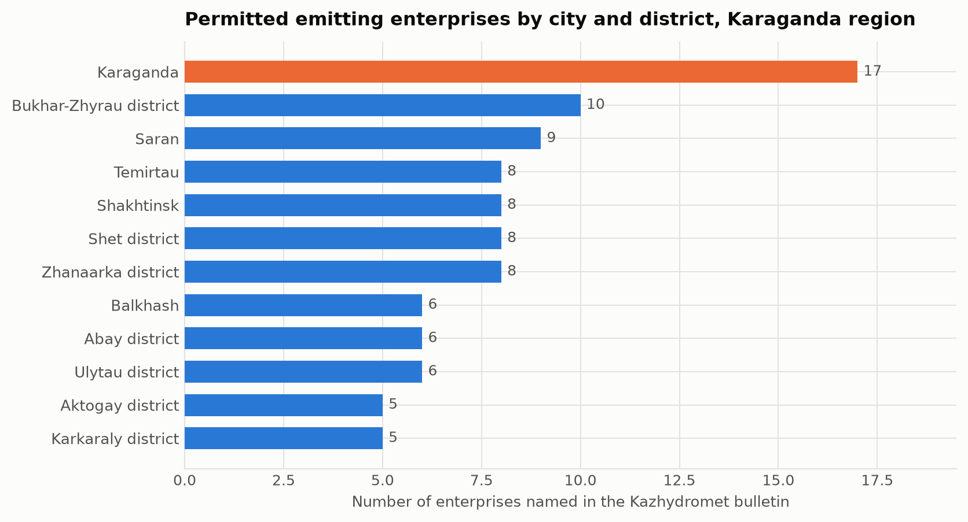
Key finding 4: the episodes are domestic, not industrial
Permitted emitting enterprises by city and district of the Karaganda region.

Slide 12
Why we conclude that
- The region has 105 permitted emitters and 585 thousand tonnes a year from stationary sources - that is the background
- But all 169 episodes were recorded at posts 6 and 8, both in Prishakhtinsk, a district of low-rise housing with individual coal stoves, not an industrial zone
- The substance that exceeds limits is particles, not stack gases - a low-level release signature
- The episodes require calm air, and calm concentrates near-ground emissions specifically
- Caveat: wind on episode days comes from the south-east twice as often as usual, and the CHP plant lies in that direction, so an industrial share of the peaks is not ruled out

Slide 13
Proposed solutions: now
- Episode warning service. The trigger is readable from an ordinary weather forecast: wind under 8 km/h plus a shallow mixing layer in the heating season. Free data, free tools, could run within one heating season
- Act on the warnings: free public transport on those days, ban open-air burning, postpone industrial maintenance releases, restrict school outdoor activity
- Twenty low-cost sensors. Karaganda has 2, Almaty has 153. This costs a fraction of one reference station and settles whether Prishakhtinsk represents the city or one neighbourhood
- Fix the reference instruments. The PM2.5/PM10 ratio sits at 0.90-1.00 against a normal 0.5-0.7 - the size separation is not working, which undermines the numbers the national ranking rests on

Slide 14
Proposed solutions: 3-10 years
- Target household coal in Prishakhtinsk first - connection to district heating, subsidised low-emission stoves, processed fuel with controlled ash. Pilot it in the catchment of post 8 and measure before and after
- Regulate the ash content of coal sold to households - administrative measure, no capital cost, immediate effect
- Continuous stack monitoring at the largest emitters, publicly disclosed
- Decarbonise the heat supply - gas conversion of the CHP plants, solar-assisted district heating, building retrofit. Nothing else brings the annual mean near the WHO guideline
- Preserve ventilation corridors in city planning, revegetate the spoil heaps
- Converge national limits towards the WHO guidelines on a published schedule

Slide 15
Conclusions
- Karaganda has an emissions problem that becomes dangerous through a dispersion bottleneck - emissions run all year, the winter anticyclone turns them into episodes
- PM2.5 is the problem, 5.6x the national limit and 6-30x the WHO guideline
- Seasonality is absolute: 169 episodes in five years, none between May and August
- Domestic coal burning drives the peaks, permitted industry sets the background
- Cheapest effective action: an episode warning service on free weather data, running within one season
- Biggest obstacle: two instruments in one district decide the ranking of a city of half a million, and they show a size-separation fault
Thank you. Questions?

