Slide 1
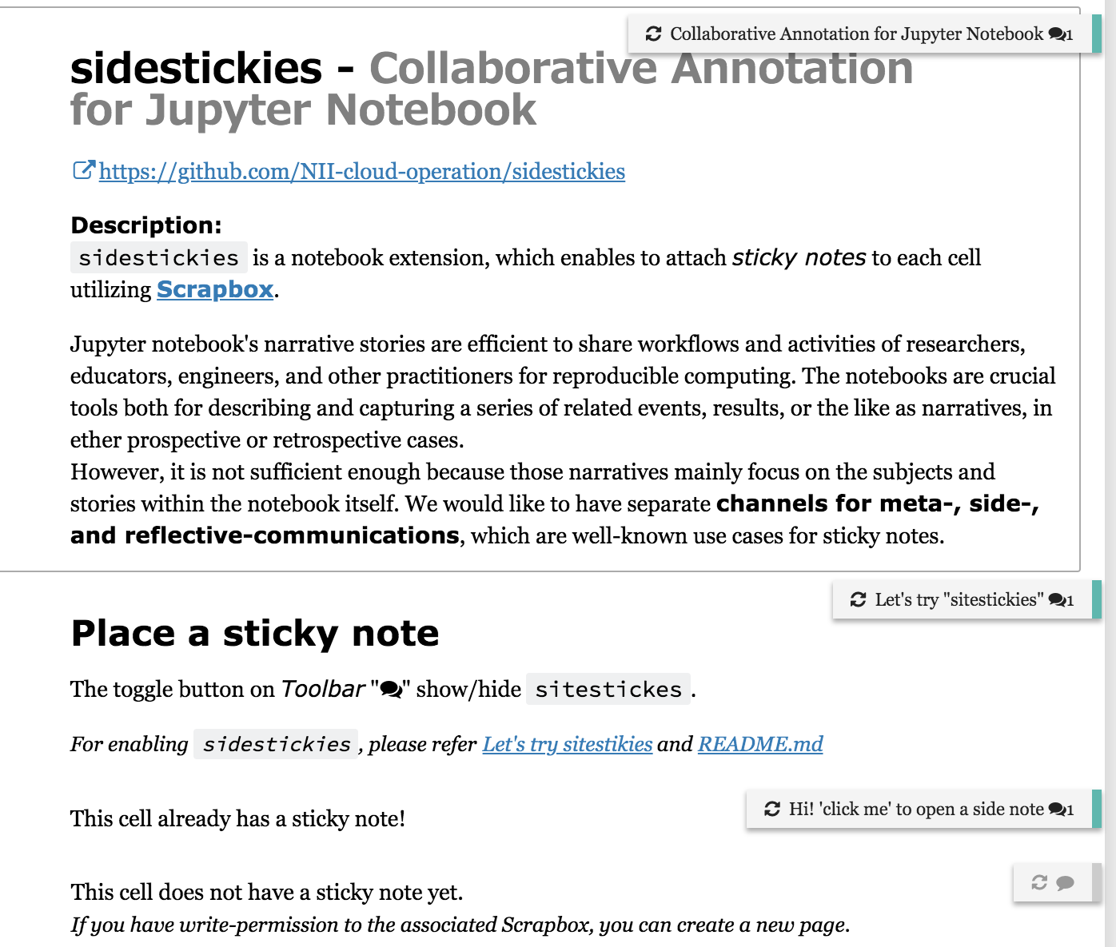
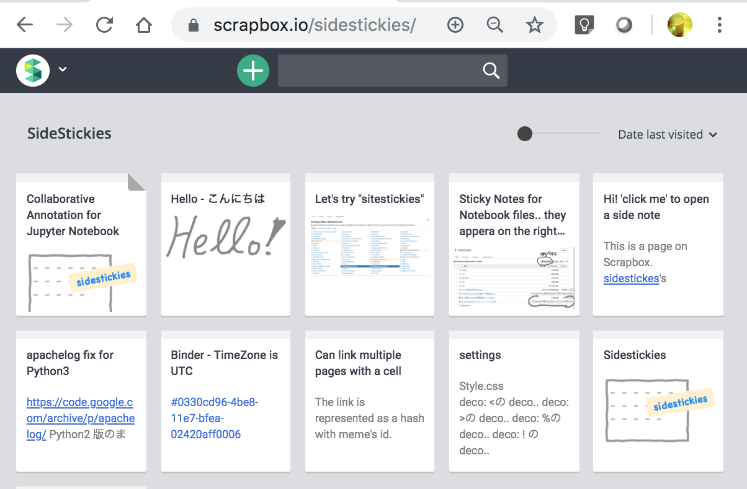

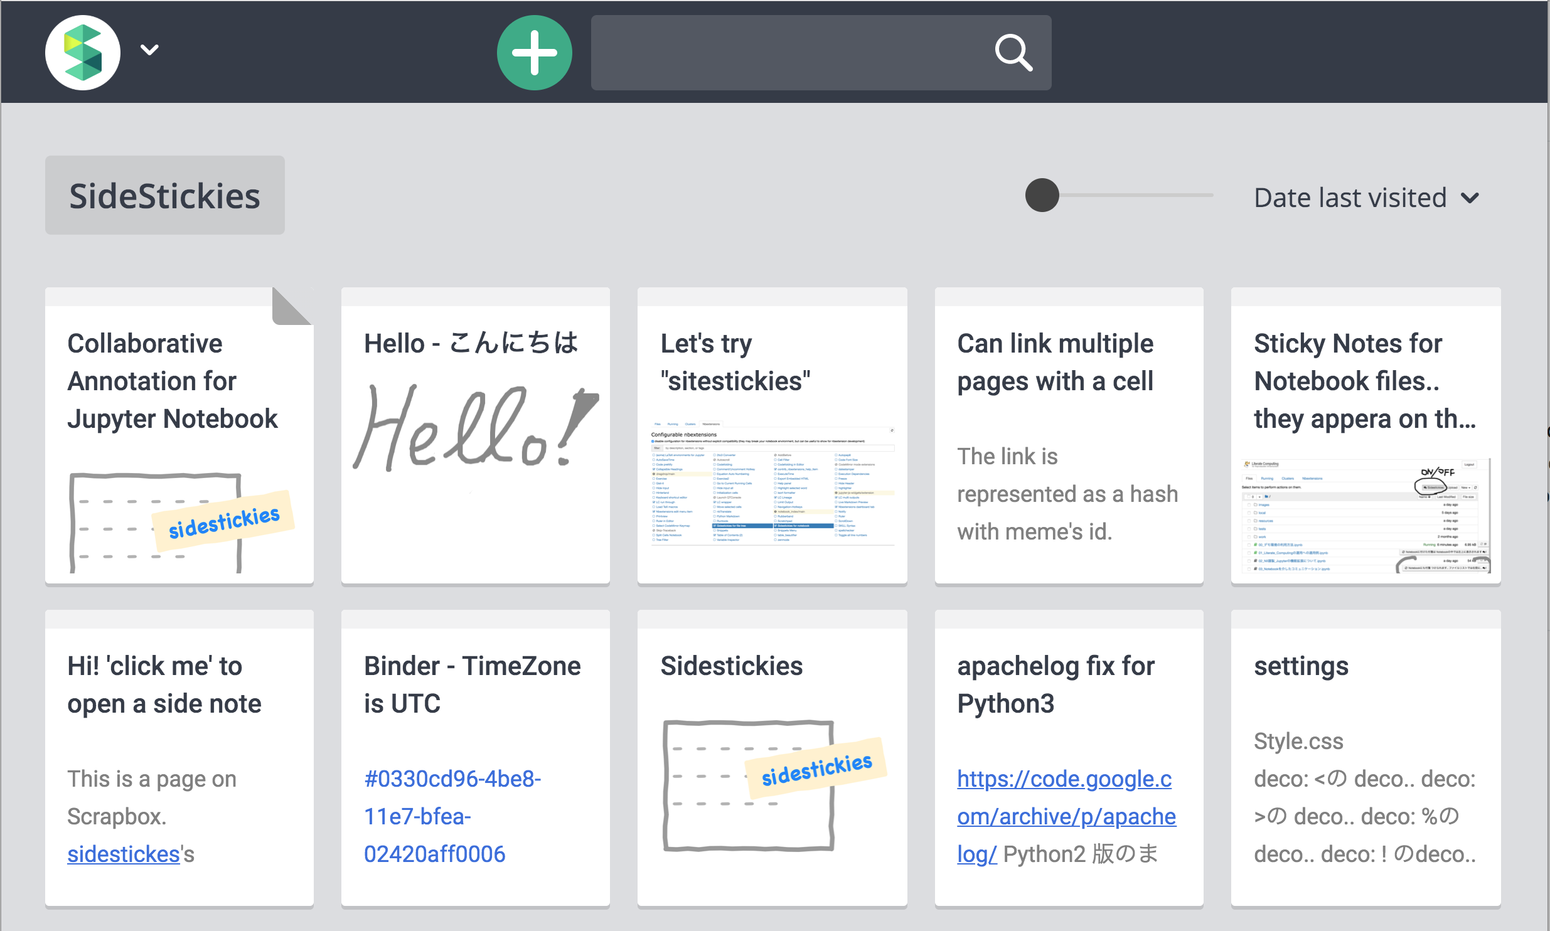
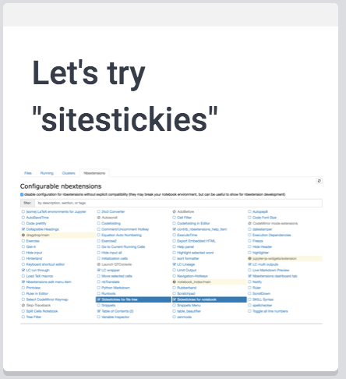
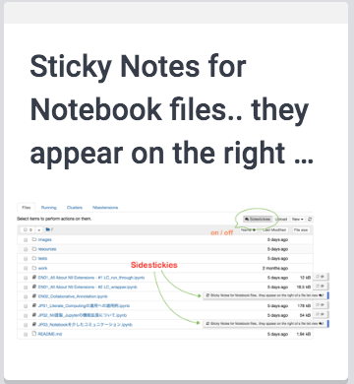
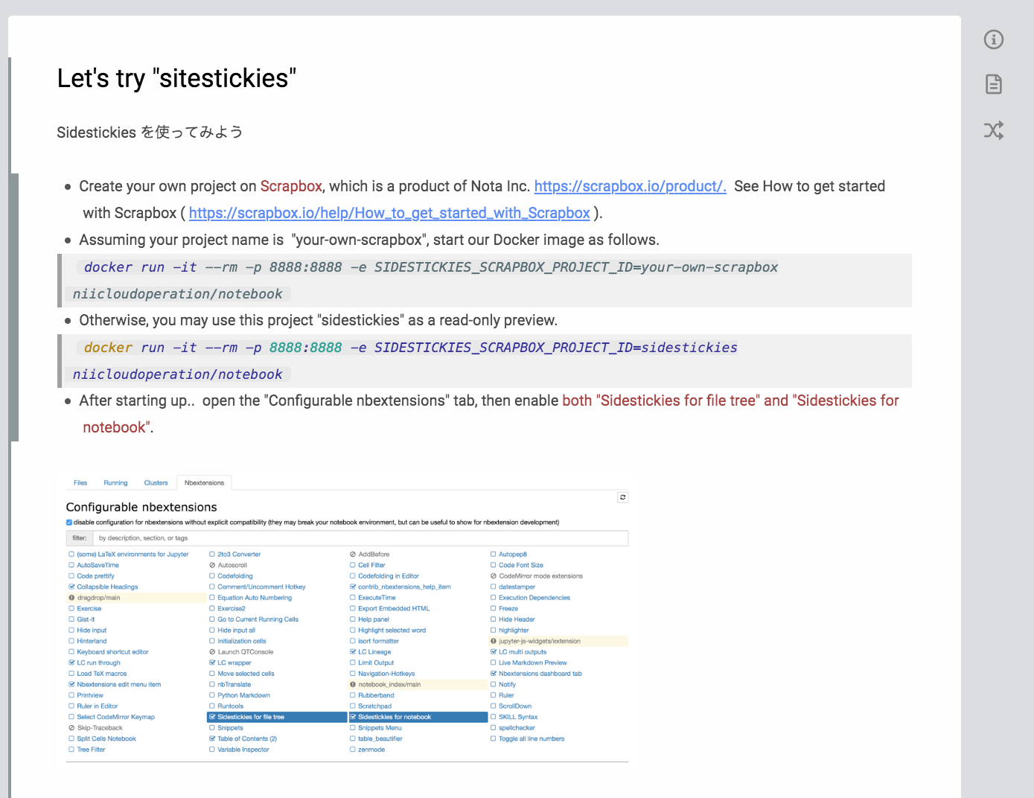
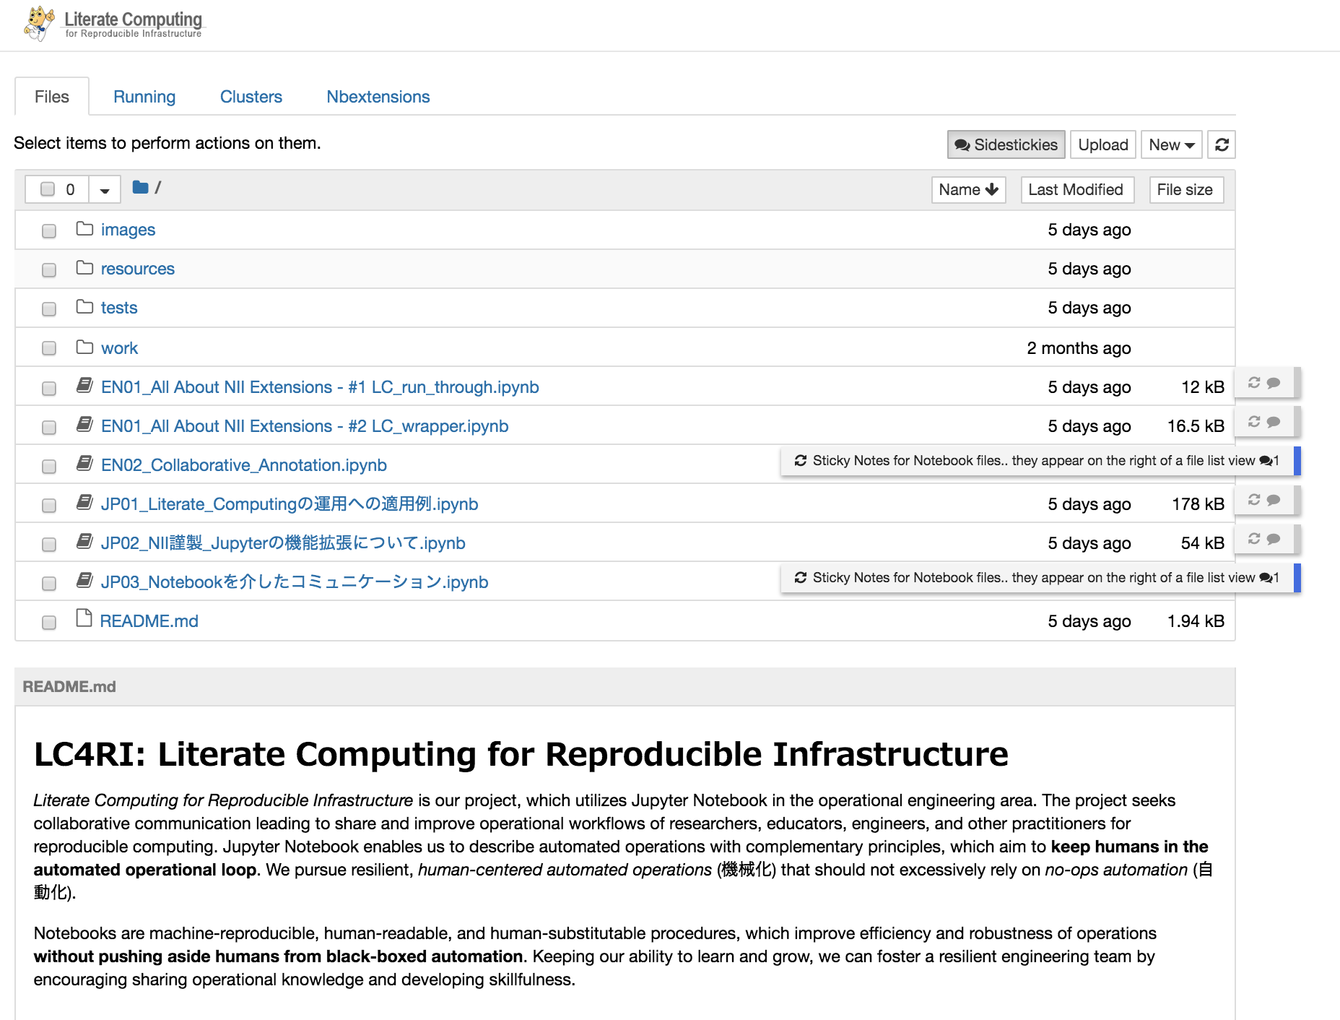
Jupyter Notebook
Scrapbox.io
“note pages in Scrapbox”
“sidestickies”
“a note page”

Slide 2
Jupyter Notebook
Scrapbox.io

Slide 3
Jupyter Notebook
Scrapbox.io
“sidestickies”

Slide 4
Jupyter Notebook
Scrapbox.io
“note pages in Scrapbox”
“sidestickies”

Slide 5
Jupyter Notebook
Scrapbox.io
“note pages in Scrapbox”
“sidestickies”
“a note page”

Slide 6

Jupyter Notebook
Scrapbox.io
Try on MyBinder
“note pages in Scrapbox”
“sidestickies”
https://mybinder.org /v2/gh/NII-cloud-operation/ Jupyter-LC_docker/sc-demo
“a note page”

Slide 7
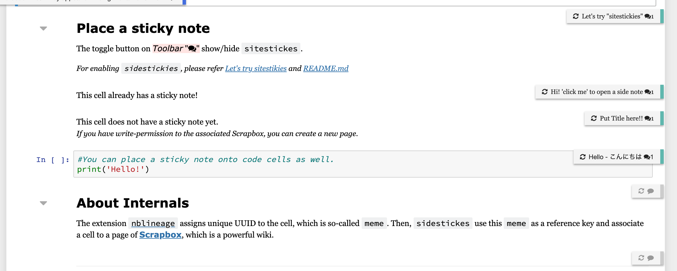

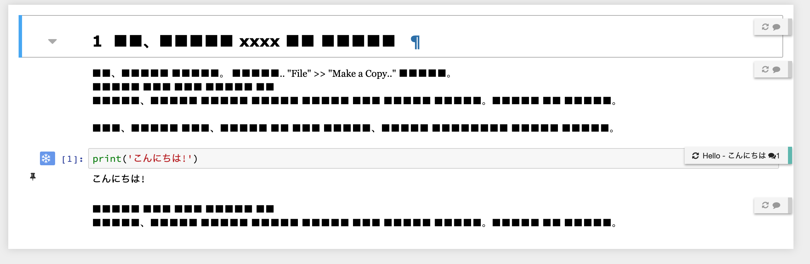

Slide 8


Jupyter Notebook
Scrapbox.io
“note pages in Scrapbox”
“A note page can associate
to multiple cells across
notebooks” and
“a cell can have multiple
note pages”

Slide 9
“note pages in Scrapbox”
“sidestickies”
“a note page”

Slide 10
Try on BinderHub
https://mybinder.org /v2/gh/NII-cloud-operation/ Jupyter-LC_docker/sc-demo

Slide 11

sidestickies Collaborative Annotation for Jupyter Notebook
Yoshi NOBU masatani (National Institute of Informatics, Japan)
Try on BinderHub
https: //github.com/NII-cloud-operation/sidestickies
https: //mybinder.org/v2/gh/
NII-cloud-operation/ Jupyter-LC_docker/sc-demo
National Institute of Informatics https://literate-computing.github.io/
National Institute of Informatics
https://literate-computing.github.io/

Slide 12
Try on BinderHub
https: //github.com/NII-cloud-operation/sidestickies
https: //mybinder.org/v2/gh/
NII-cloud-operation/ Jupyter-LC_docker/sc-demo
National Institute of Informatics https://literate-computing.github.io/
National Institute of Informatics
https://literate-computing.github.io/

Slide 15

National Institute of Informatics https://literate-computing.github.io/

