Slide 1

OperationHub Enhanced JupyterHub for DevOps Engineers
Yoshi NOBU masatani (National Institute of Informatics, Japan)
https: //github.com/NII-cloud-operation/OperationHub
National Institute of Informatics https://literate-computing.github.io/
National Institute of Informatics
https://literate-computing.github.io/

Slide 2
Features of OperationHub
A multi-user notebook environment by JupyterHub on a single server
Each user environment is isolated by a docker container
Each user can “sudo” in its container
Password authentication by PAM ; consistent alignments with host’s environment
Classified storage area:
Read-only shared directory for users to view each other's notebooks
Writable shared directory by any users
Private directory for an individual's credentials, ex. ssh private keys

Slide 3









Identify Individuals
JupyterHub
@Management
Server
Login
…
KVM
Individual credentials

Slide 4
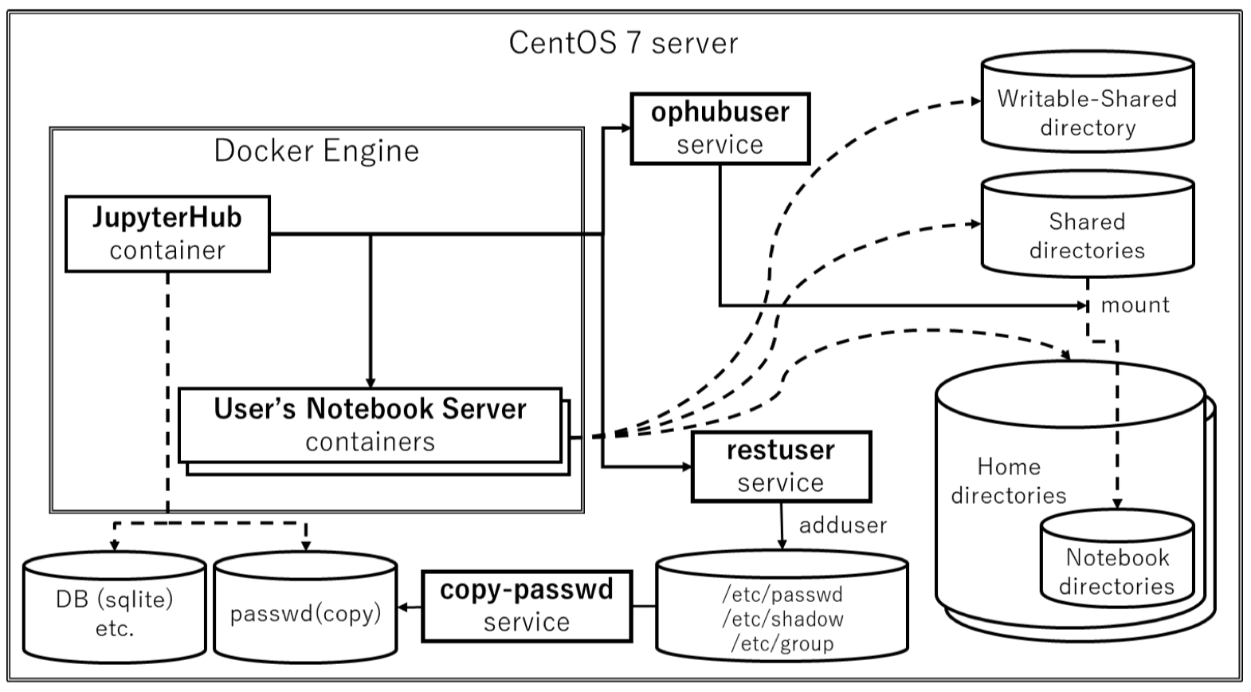

Slide 5
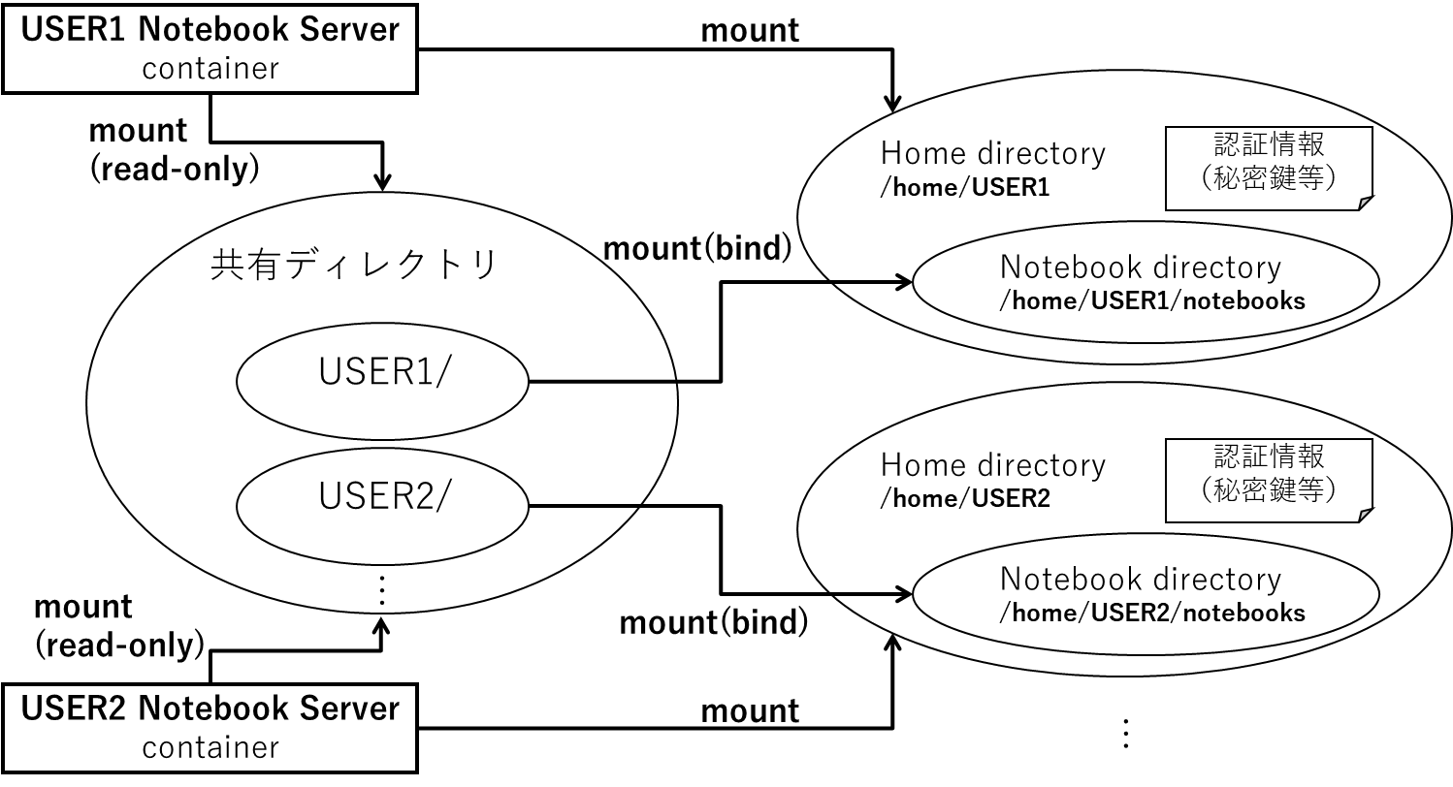
Secret Credentials
(ssh private keys etc.)
Shared Directories
Secret Credentials
(ssh private keys etc.)

Slide 6
Operation | Host & OS Administration OperationHub stop/start etc | Access to all files | JupyterHub admin control panel
Admin of Host OS | ○ | ○ | ○
Admin of JupyterHub | × | × | ○

Slide 7
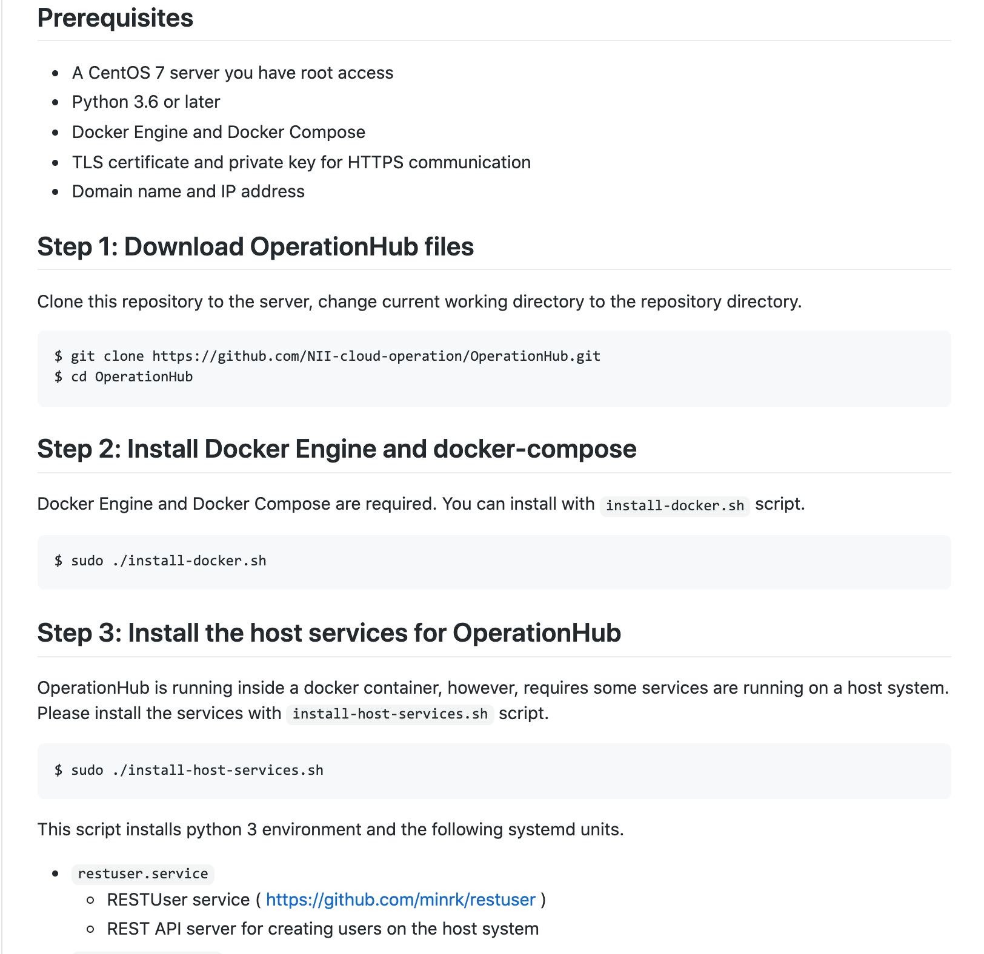
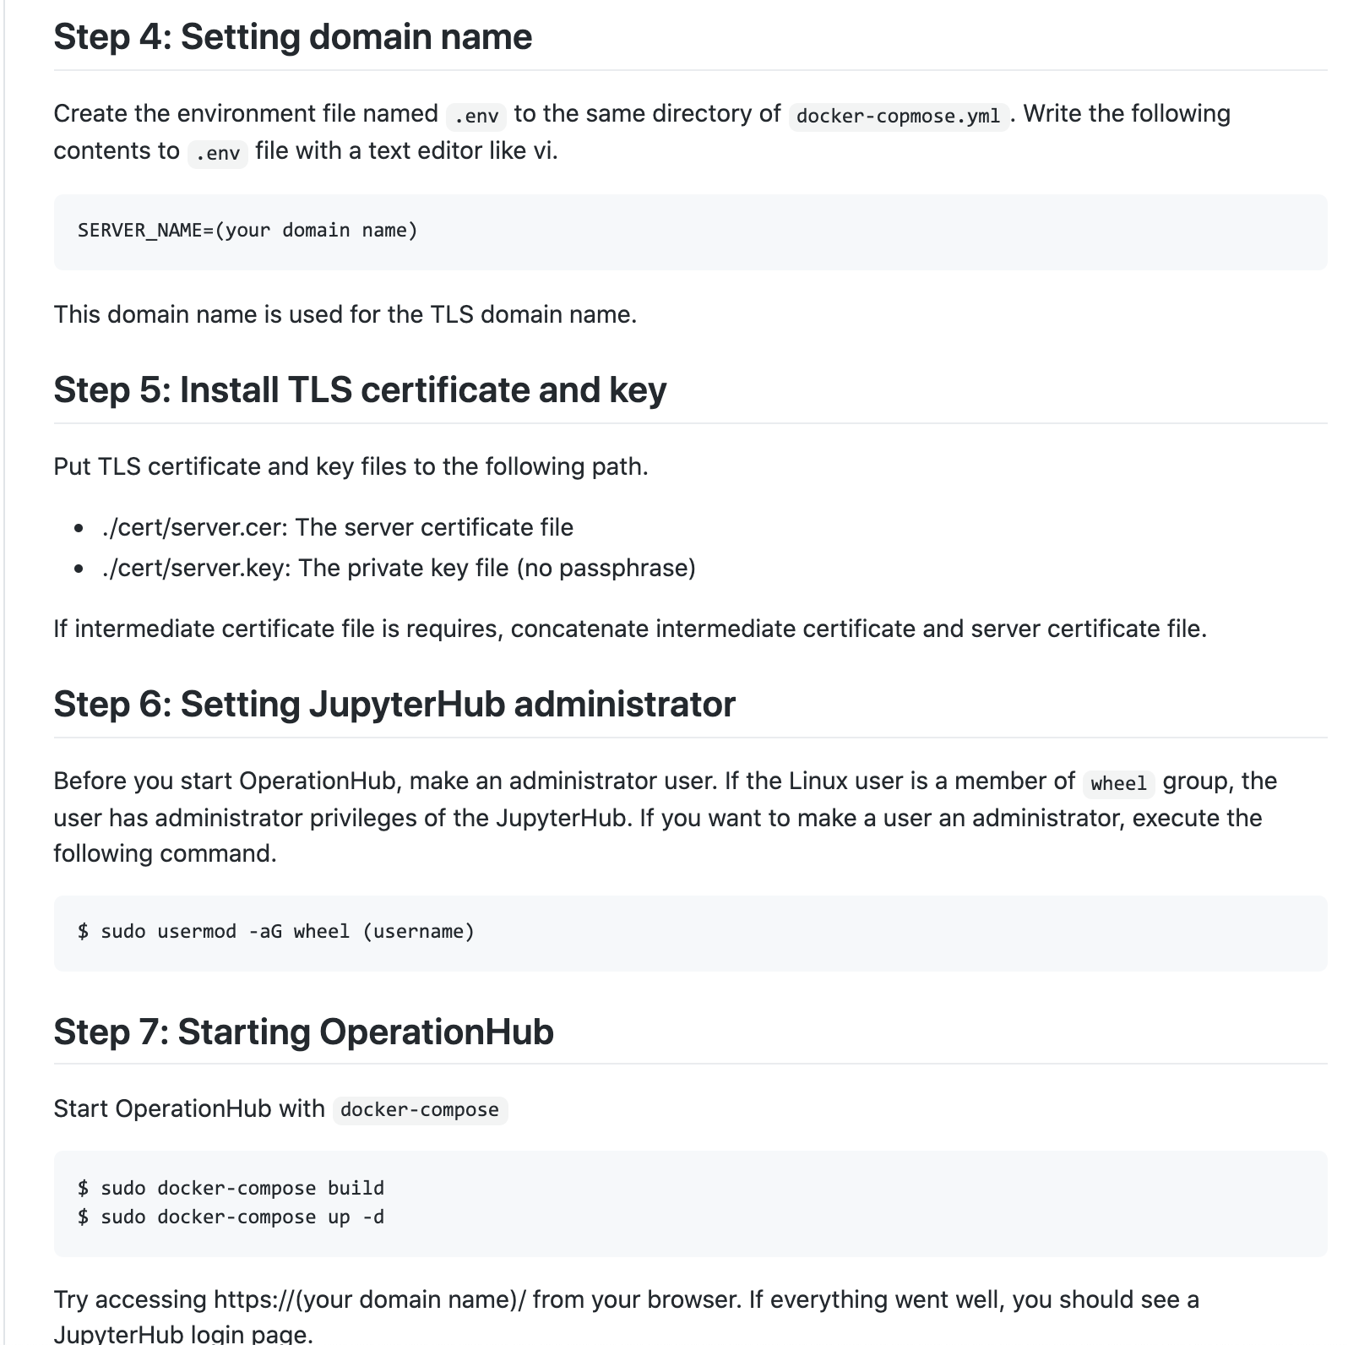
https: //github.com/NII-cloud-operation/OperationHub
National Institute of Informatics https://literate-computing.github.io/
National Institute of Informatics
https://literate-computing.github.io/

Slide 8
https: //github.com/NII-cloud-operation/OperationHub

Slide 9

















Share Reproducible Experiences
Transfer skill and knowledge through shared reproducible experiences among engineers, users, tech and non-tech.
Engineers
< Live Codes >
elaborate
notebooks
< Outputs >
test deployment of applications
User
self
administration
Expert Engineer
production deployment for users
share experiences for administration
share
experiences
Expert User
share
experience
Participant User
acquire skill and knowledge
through shared experiences
Apprentice Engineer

Slide 12
Separated environment for each operator
Authentication based on host’s PAM
Classified storage spces
Private ; owner only ; storeing indivisual credentials
Shared Read-only ; for sharing information
Shared writable ;
sudo enabled in the container – Infrastructure operation requires sudo
remote logging

Slide 13
Separated environment for each operator
Authentication based on host’s PAM
Classified storage spces
Private ; owner only ; storeing indivisual credentials
Shared Read-only ; for sharing information
Shared writable ;
sudo enabled in the container – Infrastructure operation requires sudo
remote logging

Slide 14

National Institute of Informatics https://literate-computing.github.io/

