Slide 1
Analyzing the Business Viability of a Location for an African Restaurant
The objective of this project is to find a most suitable neighborhood in Toronto for starting an African Restaurant.

Slide 2
Introduction
Background – Unless you are very familiar with the particular location under review, it might be difficult to ascertain if the location will be good for the business or not. In order for the restaurant business to thrive, the classification of the location is very important. Having this kind of data or information before setting up a restaurant, gives the business a better chance of survival.
Problem – Unless you are very familiar with the particular location, it might be difficult to predict if the named location will be good for the running of a restaurant or not. This project seeks to produce the required result in the form of information necessary for the decision-making phase..
Interest– Definitely, Investment Consultants, Investors, Business Owners would be very interested in the ability to determine the suitability of a location for the setup of a restaurant..
?

Slide 3
Data acquisition
Below are the three(3) datasets that were utilized;
The Boroughs and Neighbourhoods data of the city of Toronto was scraped from the following Wikipedia page here
The Geospatial data which contains the coordinates of the various boroughs and neighbourhoods was downloaded from the link here
The Foursquare API was utilized as the third dataset, to explore the boroughs and neighborhoods.

Slide 4
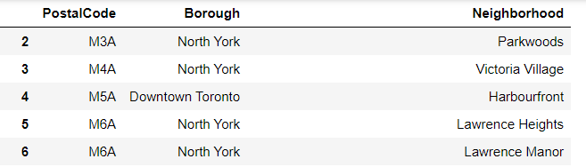
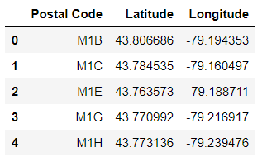
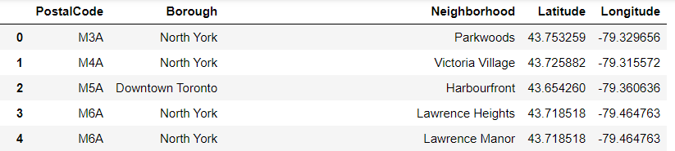
Data cleaning
Two of the data downloaded or scraped from two of the sources were merged into one table. Both datasets were merged on the PostalCode feature. The Foursquare API was utilized as the third dataset. This API helped to explore the various Boroughs and Neighbourhoods in the City of Toronto.

Slide 5
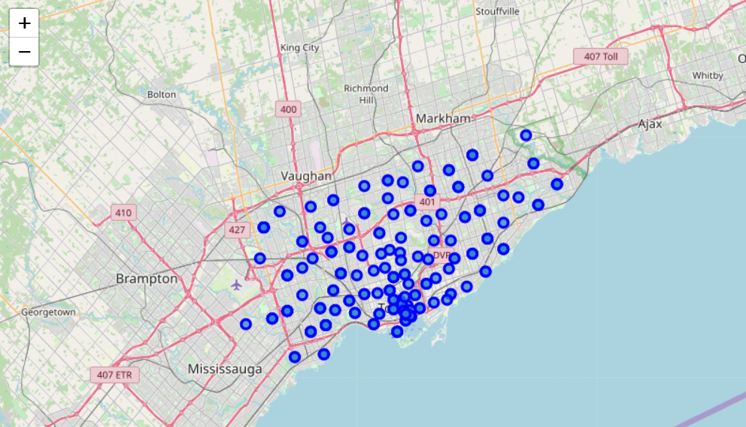
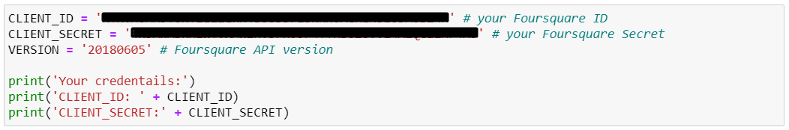
Methodology
After identifying and analyzing the problem, the next step is to detail the methodology/processes needed to arrive at the expected solution. I have already described how I acquired and cleaned the data, and from which sources. Now for the next part, I used Geocoder from Geopy library to get the latitude and longitude values of the City of Toronto. Then a map of Toronto is created with its neighborhoods superimposed on it, using the Folium Library. The next step is to define the Foursquare API credentials and version.

Slide 6
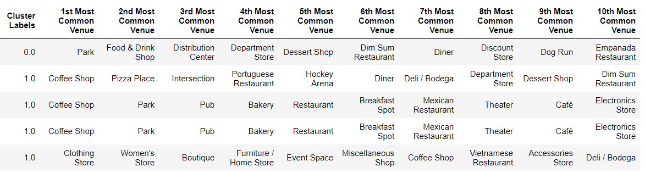
Methodology
The first Neighbourhood is selected and explored.
A request is made to the Foursquare API and a response is received in JSON format.
The returned JSON is cleaned and structured into a Pandas Dataframe.
The returned JSON contain Venues which are grouped by their Neighbourhoods, returning about 270 Unique Venues.
A new dataframe displaying the top 10 venues for each neighborhood is created.
K-Means Clustering is run to cluster the neighborhoods into 5 clusters.
A new dataframe that includes the cluster as well as the top 10 venues for each neighborhood is created.

Slide 7
Results
In Cluster 2, there are no African or Caribbean Restaurants, this is not an ideal option.
Cluster 3 is same as cluster 2, and therefore is not an ideal option either.
Cluster 5 is same as cluster 2 and 3, therefore is not an ideal option also.
Cluster 4 does not look like the ideal option. Though this cluster has a high percentage of Caribbean Restaurants, there is no African Restaurant found. Cluster 1 emerged as the most ideal option to site the African Restaurant, especially since it is the only cluster which houses all the three(3) current ones. As expected, a few people in cluster 1 are inclined towards African and Caribbean Dishes, and therefore makes it the best fit. Now the neighborhoods where there are no African Restaurants in this cluster, would be the list of neighborhoods an entrepreneur can invest and start an African Restaurant.

Slide 8
Discussions
I observed that all the three (3) African Restaurants are scattered in three (3) different Neighbourhoods, but belong to the same Borough. My recommendation will therefore be that, the neighbourhoods from Cluster 1 that belong to the borough Scarborough, but do not contain any of the three African Restaurants should be considered. This list of recommended Neighbourhoods is on the right.
Malvern
Cliffside West
Rouge
Wexford
Rouge Hill
Maryvale
Port Union
Agincourt
Highland Creek
Clarks Corners
Guildwood
Tam O'Shanter
Morningside
Sullivan
West Hill
Milliken
Woburn
Agincourt North
Kennedy Park
Steeles East
Ionview
L'Amoreaux East
East Birchmount Park
Steeles West
Birch Cliff
L'Amoreaux West

Slide 9
Conclusion
In this project, I analyzed location-based data to ascertain and draw conclusions on what locations will be viable for the running of an African Restaurant within the City of Toronto. The results were satisfactory.
Get the Full Report here
~ Robert Hammond
Notes:
In Slide Show mode, click the arrow to enter the PowerPoint Getting Started Center.

