Slide 1


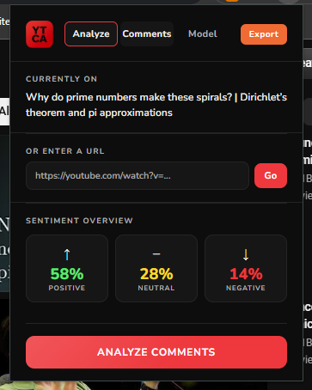
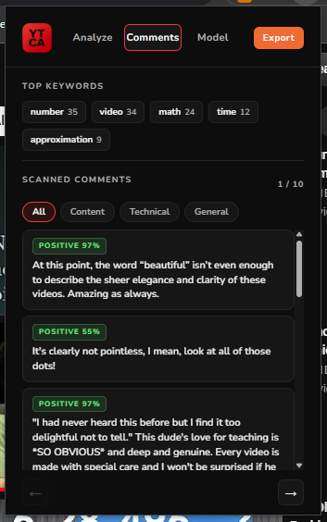
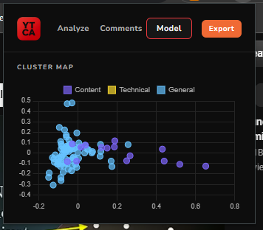
YouTube Comment Analyzer: Know your viewers better.
Nick Ze Kun Lei, Hayder AL-Musawi, Maxim Maletsky, and Kelvin Li
CMPT310 – D200. Professor Mohammad Soltanshah
Motivation & Purpose
Brief Overview
Manually reading hundreds of YouTube comments to learn about your audience is time consuming and subjective. Content creators have no quick way to know how their audience feels, what topics they care about, or more generally, if they did a good job or not.
YTCA automates this repetitive, stubborn work by fetching up to 100 comments and running them through AI models to surface meaningful insights in minutes.
What it does:
YouTube Comment Analyzer is a Chrome extension that analyzes YouTube comment sections in real-time, providing both creators and viewers with instant sentiment breakdowns and thematic cluster analysis of audience reactions and comment context using a multi-model NLP pipeline.
YTCA Demonstration
Key Methods & Technologies
AI Pipeline Diagram
Sentiment NLP: cardiffnlp/twitter-roberta-base-sentiment-latest
Sarcasm Detection: helinvian/english-sarcasm-detector
Thematic Clustering: K-Means on TF-IDF vectors (scikit-learn)
Dimensionality Reduction: PCA for 2D cluster visualization
Text Preprocessing: SpaCy lemmatization & hardcoded slang normalization
Keyword Extraction: SpaCy POS tagging
Backend: FastAPI (Python)
Frontend: Chrome Extension (HTML, CSS, JS)
Data Source: YouTube Data API v3
NLP Source: Hugging Face
YouTube URL YouTube Data API v3
Preprocessing
Sentiment Path:
Strip URLs
Normalize Slangs
RoBERTa & Sarcasm Detection
Sentiment Label (pos/neu/neg)
FastAPI
Clustering Path:
Strip URLs
Normalize Slangs
Strip Emojis
Lowercase
SpaCy Lemmatization & TF-IDF Vectorization
K-Means (K=3)
Results and Conclusion
YTCA was tested across several YouTube videos spanning different content types and different audience demographics.
We noticed that videos with informal, slang-heavy comment sections produced noticeably noisier results; as our pipeline struggle to normalize the evolving slangs.
In contrast, videos with more formal comment sections consistently produced stronger results; positive comments were reliably detected, and negative comments were found in the majority of cases, occasionally missing on “negative” words and sarcastic phrasing.
Overall, YTCA is a lightweight NLP pipeline that effectively identify negative comments without using LLMs; saving both computational power and time. Compared to LLMs like GPT-4, we save API tokens, financial cost, and have 0 data privacy concerns, making it a viable tool for real-world use.
Categorize
PCA
Chrome Extension UI:
Analyze tab
Comments tab
Model tab
PDF Export
Reference(s)
Analyzed YouTube Video: https://www.youtube.com/watch?v=EK32jo7i5LQ

