Slide 1
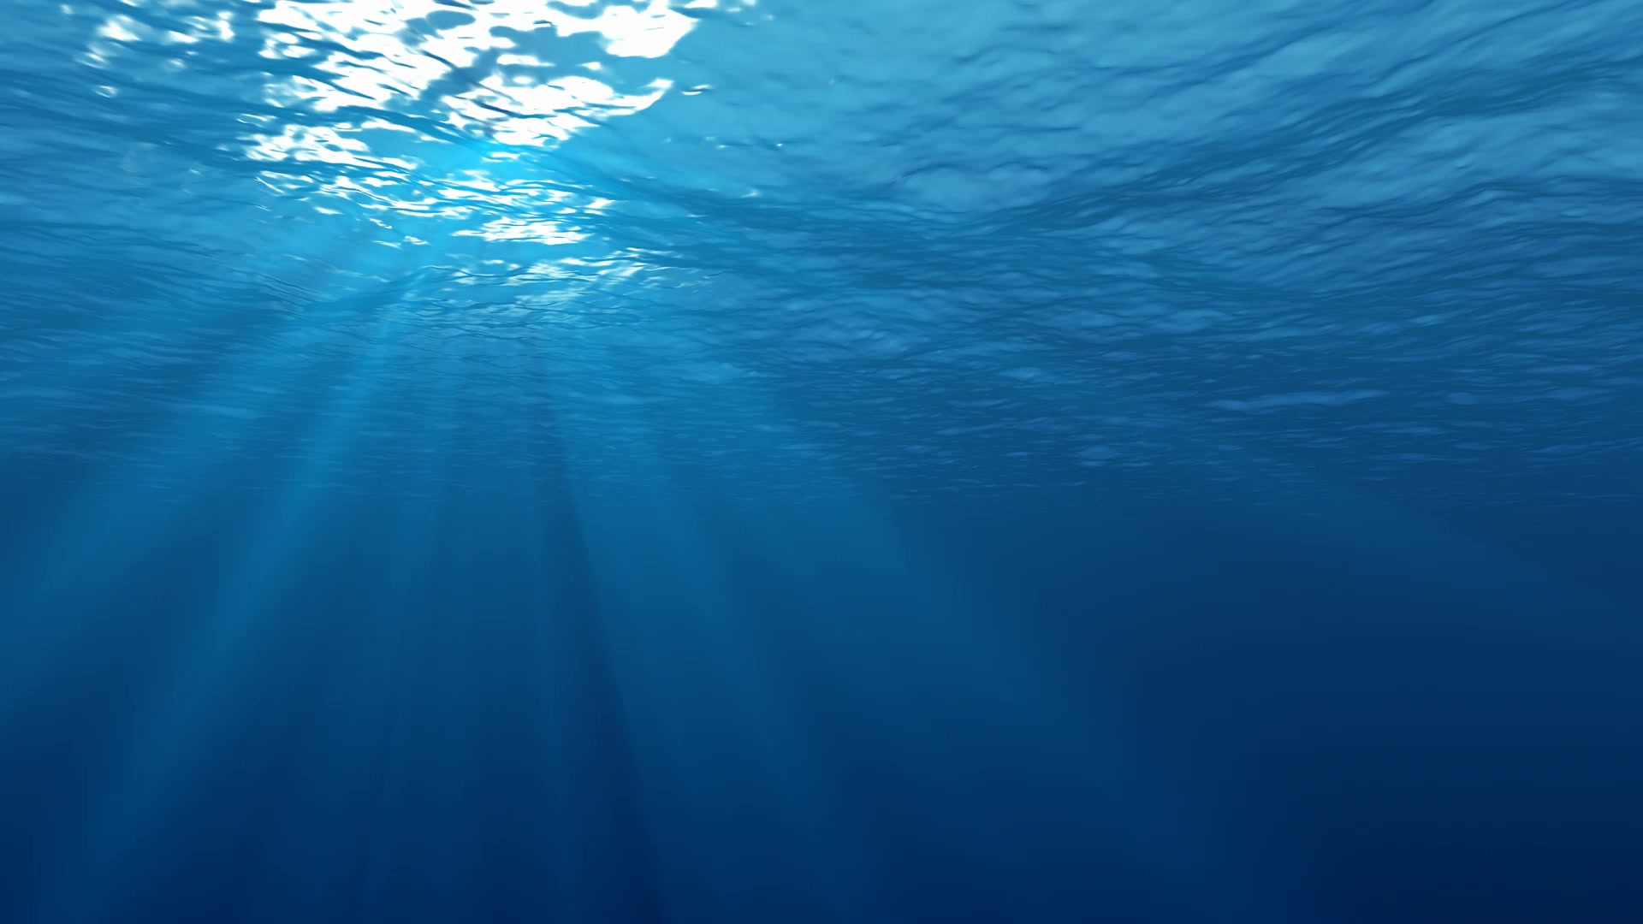
Underwater Image Enhancement
Niels Roefs

Slide 2
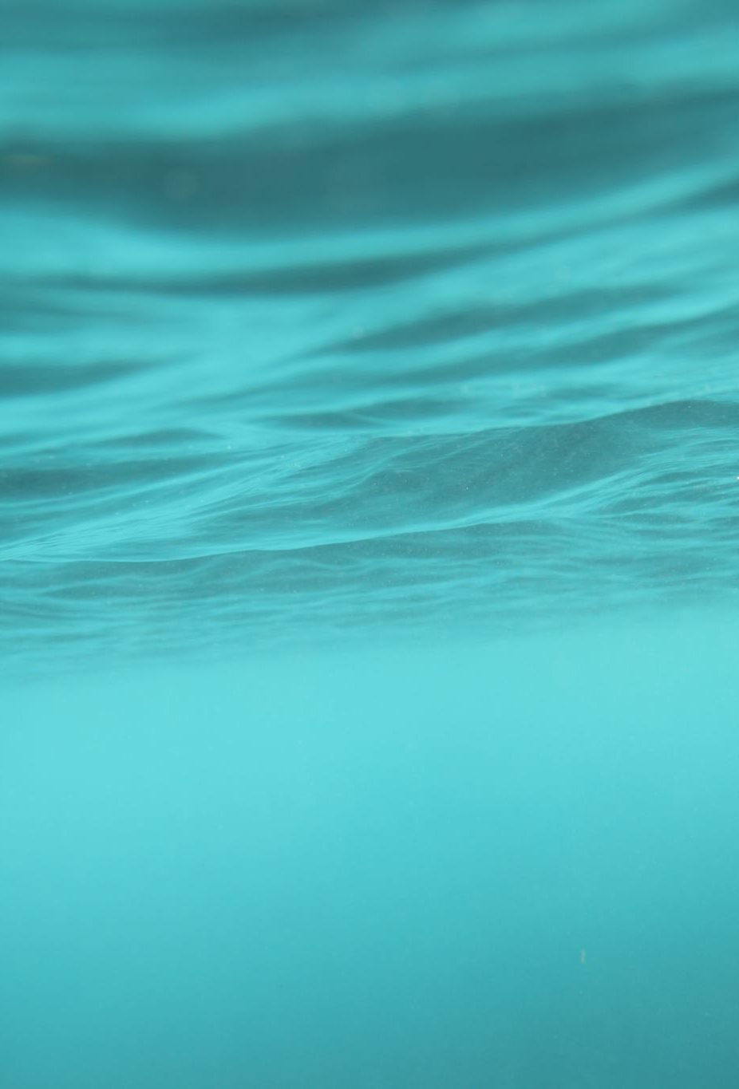
Problem & Goal
Problem: Low-quality images are a common issue underwater images
Goal: Enhance images using deep learning models — specifically, a deconvolution model and a GAN.

Slide 3
Approach
Deconvolution Model: Uses transposed convolutions to restore details in images.
GAN Model: Generative Adversarial Networks with a generator and discriminator to improve image quality by generating realistic high-quality images.

Slide 4
Dataset
EUVP
Pairs of images (or unpaired) designed for tasks like image enhancement.

Slide 5
Training
Deconvolution Model: Trained to map low-quality images to high-quality targets, optimizing pixel-wise accuracy via Mean Squared Error (MSE) loss.
GAN Model: The generator tries to create realistic high-quality images, while the discriminator ensures the authenticity of generated images through adversarial loss.

Slide 6
Demo

Slide 7
Challenges
Training models, especially GANs, is computationally expensive and time-consuming.
GANs are complicated because the generator and discriminator need to learn together, and it can be hard to make them work well together.

Slide 8
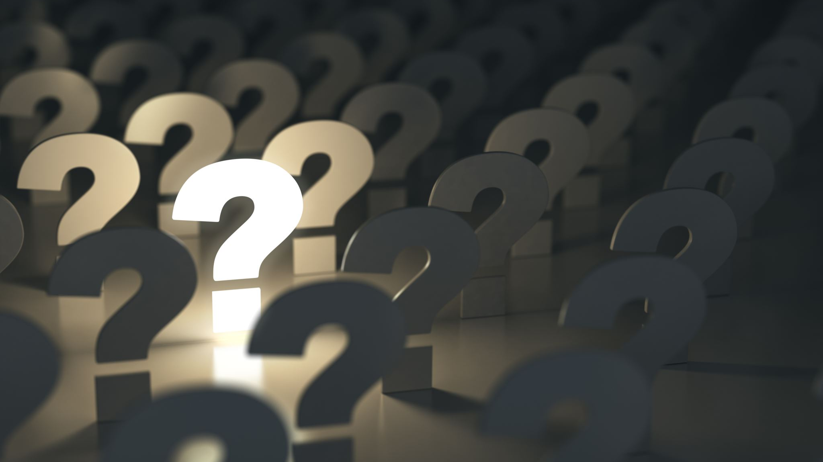
Questions?

