Slide 1
By : (bhakti.y & nikhil.k) under guidance : tanaji.s sir
Modern college of art’s, commerce & science.
“AUTOMATIC IRRIGATION PLANT CONTROL SYSTEM”

Slide 2
Contents :
introduction
Components required (hardware & software)
block diagram
working
Project progress
result

Slide 3
Introduction :
In the world of advance electronics, life of human beings should be simpler & hence to make life more simpler and convenient, we are making “Automatic Irrigation Plant Control System”.
This Irrigation System in which we’ve used PIC8F4550 microcontroller, which waters the plant’s based on the atmospheric conditions , detecting the dryness of soil , the temperature & weather conditions are displayed on LCD .

Slide 4
Components (hardware) :
PIC18F4550 target board
Soil moisture sensor (capacitive)
Temperature sensor (LM35)
Humidity sensor(DHT11)
Water pump
DC motor
Fan
LCD display

Slide 5
Components(software) :
MPLAB IDE(version 8.8)

Slide 6
Block diagram :
CONTROL PINS :(RE0-RE2)
LM35
LCD(16x2)
SOIL MOIS SENSOR
PIC18F4550 CONTROLLER
2
3
DATA PIN : (D0-D7)
4
16
DC MOTOR
HUMIDITY SENSOR

Slide 7
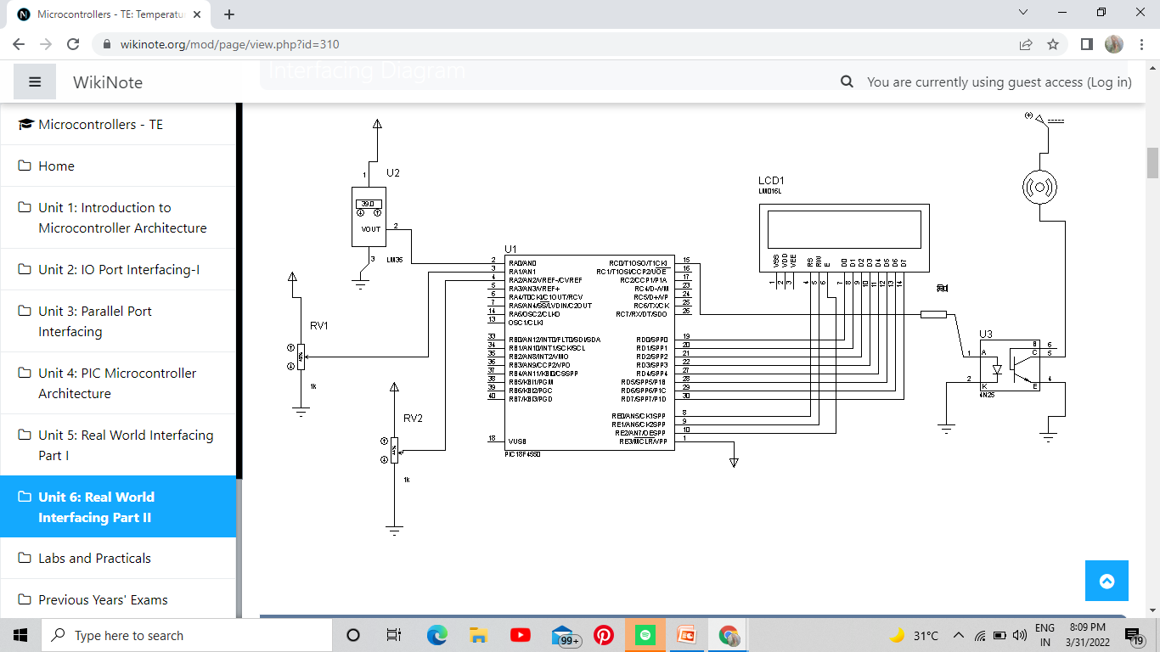
CIRCUIT DIAGRAM :

Slide 8
Working :
The working of this system can be divided into 4 units :
MICROCONTROLLER : Which is the core of the project , here we are utilizing PIC18F4550 controller. This detects the ADC data and calibrates the value & controls the motor pump and fan.
A/D CONVERSION : This part is taking control of getting the temperature analog values to programmable digitals signals.

Slide 9
SENSING UNIT : This part is having the sensors sense the Temperature, Soil moisture & Humidity in the soil and the surrounding environment.
DISPLAY UNIT : The Temperature & Humidity in the surrounding and percentage of soil moisture is displayed on the LCD.
This is how the entire “AUTOMATIC IRRIGATION PLANT CONTROL SYSTEM ” works.

Slide 10
Project progress :
Considering the project we initially tried :
Virtually Interfacing the LED to PIC18F4550 Microcontroller.
Interfacing the LCD to PIC18F4550 Microcontroller.
Interfacing the ADC to PIC18F450 Microcontroller.

Slide 11
Result :
We successfully Interfaced the LED,LCD & ADC to the PIC18F microcontroller.
We look forward to Test the Hardware part at our earliest & our best.

Slide 12
Thank You !

