Slide 1
PROJECT EURO TO US DOLLAR EXCHANGE RATE
NGUYEN THI MINH NGOC - 11219280 - DSEB 63

Slide 2
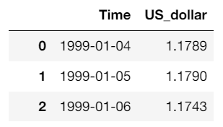
About Dataset
The dataset we'll use describes Euro daily exchange rates between 1999 and 2023. However, in this project, I want to mainly focus on the Euro to US dollar exchange rate, especially how it changed during the coronavirus pandemic (2020), with the baseline years from 2016 to 2019.
Hence, we need to take some actions to prepare the data for the project.
Cleaned Data

Slide 3
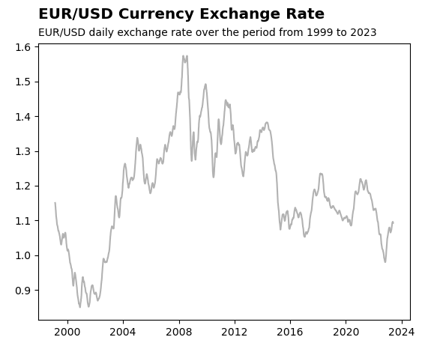
OVERALL TRENDS FROM 1999-2023
In general, the EUR to USD exchange rate fluctuated dramatically over the period of time from 1999 to 2023.
In particular, the exchange rate between them increased sharply and reached it peaks from 2003 to 2008, then fluctuated remarkably with the downward trend in the next period.

Slide 4
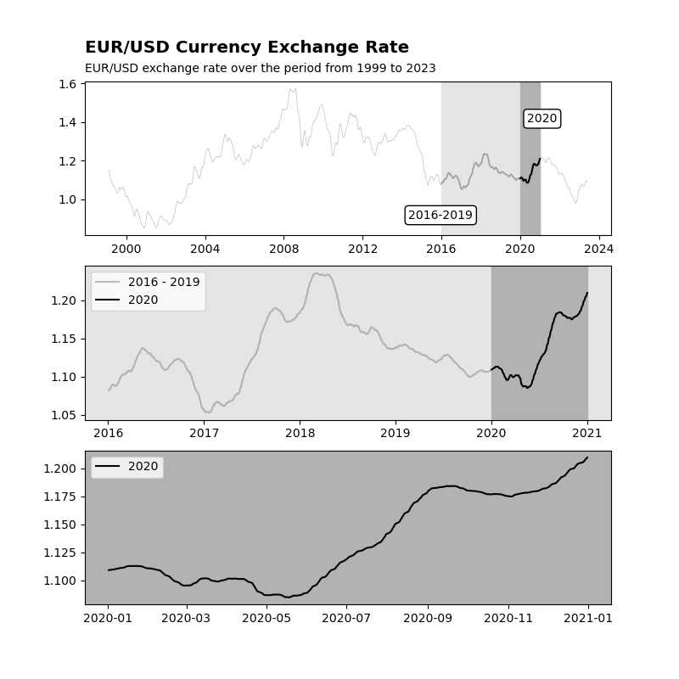
CORONAVIRUS PANDEMIC (2020) VS PERIOD 2016-2019
After increasing and reaching about 1.25 in the middle of 2018, the Euro to US dollar exchange rate witnessed a decline until about the end of early 2020.
In other words, the Euro to US dollar started to increase again in the rest of 2020.

Slide 5
CORONAVIRUS PANDEMIC (2020) VS PERIOD 2016-2019
There is many explanation for this trend and one of them is:
At the beginning of 2020, the pandemic just started, and almost people could not image of its large impact on economic in the future, so the exchange rate just followed its trend at that time.
However, from the middle of 2020, The virus's impact on global economies led to increased market volatility. Investors tended to seek refuge in safe-haven currencies, and the US Dollar is often considered a safe haven currency. This increased demand for the US Dollar relative to the Euro, leading to a depreciation of the Euro.

