Slide 1
ELK-stack installation with Salt
Juha Immonen ja Niina Villman
6.5.2019

Slide 2
Introduction
- The topic of this project was to create a small architecture for centralized logging and automate its installation with Salt
- In this project we will use the collection of open source tools, Elasticsearch, Logstash and Kibana (ELK Stack) to collect and analyze Apache2 logs.
- For the automation we used SaltStack and shell scripting

Slide 3
Environment
We installed ELK-Stack using following components and versions. We use ufw firewall which is default in Ubuntu.
  Ubuntu 18.04.1 LTS
  Elasticsearch: version '6.6.0'
  Logstash: version '1:6.6.0-1'
  Kibana: version '6.6.0'
  SaltStack: 2017.7.4 (Nitrogen)
  Nginx: 1.14.0
  Java: openjdk version 1.8.0_191

Slide 4
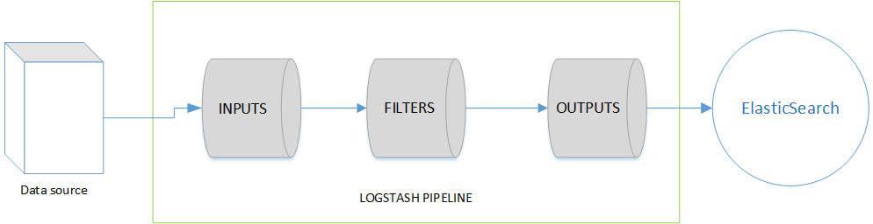
ELK-Stack architecture
Elasticsearch is the search engine and stores the data
  Elasticsearch indexes the data which makes faster searches possible
  Elasticserach uses JSON format for expressing data structures. It is easy for applications to parse and generate
Logstash processes the data and sends the data to Elasticseach
  Logstash is a tool to centralize, transform and stash your data
  Logstash processes Events. Event processing pipeline has three stages, input, filtering and output

Slide 5
ELK-Stack architecture
Kibana is a tool for visualization
  Kibana is a platform for visualization and it is meant to work with Elasticsearch
We used FileBeat to transfer the data to Logstash
  Lightweight shipper for logs
  Resource-friendly tool that collects logs from files on the server

Slide 6
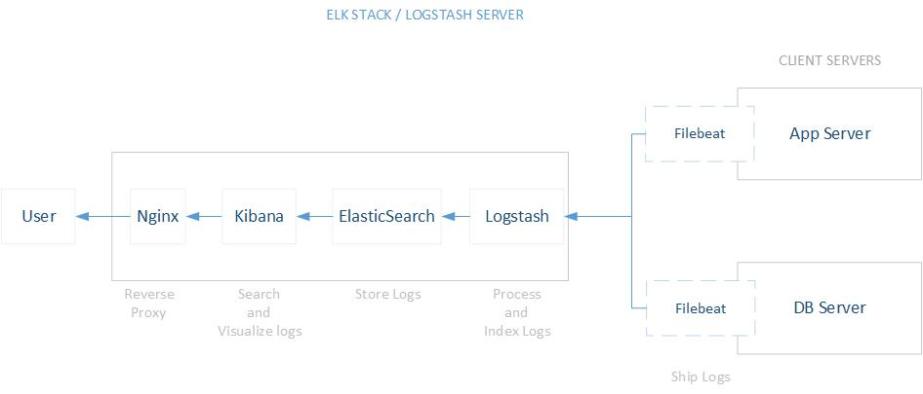

Slide 7
SaltStack
Salt is a remote execution framework and configuration management system
Manage multiple servers whether it is 2 or 10 000 machines
Basic master - client architecture. Server is master and minions can be many
Master server controls minions

Slide 8




Automatic Installation

Slide 9
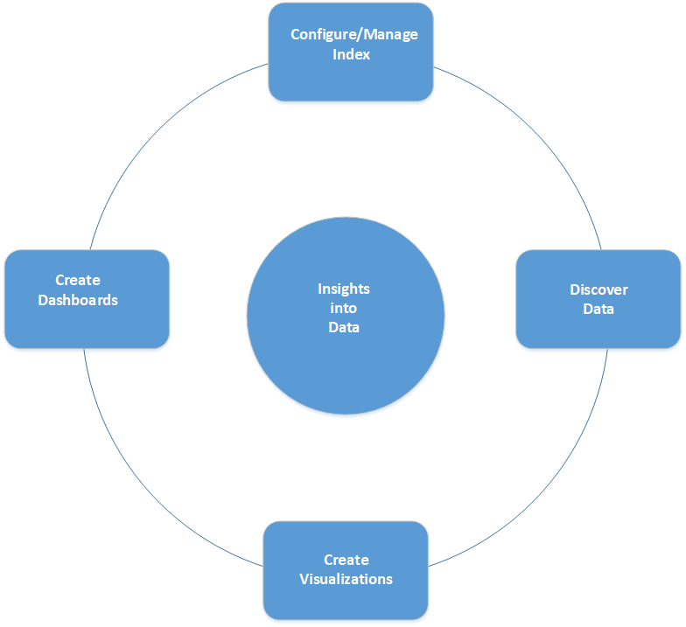
User interaction flow
1. Configure/manage index
- Kibana uses data in Elasticsearch The data should be indexed
- User creates index pattern in Kibana
2. Discover Data
- User have to also familiarize himself with the data
3. Create Visualizations
- Variety forms of visualizations, for example, pie and bar charts
4. Create Dashboards
- Collection of visualizations

Slide 10
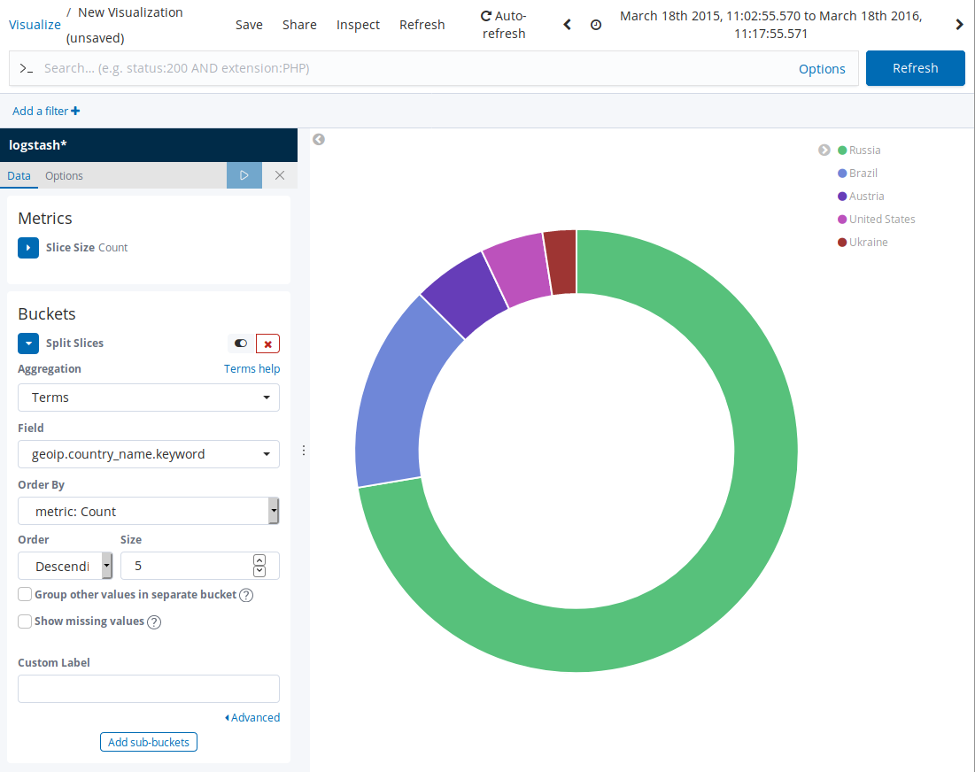
Data visualization we created from Apace2 logs using geoip.
We used data from publicly available access.log
https://gist.github.com/rm-hull/bd60aed44024e9986e3c

Slide 11
Conclusions
We successfully installed the test environment and collected data with ELK-Stack, but we only scratched the surface
The topic was interesting and we would like to study in the future more log analysis and how to apply it to the different use cases

