Slide 1
ReCell Project

Slide 2
Contents ReCell intend to take a sizable share of the market of refurbished and used devices as they continue to provide cost-effective alternatives to both consumers and businesses that are looking to save money when purchasing a smartphone. But the used and refurbished phone market has grown considerably over the past decade, and a new IDC (International Data Corporation) forecast predicts that the used phone market would be worth $52.7bn by 2023 with a compound annual growth rate (CAGR) of 13.6% from 2018 to 2023.

Slide 3
Business Problem Overview and Solution Approach
Core business idea
Recell is into selling refurbished and used smart phones. Used and refurbished devices can be sold with warranties and can also be insured with proof of purchase. Third-party vendors/platforms, such as Verizon, Amazon, etc., provide attractive offers to customers for refurbished smartphones.
Problem to tackle
The rising potential of this comparatively under-the-radar market fuels the need for an ML-based solution to develop a dynamic pricing strategy for used and refurbished smartphones. ReCell, a startup aiming to tap the potential in this market, has hired you as a data scientist. They want you to analyze the data provided and build a linear regression model to predict the price of a used phone and identify factors that significantly influence it.
Financial implications
This will increase their share of the market and bring in more money.
How to use ML model to solve the problem
Python will be used to make key business decisions.

Slide 4
Data Overview
Brief description of data provided
brand_name: Name of manufacturing brand
os: OS on which the phone runs
screen_size: Size of the screen in cm
4g: Whether 4G is available or not
5g: Whether 5G is available or not
main_camera_mp: Resolution of the rear camera in megapixels
selfie_camera_mp: Resolution of the front camera in megapixels
int_memory: Amount of internal memory (ROM) in GB
ram: Amount of RAM in GB
battery: Energy capacity of the phone battery in mAh
weight: Weight of the phone in grams
release_year: Year when the phone model was released
days_used: Number of days the used/refurbished phone has been used
new_price: Price of a new phone of the same model in euros
used_price: Price of the used/refurbished phone in euros

Slide 5
Brief description of significant manipulations made to raw data
Brand_name, os, 4g and 5g will be converted to categorical to reduce space
The rest are floats and integers
The following were execiuted on the data:
Missing value treatment
Outlier treatment
Feature engineering
Data preparation for modeling

Slide 6
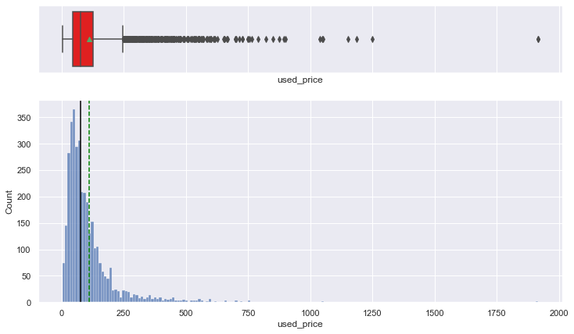
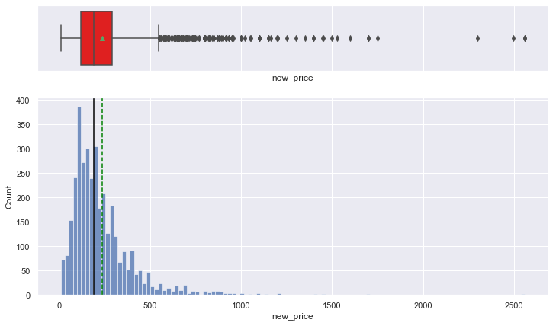
EDA

Slide 7
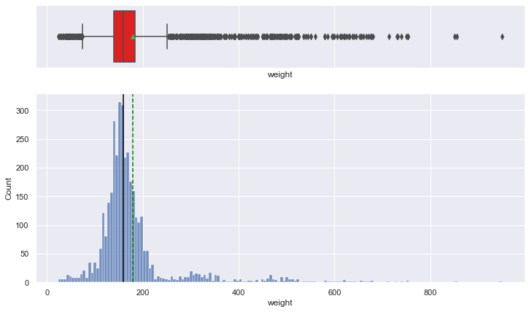
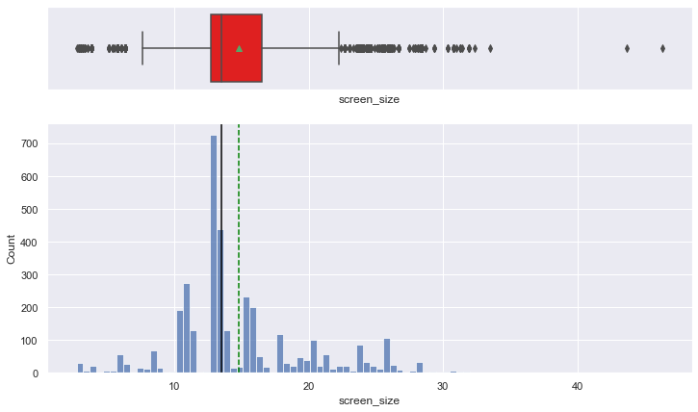

Slide 8
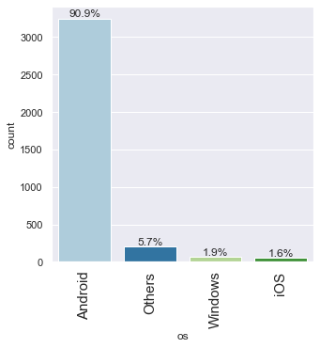
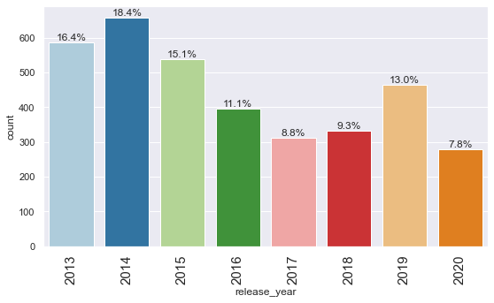

Slide 9
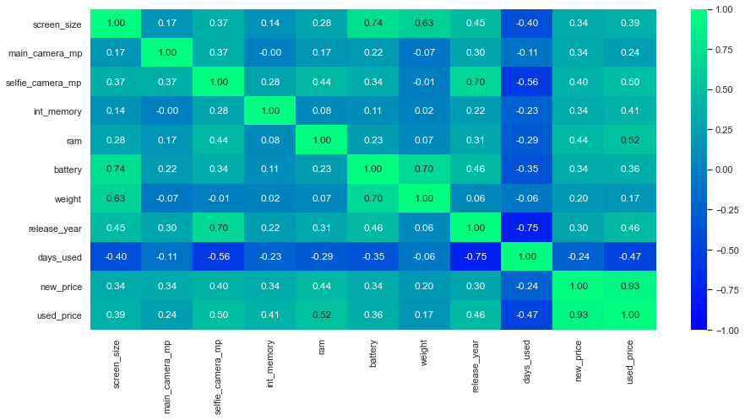
BIVARIATE

Slide 10
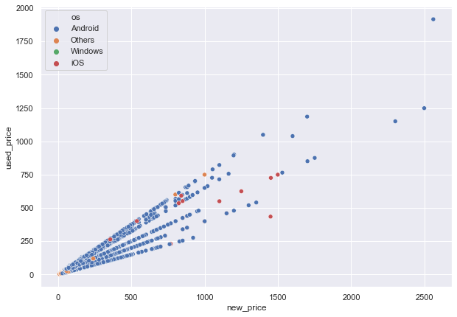
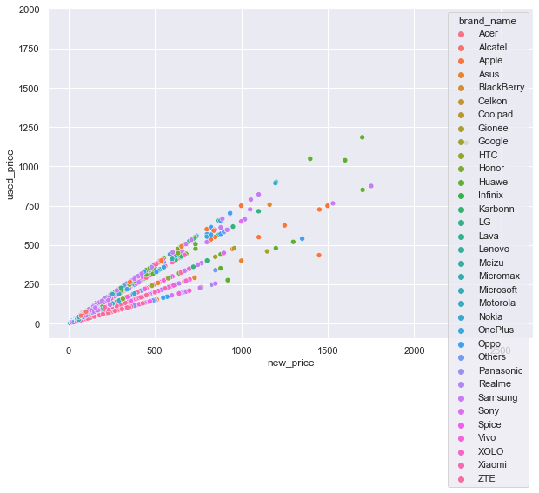

Slide 11
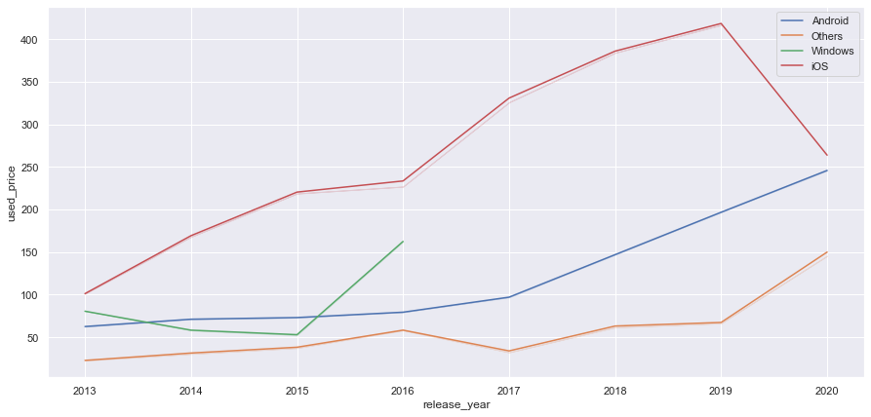
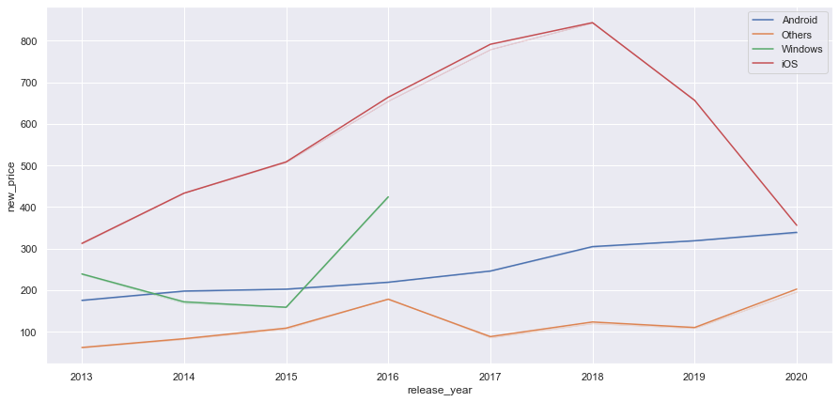

Slide 12
Model Performance Summary
Linear Model Building
We want to predict the used_price.
Before we proceed to build a model, we'll have to encode categorical features.
We'll split the data into train and test to be able to evaluate the model that we build on the train data.
We will build a Linear Regression model using the train data and then check it's performance.

Slide 13
Model Performance Summary
Checking Linear Regression Assumptions
We will be checking the following Linear Regression assumptions:
No Multicollinearity
Linearity of variables
Independence of error terms
Normality of error terms
No Heteroscedasticity

Slide 14
CONCLUSION All the variables have positive coefficient except os_others. All P-values are zero except for os_windows. negative coefficience of os_others indicates that as it icreases the used_price also decreases. the positive coefficient of the rest of the variable indicates that as they increase, used_price also goes up. Brand names like(Apple, Blackberry and Google) have the highest impact on used_price. Brand_name_HTC and brand_name_samsung have almost the same coeeficient value. Brand name determines the used_price of a smartphone not the other specification(eg camera,weight,etc)

Slide 15
Business Insights and Recommendations
Recommendations based on interpretation of the model input variables
The data must include location where a particular brand thrives.
Data must include the life span of the refurbished smartphone.
Another model can be applied to check whether the outcome is the same.
Data should be collated on the age customers.
Their education and salary levels should be added to the data.

