Slide 1

IPS Academy
Institute of Engineering & Science
Department of Computer Science & Engineering
RAITEA
Instagram Analysis Sentiment Analysis | Opinion Mining
Nirvishesh Shrivastava

Slide 2
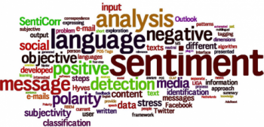
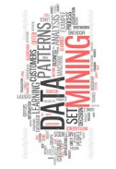
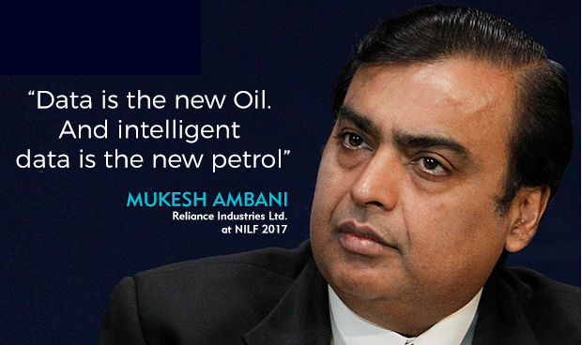

Slide 3
INSTAGRAM ANALYSIS
CONTENT:
Introduction
Flow of Algorithm
Code & Tools
Execution
Applications

Slide 4
SENTIMENT ANALYSIS
NEGATIVE
NEUTRAL
SENTIMENT ANALYSIS
EMOTIONS
POSITIVE
Opinion A
Opinion B
Opinion C
Sentiment Analysis is the process of determining whether the piece of information is positive, negative or neutral.
Also, referred to as Opinion Mining/Opinion Extraction, it makes our goal to determine the interests/opinion of the user.

Slide 5
OPINION MINING
55%
Opinion Mining is computational study of opinions, sentiments and emotions which can be expressed in text.
Opinion is very important for us because whenever we have to make any important decision at that time we seek opinion of other people for business, politics and many more.
The most important reason behind using Opinion Mining is huge amount of opinionated text available on web.
35%
10%
OPINION OF PEOPLE

Slide 6






WHY INSTAGRAM
65%
65%
55%
800 MILLION MONTHLY ACTIVE USERS
GOLDMINE OF USER SENTIMENT METHOD
HIGH MARKETING POTENTIAL
85%
25%
35%
REFLECTS MARKET TRENDS
CAN BE USED FOR OPINION MINING
AUDIENCE VARIES FROM COMMON MAN TO CELEBRITIES

Slide 7
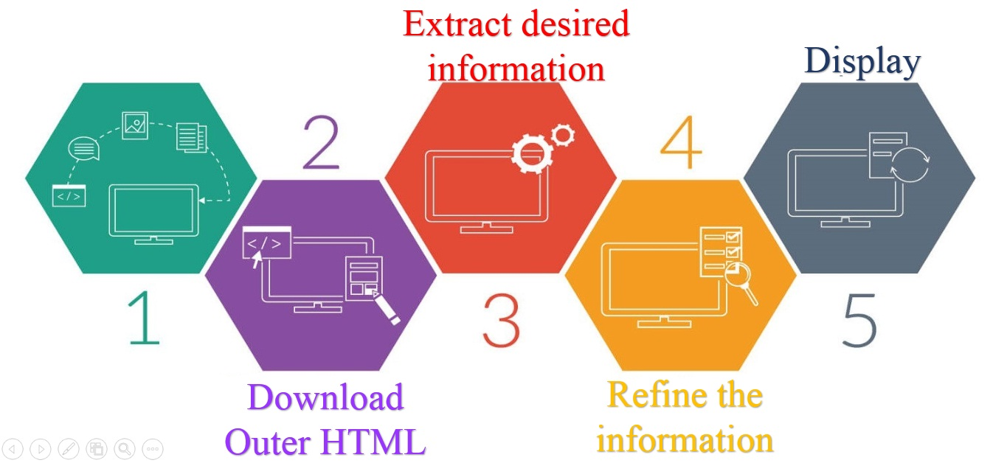
FLOW OF ALGORITHM
Get Data

Slide 8
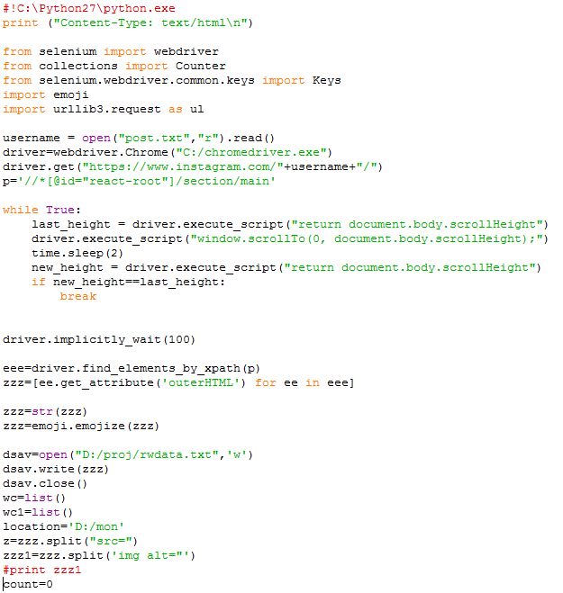
PYTHON CODE
TOOLS & LIBRABRIES
Python 2.7
WebDriver
Libraries:
Selenium
Collections
Emoji
Urllib3

Slide 9
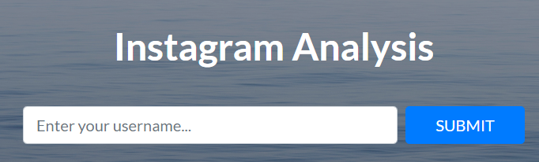
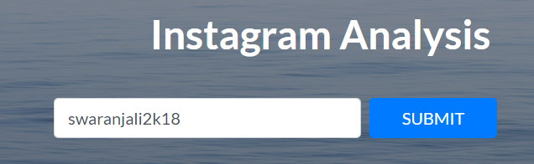
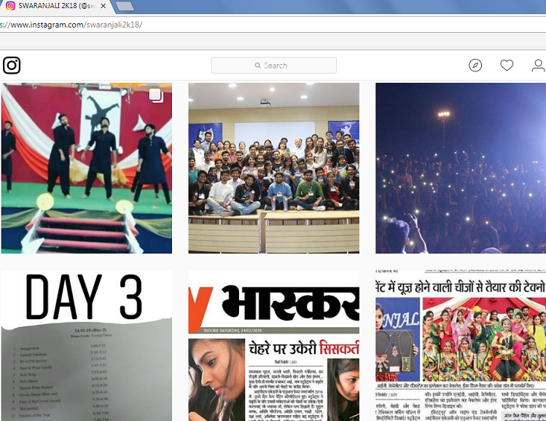
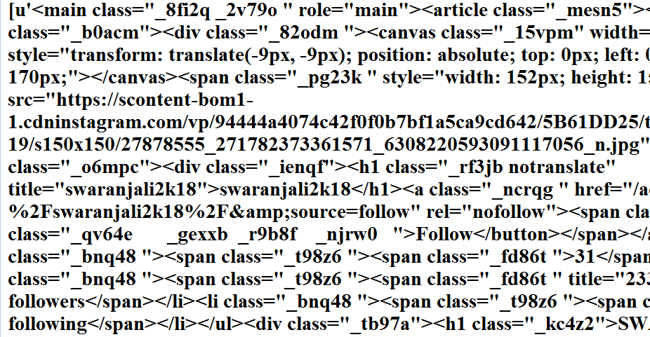
EXECUTION OF ANALYSIS

Slide 10
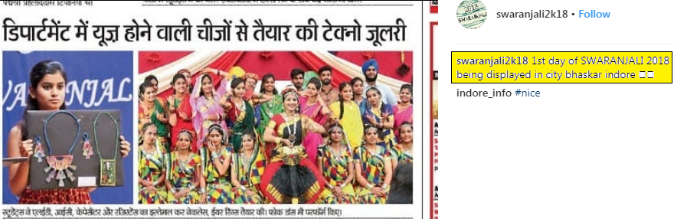
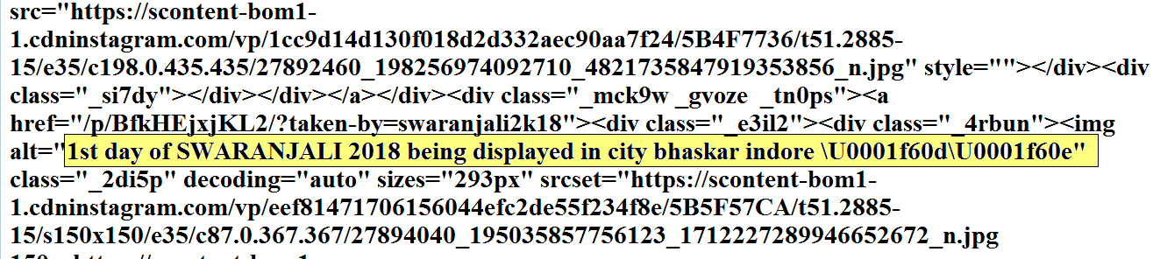
EXECUTION OF ANALYSIS

Slide 11
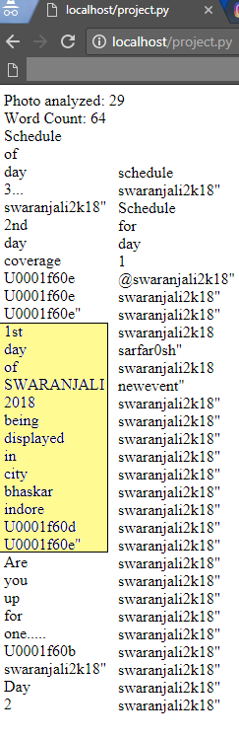
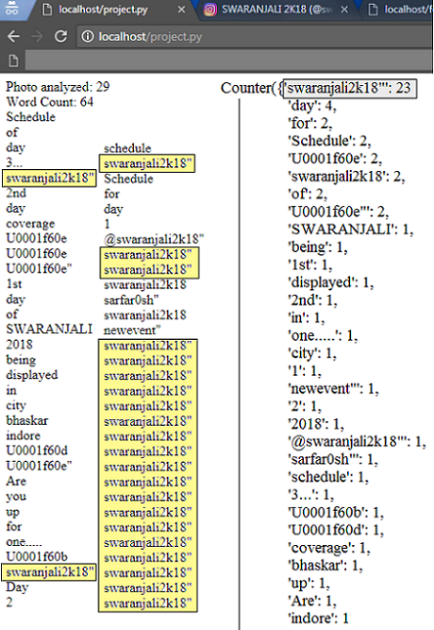
EXECUTION OF ANALYSIS

Slide 12
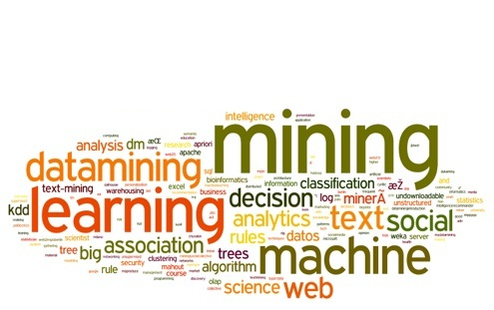
APPLICATIONS:
Opinion
Business Public Interest
Politics Public Actions
Sentiment
The scraped data can be used to monitor influencers and gain insights on the marketing efforts.

Slide 13
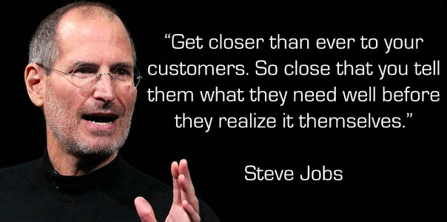
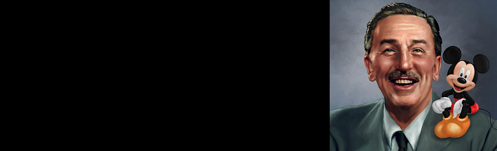
“Do what you do so well that they will want to see it again and bring their friends.”
Walt Disney

Slide 14
Thank you !

