Slide 1
Learn-mate
IBM AICTE PROJECT
Presented By:
Student name : Nisha Parashar
College Name & Department : Jaipur Engineering College and Research Centre, CSE(AI)

Slide 2
OUTLINE
Problem Statement
Technology used
Wow factor
End users
Result
Conclusion
Git-hub Link
Future scope
IBM Certifications

Slide 3
Problem Statement
Students struggle to find the right learning path that matches their interests and goals because there are too many online courses and not enough personalized guidance. Without clear direction, many students lose motivation or fail to reach their full potential, highlighting the real need for effective, individualized learning support.
Proposed Solution: LearnMate is an AI-powered personalized learning coach that interacts with students to understand their interests and current skills. It dynamically builds and continually adapts a tailored course roadmap, guiding learners step-by-step with relevant resources and projects. By providing ongoing, individualized support, LearnMate helps students stay focused, motivated, and confident on the path to achieving their educational and career goals.

Slide 4
Technology used
IBM cloud lite services
Natural Language Processing (NLP)
Retrieval Augmented Generation (RAG)
IBM Granite model
Agentic ai frameworks

Slide 5
IBM cloud services used
IBM Cloud Watsonx AI Studio
IBM Cloud Watsonx AI runtime
IBM Cloud Agent Lab
IBM Granite foundation model

Slide 6
Wow factors
LearnMate will dramatically simplify the journey of finding the right learning path, boost student motivation, and enhance skill development by providing truly personalized, adaptive educational guidance.
Unique features:
Engages students in natural AI conversations to discover interests and goals.
Creates and adapts a personalized, step-by-step learning roadmap.
Uses RAG to combine real-time course retrieval with AI guidance
Continuously assesses skills and tracks progress dynamically.
Provides motivational coaching with milestone celebrations.
Offers inclusive, responsive support allowing learners to adjust paths anytime.

Slide 7
End users
Students of all levels
Learners exploring tech fields
Professional certification candidates
Educators and tutors

Slide 8
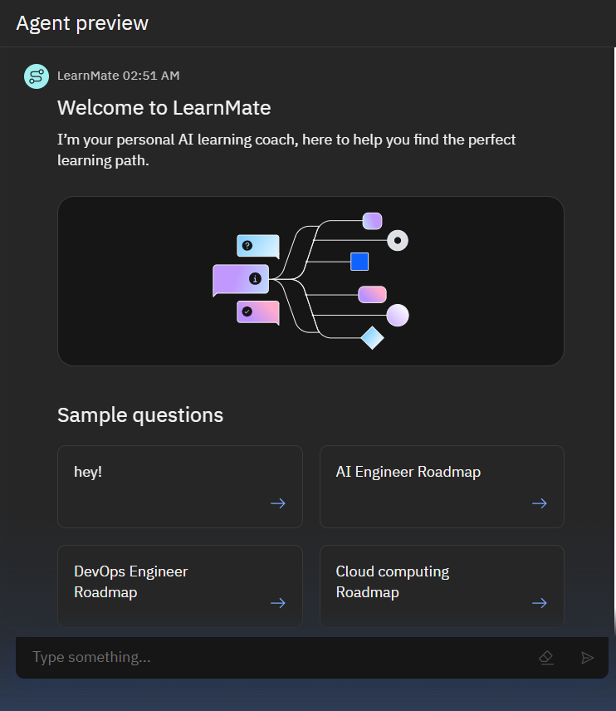
Results

Slide 9
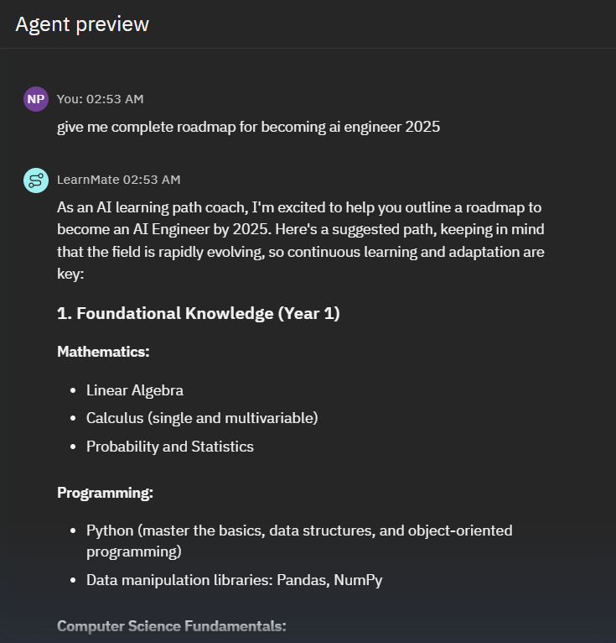
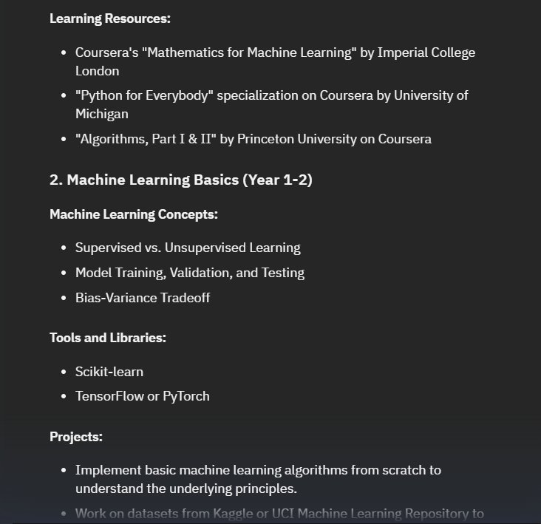
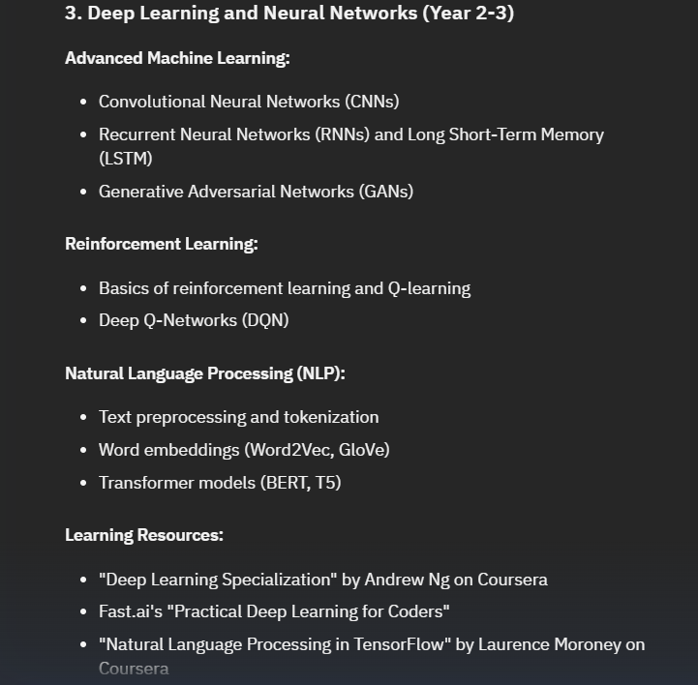
Results

Slide 10
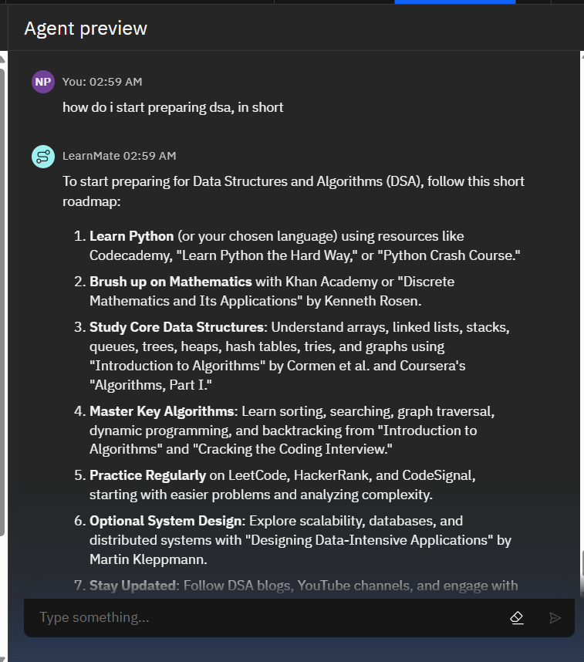
Results

Slide 11
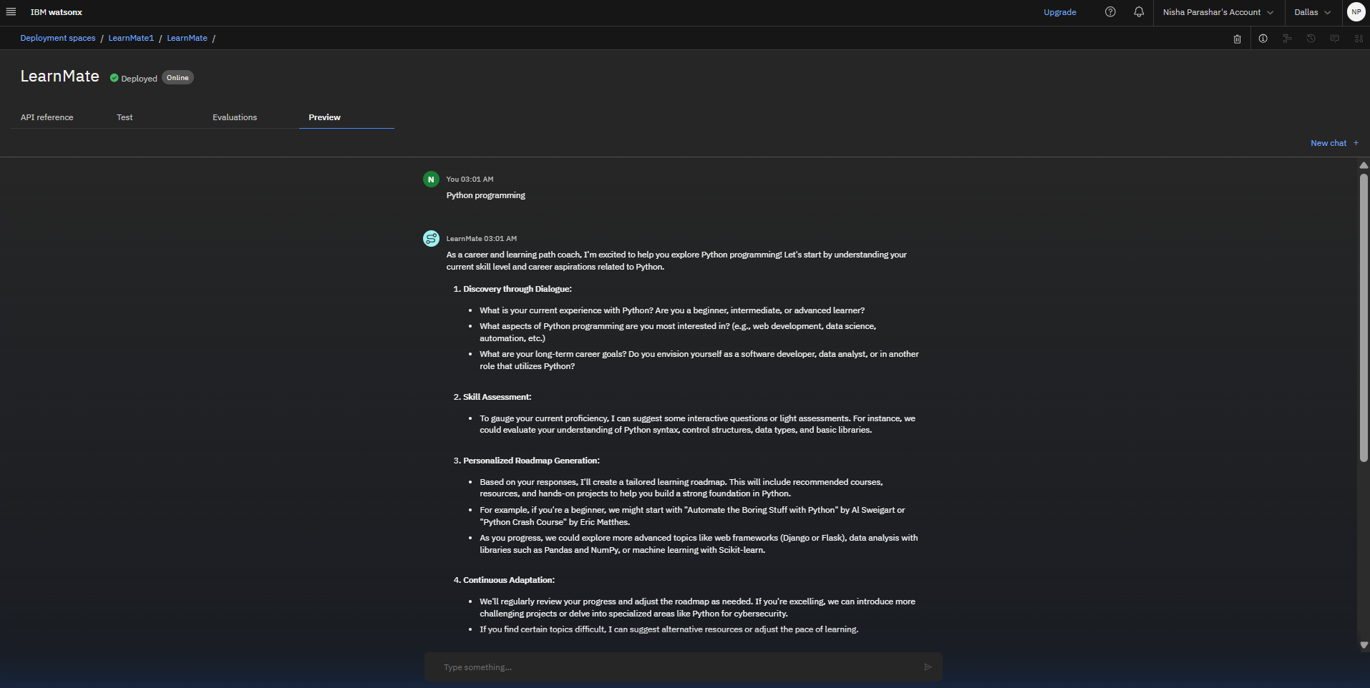
Results
Deployed AI Agent

Slide 12
Conclusion
LearnMate acts as a personalized AI coach, guiding students in discovering interests, assessing skills, and building adaptive learning roadmaps.
It saves time by automating learning path selection, resource discovery, and ongoing skill assessment.
LearnMate enhances motivation, confidence, and learning outcomes through dynamic feedback, personalized support, and real-time progress tracking.

Slide 13
GitHub Link
https://github.com/niishaparashar/LearnMate

Slide 14
Future scope
Multilingual Learning Support
Voice-Enabled Learning Coach
Real-Time Peer Collaboration Features
Automated Skill Gap & Career Pathway Analysis
Integration with Online Certification Platforms
AI-Assisted Portfolio and Resume Building

Slide 15
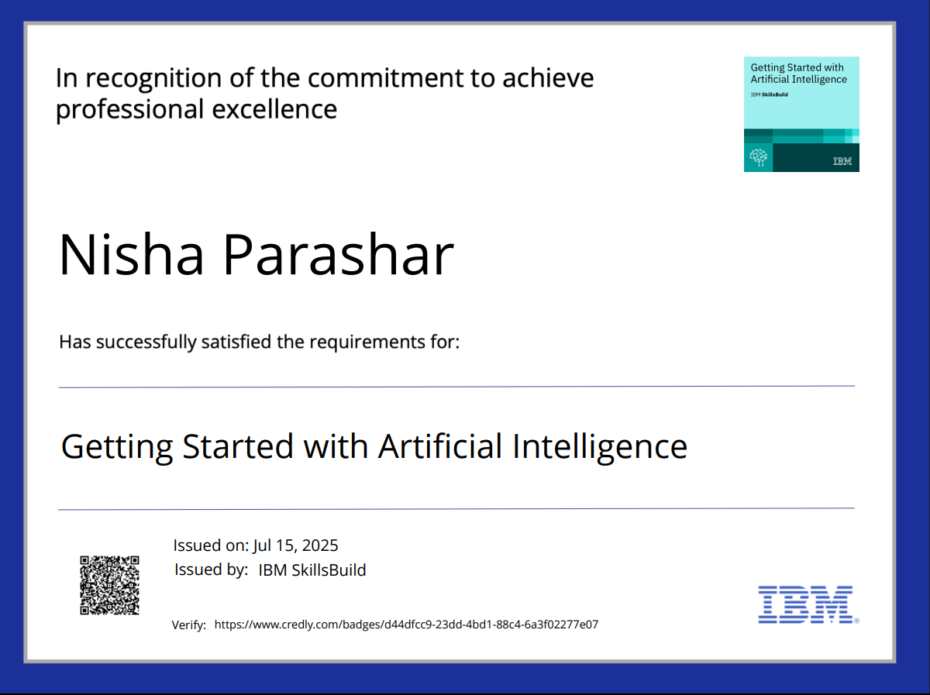
IBM Certifications

Slide 16
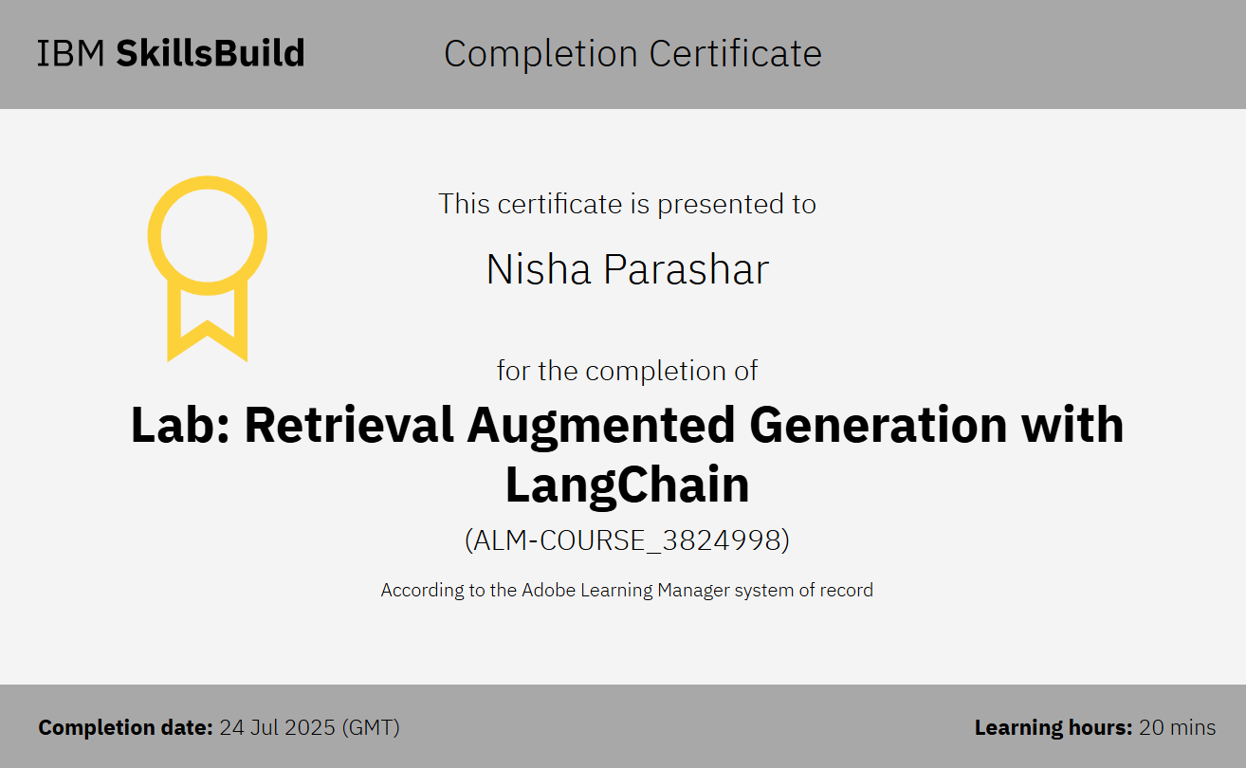

Slide 17
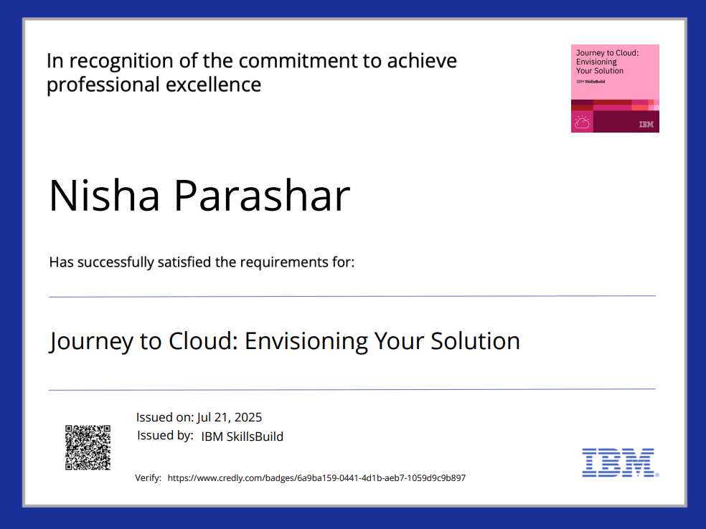

Slide 18
THANK YOU

