Slide 1
Programming with Java
Chapter 3: Introduction to Streams

Slide 2
Chapter Objectives
In this chapter, you will be:
Using Stream to
Function pipeline
Convert different Data type to Stream
Benefits of Stream

Slide 3
Chapter Concepts
Assumed Knowledge
Stream in Java
Stream pipeline
Comparison Based Stream Operations
Collectors
Optional Class
Chapter Summary
Exercise

Slide 4
Assumed Knowledge
This course focuses mainly on applied use of Java and important concepts
We assume knowledge of basic Java syntax
Appendix A covers the basics and includes suggestions for additional reading
In particular, we assume you are familiar with these topics:
Program structure (e.g., all code in methods, {…})
Data types (primitives vs. objects)
Operators (e.g., =, +, -, ==, >, ?…:, &&)
Control structures (e.g., if…else, switch, while, for)
Arrays ([])
Managed memory model (garbage collection)
Java is from the C family of languages
Knowledge of any other language in that family will help

Slide 5
Chapter Concepts
Assumed Knowledge
Stream in Java
Stream pipeline
Comparison Based Stream Operations
Collectors
Optional Class
Chapter Summary
Exercise

Slide 6
Streams in Java
Streams are not related to InputStreams, OutputStreams, etc.
Streams are NOT data structures but are wrappers around Collection that carry values from a source through a pipeline of operations.
Streams are more powerful, faster and more memory efficient than Lists
Streams are designed for lambdas
Streams can easily be output as arrays or lists
Streams employ lazy evaluation
Streams are parallelizable Interfaces with only one abstract method.
With only one abstract method, these interfaces can be easily represented with lambda expressions

Slide 7
Java Stream Creation
Empty Stream
Stream of Collection: create a stream of any type of Collection (Collection, List, Set)
Stream of Array
Stream.builder() :the build() method will create an instance of the Stream<Object>:
Stream<String> streamEmpty = Stream.empty();
Collection<String> collection = Arrays.asList("a", "b", "c"); Stream<String> streamOfCollection = collection.stream();
Stream<String> streamOfArray = Stream.of("a", "b", "c");
Stream<String> streamBuilder = Stream.<String>builder().add("a").add("b").add("c").build();

Slide 8
Demonstration
Create a program to show how to use stream object

Slide 9
Chapter Concepts
Assumed Knowledge
Stream in Java
Stream pipeline
Comparison Based Stream Operations
Collectors
Optional Class
Chapter Summary
Exercise

Slide 10
Stream Pipeline
A Stream is processed through a pipeline of operations
A Stream starts with a source data structure
Intermediate methods are performed on the Stream elements. These methods produce Streams and are not processed until the terminal method is called.
The Stream is considered consumed when a terminal operation is invoked. No other operation can be performed on the Stream elements afterwards
A Stream pipeline contains some short-circuit methods (which could be intermediate or terminal methods) that cause the earlier intermediate methods to be processed only until the short-circuit method can be evaluated.

Slide 11
Stream Methods
Intermediate Methods
map, filter, distinct, sorted, peek, limit, parallel
Terminal Methods
forEach, toArray, reduce, collect, min,max, count, anyMatch, allMatch, noneMatch, findFirst, findAny, iterator
Short-circuit Methods
anyMatch, allMatch, noneMatch, findFirst, findAny,limit

Slide 12
forEach()
forEach() : This method is used to traverse each element of the stream. It is used mainly to display the elements in a Stream.
List<String> placesToVisit= new ArrayList<String>();
placesToVisit.add("Chicago");
placesToVisit.add("Venice");
placesToVisit.add("Tokyo");
placesToVisit.add("San Francisco");
placesToVisit.add("Kyoto");
placesToVisit.add("Abu Dhabi");
placesToVisit.forEach(place -> System.out.println("Trip to " + place));

Slide 13
Map()
map() : This method is used to return a new stream based on operations done on an existing stream.
List<String> placesToVisit= new ArrayList<String>();
placesToVisit.add("Chicago");
placesToVisit.add("Venice");
placesToVisit.add("Tokyo");
placesToVisit.add("San Francisco");
placesToVisit.add("Kyoto");
placesToVisit.add("Abu Dhabi");
placesToVisit.stream().map(place -> place.toUpperCase()).forEach(place -> System.out.println(place));

Slide 14
Filter()
filter() : This method is used to return a new filtered stream based on conditions given for filtering.
List<String> placesToVisit= new ArrayList<String>();
placesToVisit.add("Chicago");
placesToVisit.add("Venice");
placesToVisit.add("Tokyo");
placesToVisit.add("San Francisco");
placesToVisit.add("Kyoto");
placesToVisit.add("Abu Dhabi");
placesToVisit.stream().filter(place -> place.length() == 5).forEach(x -> System.out.println(x));

Slide 15
Sorted()
sorted() : This method is used to sort the elements in a Stream. Argument for this method is optional.
//No Argument passed in sorted()
List<String> placesToVisit= new ArrayList<String>();
placesToVisit.add("Chicago");
placesToVisit.add("Venice");
placesToVisit.add("Tokyo");
placesToVisit.add("San Francisco");
placesToVisit.add("Kyoto");
placesToVisit.add("Abu Dhabi");
placesToVisit.stream().sorted().forEach(x -> System.out.println(x));

Slide 16
Collect()
collect() : This method stores the modified stream as a new collection type (it can be list, map etc.), after the stream operation terminates, under a new identifier.
List<Integer> number = new ArrayList();
number.add(2);
number.add(3);
number.add(4);
number.add(5);
//The Modified Stream is stored in "doubled" using collect()
List<Integer> doubled = number.stream().map(x->2*x).collect(Collectors.toList());
System.out.println(doubled);

Slide 17
Collect()
collect() : This method stores the modified stream as a new collection type (it can be list, map etc.), after the stream operation terminates, under a new identifier.
List<Integer> number = new ArrayList();
number.add(2);
number.add(3);
number.add(4);
number.add(5);
//The Modified Stream is stored in "doubled" using collect()
List<Integer> doubled = number.stream().map(x->2*x).collect(Collectors.toList());
System.out.println(doubled);

Slide 18
Stream Pipeline Example
Stream<Integer> intStream = Stream.of(10,2,7,5,6,5,8,11);
intStream.filter(n -> { System.out.println("Filtering Current Element: "+n); return n % 2 == 0; })
.map(n -> { System.out.println("Mapping Current Element: "+n); return n * n * n; })
.sorted()
.forEach(n -> System.out.println(n));

Slide 19
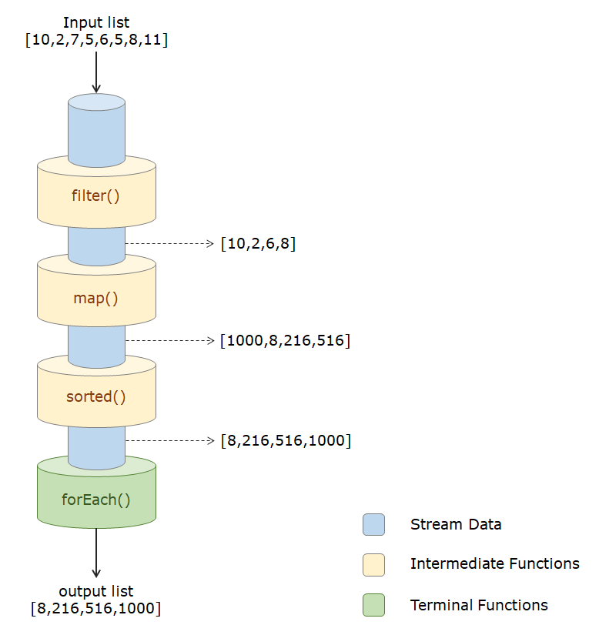
flow of execution of Pipeline Methods

Slide 20
Stream Pipeline Example2
List<String> placesToVisit= new ArrayList<String>();
placesToVisit.add("Chicago");
placesToVisit.add("Venice");
placesToVisit.add("Tokyo");
placesToVisit.add("San Francisco");
placesToVisit.add("Kyoto");
placesToVisit.add("Abu Dhabi");
//Chaining Multiple Operations of Streams Together
placesToVisit.stream() //stream()
.filter(place -> place.length() <= 8) //filter()
.map(place -> place.toUpperCase()) //map()
.forEach(x -> System.out.println(x)); //forEach()

Slide 21
Lazy Evaluation
Computation on the source data is only performed when the terminal operation is initiated, and source elements are consumed only as needed.
All intermediate operations are lazy, so they’re not executed until a result of a processing is actually needed.

Slide 22
Demonstartion
Create programs to show Stream methods and pipeline

Slide 23
Chapter Concepts
Assumed Knowledge
Stream in Java
Stream pipeline
Comparison Based Stream Operations
Collectors
Optional Class
Chapter Summary
Exercise

Slide 24
Comparison Based Stream Operations
sorted() operation
allMatch, anyMatch, and noneMatch
List<Employee> employees = empList.stream()
.sorted((e1, e2) -> e1.getName().compareTo(e2.getName()))
.collect(Collectors.toList());
List<Integer> intList = Arrays.asList(2, 4, 5, 6, 8);
boolean allEven = intList.stream().allMatch(i -> i % 2 == 0);
boolean oneEven = intList.stream().anyMatch(i -> i % 2 == 0);
boolean noneMultipleOfThree = intList.stream().noneMatch(i -> i % 3 == 0);

Slide 25
Demonstration
Create an example to show all methods

Slide 26
Chapter Concepts
Assumed Knowledge
Stream in Java
Stream pipeline
Comparison Based Stream Operations
Collectors
Optional Class
Chapter Summary
Exercise

Slide 27
Collectors
Collectors.joining()-It internally uses a java.util.StringJoiner to perform the joining operation.
partitioningBy-We can partition a stream into two – based on whether the elements satisfy certain criteria or not.
String empNames = empList.stream()
.map(Employee::getName)
.collect(Collectors.joining(", "))
.toString();
List<Integer> intList = Arrays.asList(2, 4, 5, 6, 8);
Map<Boolean, List<Integer>> isEven = intList.stream().collect(
Collectors.partitioningBy(i -> i % 2 == 0));

Slide 28
Collectors
groupingBy() - partition the stream into more than just two groups.
Mapping()- sometimes we might need to group data into a type other than the element type.
//grouped the employees based on the initial character of their first name.
Map<Character, List<Employee>> groupByAlphabet = empList.stream().collect(
Collectors.groupingBy(e -> new Character(e.getName().charAt(0))));
Map<Character, List<Integer>> idGroupedByAlphabet = empList.stream().collect(
Collectors.groupingBy(e -> new Character(e.getName().charAt(0)),
Collectors.mapping(Employee::getId, Collectors.toList())));
//mapping() maps the stream element Employee into just the employee id – which is an Integer – using the getId() mapping function. These ids are still grouped based on the initial character of employee first name.

Slide 29
Reduction Operations
A reduction operation (also called as fold) takes a sequence of input elements and combines them into a single summary result by repeated application of a combining operation
Double sumSal = empList.stream()
.map(Employee::getSalary)
.reduce(0.0, Double::sum);
//we start with the initial value of 0 and repeated apply Double::sum() on elements of the stream.

Slide 30
Parallel Stream
perform stream operations in parallel without having to write any boilerplate code
//Here salaryIncrement() would get executed in parallel on multiple elements of the stream, by simply adding the parallel() syntax.
Employee[] arrayOfEmps = {
new Employee(1, "Jeff Bezos", 100000.0),
new Employee(2, "Bill Gates", 200000.0),
new Employee(3, "Mark Zuckerberg", 300000.0)
};
List<Employee> empList = Arrays.asList(arrayOfEmps);
empList.stream().parallel().forEach(e -> e.salaryIncrement(10.0));

Slide 31
Demonstration
Create a program to show how to reduce stream
Create a program to demonstrate parallel stream

Slide 32
Chapter Concepts
Assumed Knowledge
Stream in Java
Stream pipeline
Comparison Based Stream Operations
Collectors
Optional Class
Chapter Summary
Exercise

Slide 33
Optional Class
It is a public final class and used to deal with NullPointerException in Java application.
Common methods
isPresent() – returns true if value is present
Get() – returns value if present
orElse(T other) – returns value if present, or other
ifPresent(Consumer) – runs the lambda if value is present
//Create Empty Option Object
Optional<String> empty = Optional.empty();
//Create Empty Option Object using of()
Optional<String> opt = Optional.of(name);

Slide 34
Chapter Concepts
Assumed Knowledge
Stream in Java
Stream pipeline
Comparison Based Stream Operations
Collectors
Optional Class
Chapter Summary
Exercise

Slide 35
Chapter Summary
Streams are not related to InputStreams, OutputStreams, etc.
Streams are NOT data structures but are wrappers around Collection that carry values from a source through a pipeline of operations.
Streams are more powerful, faster and more memory efficient than Lists
Streams are designed for lambdas
Streams can easily be output as arrays or lists
Streams employ lazy evaluation
Streams are parallelizable Interfaces with only one abstract method.
With only one abstract method, these interfaces can be easily represented with lambda expressions

Slide 36
Exercise
In a lottery contest the company decided to give prize to those participants whose name started with “J” and has exactly 4 letters in it. Write a chained stream operations based code to find the name of winners.
Input : [“Jack”, “John”, “Garry”, “Jill”, “Jim”, “Frank”]
Output: [Jack, John, Jill]

