Slide 2
Programming with Java
Chapter 4: Introduction to Design Pattern

Slide 3
Chapter Objectives
In this chapter, you will be:
Usage of Design Pattern
Most common Java usage pattern
Declare, Construct, Assign, Call methods

Slide 4
Chapter Concepts
Assumed Knowledge
Design Pattern
Creational Design Pattern
Structural Design Pattern
Behavioural Design Pattern

Slide 5
Assumed Knowledge
This course focuses mainly on applied use of Java and important concepts
We assume knowledge of basic Java syntax
Appendix A covers the basics and includes suggestions for additional reading
In particular, we assume you are familiar with these topics:
Program structure (e.g., all code in methods, {…})
Data types (primitives vs. objects)
Operators (e.g., =, +, -, ==, >, ?…:, &&)
Control structures (e.g., if…else, switch, while, for)
Arrays ([])
Managed memory model (garbage collection)
Java is from the C family of languages
Knowledge of any other language in that family will help

Slide 6
Chapter Concepts
Assumed Knowledge
Design Pattern
Creational Design Pattern
Structural Design Pattern
Behavioural Design Pattern

Slide 7
Design Pattern
Design patterns capture the best practices of experienced object-oriented software developers.
Design patterns are solutions to general software development problems.
“Each pattern describes a problem which occurs over and over again in our environment, and then describes the core of the solution to that problem, in such a way that you can use this solution a million times over, without ever doing it the same way twice.” [1]
[Christopher Alexander]

Slide 8
Essential Elements of Design Pattern
In general, a pattern has four essential elements.
The pattern name
The problem
The solution
The consequences

Slide 9
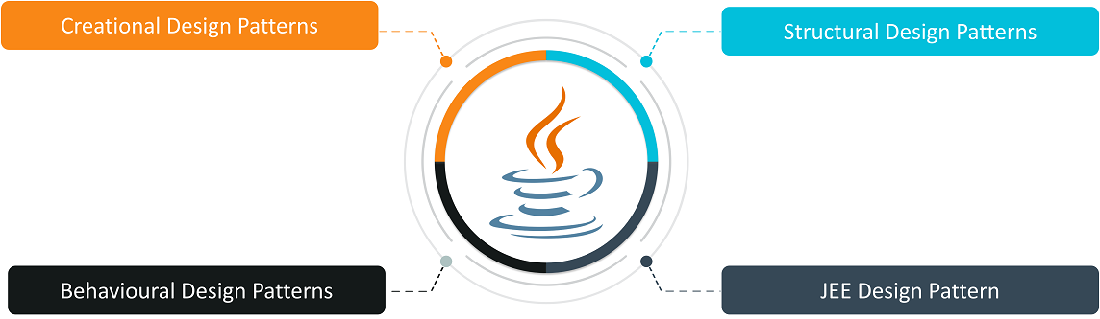
Types of Design Pattern
Creational Design Patterns are concerned with the method of creating Objects.
Structural Design Patterns deal with the composition of classes and objects which form larger structures.
Behaviour Design Patterns are concerned with the responsibility and interaction between the objects.
JEE Design Patterns are concerned with providing solutions to the Java EE-based software applications and frameworks.

Slide 10
Chapter Concepts
Assumed Knowledge
Design Pattern
Creational Design Pattern
Structural Design Pattern
Behavioral Design Pattern

Slide 11
Creational Design Patterns
Factory Pattern
Abstract Factory Pattern
Singleton Pattern
Prototype Pattern
Builder Pattern.

Slide 12
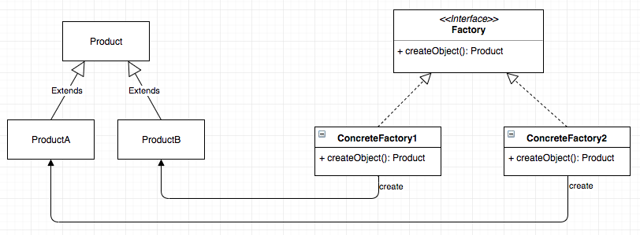
Factory Design Pattern
It follows the principle of
“Define an interface or abstract class for creating an object but let the subclasses decide which class to instantiate”.
It is also known as Virtual Constructor.
Advantages:
allow all the sub-classes to choose the type of objects so as to create them.
promotes the loose-coupling by eliminating the need to bind application-specific classes into the code.

Slide 13
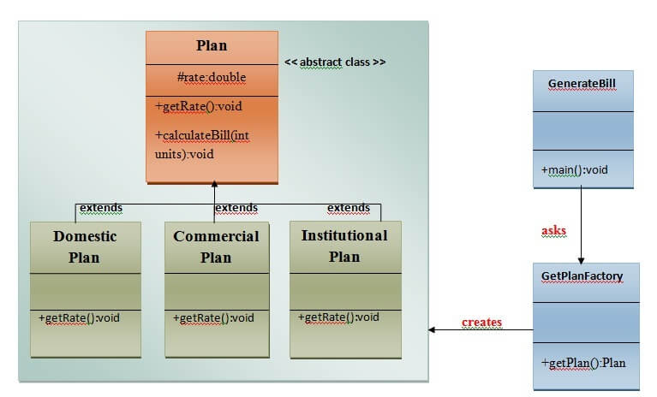
Demonstration
Convert UML diagram in Java Coding and run

Slide 14
Abstract Factory Pattern
lets you produce families of related objects without specifying their concrete classes.
Advantage
isolates the client code from concrete (implementation) classes.
It eases the exchanging of object families.
It promotes consistency among objects.

Slide 15
Example
Suppose you are writing a program to plan the layout of gardens. These could be annual gardens, vegetable gardens or perennial gardens. However, no matter which kind of garden you are planning, you want to ask the same questions:
What are good border plants?
What are good center plants?
What plants do well in partial shade?

Slide 16
Demonstration
Write a program to demonstrate the use of Abstract Factory Method

Slide 17
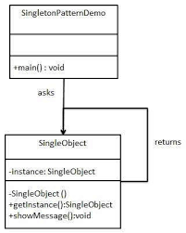
Singleton Pattern
The Singleton pattern ensures a class has only one instance, and provides a global point of access to it.
Singletons maintain a static reference to the sole singleton instance and return a reference to that instance from a static instance() method.

Slide 18
Demonstration
Write a program to demonstrate the use of Singleton Design Pattern

Slide 19
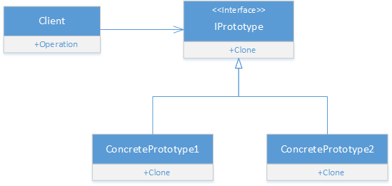
Prototype Design Pattern
cloning of an existing object instead of creating new one and can also be customized as per the requirement.
Advantage of Prototype Pattern
It reduces the need of sub-classing.
It hides complexities of creating objects.
The clients can get new objects without knowing which type of object it will be.
It lets you add or remove objects at runtime.

Slide 20
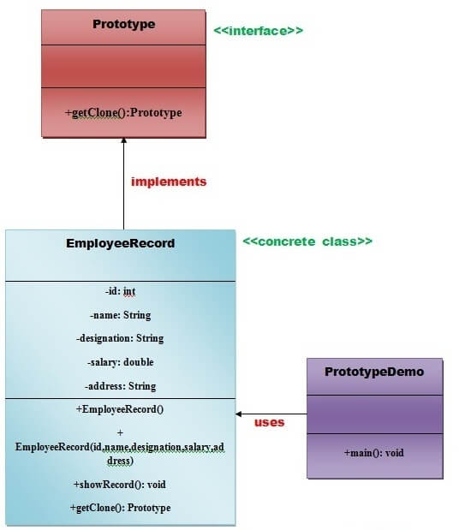
Demonstration
Write a program to demonstrate the use of Prototype Design Pattern

Slide 21
Builder Design Pattern
The Builder Pattern separates the construction of a complex object from its representation so that the same construction process can create different representations.
Advantages
The parameters to the constructor are reduced and are provided in highly readable method calls.
Builder design pattern also helps in minimizing the number of parameters in the constructor and thus there is no need to pass in null for optional parameters to the constructor.
Object is always instantiated in a complete state
Immutable objects can be built without much complex logic in the object building process.

Slide 22
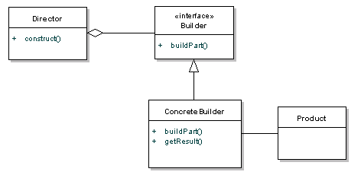
Builder Design Pattern
Builder - specifies an abstract interface for creating parts of a Product object.
ConcreteBuilder - constructs and assembles parts of the product by implementing the Builder interface. Also, it defines and keeps track of the representation it creates and provides an interface for retrieving the product .
Director - constructs an object using the Builder interface.
Product - represents the complex object under construction.

Slide 23
Demonstration
Write a program to demonstrate the use of Builder Design Pattern

Slide 24
Chapter Concepts
Assumed Knowledge
Design Pattern
Creational Design Pattern
Structural Design Pattern
Behavioral Design Pattern

Slide 25
Structural Design Pattern
Structural patterns describe how classes and objects can be combined to form larger structures.
The difference between class patterns and object patterns is that class patterns describe how inheritance can be used to provide more useful program interfaces.
Object patterns, on the other hand, describe how objects can be composed into larger structures using object composition, or the inclusion of objects within other objects.

Slide 26
Different Structural Design Patern
The Structural patterns are:
Adapter
Composite
Proxy
Flyweight
Façade
Bridge
Decorator

Slide 27
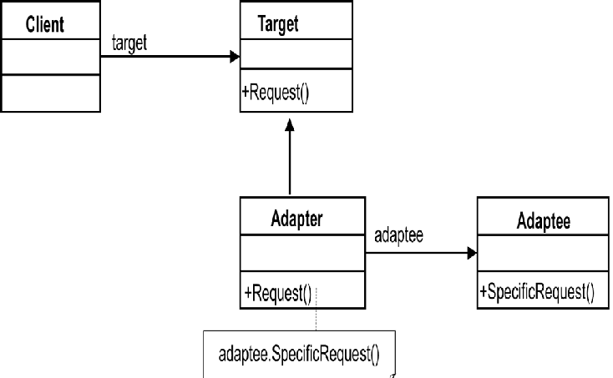
Adapter Design Pattern
Adapters are used to enable objects with different interfaces to communicate with each other.
The Adapter pattern is used to convert the programming interface of one class into that of another.
We use adapters whenever we want unrelated classes to work together in a single program.
write a class that has the desired interface and then make it communicate with the class that has a different interface.

Slide 28
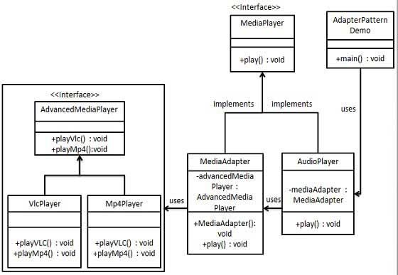
Demonstrator
Write code to demonstrate UML diagram

Slide 29
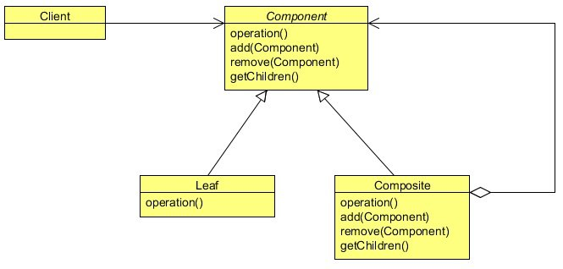
Composite Design Pattern
It allows a client object to treat both single components and collections of components identically.
Composite patterns are often used to represent recursive data structures.
Use the Composite pattern when:
You want to represent part-whole hierarchies of objects.
You want clients to be able to ignore the difference between compositions of objects and individual objects. Clients will treat all objects in the composite structure uniformly.

Slide 30
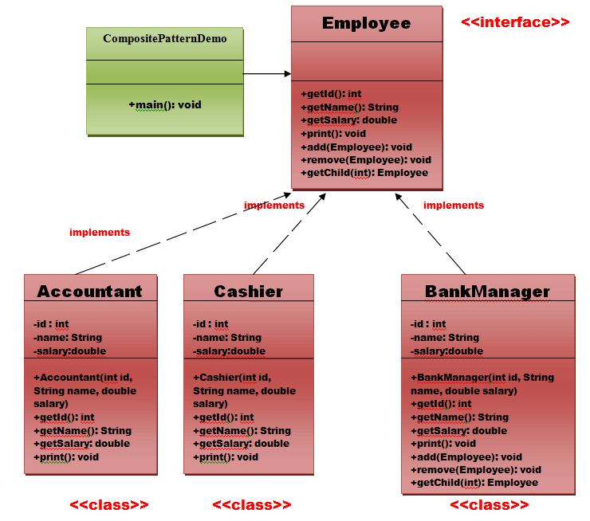
Demonstrator
Write a program to show composite design pattern

Slide 31
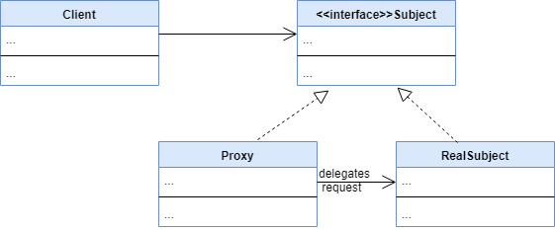
Proxy Design Pattern
The Proxy pattern allows us to create an intermediary that acts as an interface to another resource, while also hiding the underlying complexity of the component.
When to use proxy design pattern:
When we want a simplified version of a complex or heavy object.
When we want to add a layer of security to the original underlying object to provide controlled access based on access rights of the client.

Slide 32
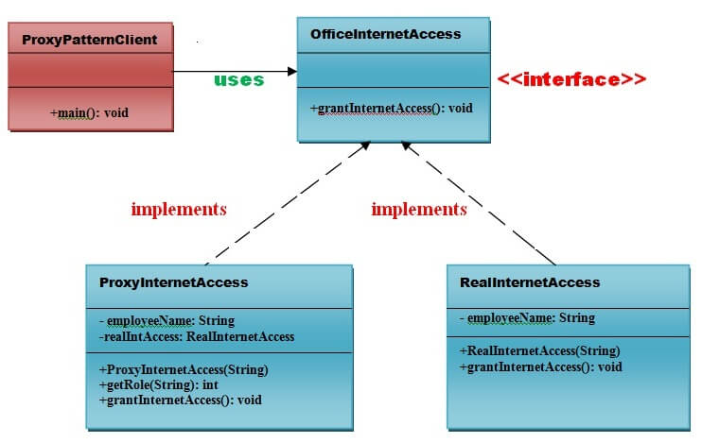
Demonstrator
Write a program to show proxy design pattern

Slide 33
Flyweight Design Pattern
When we want to create large number of similar objects having almost similar functionality. Instead of creating large number of instances of a class we can reuse already existing similar objects by storing them. IF no match found, then we will create a new object and store it for future reuse.
When we want to reduce the storage cost of large number of objects and improve performance.
When we can make object specific attributes external and can be computes on run-time.
When client doesn't enforce unique objects.

Slide 34
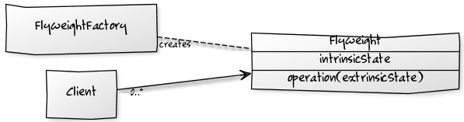
Flyweight Design Pattern
A flyweight objects essentially has two kind of attributes – intrinsic and extrinsic.
An intrinsic state attribute is stored/shared in the flyweight object, and it is independent of flyweight’s context.
Client objects maintain the extrinsic state, and they need to pass this to a flyweight object during object creation.

Slide 35
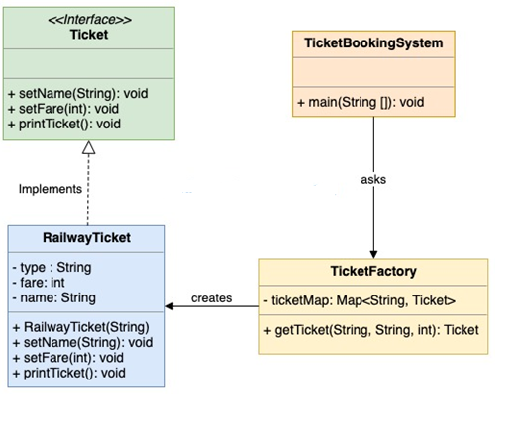
Demonstration
Convert following UML diagram to Java Code

Slide 36
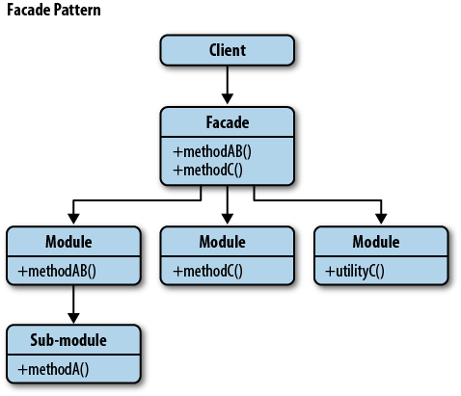
Façade Design Pattern
Facade pattern is often needed when there is a large number of interdependent classes or because parts of the code are unavailable.
It is used as a camouflage to cover the complexities of a large system
It is a wrapper class used to hide the implementation details.

Slide 37
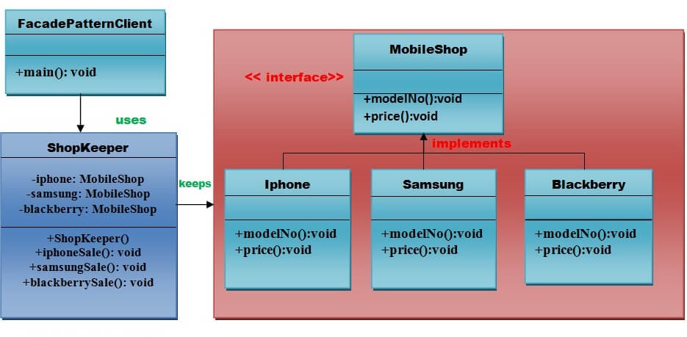
Demonstration
Convert UML diagram to Java Code

Slide 38
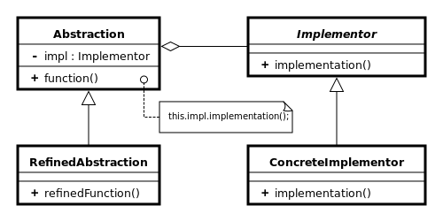
Bridge Design Pattern
“Decouples an abstraction from its implementation so that the two can vary independently.”
It decouples the abstract elements of a class from its implementation by providing a bridge structure between them.
It follows the principle which says “prefer composition over inheritance”.

Slide 39
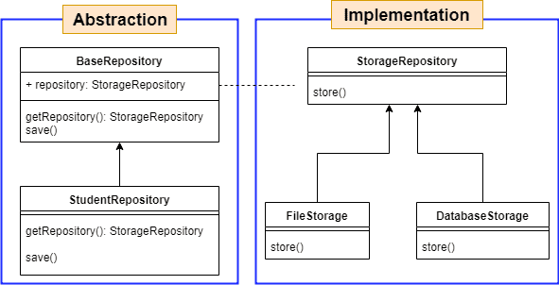
Demonstration
Demonstrate UML in Java Code

Slide 40
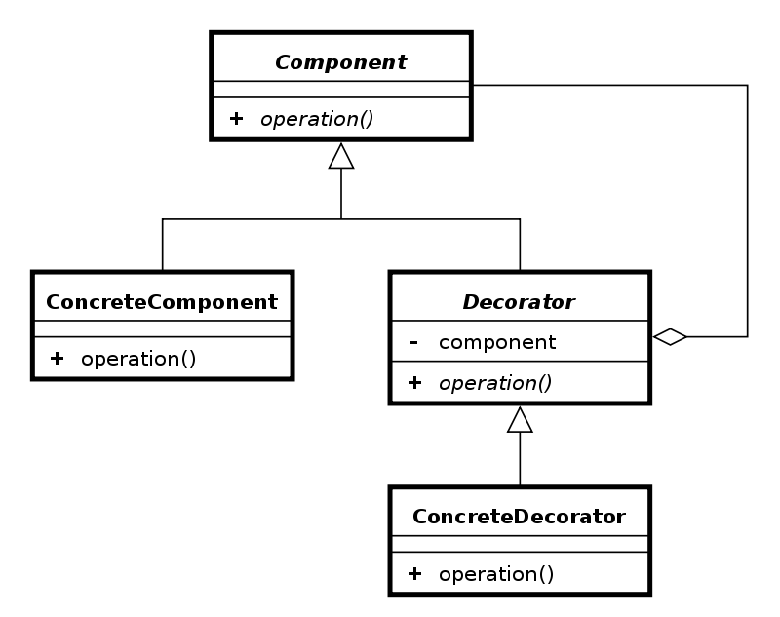
Decorator Design Pattern
Use to modify the functionality of an object at runtime.
At the same time other instances of the same class will not be affected by this.
Use inheritance or composition to extend the behavior of an object but this is done at compile time and its applicable to all the instances of the class

Slide 41
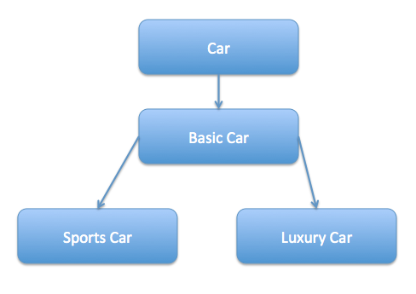
Demonstration
Convert following diagram to Java Code

Slide 42
Chapter Concepts
Assumed Knowledge
Design Pattern
Creational Design Pattern
Structural Design Pattern
Behavioural Design Pattern

Slide 43
Behavioural Design Pattern
It is concerned with the interaction and responsibility of objects.
In these design patterns, the interaction between the objects should be in such a way that they can easily talk to each other and still should be loosely coupled.
It reduces hard coding and dependencies.
It reduces the complexity of communication between the objects.
It defines the best possible way to communicate between the objects.
It saves the number of resources. By saving the number of resources, we can serve particular clients in a particular amount of time.

Slide 44
Different Behavioural Design Pattern
Chain of Responsibilities
Strategy
Command
Observer
Template Method
Iterator

Slide 45
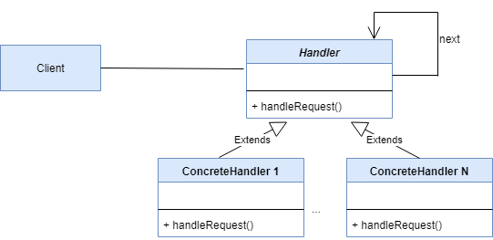
Chain of Responsibility Design Pattern
"avoid coupling the sender of a request to its receiver by giving multiple objects a chance to handle the request".
For example, an ATM uses the Chain of Responsibility design pattern in money giving process.
It reduces the coupling.
It adds flexibility while assigning the responsibilities to objects.
It allows a set of classes to act as one; events produced in one class can be sent to other handler classes with the help of composition.

Slide 46
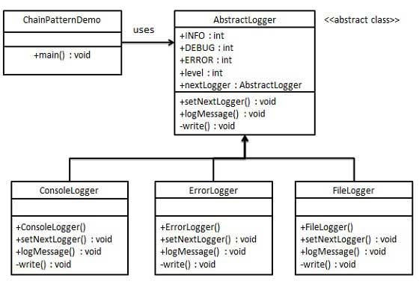
Demonstration
Convert the following UML Diagram to Java code

Slide 47
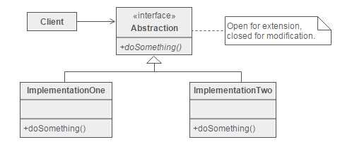
Strategy Design Pattern
"defines a family of functionality, encapsulate each one, and make them interchangeable".
It’s easy to switch between different algorithms (strategies) in runtime because you’re using polymorphism in the interfaces.
Clean code because you avoid conditional-infested code (not complex).

Slide 48
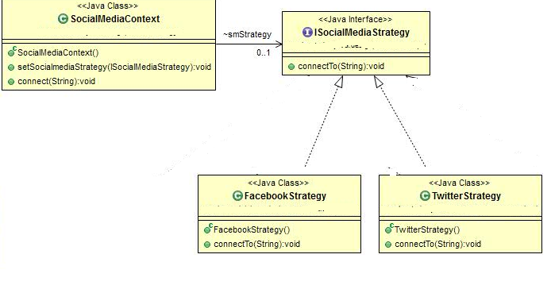
Demonstration
Convert Following UML Diagram to Java code

Slide 49
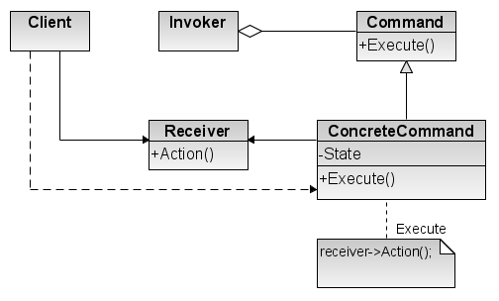
Command Design Pattern
"encapsulate a request under an object as a command and pass it to invoker object. Invoker object looks for the appropriate object which can handle this command and pass the command to the corresponding object and that object executes the command".
It is also known as Action or Transaction.
It separates the object that invokes the operation from the object that actually performs the operation.
It makes easy to add new commands, because existing classes remain unchanged.

Slide 50
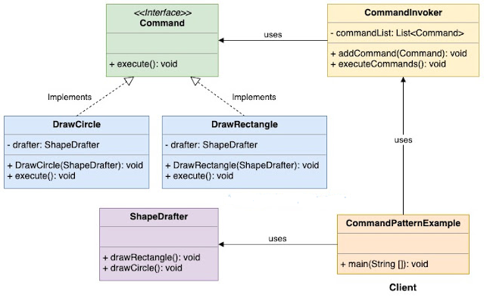
Demonstration
Convert following UML diagram in Java Code

Slide 51
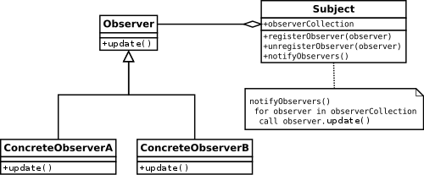
Observer Design Pattern
It specifies communication between objects: observable and observers. An observable is an object which notifies observers about the changes in its state.
For example, a news agency can notify channels when it receives news.

Slide 52
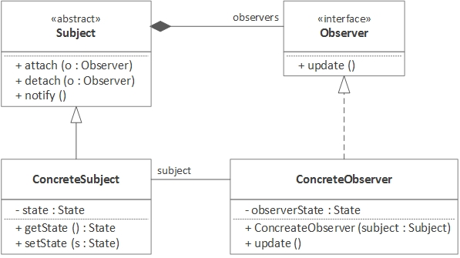
Demonstration
Convert following UML Diagram to Java Code

Slide 53
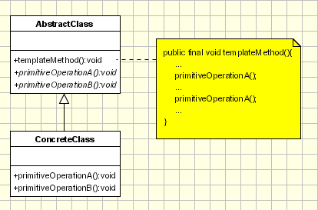
Template Design Pattern
allows you to defines a skeleton of an algorithm in a base class and let subclasses override the steps without changing the overall algorithm’s structure.
there is no code duplication.
Code reuse happens with the Template Method pattern as it uses inheritance and not composition. Only a few methods need to be overridden.
Flexibility lets subclasses decide how to implement steps in an algorithm.

Slide 54
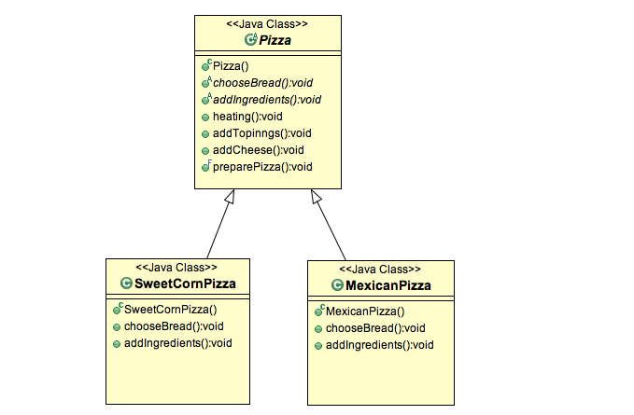
Demonstration
Demonstrate following UML Diagram in Java Code

Slide 55
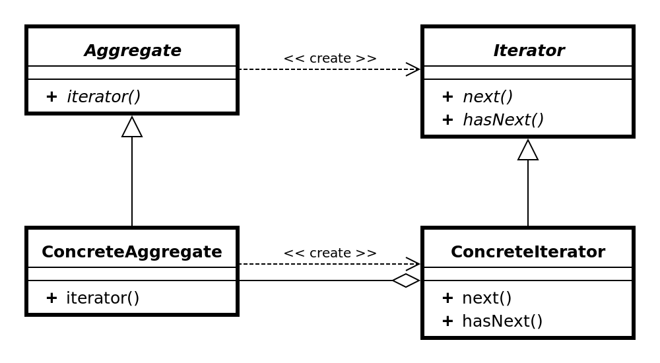
Iterator Design Pattern
It is used "to access the elements of an aggregate object sequentially without exposing its underlying implementation“
It is also known as Cursor.
It supports variations in the traversal of a collection.
It simplifies the interface to the collection.

Slide 56
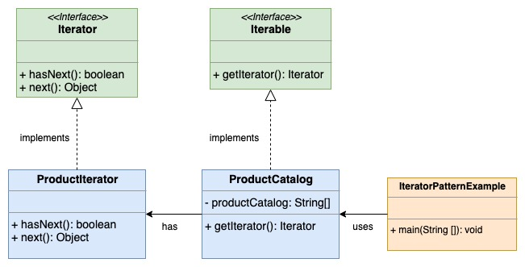
Demonstration
Convert following UML Design Pattern in Java Code

Slide 57
Chapter Summary
Design patterns capture the best practices of experienced object-oriented software developers.
Creational Design Patterns are concerned with the method of creating Objects.
Structural Design Patterns deal with the composition of classes and objects which form larger structures.
Behavioral Design Patterns are concerned with the responsibility and interaction between the objects.
JEE Design Patterns are concerned with providing solutions to the Java EE-based software applications and frameworks.

Slide 58
Exercise
Create a builder for a class, that has the following fields
Builder should be defined inside the class Dog and shound be the only of creating its instance.
public class Dog {
private String name;
private String type;
private Integer age;
private List<String> toys;
}
}

