Slide 1
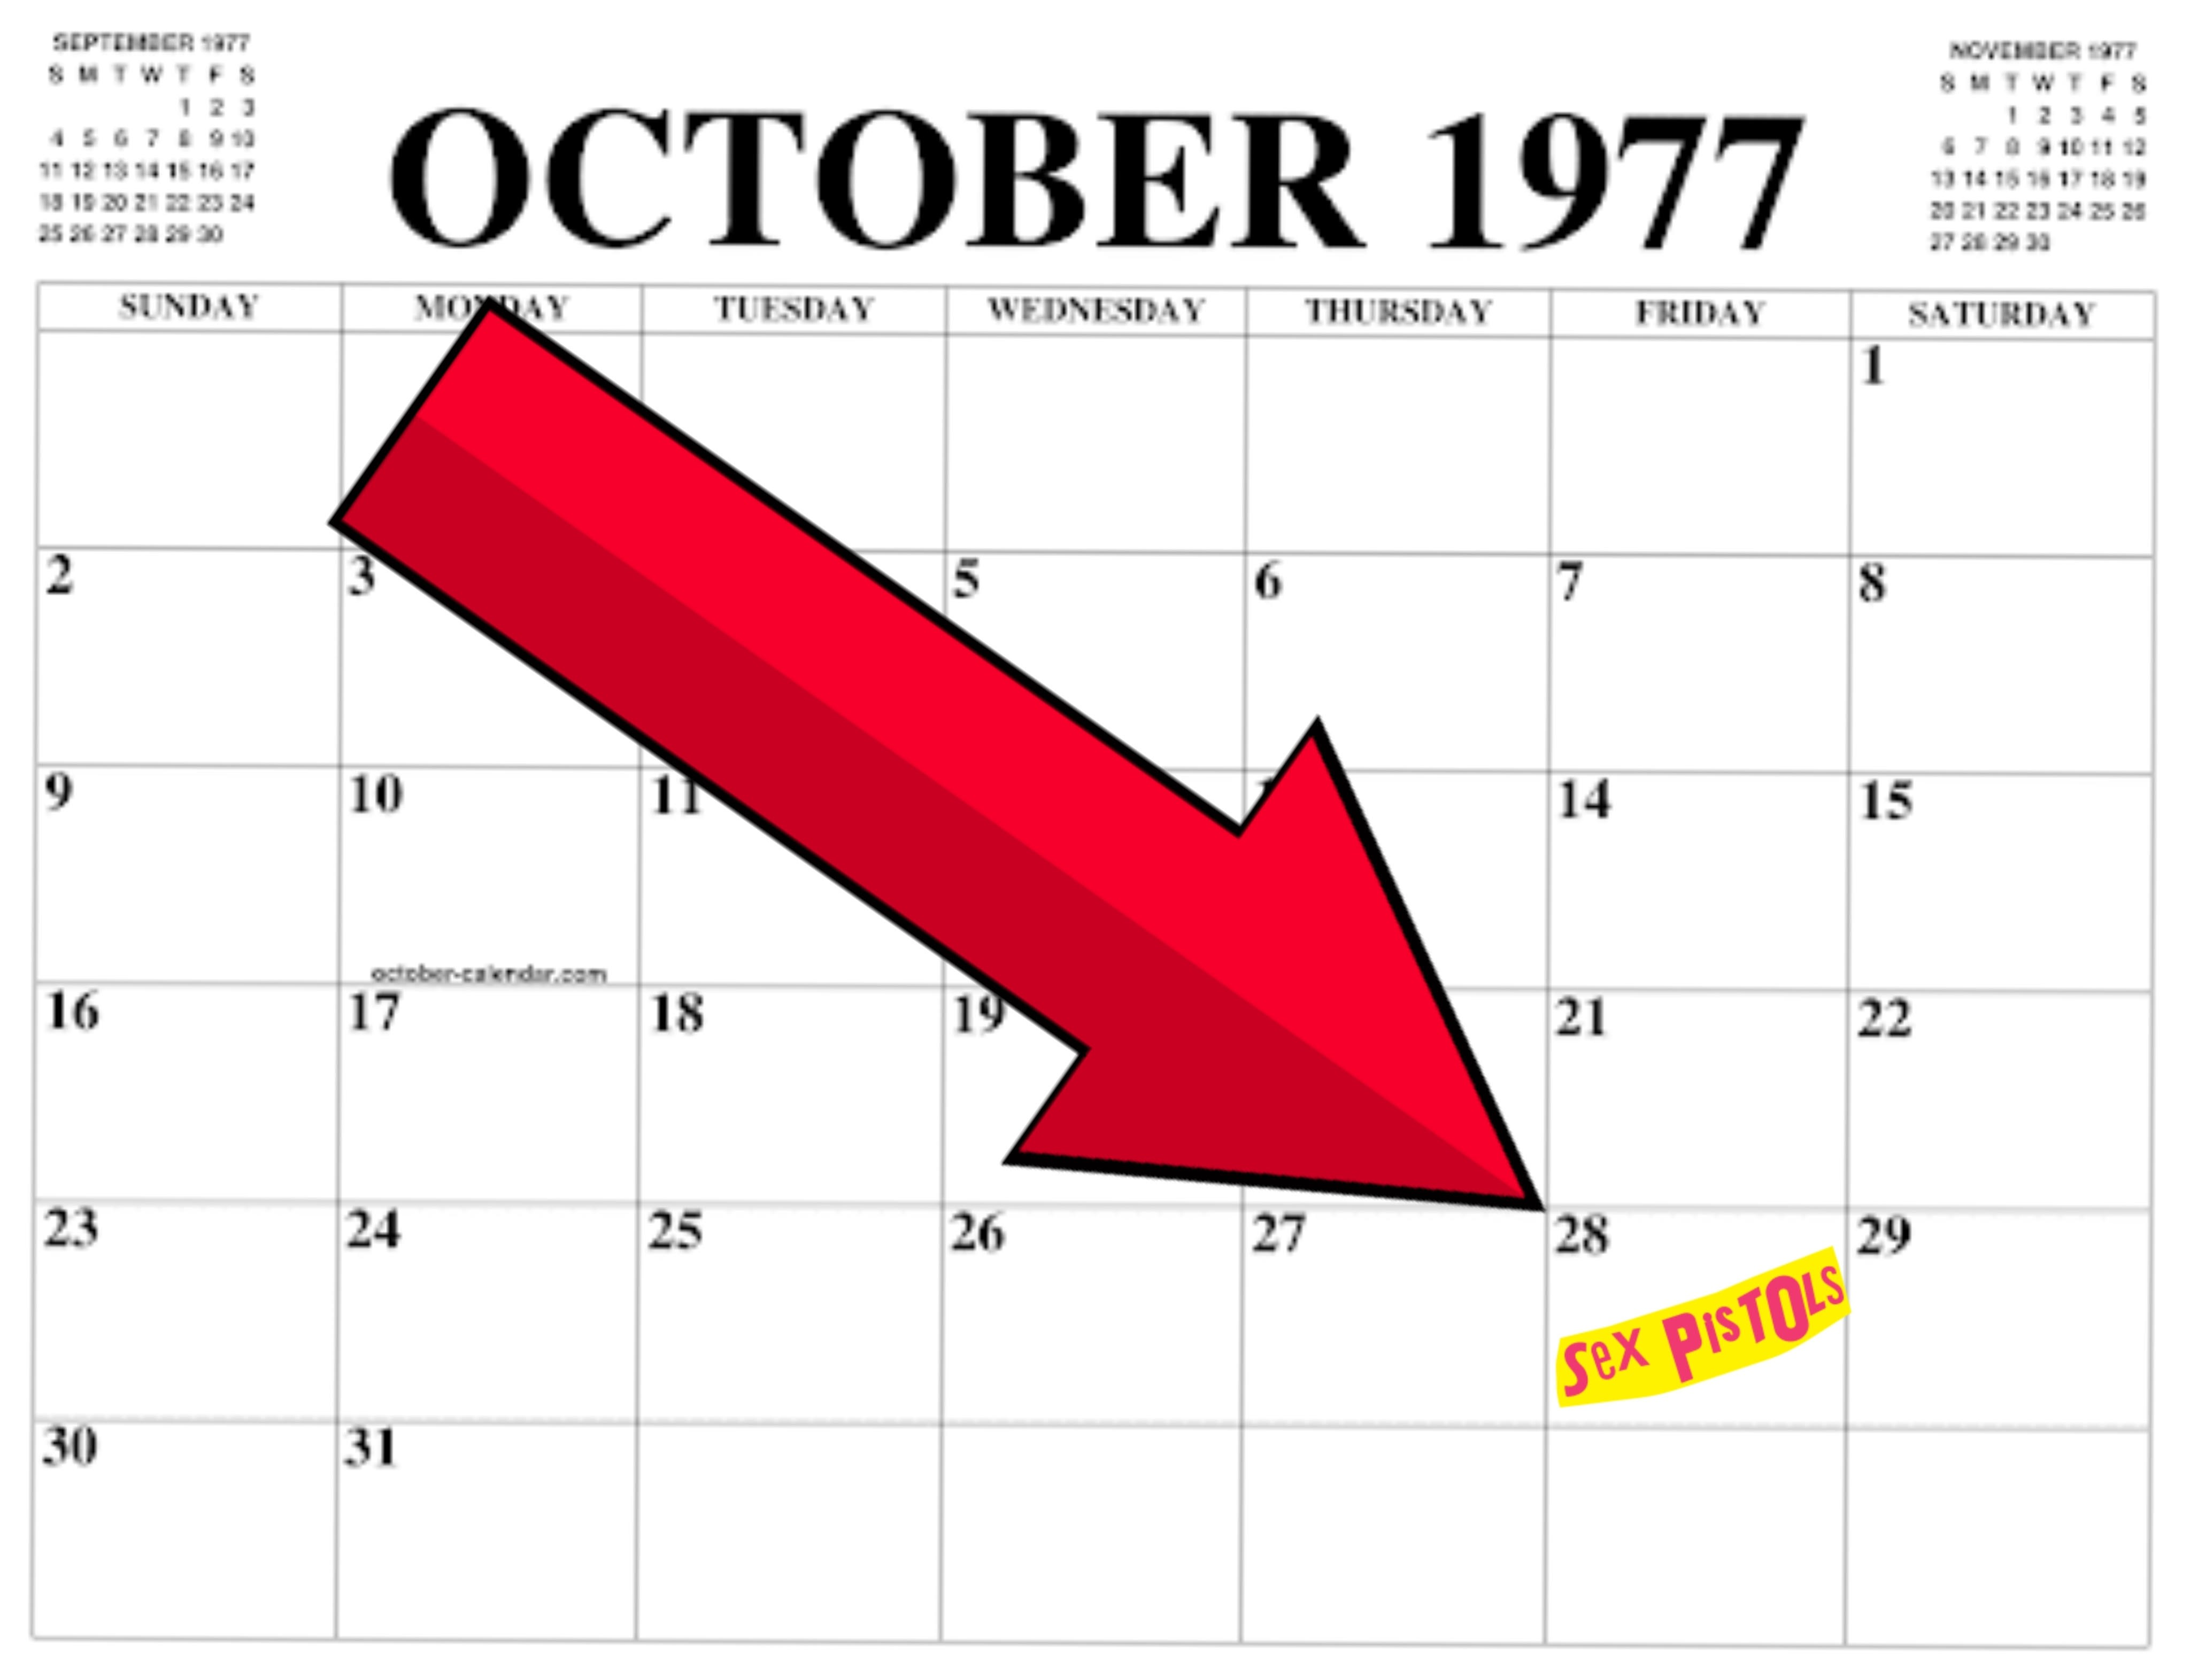
The (Imaginary) Sex Pistols Day !!!

Slide 2
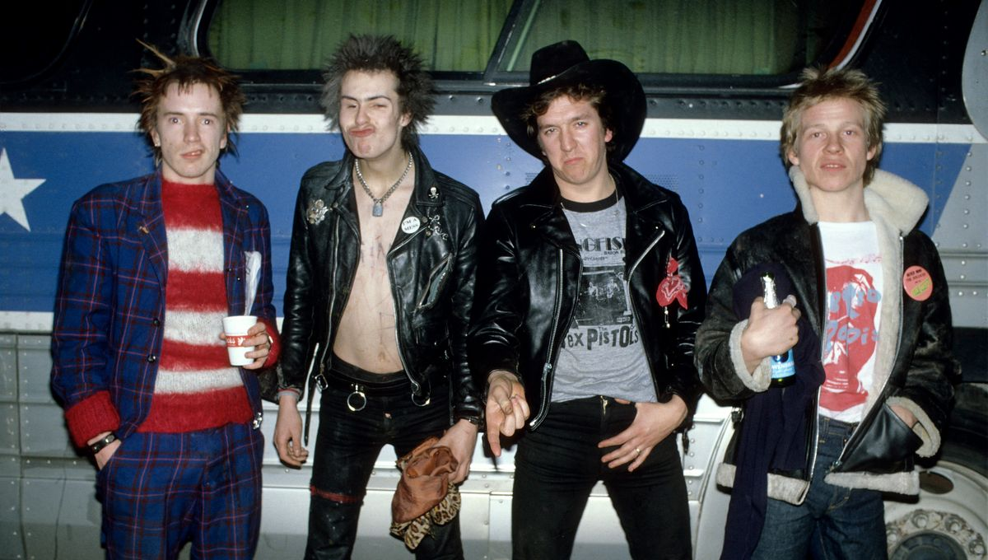
The Pistols became the Symbols of Provocation and Rebellious Style in The Culture

Slide 3
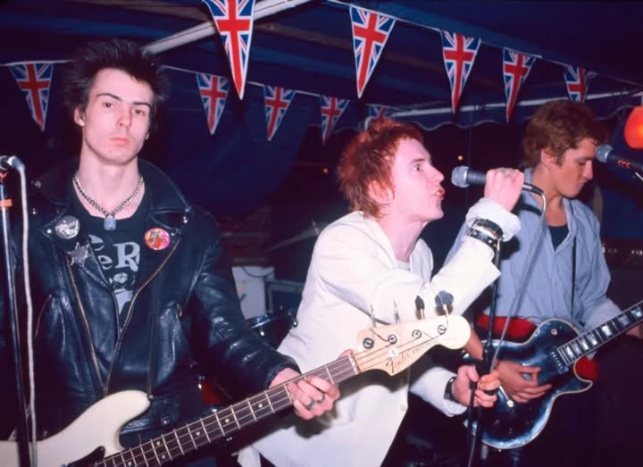
The Peak of this, was the song ‘God Save The Queen’. Which xas a schockwave in the United Kingdom and in most globally in the World.

Slide 4
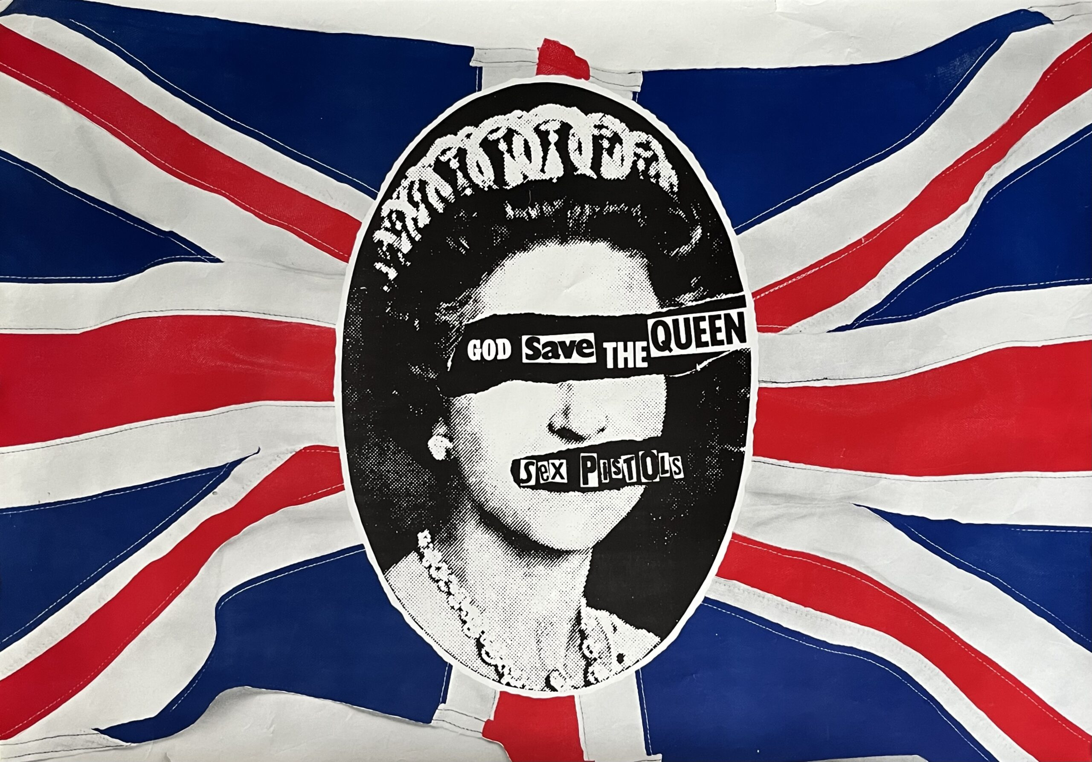
They are the ones who made it possible to make fun of the queen and the establishement, something that was unthikable before.
For example this caricature :

Slide 5
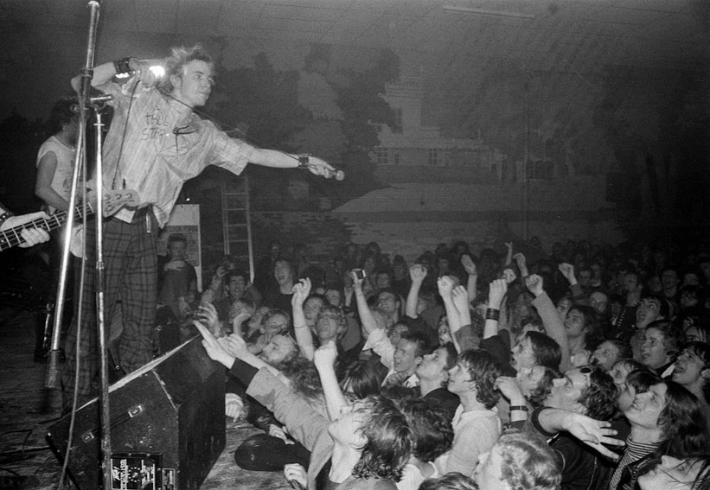
Here’s an Example of what we could do on this day

Slide 6
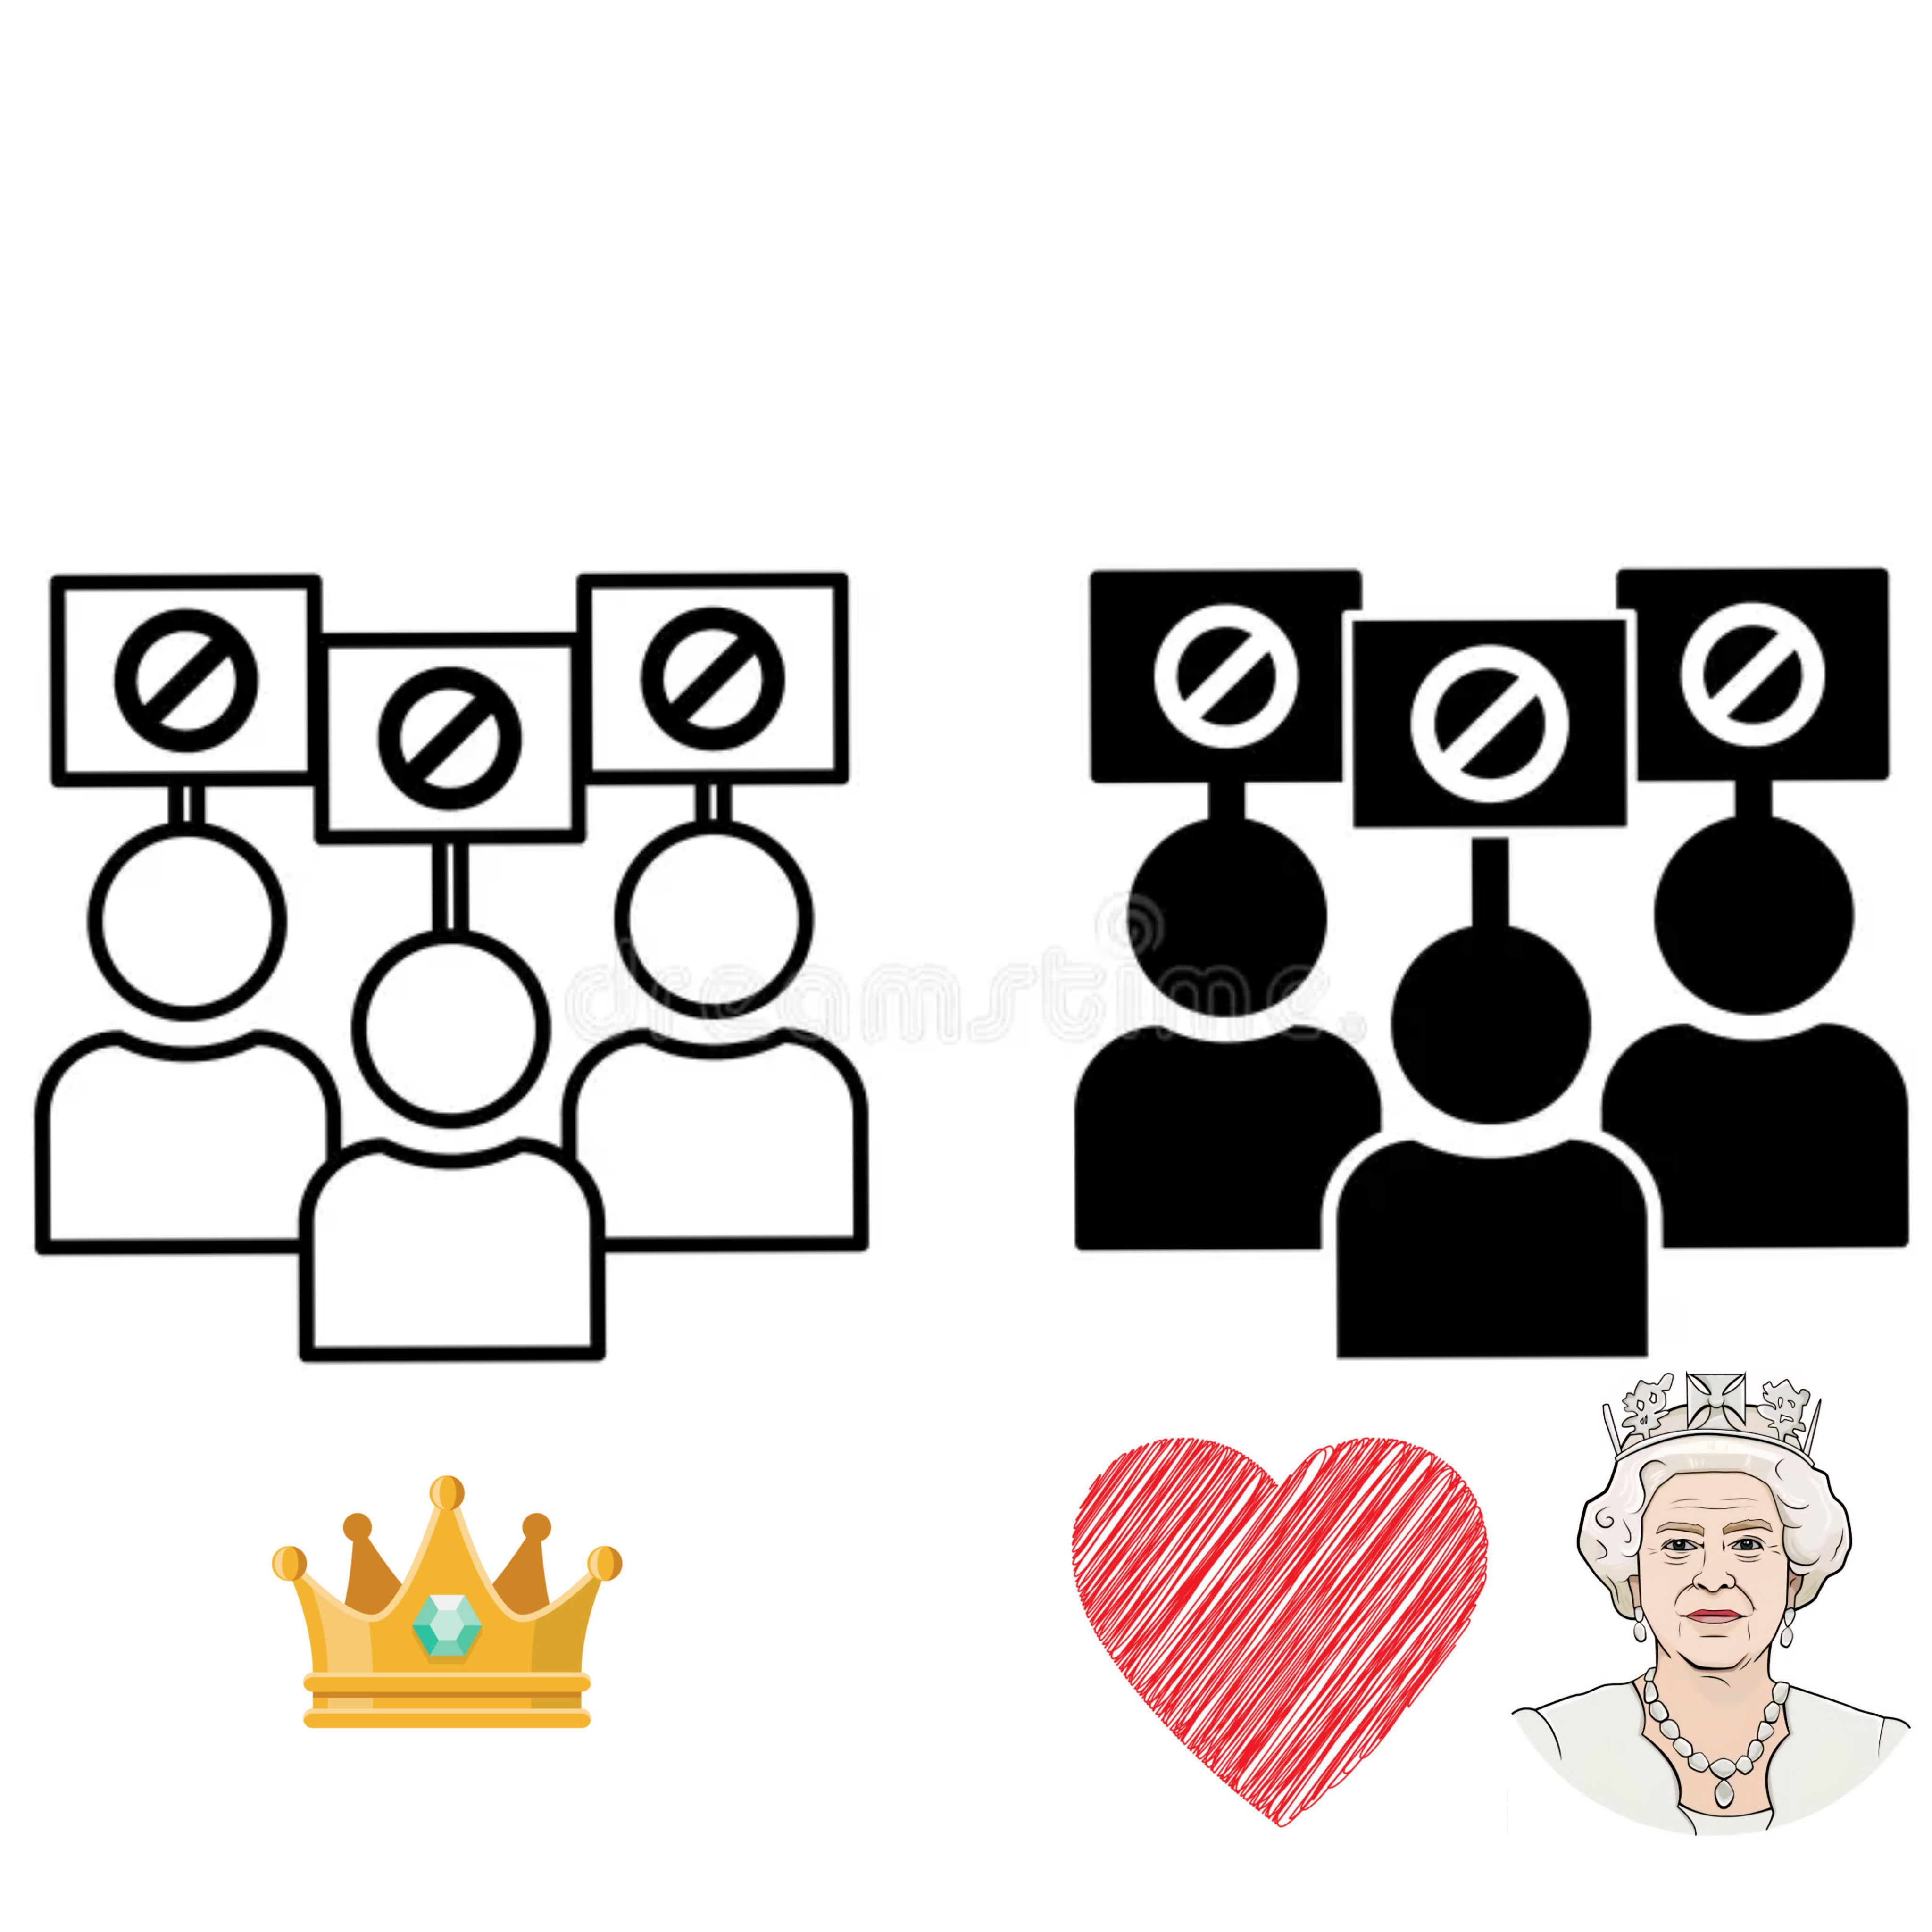
Of course some people would be against

Slide 7
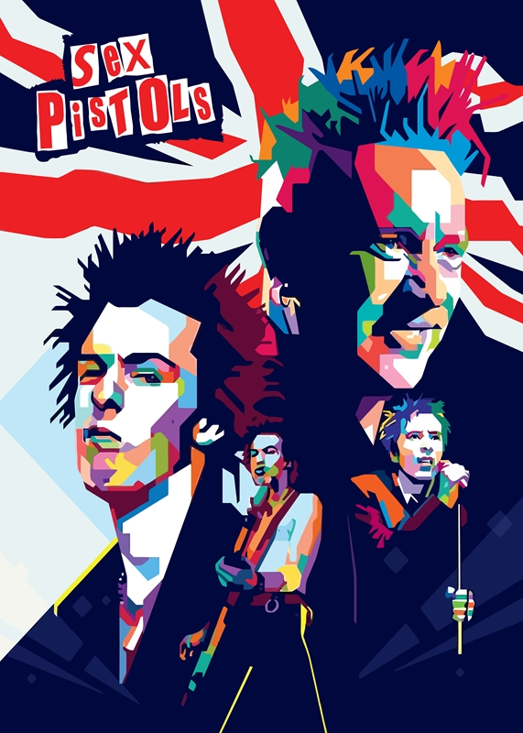
They were just a « rockers » they were a symbol, and helped the rebellious and procative style to became more acceptable, and change, profoundly influencing how the British monarchy is perceived

