Slide 1

WHOL3 – THE NEW GEN-Z WEB3 TOOL

Slide 2

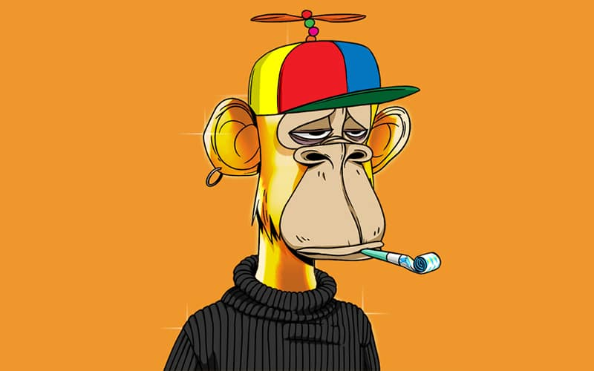
REMEMBER THIS?

Slide 3
What is A Blockchain?
A blockchain is a growing list of data blocks that are linked together.
Data
Data
Data
Reference
Reference
Reference

Slide 4
WHY WEB3 ?
Web3 is predicted to be the next iteration of the internet with decentralization at its core and integrating technologies such as blockchain.
Web3 privacy benefits.
Direct transactions in Web3.

Slide 5



Cutting the middleman
E.g. direct transfer of Bitcoins

Slide 6
Salient features of whol3
Whol3 will be a "jack of all trades".
The Whol3 Dapp will contain :-
Trading
Staking
Exchange (Swap from one cryptocurrency to another)
Transfer
Mining
Virtual Machines for Mining
Metaverse
NFTs
DAOs
Loan(optional)
Bot Trading
Community Space

Slide 7
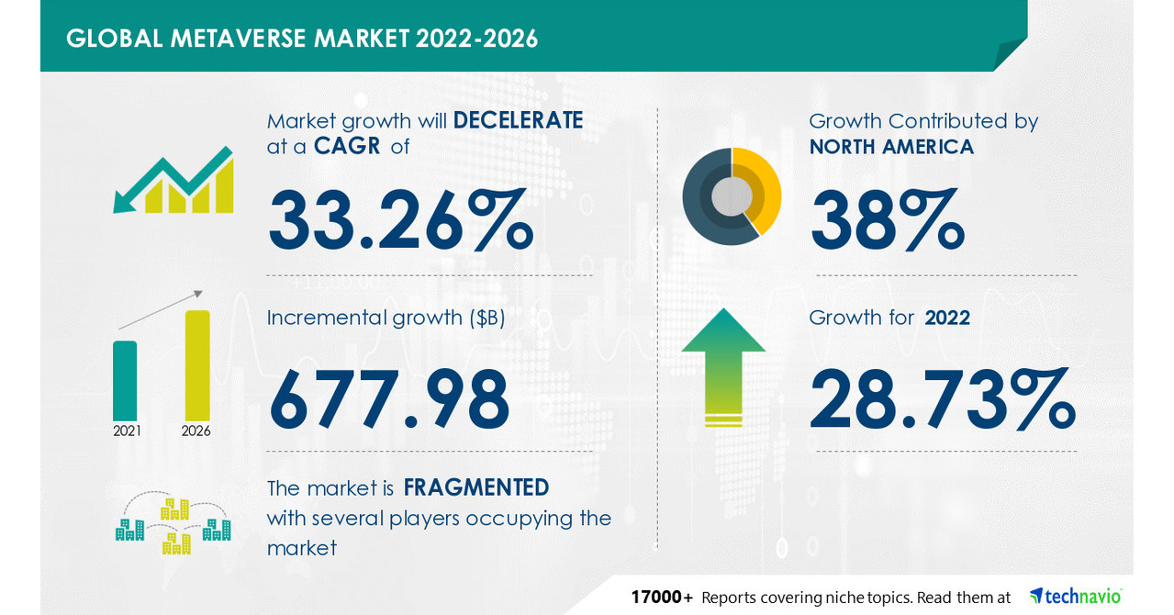
statistics
Credit: Technavio

Slide 8
Key Features
Write-only, immutable, transparent data storage
Resistant against malicious participants
Decentralized, no need for intermediaries
Open to everyone
Consistent state across all participants

Slide 9
challenges
Energy consumption
Scalability
Money laundering
Personal responsibility

