Slide 1
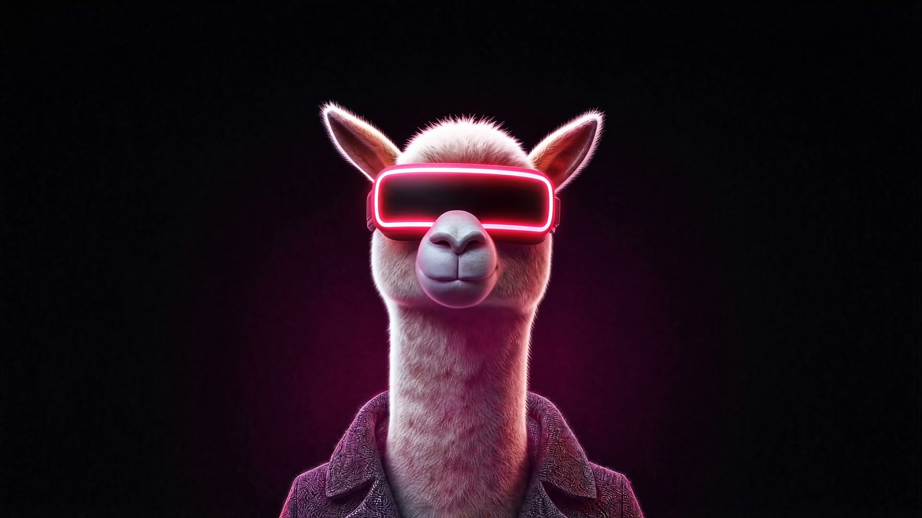
AI Gaming | Team Cyber Tesla | NeuroBridge.SI Baku 2026
PlayerOne
An AI playtester. It plays your game, catches the bug, and files the report with proof.
A free local AI does the playing. A big AI only does the judging.
roaring-alfajores-8a941a.netlify.app
github.com/nijathatamli/AI-hakaton
Notes:
PlayerOne is an AI playtester for small studios. Local model plays, engine console catches errors, a big model only judges.

Slide 2
Value for the user
Small studios ship bugs because nobody has time to replay the game
Indie teams of 1 to 15 people build PC games in Godot, Unity and Unreal with no QA team. The first bug report is often a one-star review with no steps to reproduce.
Manual testing
Slow and repetitive. Nobody replays level 3 for the hundredth time after every build.
Hiring QA
Too expensive for a small team, and still slow to turn around.
The outcome
A bug report after every build: error, stack trace, repro steps, the frames before it, and a clip.
A big AI playing
Reads a full screenshot every move: 67,000 to 85,000 tokens per minute of play.

Slide 3
How it works
Split the brain. Cheap hands, smart judge.
1
2
3
Play
Watch
Judge
>
>
Free, on your PC
Exact, zero tokens
Your AI, tiny digests
A local vision AI or our free bot plays the game with real keys and mouse. Any engine, no SDK.
Reads the engine console, catches crashes, hangs and soft-locks, keeps the last 12 seconds.
Claude, Codex or Gemini read a 45 KB summary, decide what is a real bug and write the ticket.

Slide 4
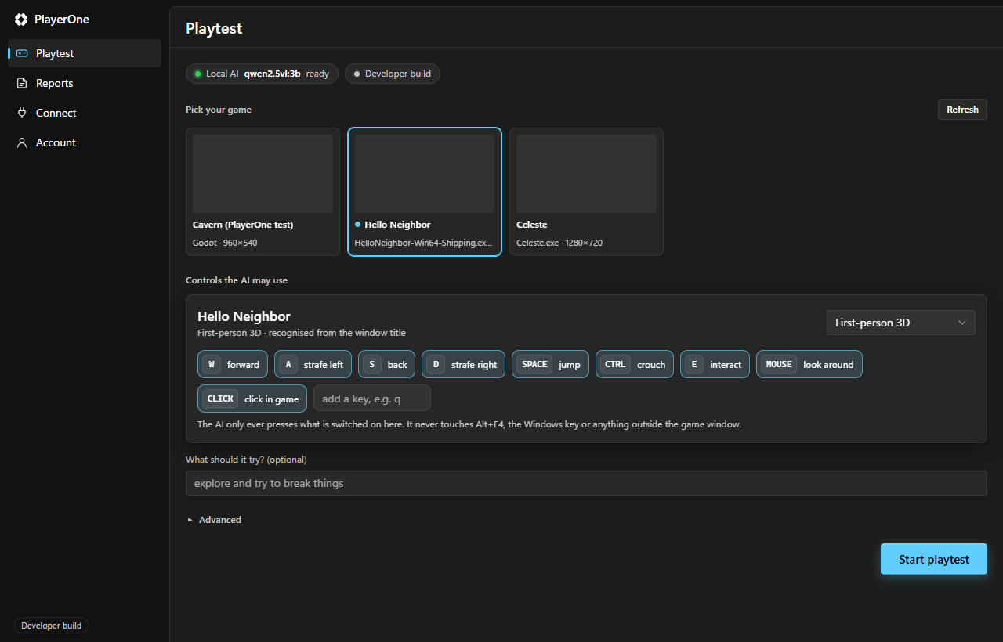
The prototype
Pick a game. It knows how to play.
PlayerOne recognises the game, suggests the controls, and you approve exactly what the AI may press. It never touches Alt+F4 or anything outside the game. F8 stops it anywhere.
v0.2.3
released with installers
5
targets: Windows x64, x86, ARM64, macOS, Linux
MCP
The desktop app: pick a window, approve controls, press Start.
Claude Code, Codex, Gemini CLI direct it

Slide 5
Prototype and use of AI
What the AI actually does, and what it does not
Plays from pixels
Works out the controls
A vision model reads each frame and picks keys, mouse look and clicks from the approved controls. Stuck? It turns away and tries something else.
Recognises the game by name or from the screen and picks a layout: first-person, platformer, top-down.
Judges with evidence
Detection is rules, on purpose
The big AI gets console errors and a contact sheet of the seconds before each incident, decides if it is a bug, and steers the player.
Crash, hang, console error and soft-lock checks need no model. That is why the clean build had 0 false alarms.

Slide 6
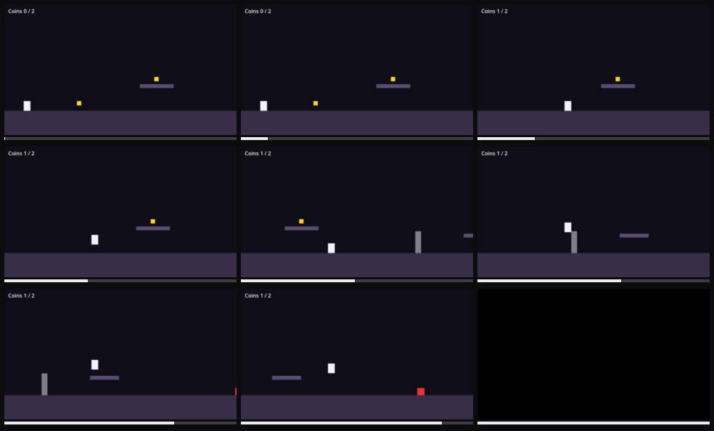
What a report looks like
Proof, not "it broke somewhere"
Error + stack trace
res://main.gd:154
Repro steps
the recorded inputs that led there
Contact sheet
36 KB, the seconds before
Clip
480p H.264, 14 KB
Contact sheet: 9 frames before the crash, 36 KB.

Slide 7
Quality testing
We broke our own game on purpose
Five planted bugs plus a clean build. One minute of real play each, three players, 18 runs. Every log, frame and clip is in the repo.
Bug | Random keys | Free bot | Local AI 3B
Soft-lock | 34 s | 15 s | 39 s
Script error | missed | 12.5 s | missed
Crash | missed | 18 s | missed
Freeze | missed | 20 s | missed
Coin counter | missed | missed | missed
False alarms | 0 | 0 | 0
What broke, and what we did
PlayerOne froze with a frozen game. Capture now has a 1.5 s deadline.
13 false alarms. It now tries every control before calling it stuck. Down to 0.
8 unit tests now cover the console classifier and token meter.

Slide 8
Compared with today
The same minute of testing, 96% fewer tokens
70,026
2,975
12-20 s
tokens a big AI spends playing one minute itself
tokens it spent judging that minute through PlayerOne
to catch a crash, a hang or a script error, report already written
about $0.14 per minute
about $0.006 per minute
vs a human replaying the level
Token counts from the meter in each session.json. Dollar figures at Claude Sonnet 5.5 input price, $2 per million tokens.

Slide 9
Failures we have not fixed
What PlayerOne still gets wrong
The coin counter bug
No error, no stall. Only a model that understands the screen can see it. The 3B model did not.
The local AI is slow
25 to 45 moves a minute against 77 for the bot. The bot is the better driver; the AI is better at judging.
A weak judge writes weak reports
The 3B judge wrote "press a key". PlayerOne now falls back to the recorded inputs.
Small sample
One run per bug, on bugs we planted ourselves. Next: real third-party games.

Slide 10
Feasibility and business
Runs today, on hardware people already own
Who pays
Data needed
None. No training data and no game source code. It works from the screen and the engine console.
Free
Local AI, crash and console capture. Costs us nothing to serve.
Running cost
Connect
Monthly. Their own Claude, Codex or Gemini key judges.
Free on the user's PC. With a cloud judge, about $0.36 per hour of play instead of $8.40.
Studio
Per seat. Shared reports, a playtest in CI after every build.
Already live
Accounts, plans and usage metering on Supabase. Stripe webhook. Installers for 5 targets.
Credits
Our hosted judge, priced on the tokens we meter.

Slide 11
Originality and next step
No SDK. No engine plugin. Any game on screen.
Other AI testing tools need engine integration and run the expensive model on every frame. PlayerOne attaches to any window, trusts the engine console first, and only sends the big model a compressed digest.
Next 30 days
Pilot with three Baku indie studios on their real games. Measure bugs found per build.
Try it
Then: Unity and Unreal log probes on real projects, and signed builds.
roaring-alfajores-8a941a.netlify.app
Download, pick your game, press Start.

