Slide 1
Human Resources Management Systems
Aytan Babayeva
Mehdi Hajiyev
Nijat Mursali
Ismayil Shahaliyev

Slide 2
Objectives
Brief information about the HRMS
Describing functional and nonfunctional requirements
Describing the diagrams
Describing the design phase such as classes and methods, data management layer, user interface layer and physical architecture layer
Demonstrate the prototype of the software

Slide 3
Introduction
Functional Requirements
Employees should be able to register to the system.
Employees should be able to login into the system.
Employees or HR should be able to modify the data in the system.
System should be able to add the employees to the system/database.
Non-functional Requirements
The number of online employees should be at most 50.
There should not be any restrictions on the # of user added to database.
The system should have a user-friendly homepage which means all links should be able to find in three clicks.

Slide 4
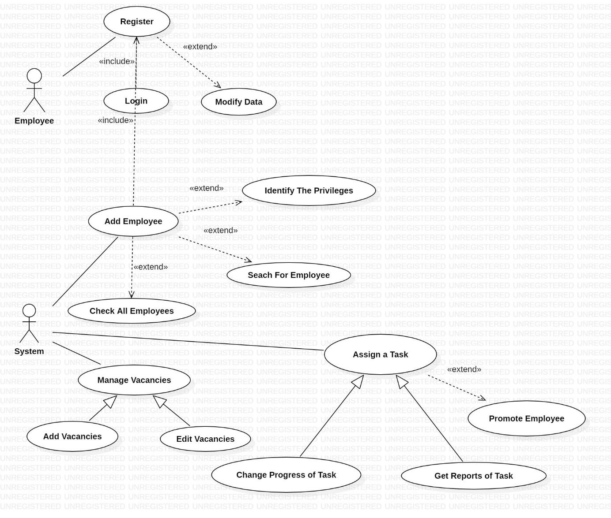
Use-Case Diagrams

Slide 5
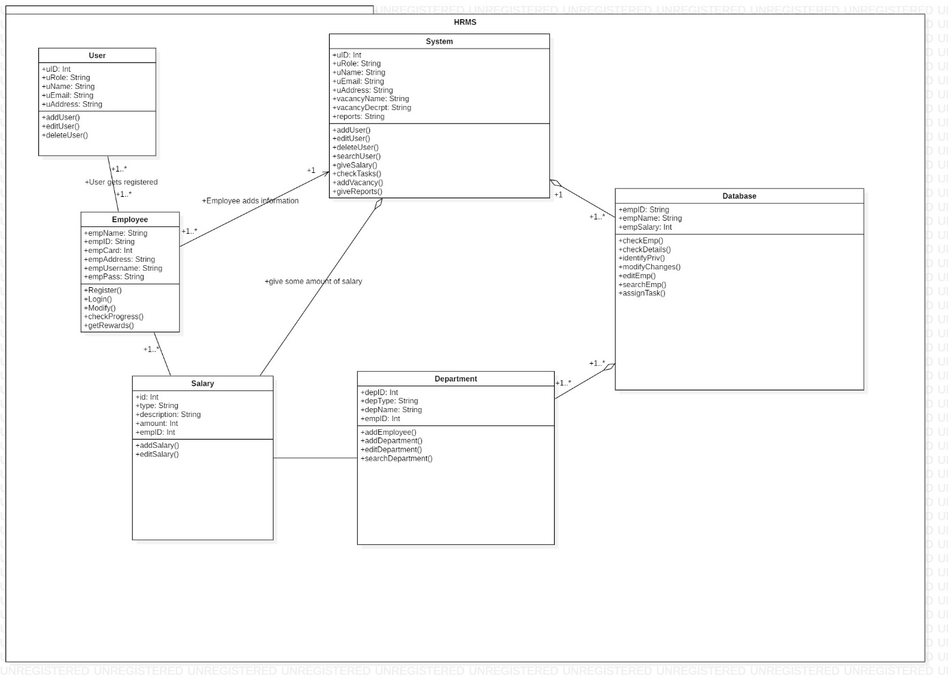
Class Diagrams

Slide 6
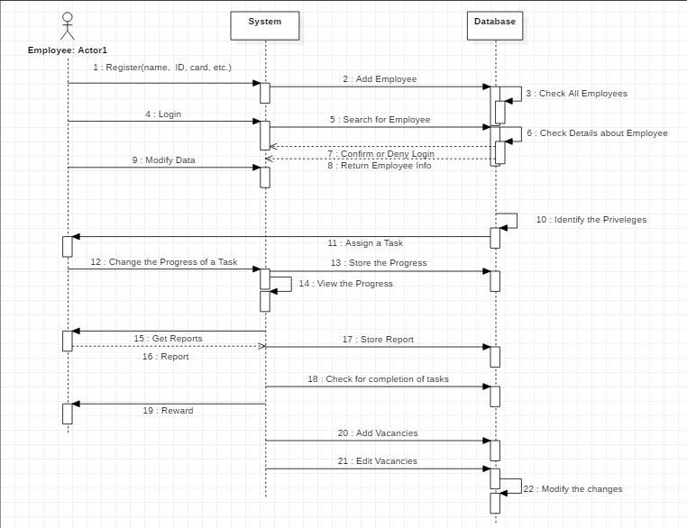
Sequence Diagrams

Slide 7
Classes and Methods Design
Deriving from Class Diagram: User, Employee, System, Salary and Department classes implemented
Made slight improvements on class diagram such as enhancing object oriented concepts of abstraction, encapsulation(private methods), inheritance and polymorphism(overriding)

Slide 8
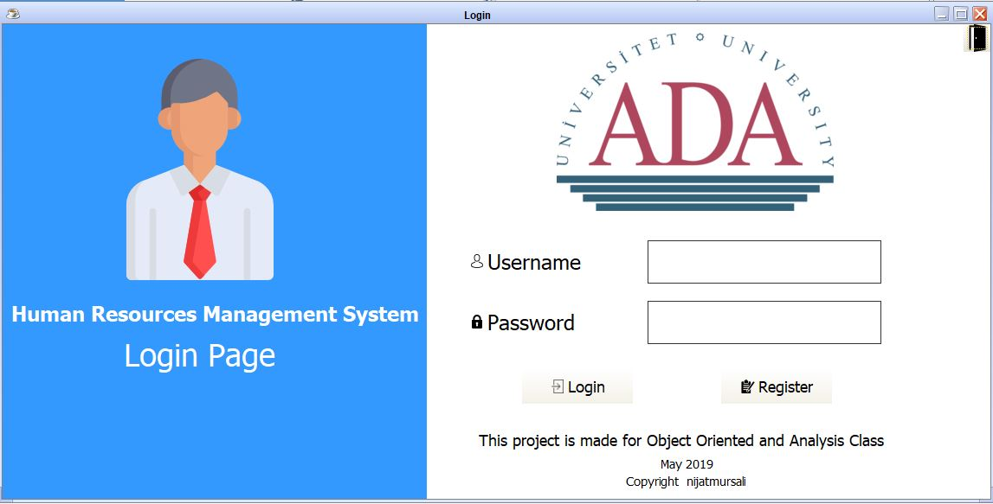
User Interface Layer Login Page

Slide 9
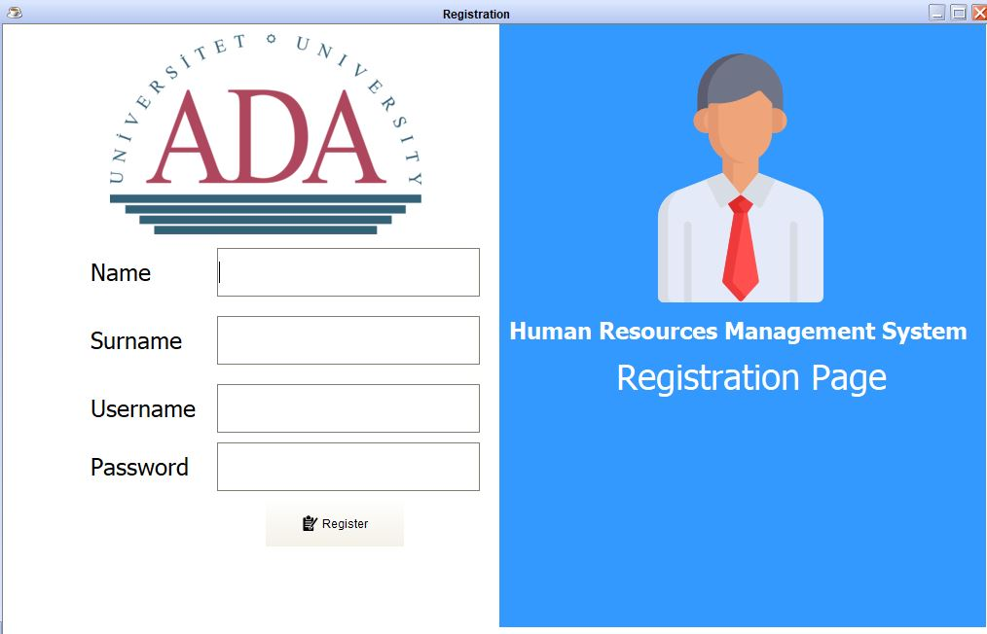
User Interface Layer Registration Page

Slide 10
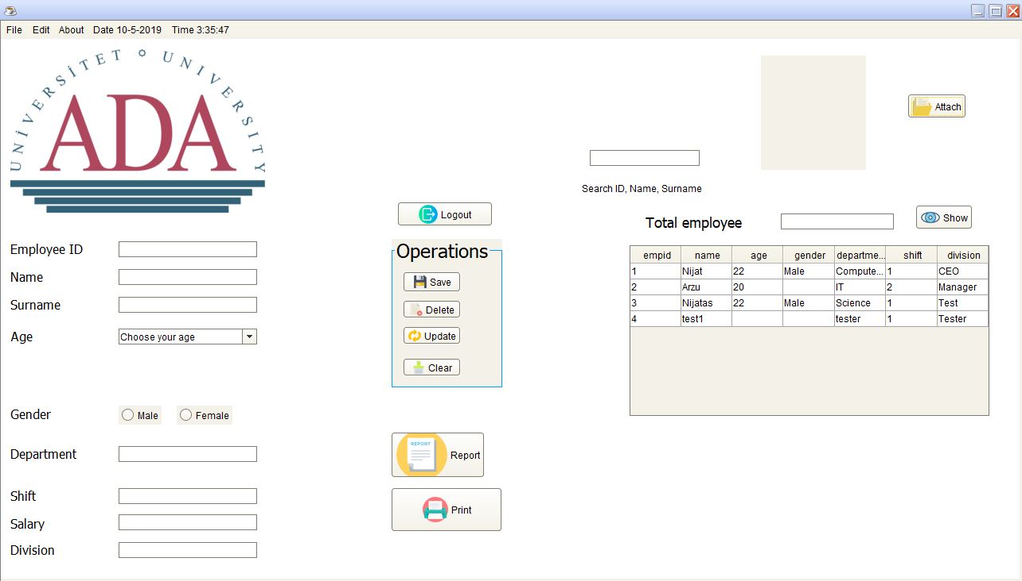
User Interface Layer Home Page

Slide 11
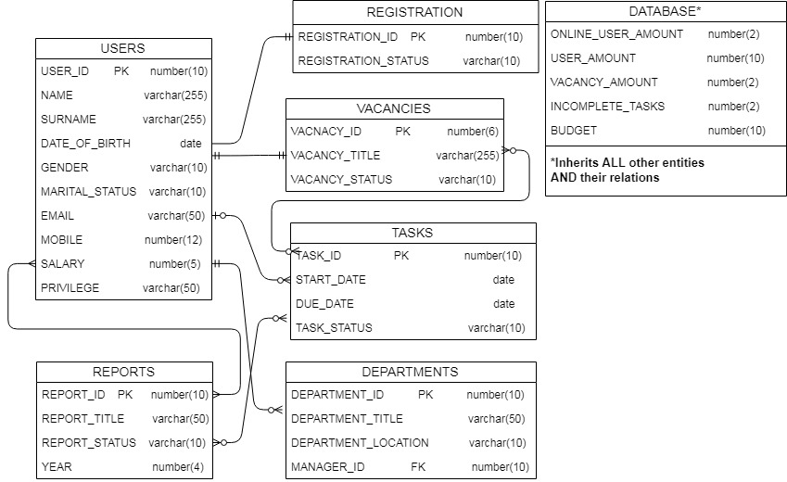
Data Management Layer

Slide 12
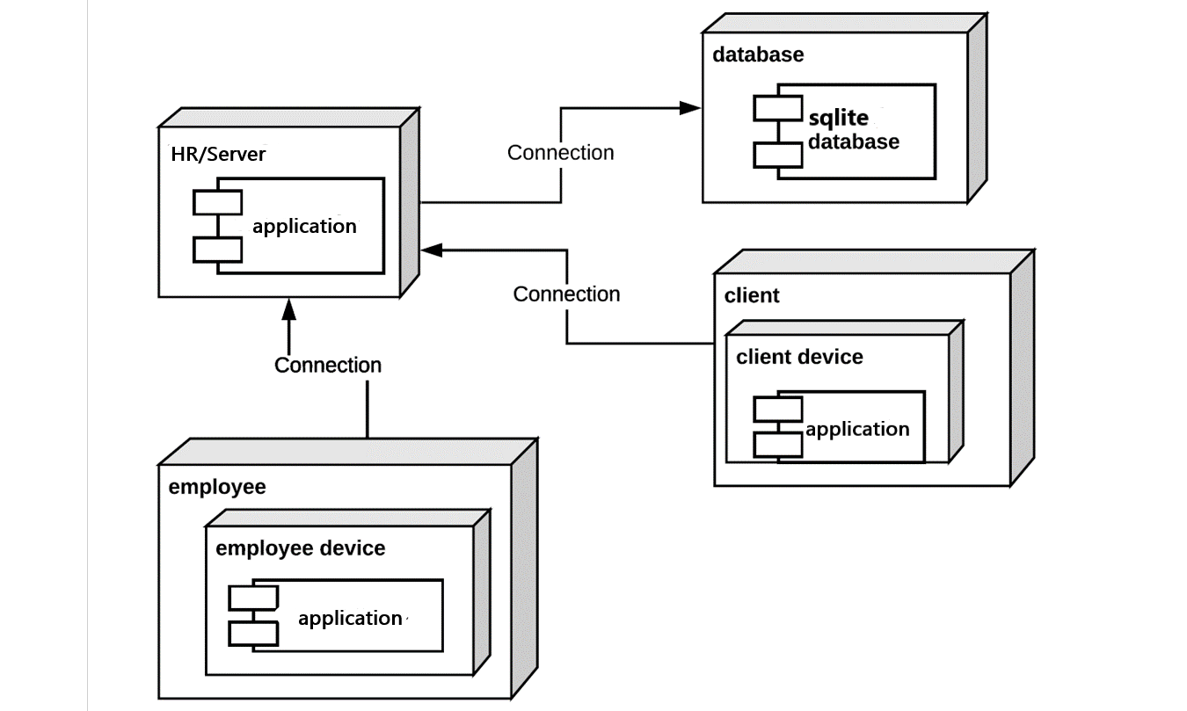
Physical Architecture Layer

Slide 13

References
GitHub Repository for the Prototype
https://github.com/nijatmursali/ObjectOriented
Human resource management system
https://en.wikipedia.org/wiki/Human_resource_management_system
Human Resources Management System (HRMS)
https://www.bamboohr.com/hr-glossary/human-resources-management-system-hrms/

