Slide 1
Vision and Perception Project
Nijat Mursali | 1919669

Slide 2
Overview
Overview
Pretrained Model
Datasets
Results
Dataset - Flowers
Data Augmentation
Results
Conclusion

Slide 3
Overview
The fundamental idea of the project was to gather the flower dataset that has 5 classes and apply two experiments:
One with pretrained network that we chose ResNet
Another one with custom CNN with data augmentation applied to the dataset

Slide 4
Dataset

Slide 5
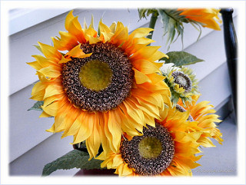
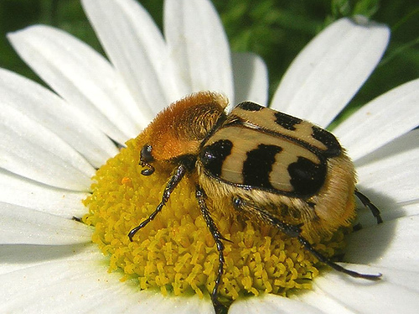
Dataset - Flower Classification
Classes in dataset: [
'daisy', 'dandelion', 'rose', 'sunflower', 'tulip']
Steps:
Applied data augmentation with several values
Overall 4323 images
3733 training samples for 5 classes
670 test samples for 5 classes

Slide 6
Data Augmentation
applied
zoom range
rotation range
width shift range
height shift range
horizontal flip

Slide 7
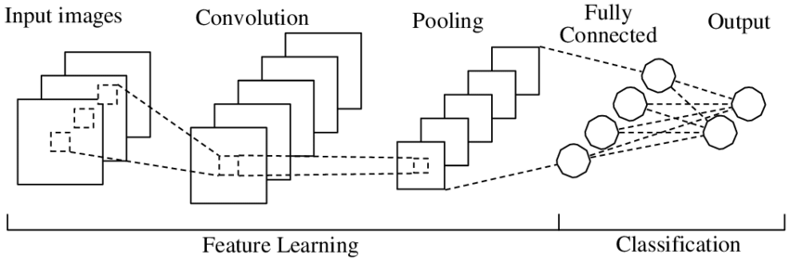
Dataset - Flower Classification
3 convolutional layer
3 pooling layer
then flattened/global max pooling?
Dense & Dropout
lr = 0.1 if epoch < 50
0.01 if epoc > 50 and epoch < 70
0.001 if epoch > 70

Slide 8
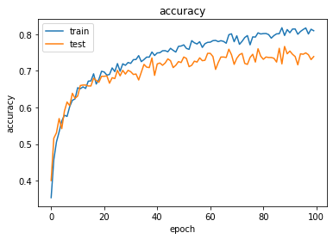
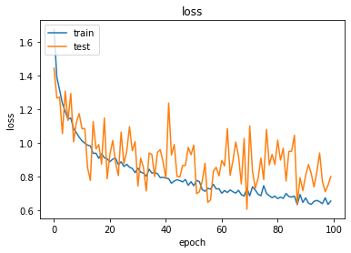
Results
Test
Loss: 0.631809
Accuracy: 0.742562
Training
Loss: 0.627271
Accuracy: 0.833491

Slide 9
Experiment with Pretrained Model
ResNet with input shape 256❌256❌3
Adam optimizer with LR=0.001

Slide 10
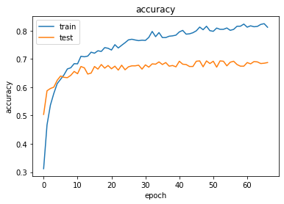
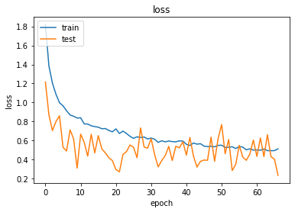
Results with Pretrained Models
Test
Loss: 0.405885
Accuracy: 0.696864
Training
Loss: 0.642642
Accuracy: 0.814526

Slide 11
Conclusion
"The one who falls and gets up is stronger than the one who never tried. Do not fear failure but rather fear not trying."
― Roy T. Bennett

Slide 12
References
Keras Documentation
https://keras.io/getting_started/
Quick Notes on How to choose Optimizer In Keras
https://www.dlology.com/blog/quick-notes-on-how-to-choose-optimizer-in-keras/
How to Configure Image Data Augmentation in Keras
https://machinelearningmastery.com/how-to-configure-image-data-augmentation-when-training-deep-learning-neural-networks/

