Slide 1


SCHOOL REVIEW ANALYSIS AND RECOMMENDER SYSTEM
Guided by
Mr. Anay Tamhankar
Mr. Prasad Deshmukh
Submitted By
Nikhil Datar (230343025011)
Rushikesh Gade (230343025014)
Vaibhav Gangurde (230343025015)
Kunal Barapatre (230343025030)

Slide 2
COntent
Introduction
Problem Statement
Project Architecture
Tools Used
Machine Learning Algorithm
Tableau
Future Scope
Conclusion

Slide 3
INTRODUCTION
Education is vital in our life.
Schooling is the phase where the life of the student starts reshaping.
Choosing the appropriate school for child is important and challenging for parents.
Hence based upon the idea of recommending the school using its previous record is the foundation of idea of our project.
Our project aims at analyzing the reviews and corresponding ratings of the school and comparing them based on average ratings.

Slide 4

Problem statement
To develop the model which will analyze historical data like reviews and ratings that can help people to choose appropriate school for their child.
The goal is to recommend the right school to the client based on various factors and their requirements.

Slide 5
Project Architecture
Data Collection
Data preprocessing (PySpark)
Machine Learning
(NLP)
Clustering
(K-Means)
Recommender System
Data Visualization
(Tableau)

Slide 6
Tools used
Octoparse
spark
Machine Learning
Natural Language Processing
K-Means Clustering
Recommender system
Tableau

Slide 7
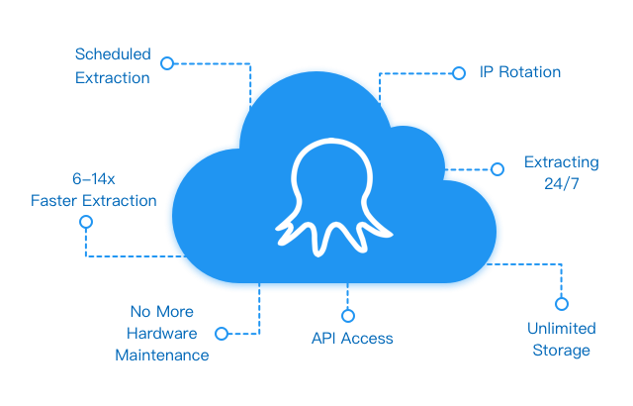
Octoparse
Software for data extraction.
Scrape web data and turn web pages into structured data files
The user-friendly tool.

Slide 8
Data preprocessing
1) Cleaning the columns according to requirement
2) Converting target columns into integer format
3) Droping missing values

Slide 9
Pyspark
Developed by Apache Spark Community for integrating Python with Spark
Python API for Apache Spark
Distributed computing framework
Big data computational engine
Performs real-time
large-scale data processing
Data processing with high computational power

Slide 10
Natural language processing
Subfield of artificial intelligence (AI)
Ability to understand text and spoken words in the same way human beings does.
Used for valuable text mining and sentiment analysis.
Take input using AI, process it and convert into computer format.
CountVectoriser()
Converts texts in lower case
Removes the stop words
Convert the text into numerical format

Slide 11
Clustering (K-Means)
Task of creating a collections in such a way that the elements with great similarity will be grouped together.
Unsupervised Learning algorithm.
Used for grouping the unlabled data into clusters.
K-Means Clustering
The K defines the no of clusters to be done.
We have provided the categories and keywords based on which the clusters of the similar category reviews are created.
Faculty, Fees, Event, Infrastructure etc.

Slide 12
Recommender system
Information filtering system.
Used for decision making purpose.
Suggests relevant items to users.
Collaborative filtering.
Content-based algorithms.
Analyze Information by User.
Find the correlation Matrix.
Recommend on the basis of Rating.

Slide 13
Tableau
Used for data visualization purpose or analysis purpose.
Platform for showcasing the numerical data in eye catching visualization so senior can make important decision.
Helps user to create different Graphs, Charts, Map, Dashboard, Stories.
We have use the Tableau for Recommending the School on the basis of requirement and factor chosen by client.

Slide 14
Future Scope
Created model in limited scope. If we implement model on large scale and various field we can make powerful website and application ( e.g. what’shot)
This system when we applied in medical field will really improve the awareness towards physical and mental health.
Business can take informed decision and serve the society better by analyzing the sentiment of customers.
Overall future scope of this project is very large and importance can be understood by some facts as well
From 1979 recommender system is key algorithm in this field.
Ben Allison a sr.ml scientist amazon development center Scotland in his speech in re’MARS mentioned “data is vital and recommendation system is lifeline of the data based businesses”

Slide 15
Conclusion
From 1979 till now recommender system being totally a master in this field.
Recommendation system is a powerfull tool used by many companies, increasing research in this field shows that in many fields it is proven the best.
To conclude I would say that in this project we successfully gathered, processed and analyzed the reviews and using various techniques we successfully be abled to recommend the schools to the user.
This project not only given us the new perspective but also shows us that by implementing this types of systems we can make significant decisions very efficiently.

Slide 16
THANK YOU.

