Slide 1
University of Asia and the Pacific · BS Data Science · June 2026
Predicting Open-Market Residential Property Values in Metro Cebu
Using Machine Learning and Geospatial Features
Chris Dominic Estreba
BS Data Science Capstone
Notes:
Say: Title, your name, program, and the framing: an open-market residential valuation study for Metro Cebu using machine learning plus geospatial features.
Defend: This is a decision-support tool for triangulation, not a replacement for professional appraisal.

Slide 2
OUTLINE
2 / 40
Outline
The study follows the CRISP-DM arc, mapped to the thesis chapters.
1
Introduction — the valuation problem in Metro Cebu
6
Modeling — stratified models, selection, tuning
2
Review of Related Literature — what is known, and the gap
7
Evaluation — accuracy, model comparison, ablation
3
Methodology — data, geospatial features, modeling design
8
Results & Discussion — drivers and spatial structure
4
Data Understanding — collection and exploratory analysis
9
Conclusions — answers, contributions, limits
5
Data Preparation — cleaning, preparing data for models
10
Recommendations — practice, policy, future work
Notes:
Say: The talk follows the CRISP-DM arc mapped to the thesis chapters — problem, literature gap, methodology, data, modeling, evaluation, results, and the tool.
Defend: This order shows the study is not just a model; it moves from problem evidence to a reproducible decision-support prototype.

Slide 3
01
Introduction
The valuation problem in Metro Cebu
Notes:
Section 1 — Introduction.

Slide 4
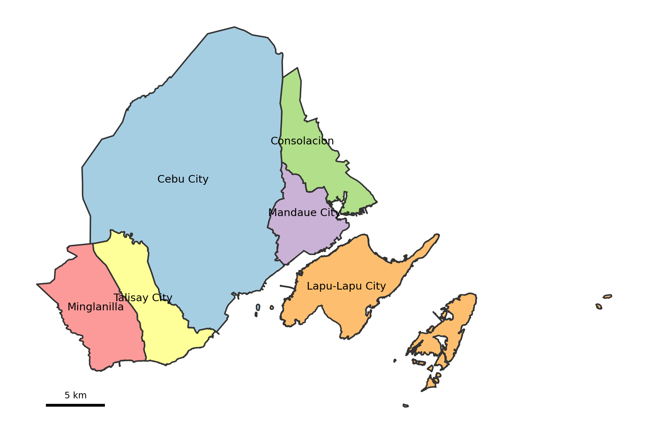
1 · INTRODUCTION
4 / 40
Where this study is set
7.3%
Cebu economic growth in 2024 — among the fastest outside Metro Manila, led by IT-BPM and a tourism rebound. (PSA Cebu, 2025)
11.5%
Metro Cebu residential price growth in 2025 — the highest rate outside the NCR. New infrastructure is redrawing which barangays count as accessible. (BSP, 2025)
Central core: six LGUs — Cebu City, Mandaue, Lapu-Lapu, Talisay, Minglanilla, Consolacion — the most active transactions and densest infrastructure.
TAKEAWAY
Prices are moving faster than the references people use to interpret them.
Notes:
Say: The study is set in six Metro Cebu LGUs: Cebu City, Mandaue, Lapu-Lapu, Talisay, Minglanilla, and Consolacion.
Defend: Timing matters: Cebu grew 7.3% in 2024 (PSA) and residential prices rose 11.5% in 2025 (BSP), so prices are moving faster than the references people use.

Slide 5
1 · INTRODUCTION
5 / 40
The fragmented-references problem
A family buying or an owner selling asks the same question — what is this property worth? No single public source answers it. Price is pieced together from several partial references, each built to answer a different question.
Reference
Built for
What it misses
Broker & agent opinion
Local market knowledge
Not standardized or reproducible across people
Bank appraisals
Lending & collateral risk
Conservative; not the seller's market question
BIR zonal values
Taxation & assessment
Not live prices; often not updated (BIR, n.d.; Otsuka et al., 2023)
Online listings
Current, property-level
Asking prices — full of seller strategy and noise
TAKEAWAY
Metro Cebu has plenty of valuation activity, but no consistently shared, spatially detailed reference layer.
Notes:
Say: There is no single public answer to “what is this property worth.” Buyers and sellers piece together broker opinions, bank appraisals, BIR zonal values, and online listings.
Defend: Each reference is built for a different purpose. BIR zonal values are for taxation, not live market value, and can be stale; that gap is exactly what RQ4 measures.

Slide 6
1 · INTRODUCTION
6 / 40
The problem, research questions & scope
PROBLEM
Metro Cebu lacks a transparent, property-level, spatially detailed reference for interpreting residential price evidence. This study builds that missing layer — a decision-support tool, not a replacement for professional appraisal.
RQ
Research question
Use in study
Scope
RQ1
Which value drivers significantly influence residential prices?
Identify pricing variables
▪
Six LGUs; eight polycentric CBD nodes.
▪
Open-market segment only for the deployed model.
RQ2
Which model is most suitable for deployment — Hedonic, Random Forest, or XGBoost?
Select deployable model
▪
A prototype web application for triangulation.
RQ3
Do geospatial features improve accuracy, and does this differ by property type?
Test spatial lift
▪
Cross-sectional snapshot, late 2025.
Who benefits
RQ4
How large is the gap between model estimates and BIR zonal values?
Quantify valuation gap
▪
Brokers, buyers, sellers, banks, and LGUs — an inspectable, transparent reference layer.
Notes:
Say: The problem is the missing transparent, property-level, spatially detailed reference for interpreting Metro Cebu residential prices.
Defend: Keep the scope disciplined: open-market listings only for the deployed model, a late-2025 cross-sectional snapshot, and a prototype decision-support tool — not a substitute for appraisal.

Slide 7
02
Review of Related Literature
What is known, and the gap
Notes:
Section 2 — Review of Related Literature.

Slide 8
2 · REVIEW OF RELATED LITERATURE
8 / 40
The core obstacle — and the gap it leaves
Data scarcity is the obstacle
The research gap — and the bridge
International work finds data scarcity — not valuer misconduct — is the primary barrier to accurate valuation in developing markets.
No published, reproducible, property-level Cebu model integrates open-market listings, geospatial accessibility, and explainable ML.
▪
Property-level — every listing geocoded across six LGUs.
▪
Kenya — a census of 427 Nairobi valuers ranked "limited information" the top problem. (Cheloti, 2021)
Open-market — aligned to the IVS Market Value basis.
▪
Nigeria (Lagos) — of 300 valuers, 92.7% cited insufficient market evidence. (Ajibola, 2010)
▪
Geospatial — the location signal is engineered, not ingested.
▪
The fix is not better judgment but a better, shared evidence base.
▪
Explainable — SHAP behind every prediction.
▪
Notes:
Say: In developing-market valuation, the binding constraint is data scarcity, not simply valuer judgment. Kenya and Nigeria studies both point to limited market evidence.
Defend: The gap here is local and reproducible: no published Metro Cebu model combines property-level listings, geospatial accessibility, and explainable ML.

Slide 9
2 · REVIEW OF RELATED LITERATURE
9 / 40
Two modeling traditions — and why we stratify
Location is the dominant driver, yet Cebu evidence is thin — Agosto (2020) is the only Cebu-specific study, and Philippine ML work is Manila-heavy.
Hedonic regression
Why model property types separately?
▪
Interpretable; one explicit coefficient per attribute — the classic basis of valuation. (Rosen, 1974)
▪
Dröes, Hoesli & Bourassa (2019) — modeling submarkets separately lifted R² from 0.637 to 0.782.
▪
Struggles with non-linear effects and correlated features.
▪
Usman et al. (2020), Malaysia — segmenting improved fit ~ 7% and cut error over 10%.
Machine learning
▪
Captures non-linear, interacting effects. (Breiman, 2001)
▪
Different property types are priced by different logic, so one pooled equation fits all of them worse.
▪
Tree ensembles tend to win on tabular data. (Grinsztajn et al., 2022; Tanamal et al., 2023)
Notes:
Say: Hedonic regression gives interpretable attribute effects; machine learning captures nonlinear and interacting effects, with tree ensembles strong on tabular data.
Defend: We stratify because property types price differently. Prior work shows submarket models lifting R² from 0.637 to 0.782 and segmentation improving fit about 7% while cutting error more than 10%. Pooling would blur the markets.

Slide 10
03
Methodology
Data, geospatial features, modeling design
Notes:
Section 3 — Methodology.

Slide 11
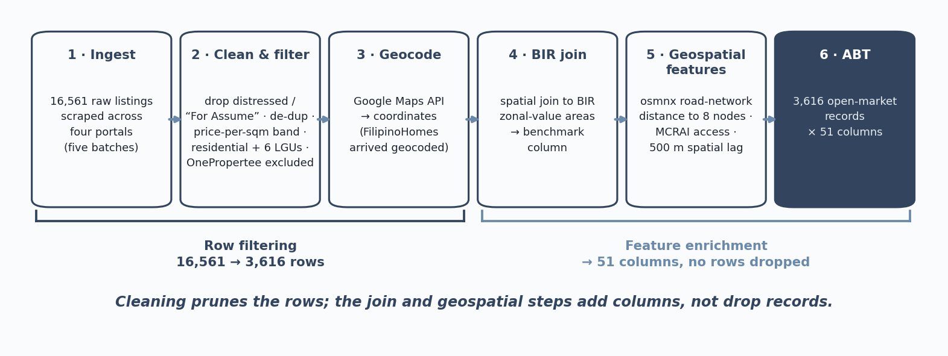
3 · METHODOLOGY
11 / 40
Research design and the data pipeline
A quantitative, non-experimental design — predictive (estimate price) and prescriptive (surface the benchmark gap). Target: price per square meter, validated by a licensed broker.
Source
Role in the study
Lamudi, FilipinoHomes, DotProperty
Open-market listings — the training data
BIR zonal values
Administrative benchmark — the valuation-gap diagnostic
Google Maps & OpenStreetMap
Points of interest and geocoding for MCRAI
Road network via osmnx
Network distances to economic nodes
Notes:
Say: The design is quantitative and non-experimental: predictive because it estimates price, and prescriptive because it surfaces the benchmark gap.
Defend: Walk the pipeline — Ingest, Clean, Geocode, BIR join, Geospatial features, ABT. It starts with 16,561 raw listings from Lamudi, FilipinoHomes, and DotProperty; OnePropertee was excluded for geocoding and per-sqm contamination. The clean ABT has 3,616 rows and 51 columns. Cleaning and scope filters prune rows; the later steps mainly add columns.

Slide 12
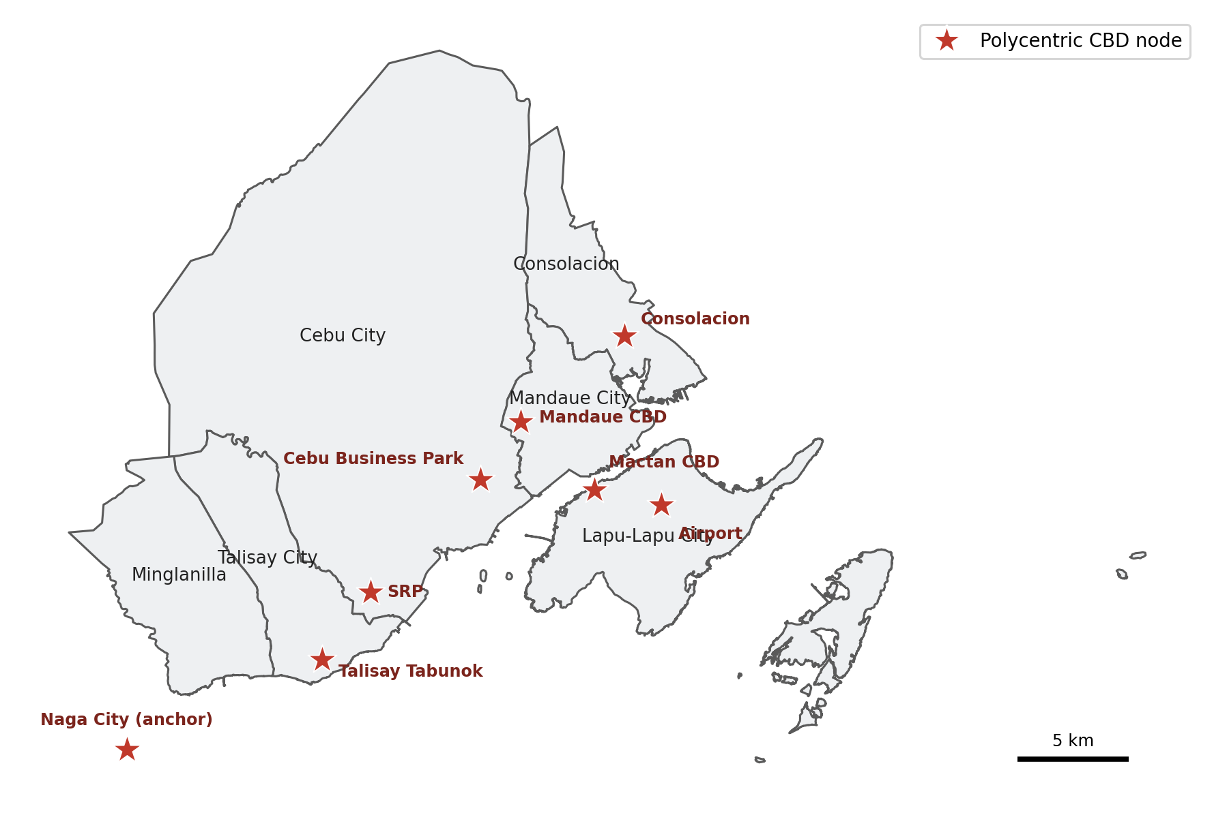
3 · METHODOLOGY
12 / 40
Geospatial features — distance to economic centers
▪
Shortest-path road-network distance (not straight-line) to eight economic nodes.
▪
Nodes: Cebu Business Park, Mandaue CBD, Mactan CBD, SRP, Talisay Tabunok, Consolacion, Naga City (anchor), and the airport.
▪
Grounded in polycentric urban economics. (Giuliano & Small, 1991; McMillen, 2003; JICA, 2015)
▪
Road distance captures real travel cost — including the Mactan bridge crossing.
Notes:
Say: The distance features are shortest-path road-network distances, not straight-line distances, to eight economic nodes.
Defend: The node set is grounded in polycentric urban economics and the JICA Mega Cebu roadmap, not chosen arbitrarily. Road distance captures real travel cost, including the Mactan bridge; that is why Mactan-island distances inflate. Transport accessibility is carried through these node distances.

Slide 13
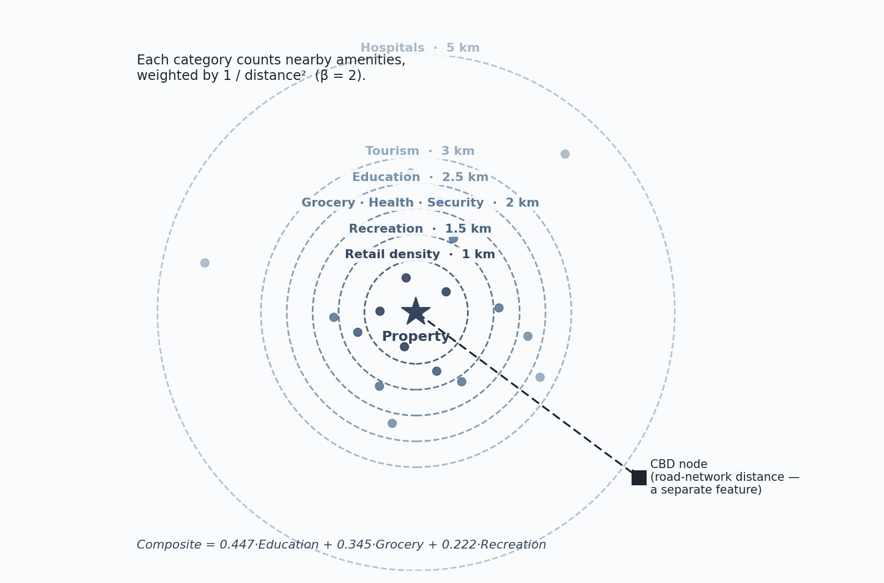
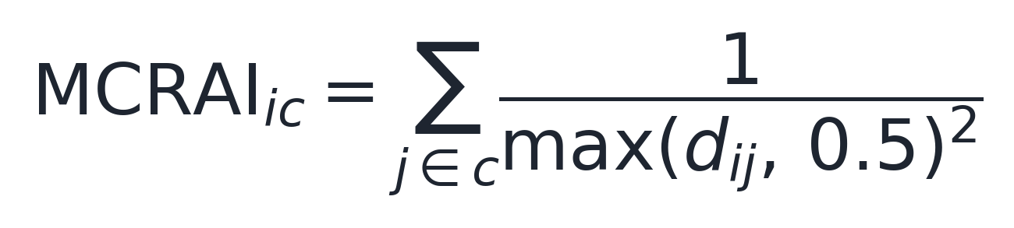
3 · METHODOLOGY
13 / 40
MCRAI — measuring access to amenities
▪
For each property, count the nearby amenities in a category (schools, groceries, hospitals…).
▪
Closer amenities count more — the score fades with the square of road distance.
▪
Each category has its own reach: a hospital serves a wider area than a corner store.
▪
Distances in km, floored at 0.5 km. (Hansen, 1959)
Notes:
Say: MCRAI is a gravity-style accessibility score: nearby amenities count more, weighted by 1 over road distance squared, with a 0.5 km floor and category-specific reach.
Defend: The logic follows Hansen accessibility. The squared-distance decay and floor are a defensible baseline; the floor avoids extreme values beside an amenity. Be honest that beta and radii are sensible conventions, not estimated from Cebu data yet.

Slide 14
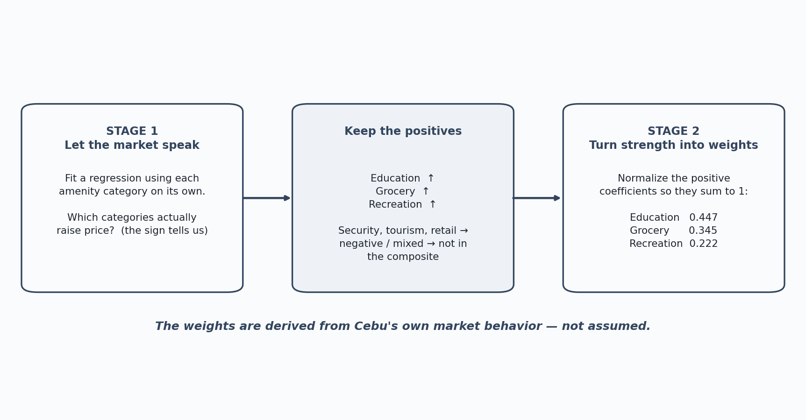
3 · METHODOLOGY
14 / 40
MCRAI weights — and the evaluation protocol
The weights are revealed, not assumed
Two more design choices
▪
Spatial lag — average price of nearby same-type listings within 500 m. (Tobler, 1970)
▪
Target — the log of price per square meter; converted back for the price surface.
Evaluation protocol
▪
GroupKFold(5) , groups defined by coordinate cluster — the same location never sits in both train and test.
▪
Stricter than a random 80/20 split; every reported figure is out-of-fold.
Stage 1 finds implicit prices (signs); Stage 2 normalizes the positive ones. Result: education 0.447, grocery 0.345, recreation 0.222.
Notes:
Say: MCRAI weights are revealed from the data, not assumed: OLS estimates implicit prices, then positive significant categories are normalized.
Defend: The composite weights are education 0.447, grocery 0.345, recreation 0.222; security, tourism, and retail stay outside the composite. Evaluation uses GroupKFold(5) by coordinate cluster so the same location cannot appear in train and test. A plain random split leaks co-located listings and was optimistic, especially for lots.

Slide 15
04
Data Understanding
Collection and exploratory analysis
Notes:
Section 4 — Data Understanding.

Slide 16
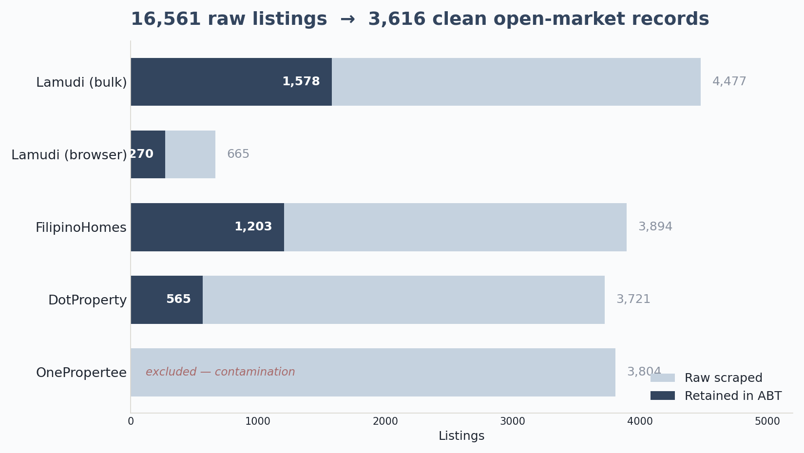
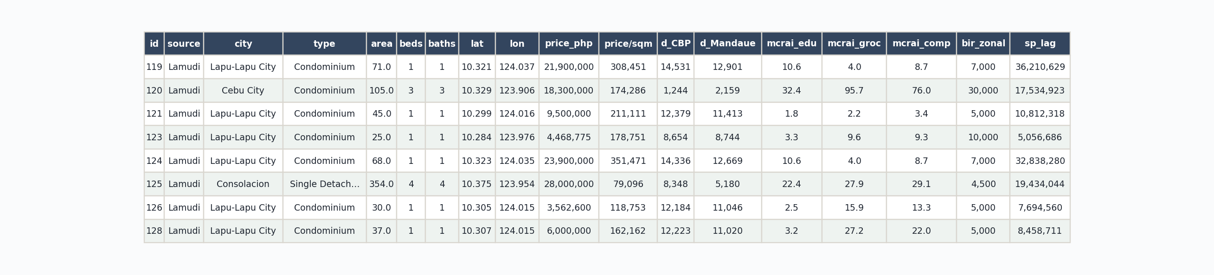
4 · DATA UNDERSTANDING
16 / 40
From collection to a clean ABT
▪
16,561 listings scraped across three portals; 3,616 survived to the ABT.
▪
Filters: geocoding, six-LGU and residential constraints, a price-per-sqm sanity band, distressed-listing removal, de-duplication.
▪
OnePropertee was excluded entirely — bad geocoding and mis-extracted prices would have contaminated the model.
A slice of the assembled ABT — 18 of 51 columns: structural attributes, coordinates, node distances, MCRAI scores, BIR benchmark, spatial lag.
Notes:
Say: The funnel is intentionally conservative: 16,561 raw listings became 3,616 clean ABT rows, roughly one in five kept.
Defend: Retention is Lamudi 1,578 plus 270 browser rows, FilipinoHomes 1,203, and DotProperty 565; OnePropertee was excluded to avoid contamination. The small N is the data-scarcity reality the literature describes, so the study uses Random Forest and grouped CV rather than overstating precision.

Slide 17
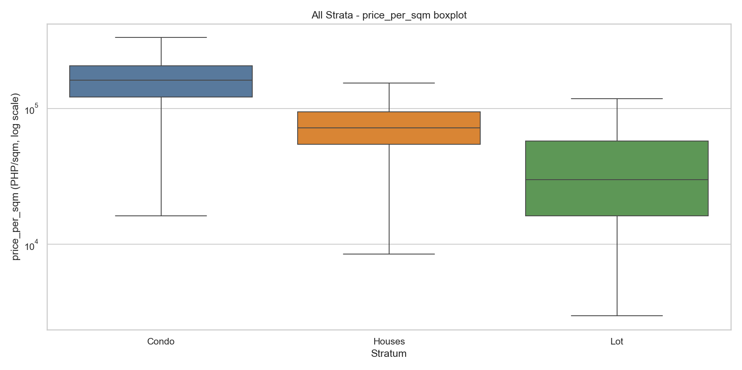
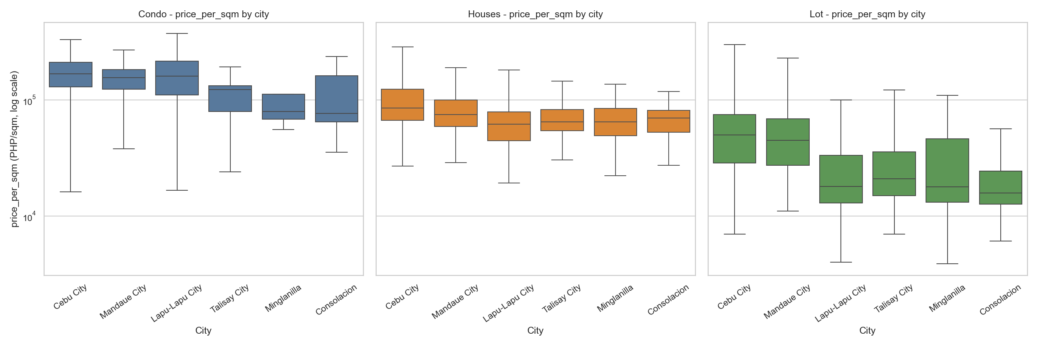
4 · DATA UNDERSTANDING
17 / 40
The price signal across the market
Price varies across the map
Cebu City ~₱113,600/m², Mandaue ~96,100, Lapu-Lapu ~92,100; a lower southern band ~47–57k. Location is modeled explicitly.
Target is right-skewed
Condos command the highest unit prices, vacant lots the lowest — so the target is modeled in log.
MCRAI coverage Zero rates checked before modeling: education (0.3%) and grocery (4.3%) effectively complete; security sparsest (26.6%). High rates flag thin catchments, not data failure.
Notes:
Say: Price per square meter is right-skewed, so the target is modeled in log. Prices also spread sharply by geography.
Defend: Cebu City is about ₱113,600 per sqm, Mandaue ₱96,100, and Lapu-Lapu ₱92,100, with a lower southern band around ₱47,100–56,800. Some CBD distances are collinear; that matters for OLS and is handled with VIF trimming, while trees can tolerate correlated predictors. MCRAI zero rates were checked before modeling, with security the sparsest layer.

Slide 18
4 · DATA UNDERSTANDING
17 / 40
The price signal across the market
Price varies across the map
Cebu City ~₱113,600/m², Mandaue ~96,100, Lapu-Lapu ~92,100; a lower southern band ~47–57k. Location is modeled explicitly.
Notes:
Say: Price per square meter is right-skewed, so the target is modeled in log. Prices also spread sharply by geography.
Defend: Cebu City is about ₱113,600 per sqm, Mandaue ₱96,100, and Lapu-Lapu ₱92,100, with a lower southern band around ₱47,100–56,800. Some CBD distances are collinear; that matters for OLS and is handled with VIF trimming, while trees can tolerate correlated predictors. MCRAI zero rates were checked before modeling, with security the sparsest layer.

Slide 19
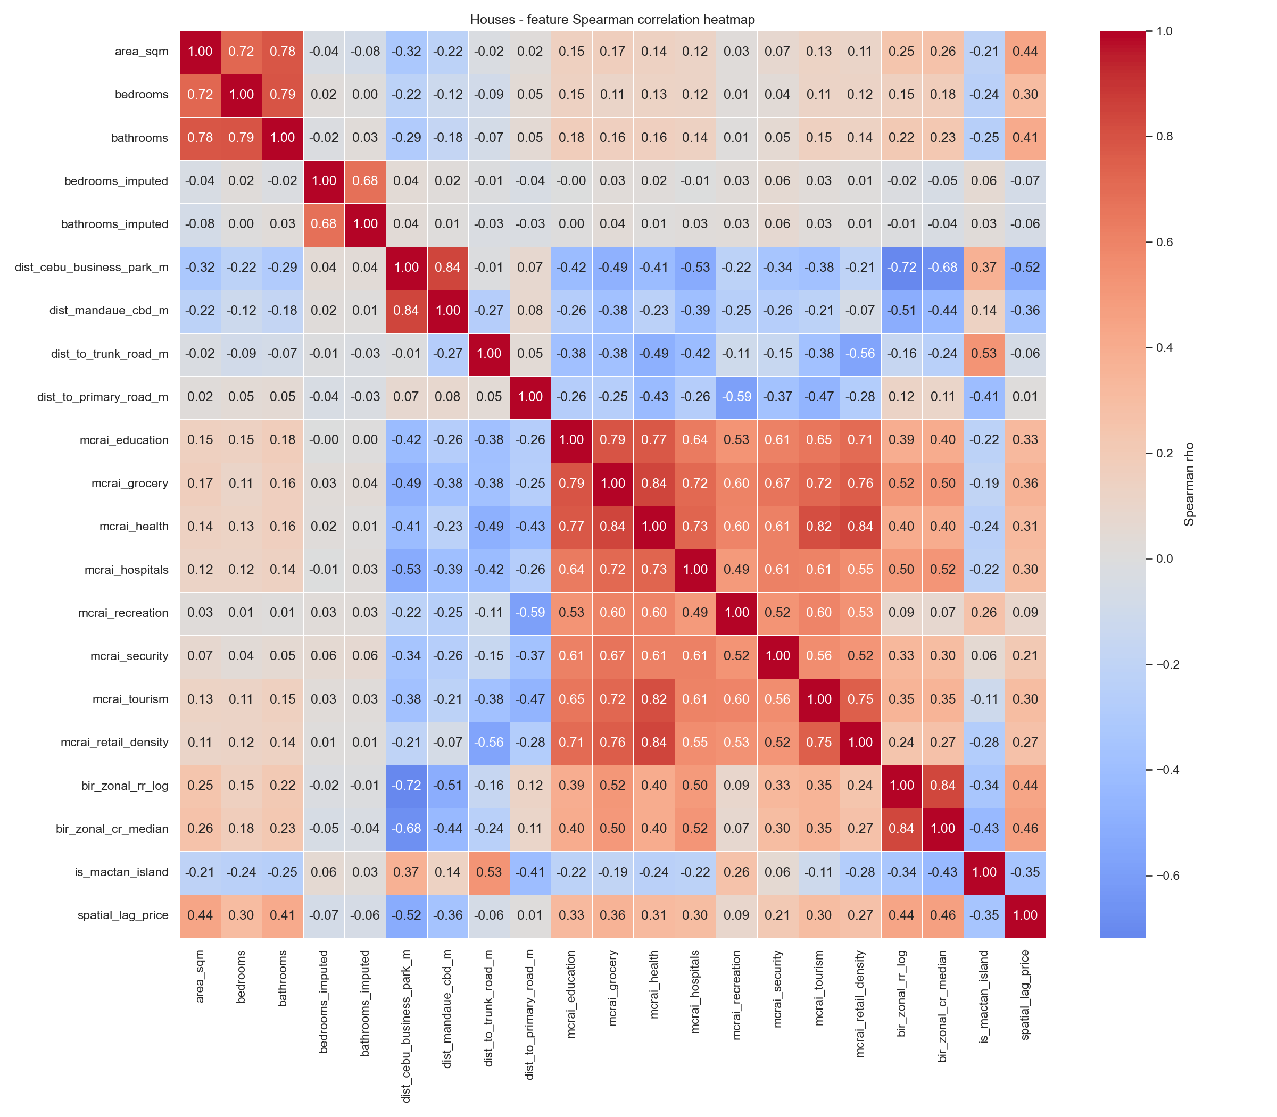
4 · DATA UNDERSTANDING
17 / 40
The price signal — and can we trust the features?
Some features move together
Southern-corridor CBD distances are collinear — matters for the OLS baseline (VIF), not the trees.
Several southern-corridor CBD distances move together — an early collinearity warning.
Random Forest tolerates correlated predictors, so the substantively meaningful nodes were kept.
Notes:
Say: Price per square meter is right-skewed, so the target is modeled in log. Prices also spread sharply by geography.
Defend: Cebu City is about ₱113,600 per sqm, Mandaue ₱96,100, and Lapu-Lapu ₱92,100, with a lower southern band around ₱47,100–56,800. Some CBD distances are collinear; that matters for OLS and is handled with VIF trimming, while trees can tolerate correlated predictors. MCRAI zero rates were checked before modeling, with security the sparsest layer.

Slide 20
05
Data Preparation
Cleaning, and preparing data for the models
Notes:
Section 5 — Data Preparation.

Slide 21
5 · DATA PREPARATION
19 / 40
Cleaning kept every decision visible
A clean, defensible table
A data-integrity story
▪
Imputed values were flagged , never silently filled — imputation stays auditable.
▪
Early models were dominated by a single suspicious feature in the SHAP rankings.
▪
Structurally-absent fields (bedrooms for vacant lots) were left unimputed, not faked.
▪
The cause: the target had quietly come to mean two different things across scrape batches — acting as a scale-selector.
▪
Hard duplicates dropped; a price-per-sqm sanity band applied.
▪
Tracing and fixing it (redefining the target to log price per square meter) is exactly why the final metrics are dependable.
▪
The modeling subset is 3,372 of 3,616 rows, after model-requirement filters.
TAKEAWAY
The aim was a clean, defensible table — usable rows without inventing evidence.
Notes:
Say: Cleaning kept every decision visible: imputed values were flagged, structurally absent fields were not faked, duplicates were removed, and price-per-sqm sanity checks caught area-entry errors.
Defend: Distressed or “For Assume” listings were removed because they quote loan balances, not market value. The integrity story is important: an early SHAP-dominant feature exposed a target-definition problem across scrape batches, and fixing the target to log price per sqm is why the final metrics are dependable.

Slide 22
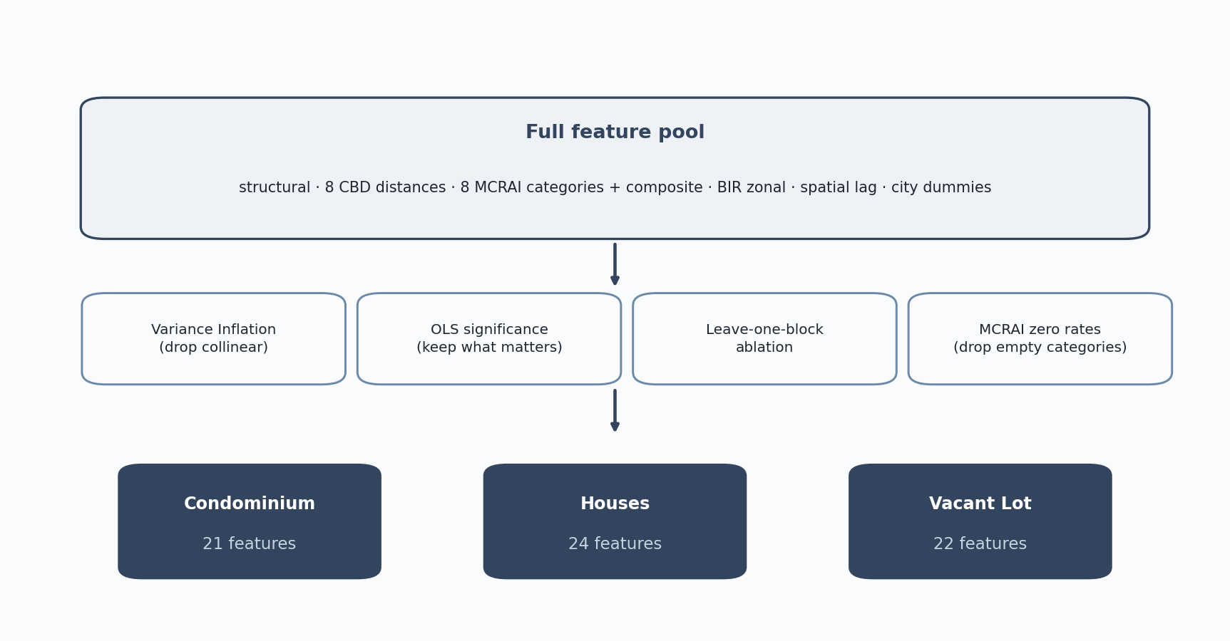
5 · DATA PREPARATION
20 / 40
Preparing the data for modeling
1
Split by property type
Condominiums, houses, and vacant lots become three separate datasets.
2
Encode and assemble
Cities become indicator columns; structural, distance, MCRAI, benchmark, and spatial-lag features are joined per row.
3
Select features per stratum
Four screens — variance inflation, OLS significance, leave-one-block ablation, MCRAI zero rates — yield three tailored sets: 21 / 24 / 22.
MCRAI COVERAGE Zero rates checked before modeling: education (0.3%) and grocery (4.3%) effectively complete; security sparsest (26.6%). High rates flag thin catchments, not data failure.
Notes:
Say: Preparing for modeling has three moves: split by property type, encode and assemble the feature blocks, then select features per stratum.
Defend: The selection screens were VIF, OLS significance, leave-one-block ablation, and MCRAI zero rates. They produced tailored feature counts of 21, 24, and 22. One common feature set would be weaker because the screens gave different answers for condos, houses, and lots.

Slide 23
06
Modeling
Stratified models, selection, tuning
Notes:
Section 6 — Modeling.

Slide 24
6 · MODELING
22 / 40
One model cannot price three markets
5.8×
▪
Built area and land-only follow fundamentally different price logic.
▪
A single pooled model averages these into one blurred equation that fits none of them well.
The condominium median price per square meter runs about 5.8 times the vacant-lot median.
▪
So the study fits three separate models, one per property type. (Dröes et al., 2019; Usman et al., 2020)
TAKEAWAY
Stratifying is itself an evidence-based finding, not a convenience.
Notes:
Say: One pooled model cannot price three markets. Condo unit prices are about 5.8 times the vacant-lot median, and built homes versus bare land follow different price logic.
Defend: The three separate models are evidence-based, not just convenient. The literature shows stratified submarket models fit better, and this deck’s own feature-selection results show that each property type behaves differently.

Slide 25
6 · MODELING
23 / 40
Feature sets differ by property type
Condominium · 21
Houses · 24
Vacant Lot · 22
Structural — area, bedrooms, bathrooms (+ imputed flags) CBD distances (8) — CBP, Mandaue, Mactan, SRP, Talisay, Consolacion, Naga, airport Access & benchmark — MCRAI composite, BIR zonal, spatial lag City indicators (5)
Structural — area, bedrooms, bathrooms (+ imputed flags) CBD distances (8) — full node set Access & benchmark — MCRAI composite, BIR zonal, spatial lag City indicators (5) Sub-type (3) — House & Lot, Single Detached, Townhouse
Structural — area CBD distances (8) — full node set MCRAI individual (6) — education, grocery, health, hospitals, recreation, tourism Benchmark — BIR zonal, spatial lag City indicators (5)
COLLINEARITY CBD nodes cluster (VIF>5) → kept in trees, OLS trims redundant terms. MCRAI composite blends its parts → dropped in OLS, kept for trees/SHAP. Residual spread rises with price → OLS uses HC3; trees unaffected.
Notes:
The shared core is eight CBD distances, BIR zonal benchmark, spatial lag, and city indicators.
The differences reflect what each property type actually has: built homes get structure and an MCRAI composite; vacant lots get land area and individual amenity categories.
Defend MCRAI: For condos and houses, the MCRAI categories are highly inter-correlated, roughly 0.57–0.96, so the composite is the parsimonious accessibility summary. For vacant lots, specific amenities carry distinct signal, so education, grocery, health, hospitals, recreation, and tourism stay separate; the lot model drops the composite, security, and retail density.
Defend imputation flags: bedrooms_imputed and bathrooms_imputed are 0/1 flags. Observed beds/baths use the reported value and flag 0; missing values are median-imputed by property type and city and flag 1. This lets the model distinguish observed from filled values. Lots have no flags because beds/baths are structurally absent, not missing.
Close: Same selection procedure, different strata-specific answers — that difference is a finding.

Slide 26
6 · MODELING
24 / 40
The model lineup — and tuning
The lineup — all fit per stratum on log price/m²
Hyperparameters
▪
OLS hedonic — interpretable baseline (HC3 robust errors). (Rosen, 1974)
RF — deployed, tuned
Trees
Max feat
Min leaf
Condominium
300
0.7
1
▪
Random Forest — non-linear, robust on small samples. (Breiman, 2001)
Houses
300
1.0
2
Vacant Lot
300
1.0
1
▪
XGBoost — gradient boosting on tabular data. (Chen & Guestrin, 2016)
Comparators, standard settings. XGBoost: 300 trees, lr 0.05, max depth 6 — held constant across strata. OLS: log-log with HC3, a fixed form, no tuning grid — so the head-to-head stays fair.
▪
SHAP explains every prediction, feature by feature. (Lundberg & Lee, 2017)
Why these three
Set aside for clear reasons: SVR (costly to tune, weak interpretability), LASSO/Ridge (subsumed by OLS), Deep nets (need >10,000 samples; lose global interpretability).
Notes:
Say: The model lineup spans interpretability to accuracy: OLS hedonic with HC3 as the baseline, Random Forest as the deployed model, XGBoost as a tree-boosting comparator, and SHAP for explanations.
Defend: SVR, LASSO/Ridge, and deep nets were set aside for clear reasons — tuning burden, overlap with OLS, or sample-size and interpretability limits. The deployed RF was tuned per stratum with 300 trees; comparators ran at standard settings so the head-to-head stayed fair.

Slide 27
07
Evaluation
Accuracy, model comparison, ablation
Notes:
Section 7 — Evaluation.

Slide 28
7 · EVALUATION
26 / 40
Headline accuracy — all three models
MdAPE — typical error (lower is better)
Reading the metrics
Property type
OLS
Random Forest †
XGBoost
▪
MdAPE — median absolute % error; robust to a few extreme listings.
Condominium
24.5%
19.3%
19.8%
Houses
25.1%
22.7%
23.6%
▪
PE20 — the share within 20% of the listing; the practical hit-rate.
Vacant Lot
44.8%
38.4%
40.2%
▪
Peer benchmark: comparable small-sample studies report MAPE 48–53% (Nyanda, 2024) — these errors are competitive.
PE20 — share within 20% (higher is better)
Property type
OLS
Random Forest †
XGBoost
Condominium
40%
51%
50%
Houses
41%
44%
43%
Vacant Lot
22%
26%
27%
TAKEAWAY
Tree models beat OLS in every stratum; Random Forest is best-or-tied and deployed. Condos and houses estimate well; vacant lots remain weakest.
Notes:
Say: Under identical leak-free folds, Random Forest gives the best typical error: MdAPE 19.3% for condos, 22.7% for houses, and 38.4% for vacant lots.
Defend: OLS is worse at 24.5 / 25.1 / 44.8, and XGBoost is close at 19.8 / 23.6 / 40.2. MdAPE is robust to extreme listings; PE20 is the practical hit-rate. Do not claim IAAO assessment-grade compliance. Vacant lots are weakest because key parcel attributes are missing from listings.

Slide 29
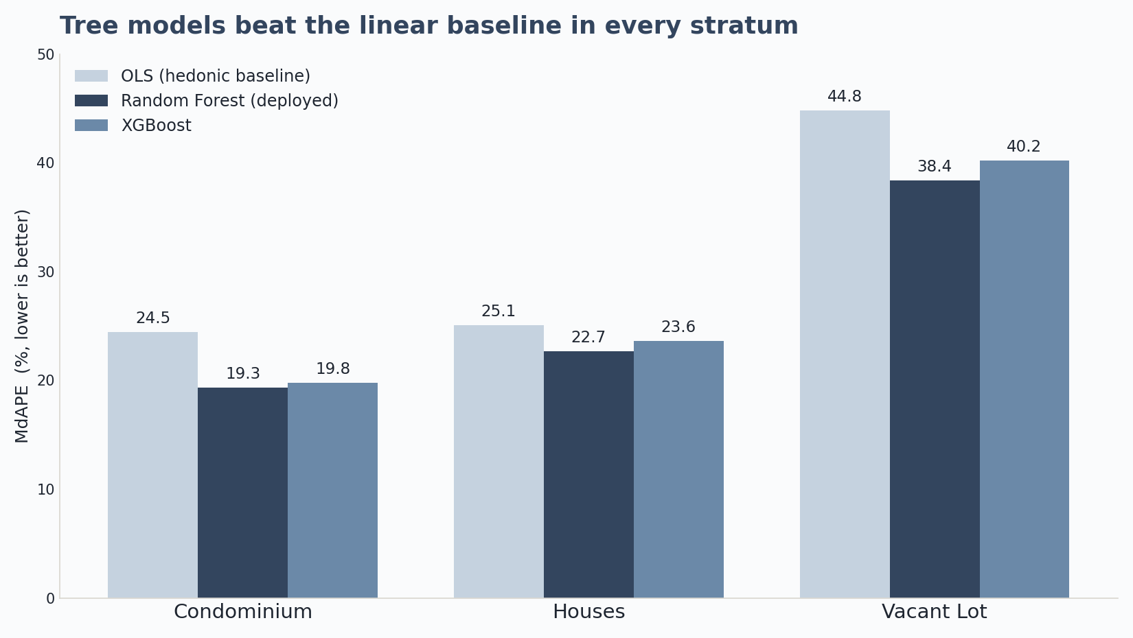
7 · EVALUATION
27 / 40
Which model performed best? (RQ2)
▪
Under identical leak-free folds, both tree models beat the OLS baseline in every stratum.
▪
RF and XGBoost are close; RF edges it on the deployed grouped-CV (19.3 vs 19.8 / 22.7 vs 23.6 / 38.4 vs 40.2).
▪
Because the tree models are so close, the fair reading is "RF best-or-tied."
▪
Random Forest was deployed — robust on small samples, and simpler to maintain.
Notes:
Say: RQ2 answer: both tree models beat OLS in every stratum, and Random Forest is best-or-tied under grouped cross-validation.
Defend: RF only edges XGBoost slightly — 19.3 vs 19.8, 22.7 vs 23.6, 38.4 vs 40.2 — so the point is not a big accuracy gap. RF was deployed because it is robust on small samples and simpler to maintain.

Slide 30
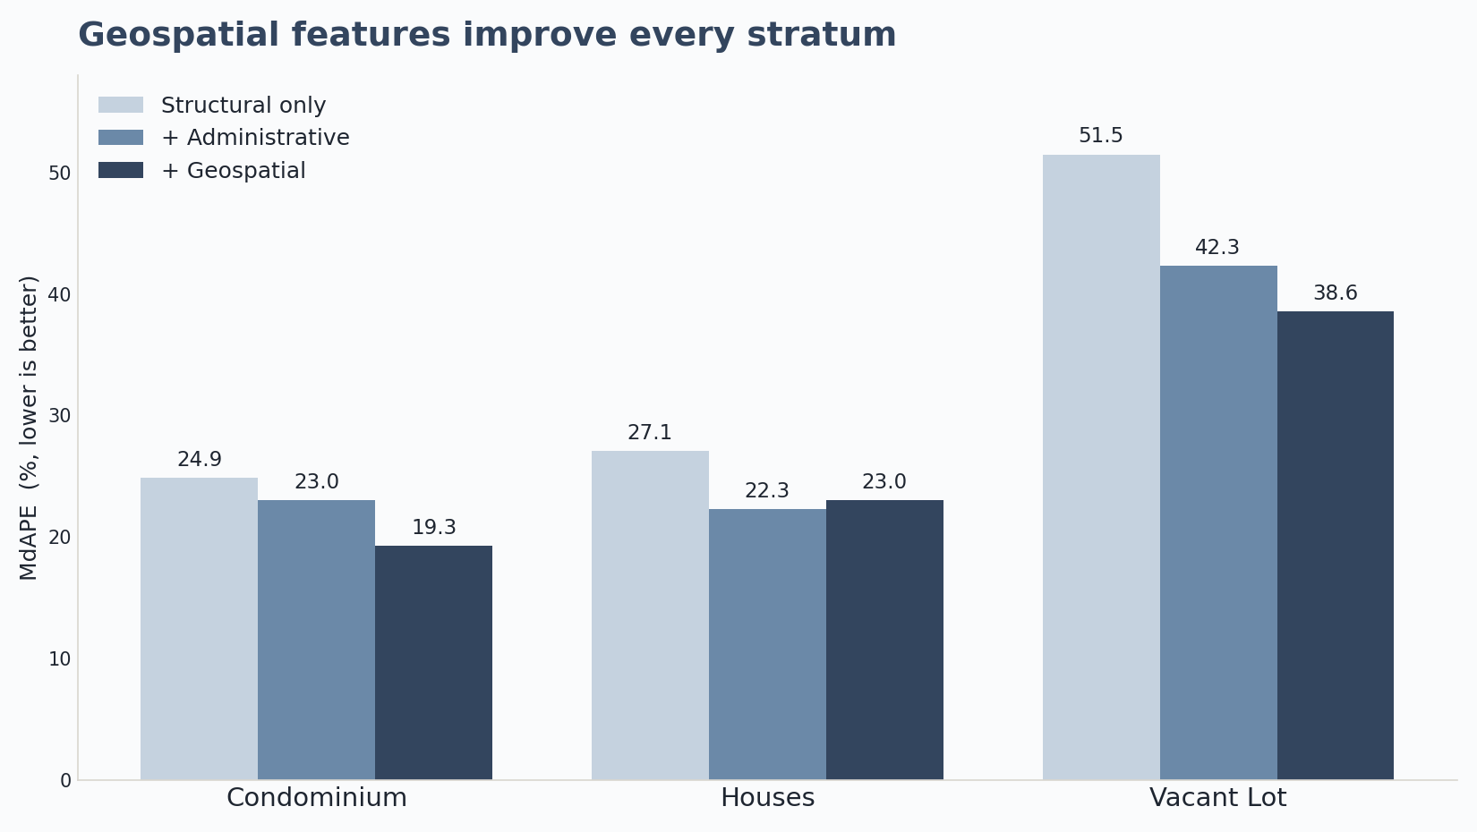
7 · EVALUATION
28 / 40
Do geospatial features earn their place? (RQ3)
Three-tier ablation: Structural → + Administrative → + Geospatial.
Where the model errs
▪
▪
At the center of the distribution the models are near-unbiased — median signed error within a few percent of zero.
▪
Geospatial improves every stratum vs structural-only: condo +5.7, houses +4.2, lot +13.0 pts.
▪
The damage is in the tails : a few extreme misses, not broad bias.
▪
They add the most where benchmarks are weakest — condos and bare land.
▪
Those misses are atypically cheap listings — condition, title issues, distressed pricing, or terrain the data never records.
TAKEAWAY
Reliable for typical properties; it cannot price what the data never captured.
Notes:
Say: RQ3 answer: geospatial features earn their place. The ablation moves from structural only, to administrative location, to geospatial features.
Defend: Against structural-only, geospatial improves every stratum — condo +5.7 points, houses +4.2, vacant lot +13.0. Even after city and BIR benchmark, it still adds for condo (+3.7) and lot (+3.8), while houses are roughly flat. Errors concentrate in the tails: atypically cheap listings with condition, title, terrain, or distress signals the data never captured.

Slide 31
08
Results and Discussion
Drivers and spatial structure
Notes:
Section 8 — Results and Discussion.

Slide 32
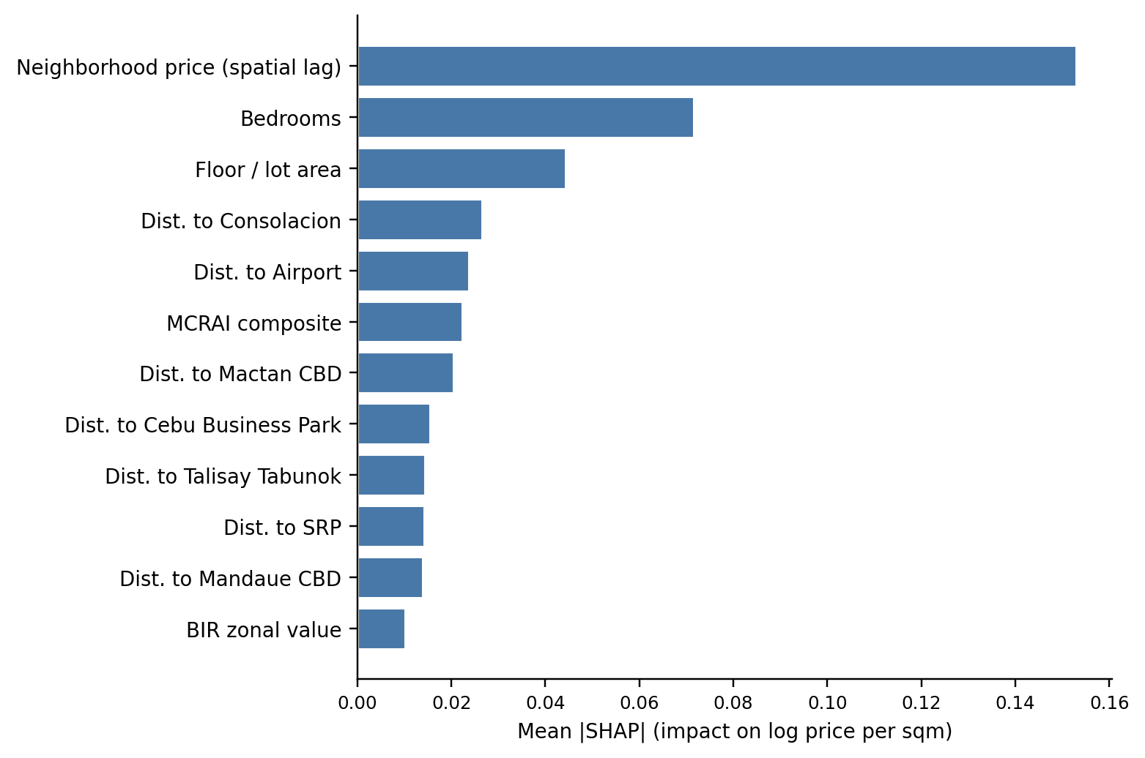
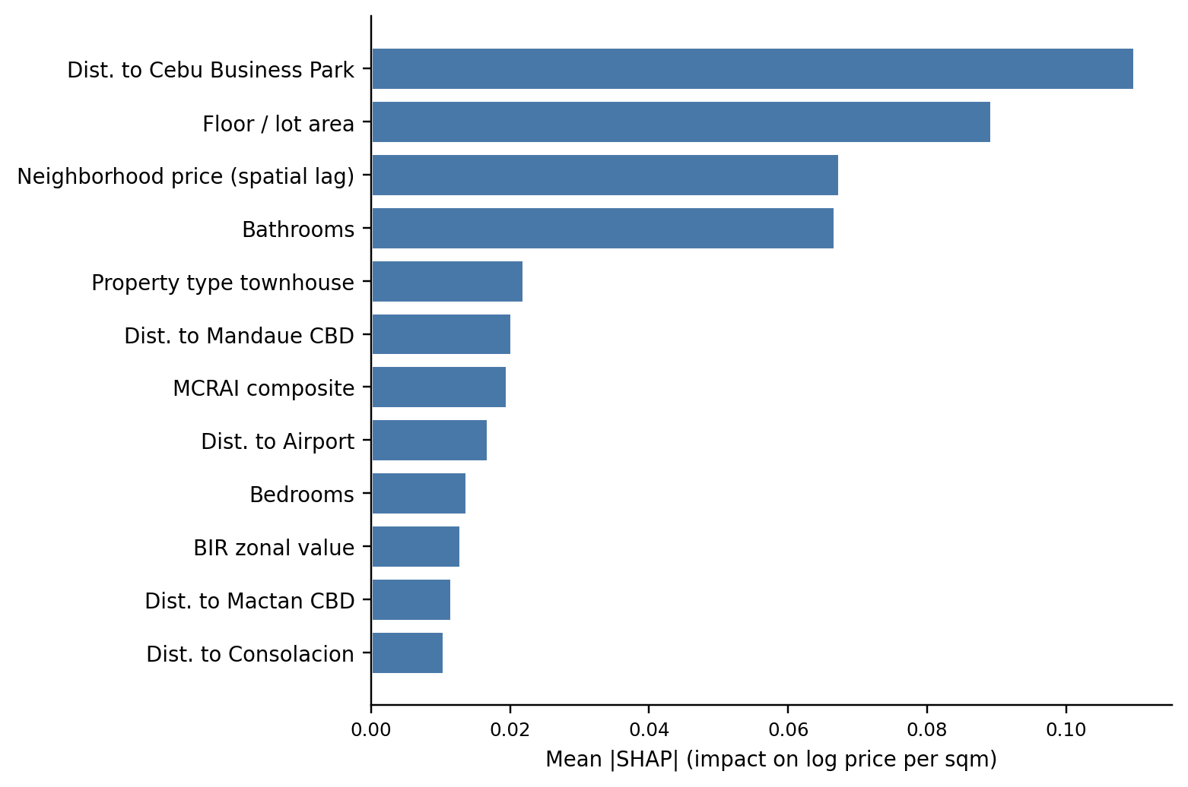
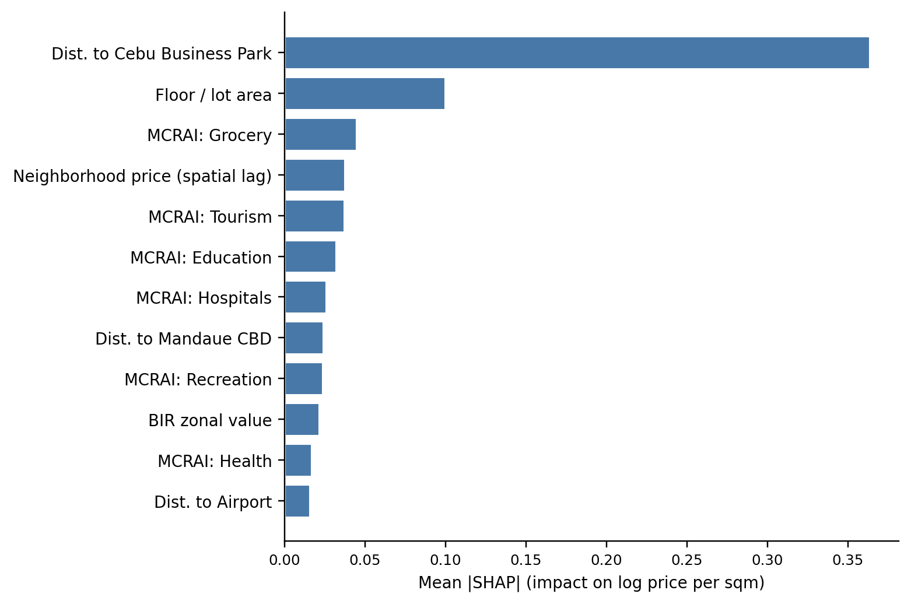
8 · RESULTS & DISCUSSION
30 / 40
What drives price — three findings
1
Location dominates
2
Drivers differ by type
3
MCRAI is selective
Geospatial features carry most SHAP attribution across every stratum.
The strata behave differently — validating a separate model for each.
Education, grocery, recreation add value; security, tourism, retail are diagnostic.
Condominiums — neighborhood price (spatial lag) leads; weight spreads across several nodes.
Houses — distance to Cebu Business Park is the single strongest driver; classic bid-rent.
Vacant lots — CBP distance leads; individual amenity categories are second.
Notes:
Say: The SHAP results give three findings: location dominates, drivers differ by property type, and MCRAI is selective.
Defend: Condos track neighborhood price through spatial lag; houses and lots are driven most by distance to CBP; bare land also responds to individual amenity access. Negative signs on some amenities are not “amenities lower value” — they reflect spatial sorting where congestion or commercial intensity deters some buyers.

Slide 33
8 · RESULTS & DISCUSSION
31 / 40
A polycentric price surface
Polycentric, not monocentric
The Mactan submarket & spatial sorting
▪
CBP still anchors land and detached housing — the historic core matters most there.
▪
The Mactan signal comes through the condominium stratum, via airport and Mactan-CBD distance — a submarket bundle, not a raw island premium.
▪
But it does not stand alone: condo weight spreads across the Mactan/airport corridor and the northern Mandaue–Consolacion nodes.
▪
Negative signs on security, tourism, and retail are not proof of harm.
▪
The reading is a corridor of linked centers , consistent with the JICA roadmap and polycentric theory. (Giuliano & Small, 1991; McMillen, 2003)
▪
They reflect spatial sorting — these uses cluster where congestion deters some buyers. (Tiebout, 1956; Bayer & McMillan, 2012)
Notes:
Say: The price surface is polycentric, not monocentric. CBP anchors land and detached housing, but condo weight spreads across the Mactan-airport corridor and Mandaue–Consolacion nodes.
Defend: Read the Mactan signal as a submarket bundle — airport access, bridge connectivity, and tourism-adjacent demand — not a raw island premium. Negative security, tourism, or retail signs are spatial sorting signals, not proof those amenities harm value.

Slide 34
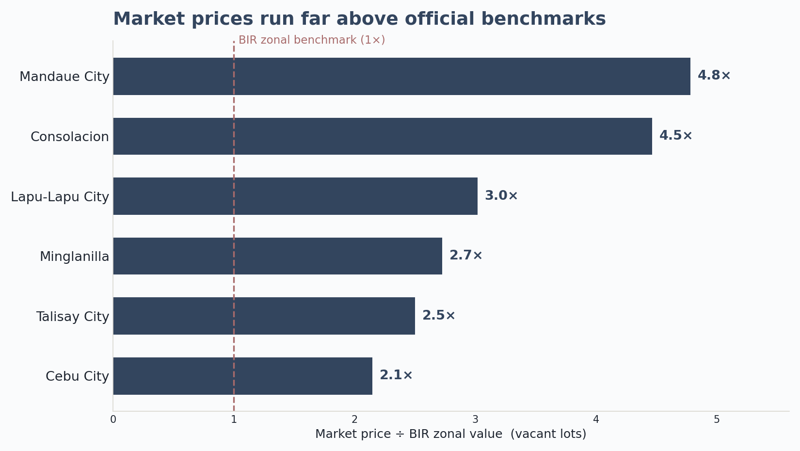
8 · RESULTS & DISCUSSION
32 / 40
The valuation gap (RQ4)
On the clean land-to-land comparison, vacant-lot market price runs ~3× the BIR benchmark overall.
Is the model good enough?
▪
Yes — as a reference for triangulating price , and within clear limits.
▪
From ~2.2× in Cebu City to ~4.8× in Mandaue ; listings exceed the benchmark in nearly every LGU.
▪
Typical error stays substantial even in the best strata — it informs a valuation judgment rather than settling it.
▪
Read it as a research signal that benchmarks are stale — not a correction factor to apply.
▪
Strongest for condos and houses; only indicative for vacant lots and thin LGU×type cells.
▪
It complements professional appraisal judgment; it does not replace it.
Notes:
Say: RQ4 answer: on the clean land-to-land comparison, vacant-lot market price runs about three times the BIR benchmark overall.
Defend: The gap ranges from about 2.2× in Cebu City to about 4.8× in Mandaue, and listings exceed the benchmark in nearly every LGU. Frame this carefully as a research signal that benchmarks are stale, not a correction factor to apply. The tool supports triangulation; it does not settle final appraisal value.

Slide 35
▸
The Decision-Support Tool
The applied deliverable
Notes:
The decision-support tool — the applied deliverable.

Slide 36
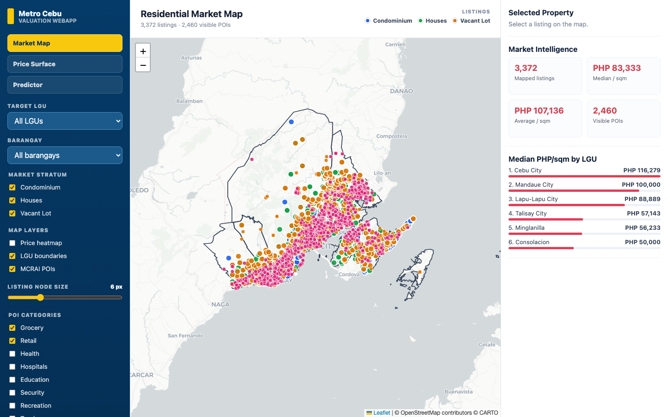
THE DECISION-SUPPORT TOOL
34 / 40
The decision-support tool
Market Map
A prototype web app where the backend runs the exact deployed models — listings, predictions, and the valuation gap in one place.
Live demo
▪
Market Map — open-market listings with filters and market-intelligence summaries.
▪
Price Surface — the predicted price-per-m² surface, aggregated by barangay.
▪
Property Predictor — a property-level estimate with its SHAP breakdown.
Switching to the live application for a walkthrough.
Notes:
Say: The prototype has three views: Market Map for listings and filters, Price Surface for predicted price per sqm by barangay, and Property Predictor for a property-level estimate with SHAP breakdown.
Defend: The backend runs the exact deployed Random Forest models, so the tool always shows its reasoning. Keep the scope clear: market_segment is fixed to open_market for the deployed surface. Switch to the live demo here.

Slide 37
09
Conclusions
Answers, contributions, limits
Notes:
Section 9 — Conclusions.

Slide 38
9 · CONCLUSIONS
36 / 40
Answers, contributions, limits
RQ1 · Location dominates
RQ2 · Tree models win
RQ3 · Geospatial helps
RQ4 · BIR gap systematic
Spatial lag for condos; CBP distance for houses and lots; amenities for bare land.
Beat OLS everywhere; Random Forest best-or-tied and simpler to deploy.
Material uplift, especially where administrative benchmarks are weakest.
Large, positive, systematic — about 3× on the clean lot comparison.
Contributions
Limitations
▪
Per-type modeling with evidence-based feature selection, and a polycentric distance set — not a single-CBD measure.
▪
Asking-price ceiling — trained on listings, not verified deed-of-sale transactions.
▪
Cross-sectional snapshot — a late-2025 view; no temporal modeling.
▪
A two-stage MCRAI (OLS signs screen categories; positive-only composite), with all headline results under leak-free grouped CV.
▪
Vacant-lot data ceiling and thin cells — some LGU×type combinations are too sparse for reliable single-cell estimates.
▪
A reproducible, explainable web prototype — TypeScript + Leaflet over a Python service running the deployed models.
Notes:
Say: Close the thesis answers: location dominates, tree models win, geospatial features help, and the BIR gap is systematic.
Defend: Contributions are per-type modeling, evidence-based feature selection, a polycentric distance set, two-stage MCRAI, leak-free grouped CV, and an explainable web prototype. Volunteer the limits: asking prices rather than deeds, cross-sectional snapshot, vacant-lot data ceiling, and thin LGU-by-type cells. Owning the limits is the strongest defense.

Slide 39
10
Recommendations
Practice, policy, future work
Notes:
Section 10 — Recommendations.

Slide 40
10 · RECOMMENDATIONS
38 / 40
For practice and policy
Practice
Policy
▪
Read the surface as a triangulation tool, alongside zonal values and comparables — not a final appraisal.
▪
Keep recognizing secondary and corridor subcenters (Mactan, Consolacion, Naga), not just CBP.
▪
Weight polycentric distance and property type ahead of the amenity composite.
▪
Use MCRAI as an adaptable template, not a finished index.
▪
On deployment: the prototype shows its open-market-only scope and should be refreshed as data drifts.
▪
Treat the valuation gap as a research signal; validate against transactions before any operational use.
Notes:
Say: For practice, read the surface as a triangulation tool alongside zonal values and comparables — not as a final appraisal.
Defend: Weight polycentric distance and property type before the amenity composite. For policy, keep recognizing secondary and corridor subcenters such as Mactan, Consolacion, and Naga. Treat the valuation gap as a research signal and validate it against transactions before operational use.

Slide 41
10 · RECOMMENDATIONS
39 / 40
For future research
▪
Put MCRAI on an empirical footing — estimate the decay rate, radii, and weights from data rather than fixing them.
▪
Test spatial heterogeneity directly with Geographically Weighted Regression (GWR / MGWR).
CLOSING
▪
Enrich inputs — parcel attributes (frontage, corner-lot), a time dimension, and macro indicators. (Udomsap & Abid, 2020)
This thesis is a demonstrated, reproducible workflow more than a finished product — a custom MCRAI, a polycentric distance set, and a Random Forest + SHAP pipeline that can be rebuilt, checked, and adapted for other Philippine secondary cities.
▪
Triangulate against complementary reference prices instead of a single market-facing target.
A defensible template for local valuation analytics — a clearer starting point for the family deciding what a home is worth.
Notes:
Say: Future work should put MCRAI on an empirical footing: estimate the decay rate, category radii, and weights from data rather than fixing them.
Defend: Next steps are GWR or MGWR for spatial heterogeneity, richer inputs such as frontage, zoning, slope, titling, time, and macro indicators, and triangulation against complementary reference prices. Closing line: the thesis is a demonstrated, reproducible workflow — a defensible template for local valuation analytics in Philippine secondary cities.

Slide 42
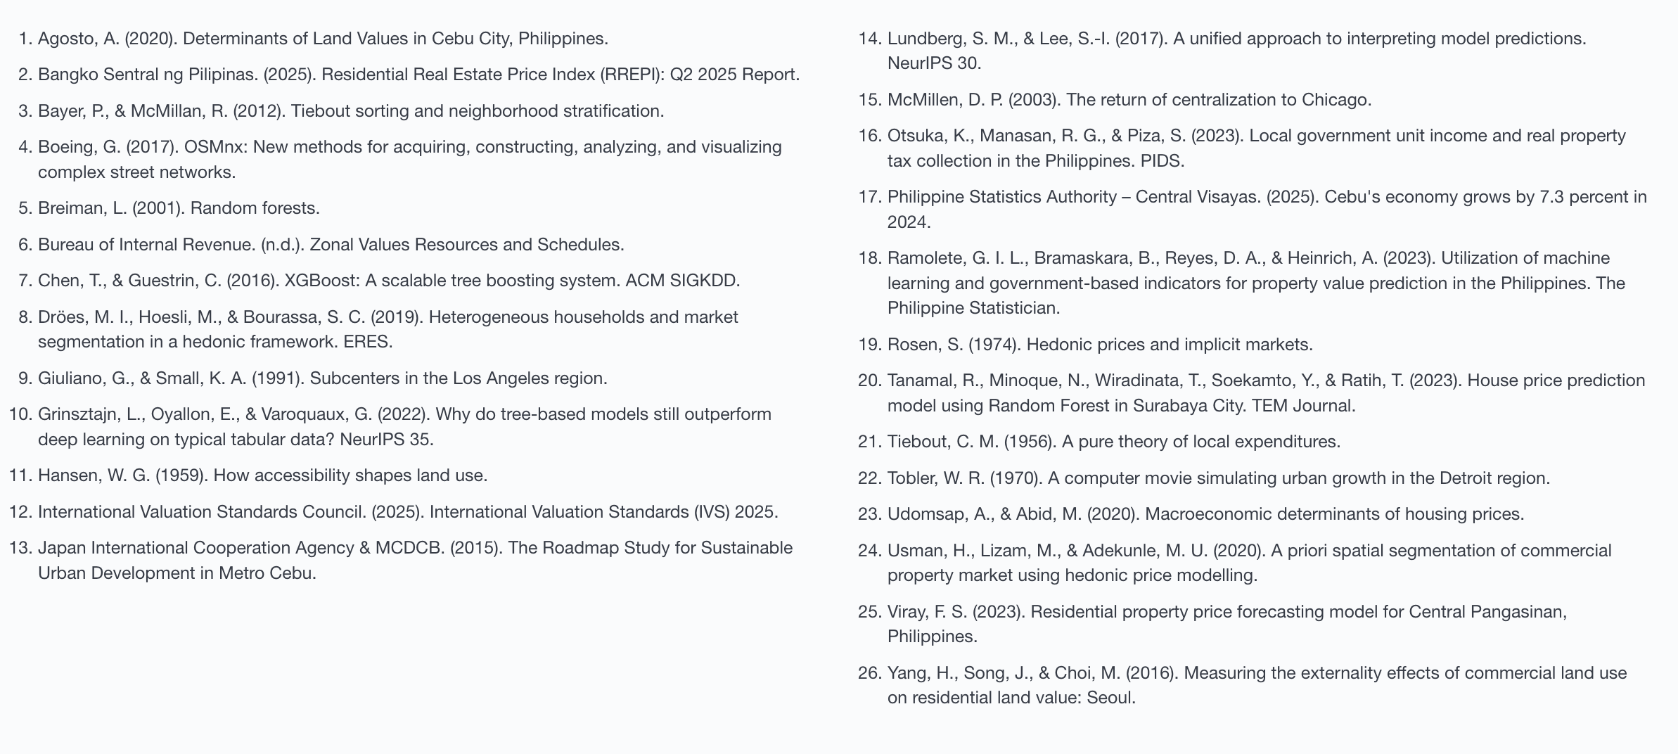
REFERENCES
40 / 40
References
Thank you
Chris Dominic Estreba
BS Data Science · University of Asia and the Pacific
Notes:
Thank you. References.

