Slide 1
UA&P · BS Data Science · June 2026
Predicting Open-Market Residential Property Values in Metro Cebu
Using Machine Learning and Geospatial Features
Chris Dominic Estreba
BS Data Science Capstone

Slide 2
[ photo: a Cebu family / a home ]
Everyone needs a place to live.

Slide 3
[ photo: Cebu homes / skyline ]
A home is the biggest purchase most families ever make.

Slide 4
[ photo: a property listing ]
You find one. ₱6.5M.
Is that fair?

Slide 5
[ photo: a real-estate broker ]
Ask a broker — you get a number.

Slide 6
[ photo: an appraiser at work ]
Ask an appraiser — you get a different one.

Slide 7
None of them agree. And none of them says why.

Slide 8
[ photo: a 'For Sale' sign ]
Now you're the seller. What is it worth?

Slide 9
[ photo: an empty house / keys ]
Too high, it sits for months. Too low, you leave money behind.

Slide 10
[ photo: one house, five question marks (buyer · seller · broker · bank · LGU) ]
Everyone guesses — from a different corner.

Slide 11
[ photo: a tax / zonal schedule ]
BIR zonal values — built for taxation, not live market prices. And not always updated.
BIR, n.d.; Otsuka et al., 2023

Slide 12
[ photo: a bank facade ]
Bank appraisals — tied to lending and collateral risk. A different question than market value.

Slide 13
[ photo: a property listings website ]
Online listings — asking prices, not verified sales. Full of seller strategy and noise.

Slide 14
Each one is useful. But they answer different questions — and they don't line up.
The references exist. Nothing connects them.
▶ animate the second line on click

Slide 15
02
The Market

Slide 16
7.3%
Cebu's economy grew in 2024.
▪ Among the fastest-growing provinces in the country.
▪ Driven by IT-BPM and call-center expansion.
▪ And a strong post-pandemic rebound in tourism.
PSA Cebu, 2025

Slide 17
11.5%
And home prices followed in 2025.
▪ Metro Cebu's growth — the highest rate outside Metro Manila.
▪ From the BSP residential property price index (RREPI).
▪ Prices moving faster than benchmarks and incomes can adjust.
BSP, 2025

Slide 18
[ photo: CBRT / Cebu–Cordova Expressway / SRP ]
New infrastructure keeps redrawing what counts as ‘near’.

Slide 19
03
The Question

Slide 20
THE BUSINESS PROBLEM
No defensible, market-facing price reference for Metro Cebu homes.

Slide 21
THE DATA PROBLEM
Turn a property — and where it sits — into a defensible price per square meter.
▪ Property-level data at scale, drawn from online listings.
▪ Location turned into measurable features — distances, accessibility, neighborhood price.
▪ A model that generalizes honestly, and explains its reasoning.

Slide 22
OBJECTIVES
▪ Predictive — estimate open-market price per square meter across Metro Cebu.
▪ Prescriptive — show where those estimates diverge from official benchmarks.

Slide 23
RESEARCH QUESTIONS
▪ 1 What value drivers influence price?
▪ 2 Which model deploys best?
▪ 3 Do geospatial features help?
▪ 4 How large is the BIR gap?

Slide 24
THE SOLUTION
A stratified, explainable ML model — delivered as a prototype for triangulation.

Slide 25
ROADMAP — CRISP-DM
Business → Data → Prep → Modeling → Evaluation → Deployment

Slide 26
04
The Field

Slide 27
TWO TRADITIONS
▪ Hedonic regression — interpretable, classic.
▪ Machine learning — flexible, higher accuracy.
Rosen, 1974; Breiman, 2001

Slide 28
WHAT DRIVES PRICE IN THE LITERATURE
▪ Structural
▪ Economic / benchmark
▪ Geospatial / accessibility
▪ Amenity / point-of-interest

Slide 29
INTERNATIONAL EVIDENCE
▪ Tree models tend to outperform linear models on tabular property data.
▪ But small samples demand caution.
Grinsztajn et al., 2022; Tanamal et al., 2023

Slide 30
PHILIPPINE & CEBU EVIDENCE
▪ ML work is mostly Manila / Pangasinan-centric.
▪ Agosto (2020) is the only Cebu study — transport accessibility is the primary driver.
Viray, 2023; Ramolete et al., 2023; Agosto, 2020

Slide 31
THE GAP
Nothing property-level, geospatial, and explainable — for Metro Cebu.

Slide 32
OUR BRIDGE
This study builds exactly that.
▪ Property-level — every listing geocoded across the six LGUs.
▪ Open-market — aligned to the IVS Market Value basis.
▪ Geospatial and explainable — with SHAP behind every prediction.

Slide 33
Why open-market listings?
The closest available proxy to IVS Market Value.
Arm's-length asking evidence — the basis a willing buyer and seller actually meet on.
IVSC, 2025

Slide 34
Why geospatial features?
Location is price — so we construct the location signal, not ingest it.

Slide 35
05
The Data

Slide 36
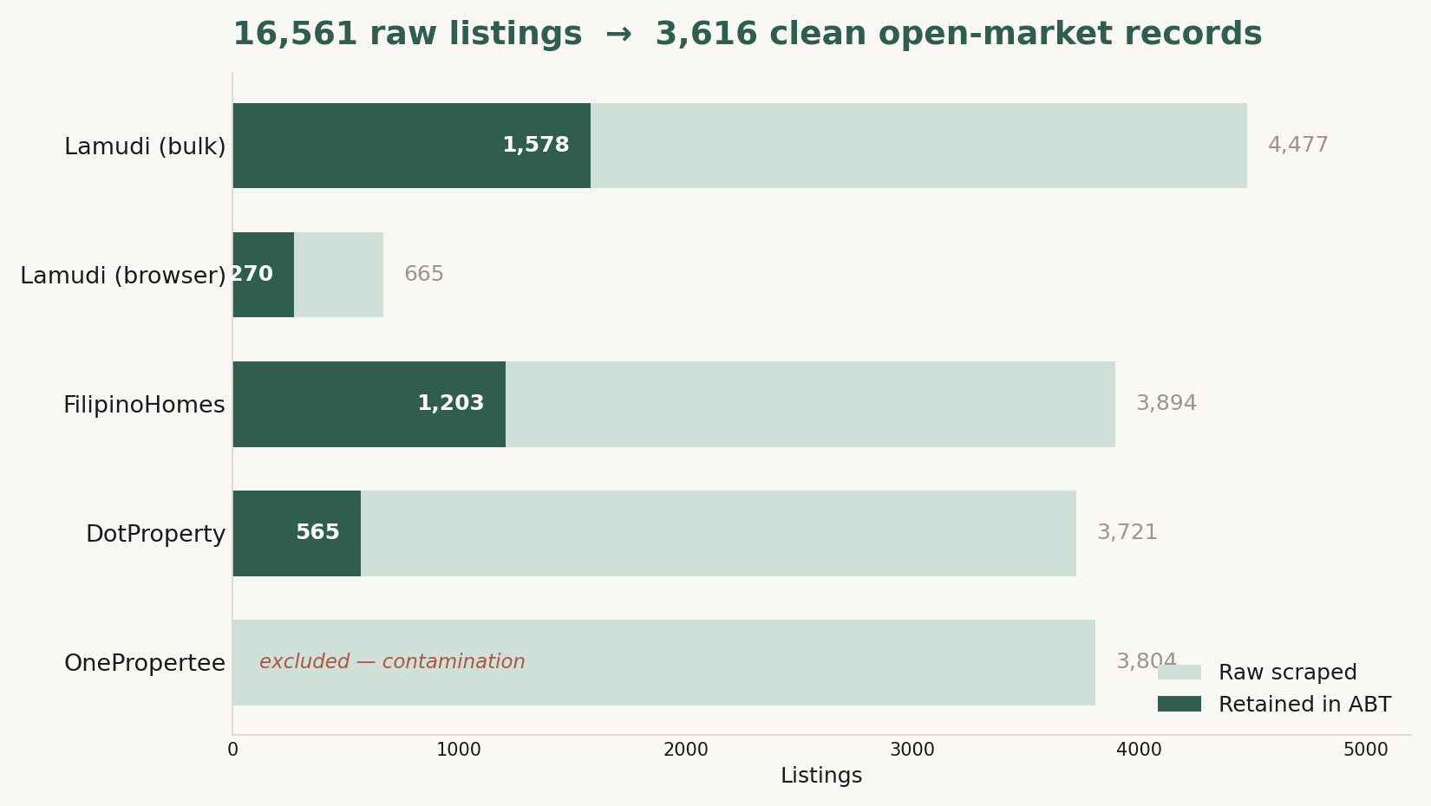
COLLECTION FUNNEL
▪ 16,561 listings scraped — only 3,616 survived.
▪ Geocoding, the six-LGU and residential filters, a price-per-sqm sanity band, and de-duplication did the cutting.
▪ OnePropertee was dropped entirely — city-centroid geocoding and mis-extracted prices.

Slide 37
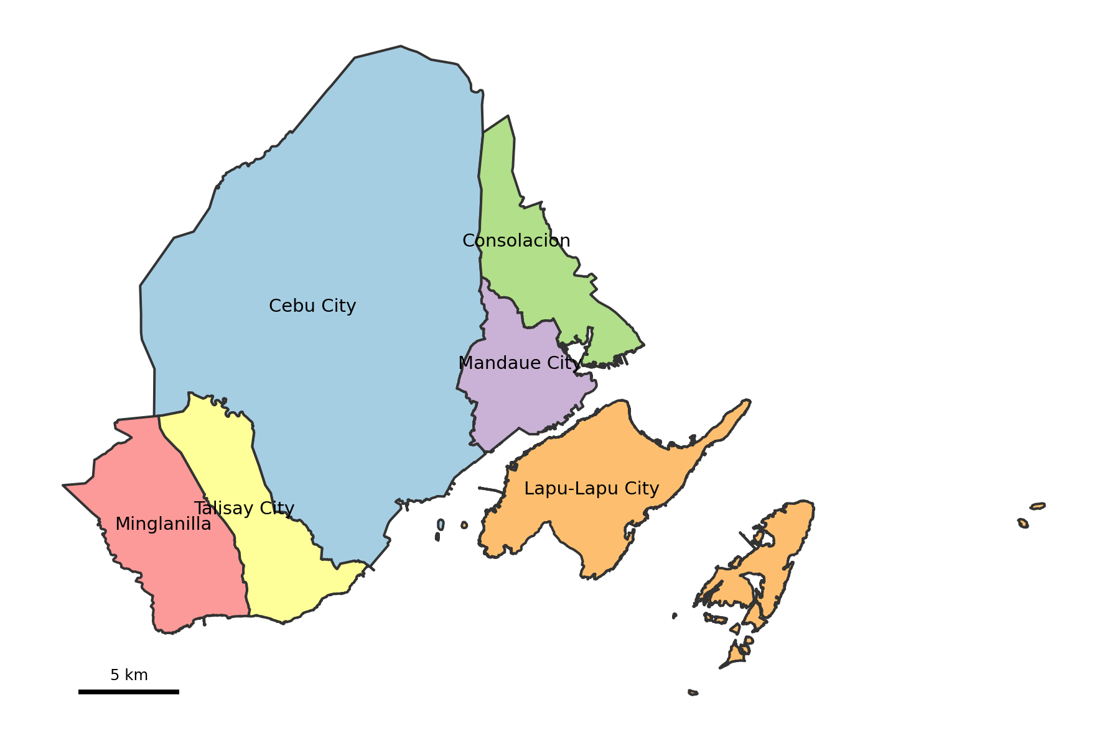
STUDY AREA
The six LGUs in scope.

Slide 38
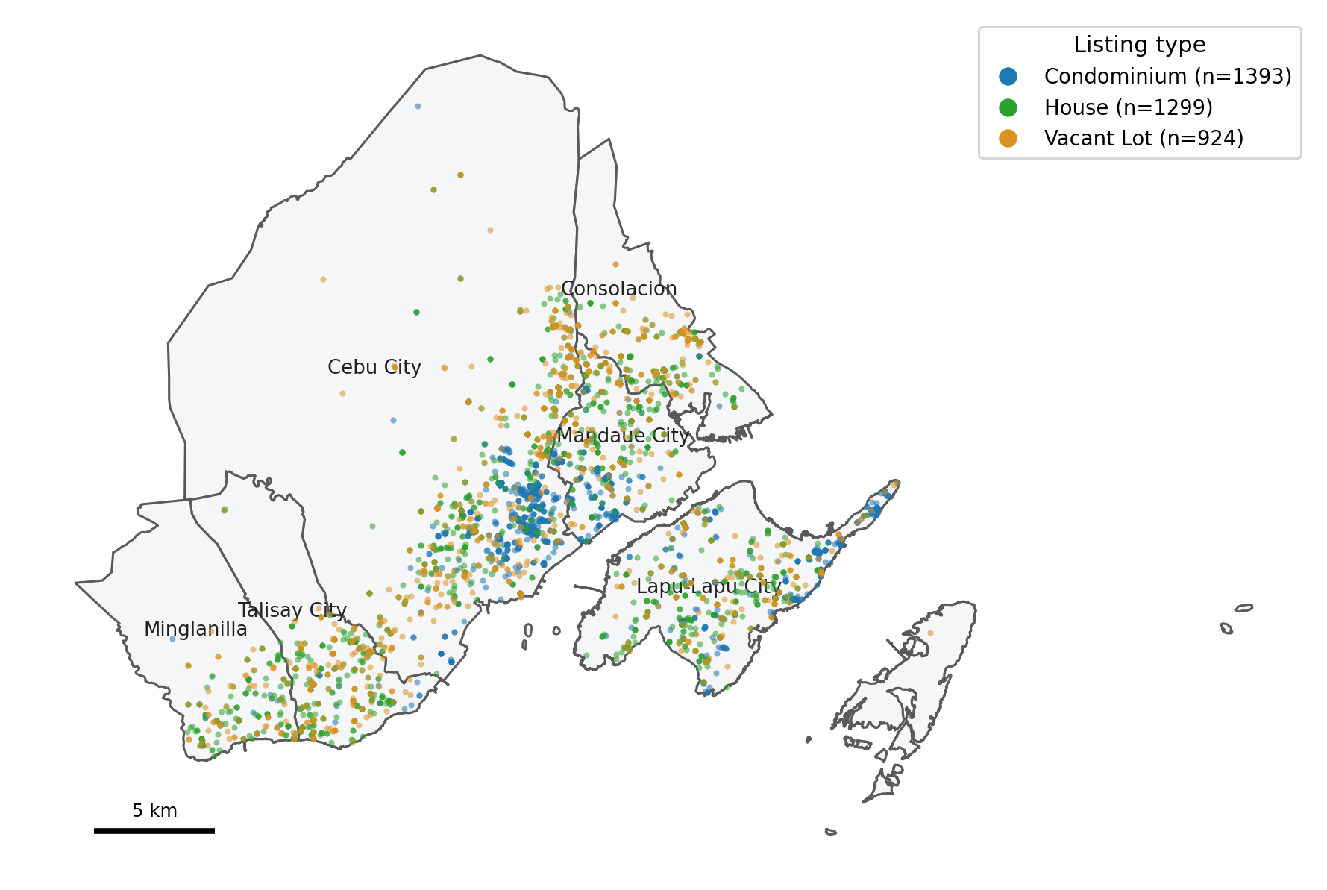
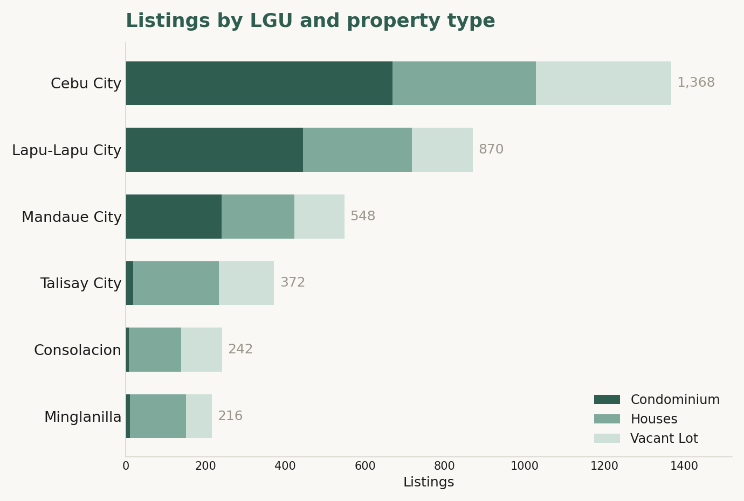
WHERE THE LISTINGS SIT
Across the six LGUs.
Concentrated in Cebu City and the island; thin in the south.

Slide 39
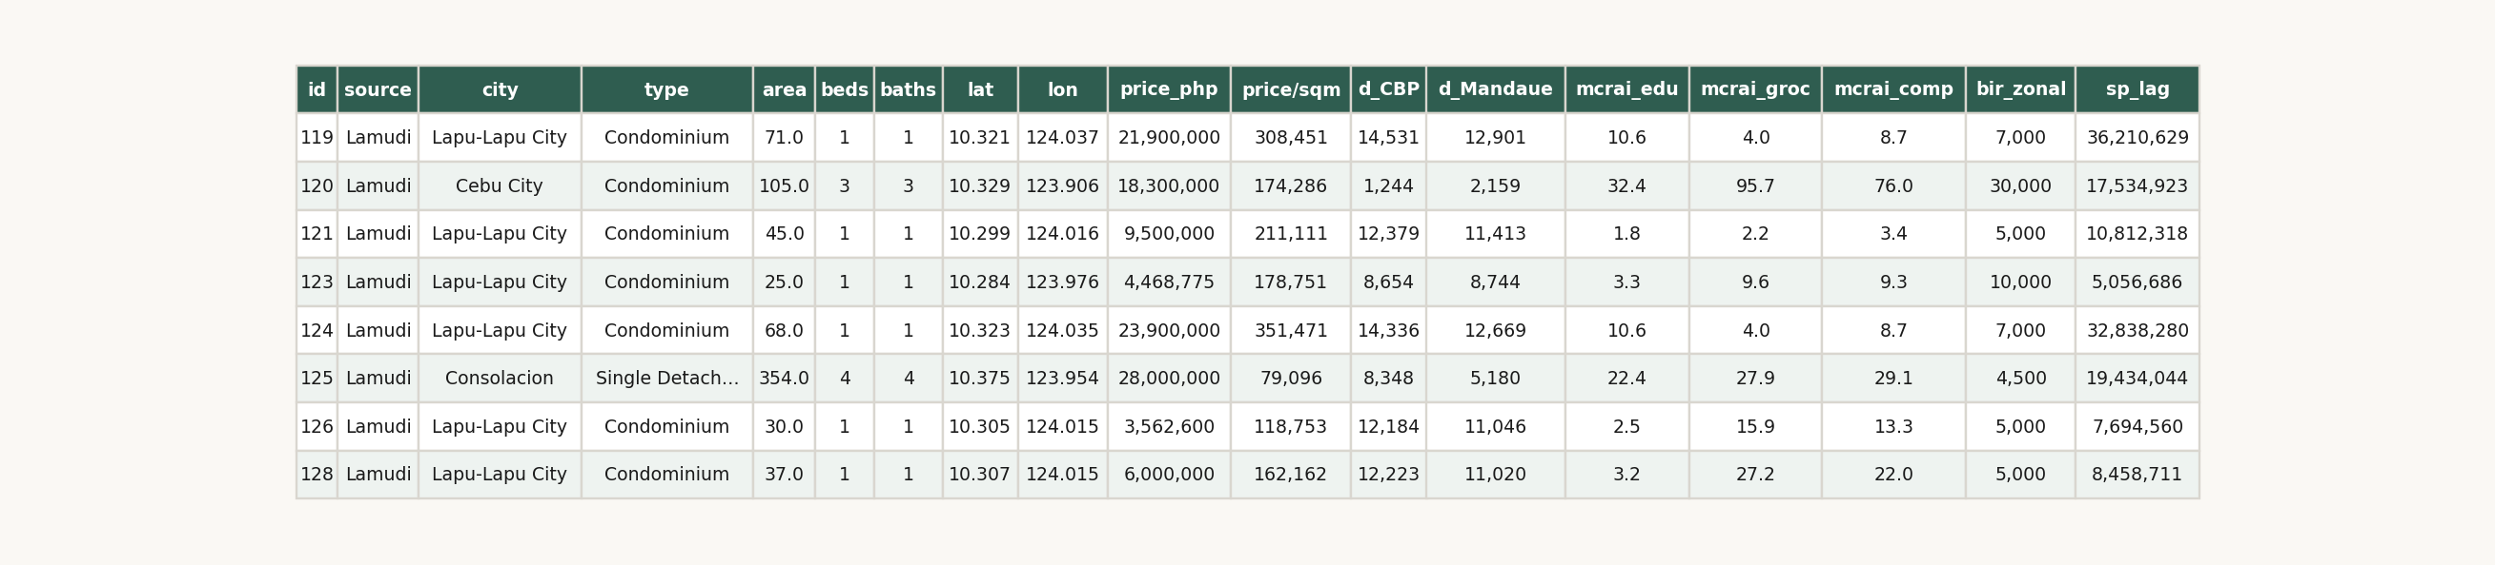
ONE ROW OF THE DATA
18 of 51 columns — structural, location, distances, MCRAI, benchmarks.

Slide 40
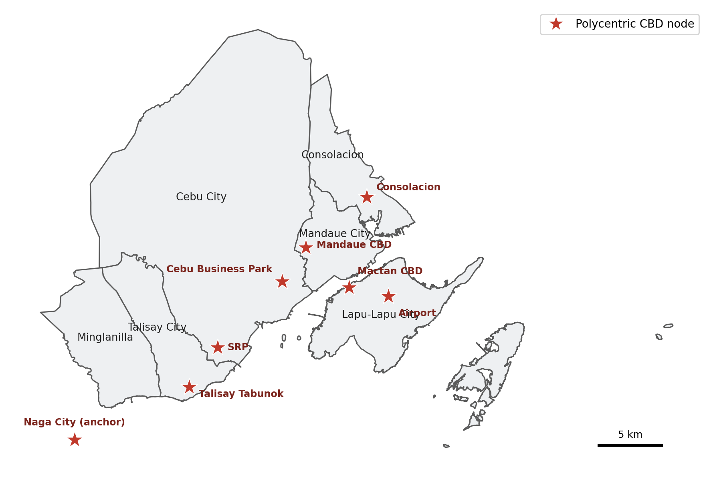
ENGINEERED LOCATION — CBD DISTANCE
Shortest-path road distance to 8 polycentric nodes.
Giuliano & Small, 1991; McMillen, 2003; JICA, 2015; Boeing, 2017

Slide 41
MCRAI — WHAT IT IS
Metro Cebu Residential Accessibility Index (MCRAI)
MCRAIic = Σ 1 / max(dij, 0.5)² (β = 2)
Nearer amenities count more — accessibility decays with the square of road-distance.
Hansen, 1959

Slide 42
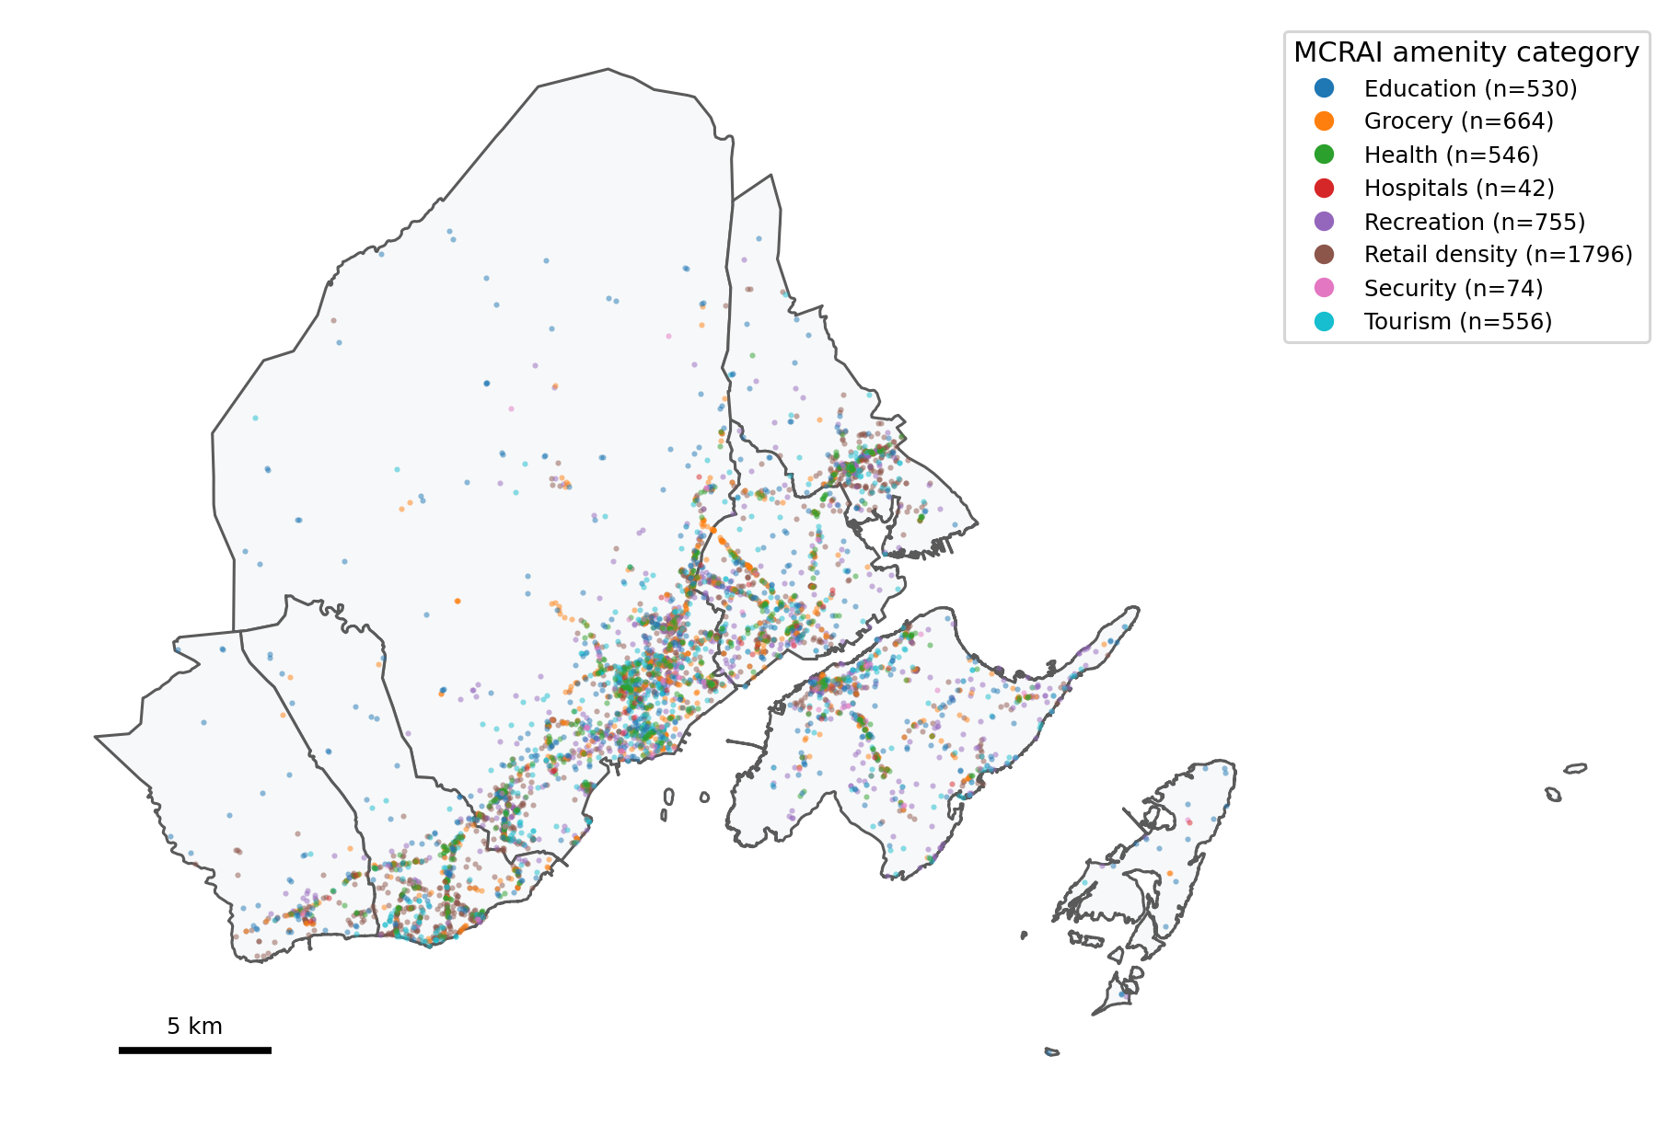
MCRAI — HOW IT'S BUILT
Eight amenity categories, each with its own radius. The composite keeps only positive-signal categories.

Slide 43
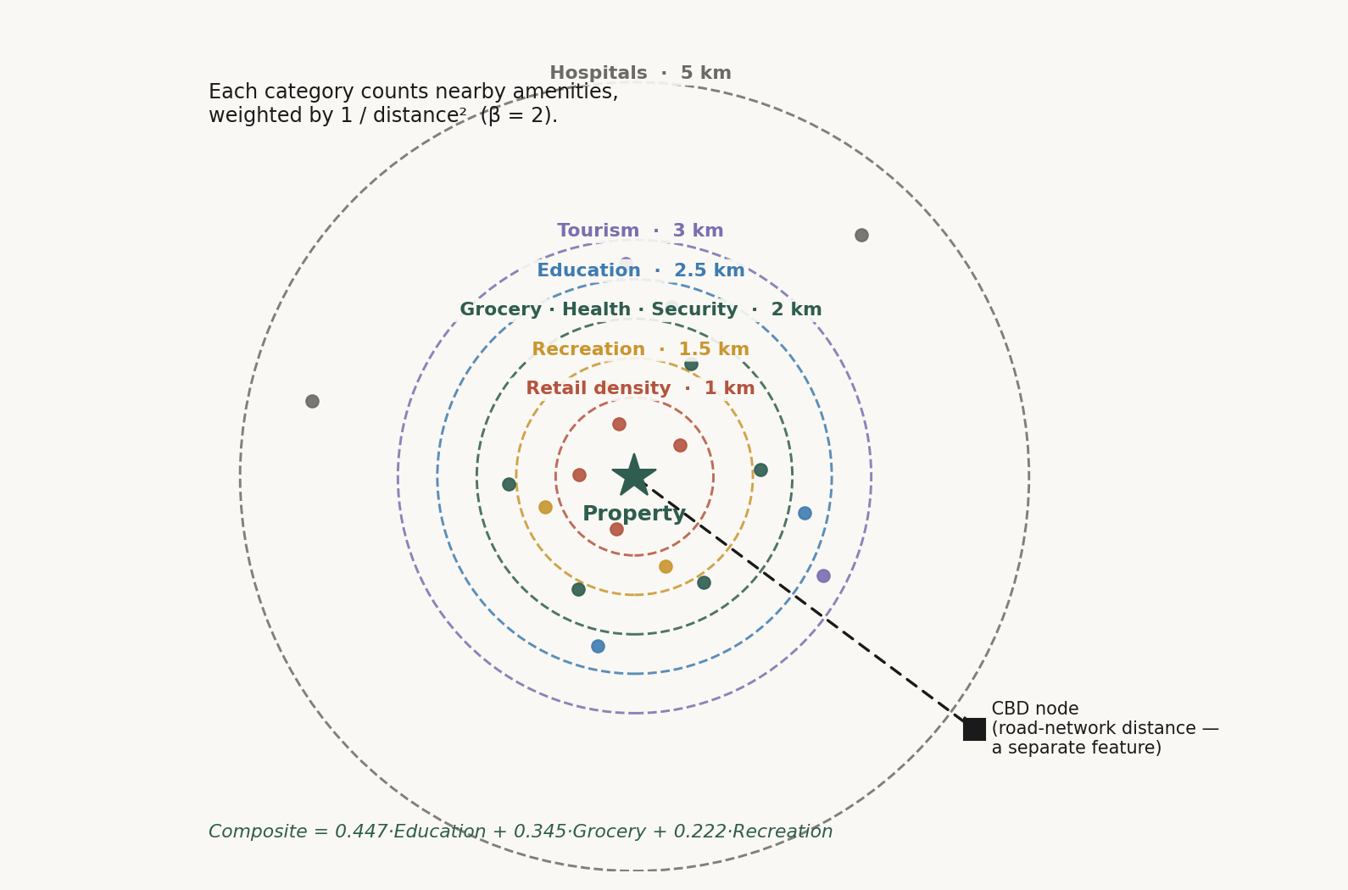
MCRAI — HOW ONE PROPERTY SCORES
▪ Each category has its own catchment radius (1–5 km).
▪ Nearer amenities count more — inverse-square decay (β = 2).
▪ Transport enters separately, as road-network distance.
Hansen, 1959

Slide 44
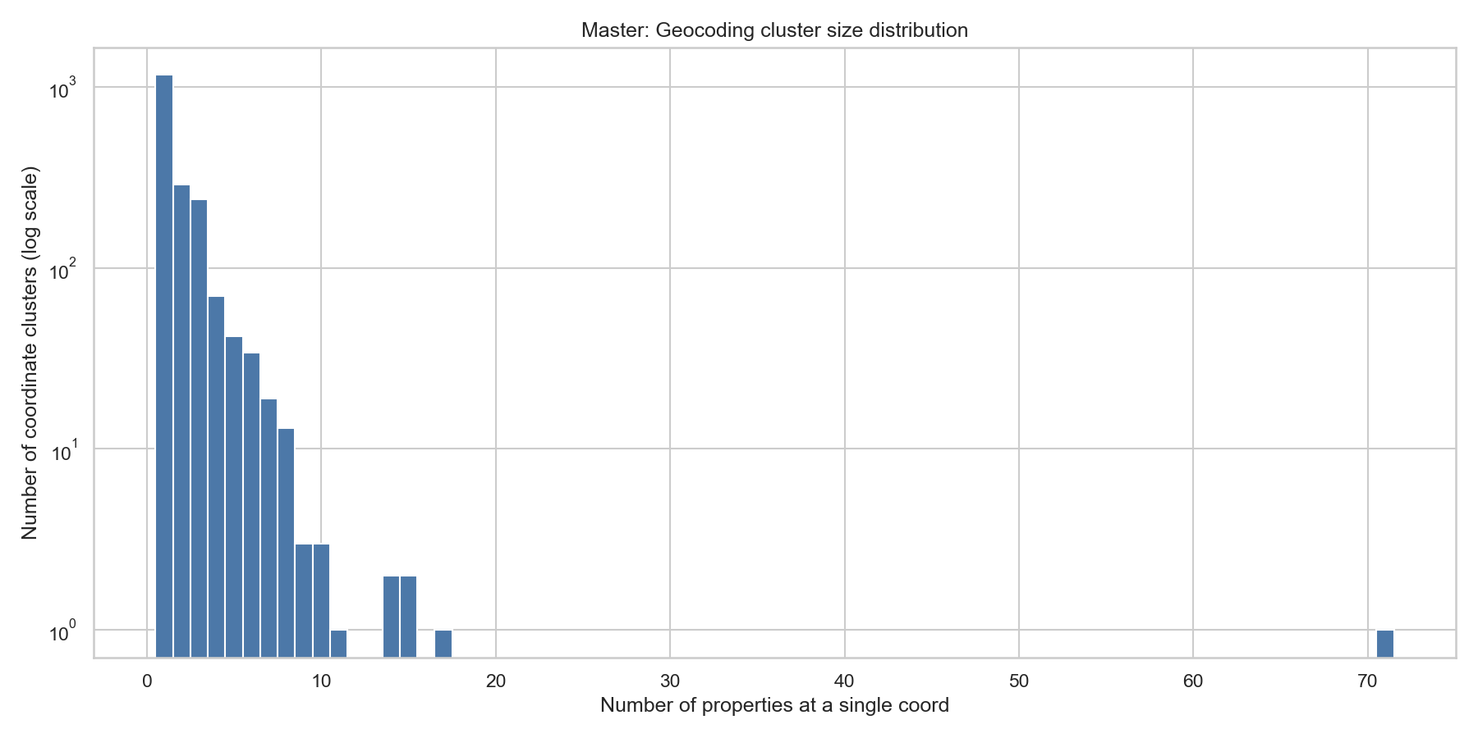
ENGINEERED LOCATION — SPATIAL LAG
Mean price of nearby same-type listings within 500 m.
Tobler, 1970

Slide 45
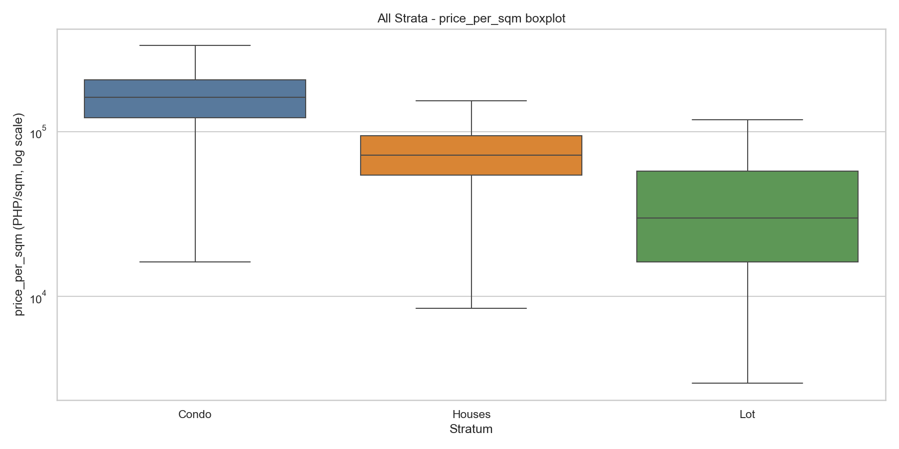
PRICE PER SQUARE METER IS SKEWED
▪ Price per square meter is right-skewed — a few premium units stretch the tail.
▪ Modeled in log: it tames the skew but keeps a per-unit meaning.
▪ Predictions are back-transformed for the price surface.

Slide 46
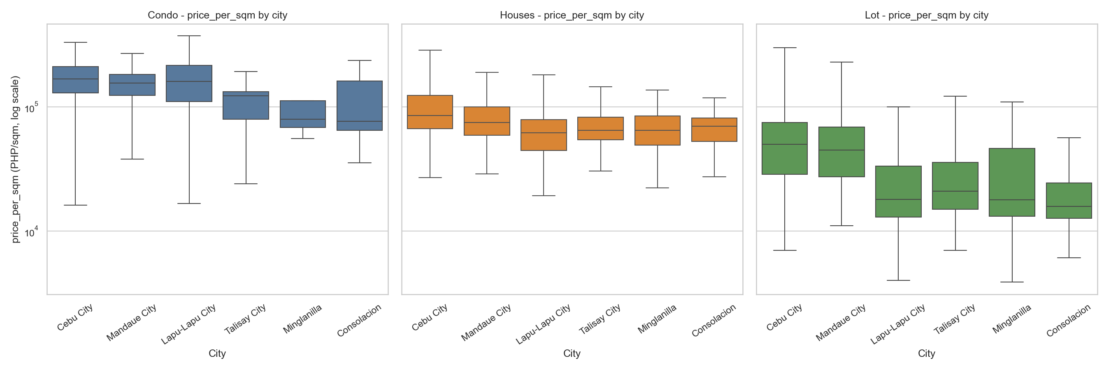
PRICE VARIES ACROSS THE MAP
▪ Premium signal sits in the core and island: Cebu City ~₱113,600/sqm, Mandaue ~₱96,100, Lapu-Lapu ~₱92,100.
▪ Talisay, Minglanilla, Consolacion form a lower band (~₱47–57k).
▪ Location can't be assumed uniform — it has to be modeled.

Slide 47
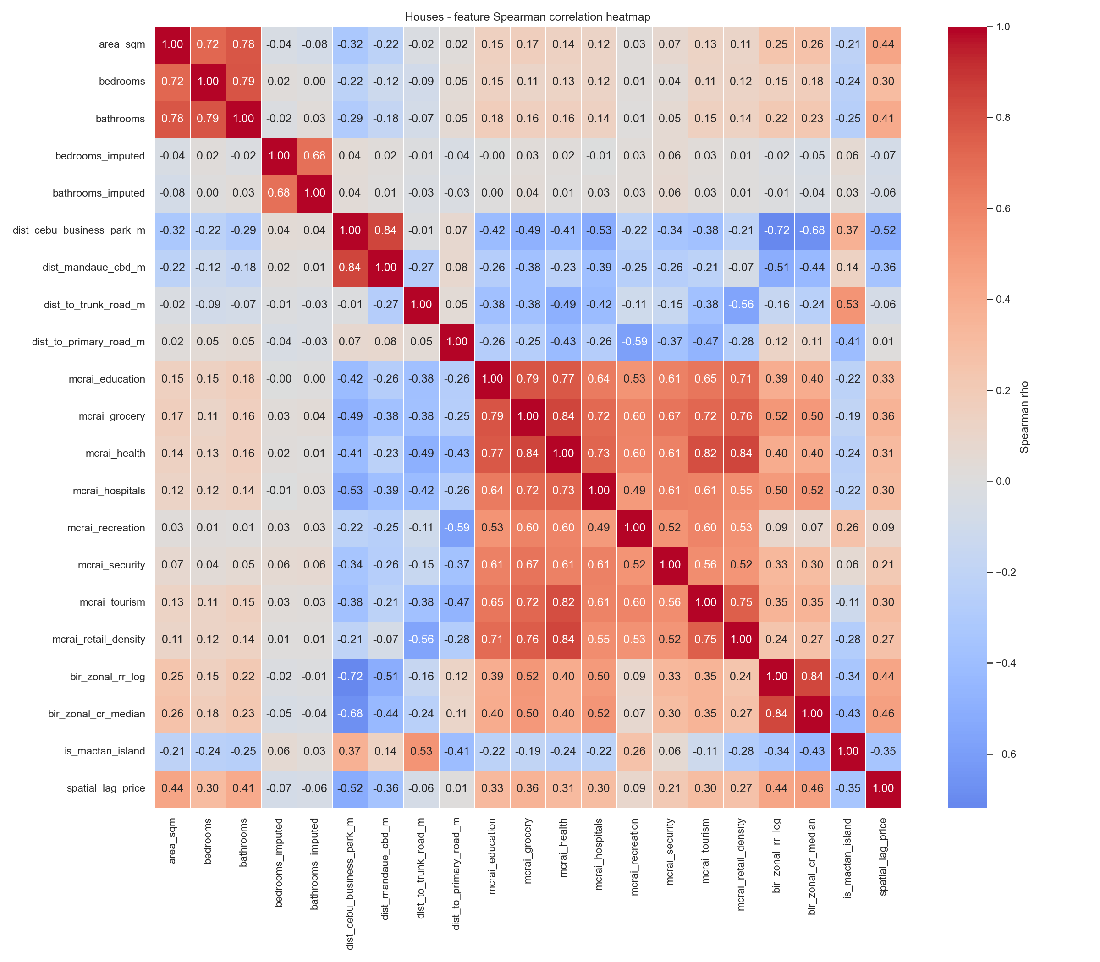
DO WE TRUST THE FEATURES?
▪ Several CBD-distance features move together — the southern corridor is geographically nested.
▪ A flag for the linear baseline, not the trees: OLS trimmed the collinear terms (confirmed with VIF).
▪ Random Forest tolerates correlated predictors, so the meaningful nodes stayed.

Slide 48
06
Groundwork

Slide 49
THE FINDING THAT CHANGED EVERYTHING
▪ The condo median runs ≈ 5.8× the vacant-lot median.
▪ Built area vs land-only are different price logics.
▪ A single pooled model would blur them — so we stratify by type.

Slide 50
CLEANING, HONESTLY
Cleaning kept every decision visible.
▪ Imputed values were flagged, never silently filled.
▪ Structurally-absent fields (beds/baths for lots) left blank, not faked.
▪ Hard duplicates dropped; a price-per-sqm sanity band applied.

Slide 51
A DATA-INTEGRITY STORY
One feature was quietly hijacking the target.
▪ A scale-selector feature dominated the SHAP rankings.
▪ The target had come to mean two different things across scrape batches.
▪ Tracing and fixing it is why the final metrics can be trusted.

Slide 52
07
The Build

Slide 53
ONE MODEL ISN'T ENOUGH
A single model would treat condos, houses, and lots as one market — and they differ 5.8×.

Slide 54
SO WE BUILT THREE
▪ Condominium — 1,300
▪ Houses — 1,223
▪ Vacant Lot — 849
Dröes et al., 2019; Usman et al., 2020

Slide 55
FEATURES PER STRATUM
Feature group | Condo | Houses | Lot
Structural — area | ✓ | ✓ | ✓
Bedrooms / bathrooms | ✓ | ✓ | —
CBD distances (8 nodes) | ✓ | ✓ | ✓
MCRAI composite | ✓ | ✓ | —
MCRAI individual categories | — | — | ✓ (6)
BIR zonal + spatial lag | ✓ | ✓ | ✓
Property-type dummies | — | ✓ | —
Total features | 21 | 24 | 22

Slide 56
THE MODEL LINEUP
▪ OLS — interpretable hedonic baseline.
▪ Random Forest & XGBoost — capture non-linear, interacting effects.
▪ SHAP — explains every prediction, feature by feature.
Rosen, 1974; Breiman, 2001; Chen & Guestrin, 2016; Lundberg & Lee, 2017

Slide 57
HONEST EVALUATION
GroupKFold by location — the honest test.
▪ Listings are grouped by coordinate cluster.
▪ The same spot never appears in both train and test.
▪ Stricter than a random 80/20 split — it blocks neighborhood memorization.

Slide 58
RANDOM FOREST DEPLOYED (RQ2)
▪ Tree models beat OLS in every stratum.
▪ RF edged XGBoost (19.3 vs 19.8 / 22.7 vs 23.6 / 38.4 vs 40.2 MdAPE).
▪ Deployed for robustness on small samples and simplicity.

Slide 59
08
The Appraisal

Slide 60
HEADLINE ACCURACY
Property type | Typical error (MdAPE) | Within 20% (PE20)
Condominium | 19.3% | 51%
Houses | 22.7% | 44%
Vacant Lot | 38.4% | 26%

Slide 61
WHAT THAT MEANS
▪ MdAPE — half of estimates fall within this error.
▪ PE20 — the share landing within 20% (the practical hit-rate).
▪ Reported with MAPE, COD, PRD — but not claiming IAAO compliance.

Slide 62
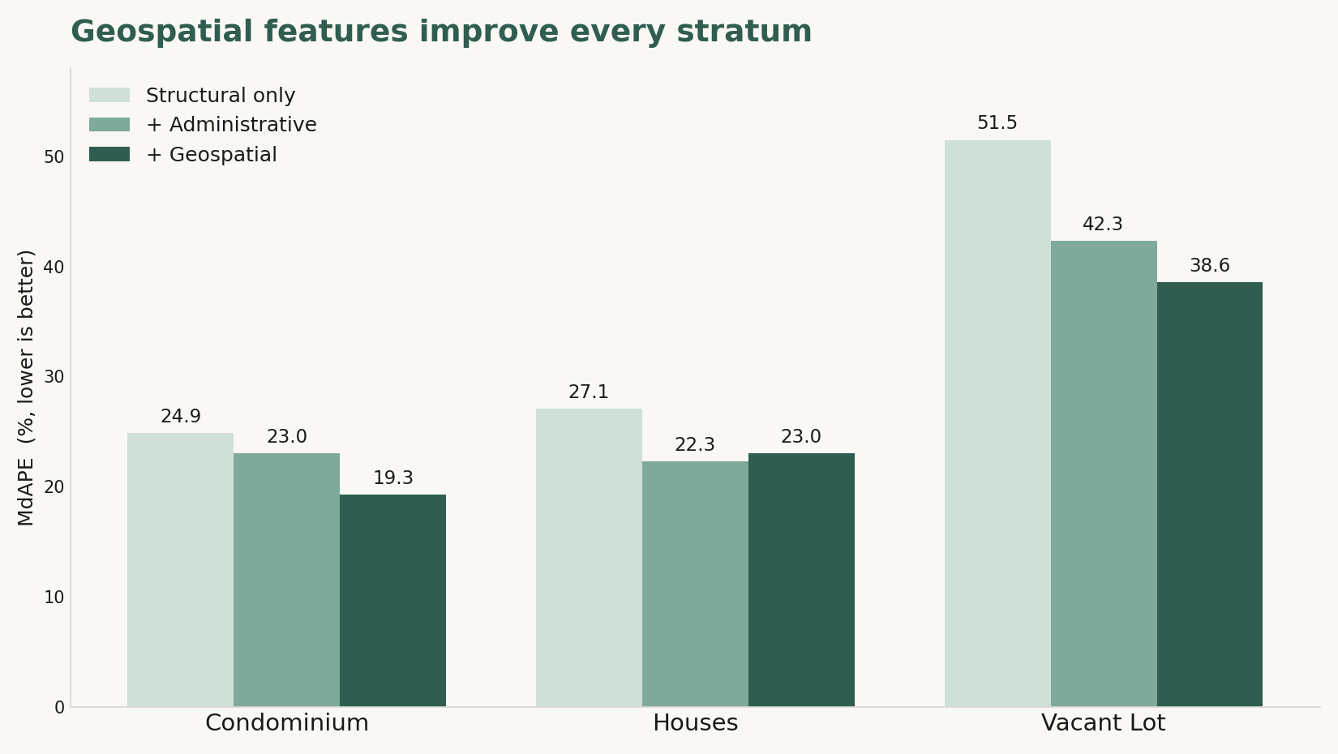
DO GEOSPATIAL FEATURES HELP? (RQ3)
▪ Geospatial features improve every stratum over structural-only.
▪ Biggest lift where benchmarks are weakest: vacant lots (+13 pts) and condos (+5.7).
▪ For houses, city + BIR zonal already capture most of the location signal.

Slide 63
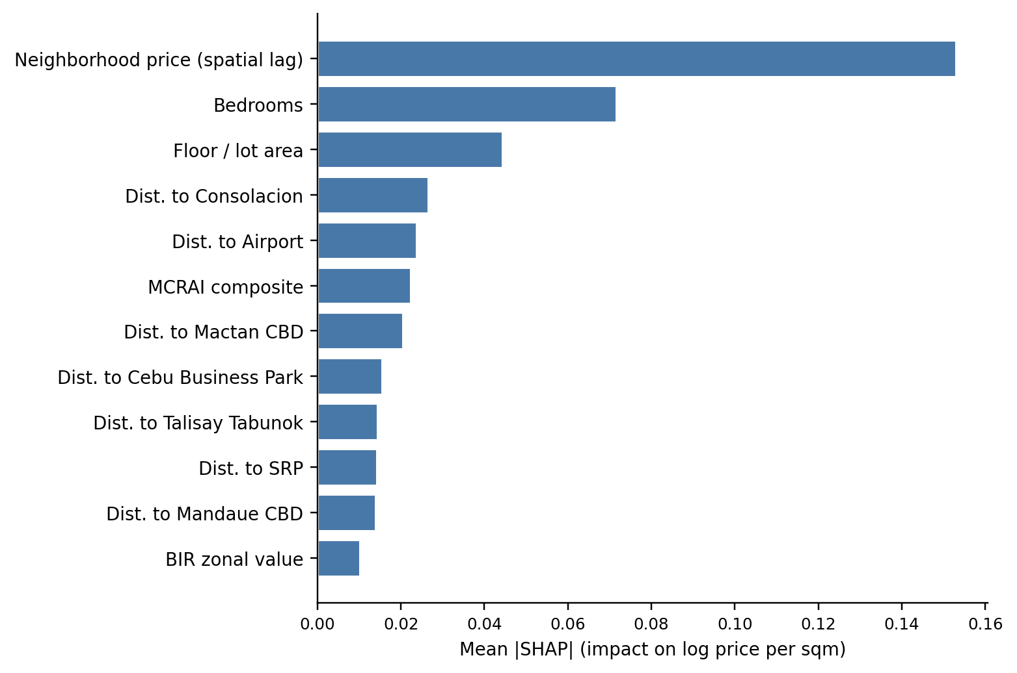
WHAT DRIVES PRICE — CONDOMINIUMS (RQ1)
▪ Neighborhood price level (spatial lag) leads — condos track their block.
▪ Weight spreads across several nodes — Consolacion, airport, Mactan, CBP.
▪ The signature of a multi-node, polycentric market.

Slide 64
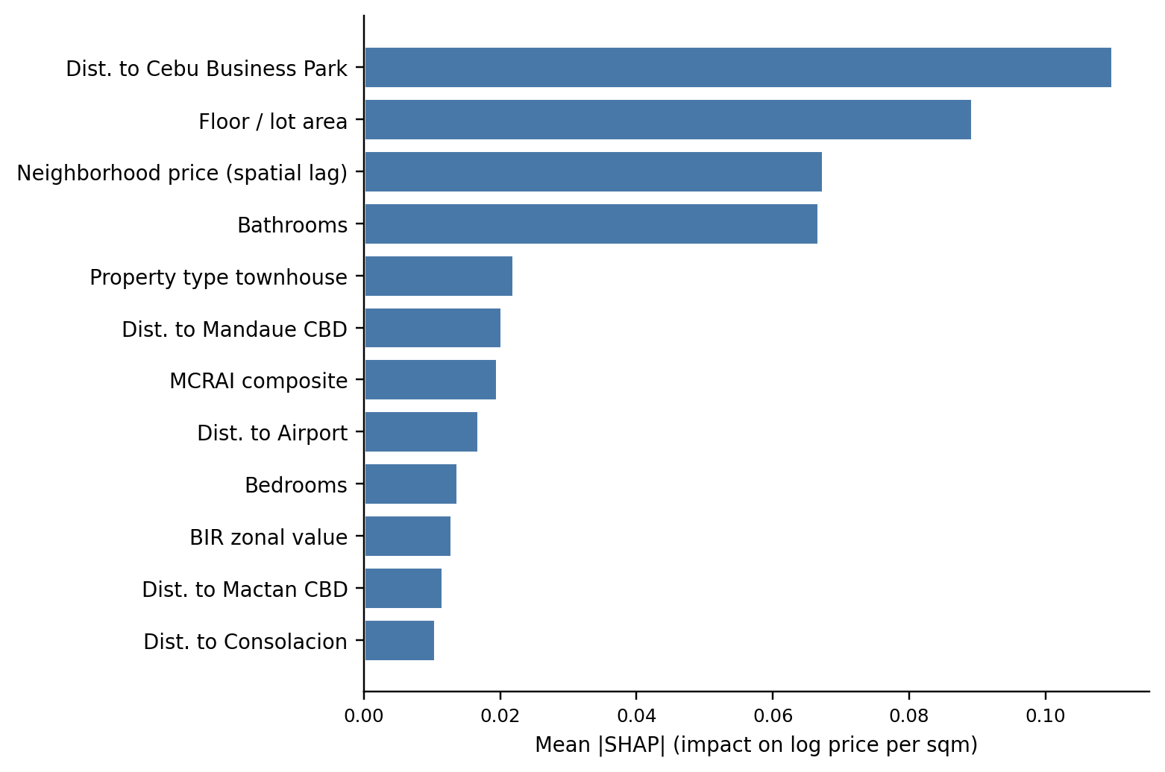
WHAT DRIVES PRICE — HOUSES (RQ1)
▪ Distance to Cebu Business Park is the single strongest driver.
▪ Classic bid-rent: detached-house value falls with distance from the core.
▪ Amenities enter only as the bundled MCRAI composite.

Slide 65
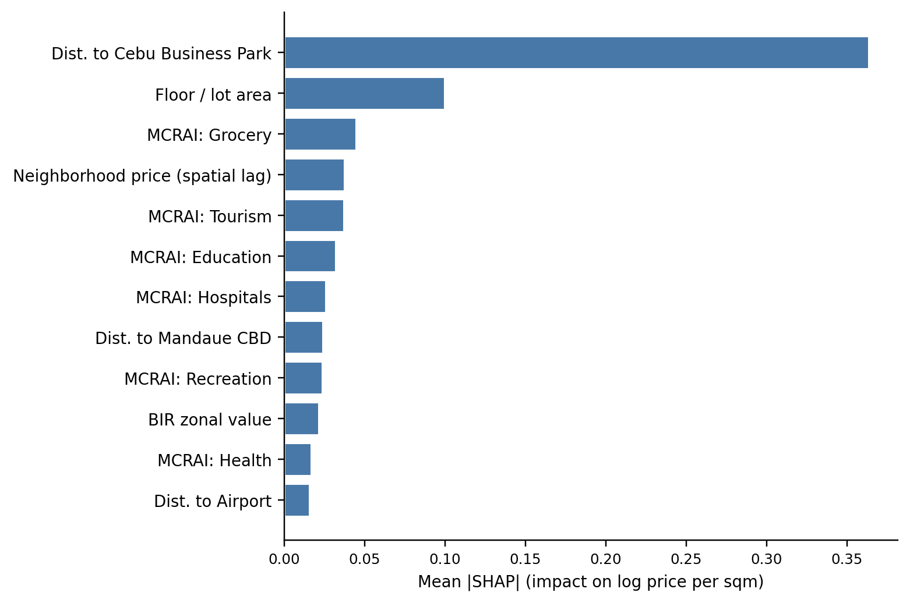
WHAT DRIVES PRICE — VACANT LOTS (RQ1)
▪ Distance to Cebu Business Park leads — the steepest bid-rent gradient of the three.
▪ Individual amenities are the second-largest driver — bare land responds to specific nearby access.
▪ Still the weakest stratum: unrecorded parcel attributes (frontage, zoning) cap accuracy.

Slide 66
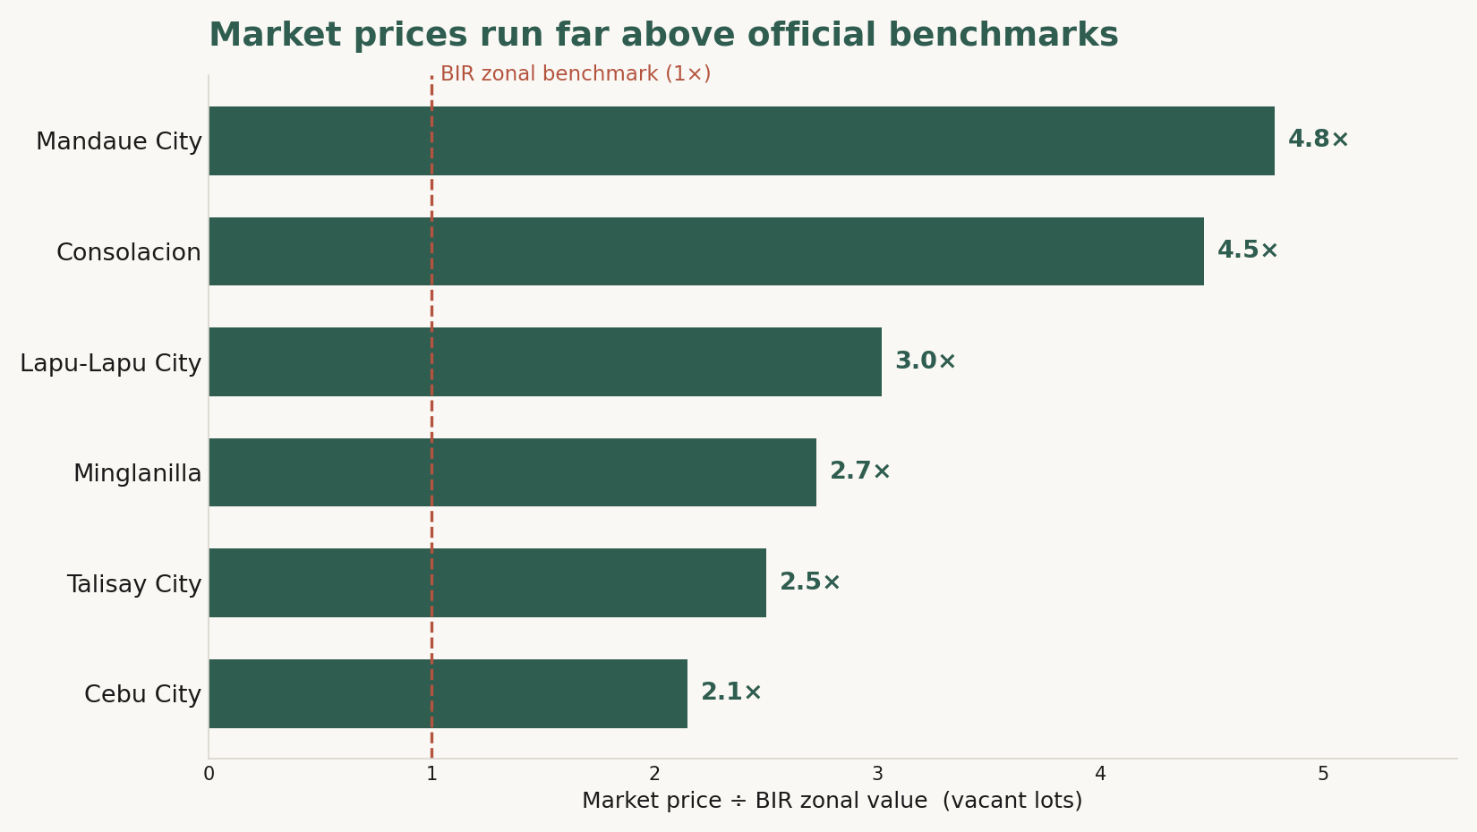
THE VALUATION GAP (RQ4)
▪ Market prices run ~3× the BIR zonal benchmark for vacant lots.
▪ Systematic, not noise — listings beat BIR in nearly every LGU.
▪ A signal that benchmarks are stale — not a correction factor to apply.

Slide 67
IS IT GOOD ENOUGH?
▪ A triangulation reference, not a replacement.
▪ Strongest for condos and houses; indicative for lots.
▪ It complements professional judgment — never replaces it.

Slide 68
09
The Walkthrough

Slide 69
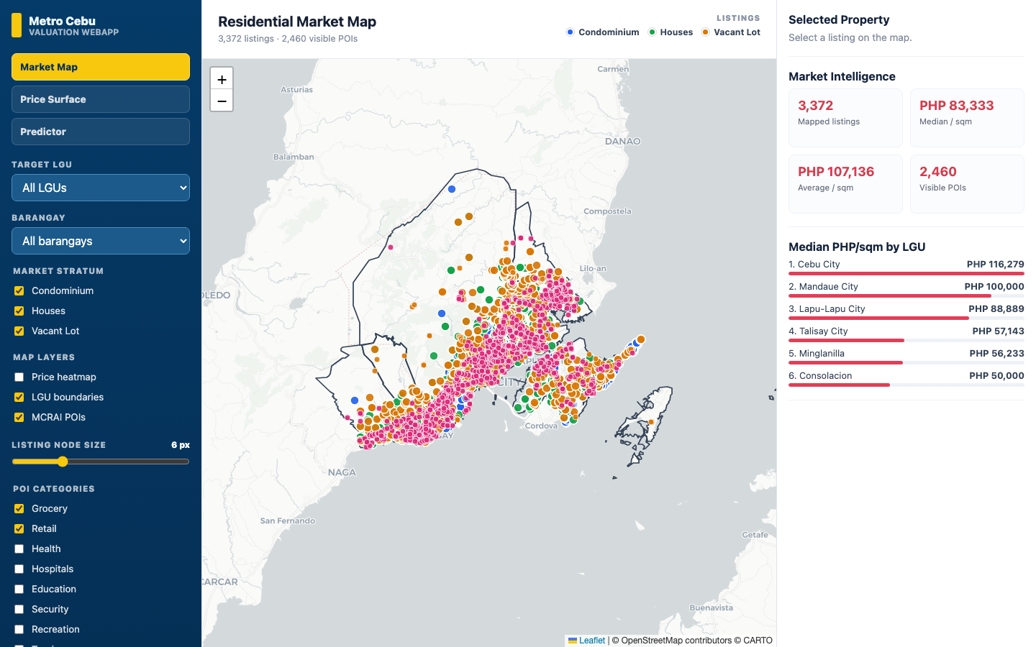
MARKET MAP
Open-market listings with filters.

Slide 70
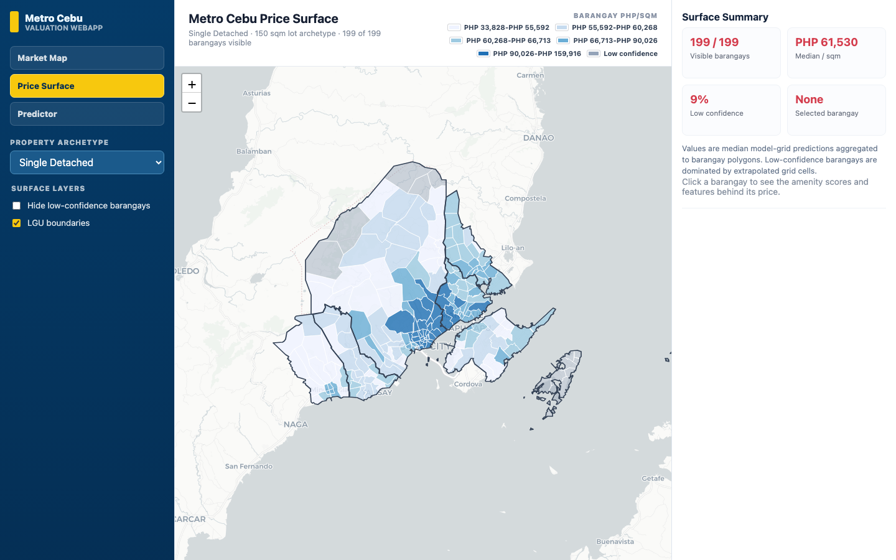
PRICE SURFACE
Predicted ₱/sqm by barangay.

Slide 71
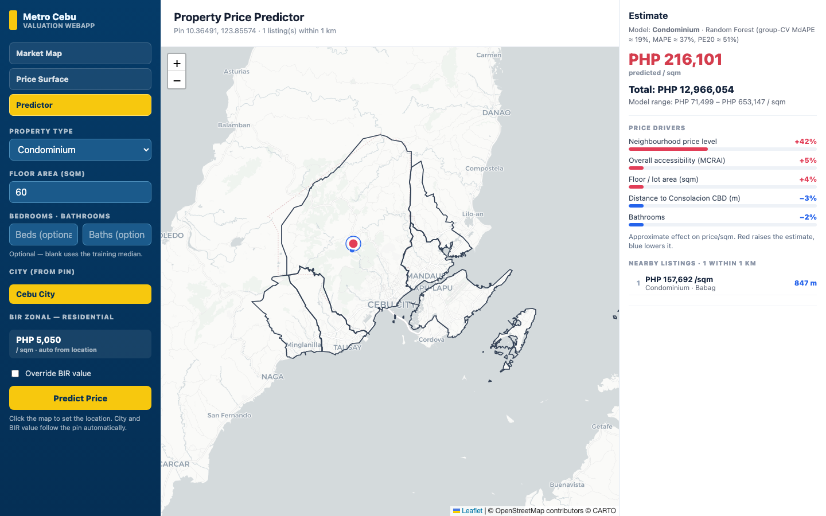
PROPERTY PREDICTOR
A live estimate — and its SHAP reasoning.

Slide 72
10
The Close

Slide 73
ANSWERS TO THE FOUR QUESTIONS
▪ RQ1 — Location dominates; drivers differ by type.
▪ RQ2 — Random Forest deployed.
▪ RQ3 — Geospatial helps, most where benchmarks are weak.
▪ RQ4 — The BIR gap is large and systematic.

Slide 74
CONTRIBUTION
▪ Methodological — per-type modeling, polycentric distances, the two-stage MCRAI, leak-free CV.
▪ Practical — a reproducible, explainable web prototype.

Slide 75
LIMITATIONS
▪ Asking-price ceiling (not deed-of-sale).
▪ Cross-sectional snapshot.
▪ Vacant-lot data ceiling.

Slide 76
RECOMMENDATIONS — PRACTICE & POLICY
▪ Use as triangulation, not a final number.
▪ Recognize secondary subcenters; MCRAI as a template, not a finished index.

Slide 77
RECOMMENDATIONS — FUTURE RESEARCH
▪ Estimate MCRAI parameters from data.
▪ Enrich parcel attributes; add a time dimension.
Udomsap & Abid, 2020

Slide 78
A clearer starting point for the family deciding what a home is worth —
not the last word on it.

Slide 79
REFERENCES
Agosto, A. (2020). Determinants of Land Values in Cebu City, Philippines.
Bangko Sentral ng Pilipinas. (2025). Residential Real Estate Price Index (RREPI): Q2 2025 Report.
Boeing, G. (2017). OSMnx: New methods for acquiring, constructing, analyzing, and visualizing complex street networks.
Breiman, L. (2001). Random forests.
Bureau of Internal Revenue. (n.d.). Zonal Values Resources and Schedules.
Chen, T., & Guestrin, C. (2016). XGBoost: A scalable tree boosting system. ACM SIGKDD.
Dröes, M. I., Hoesli, M., & Bourassa, S. C. (2019). Heterogeneous households and market segmentation in a hedonic framework. ERES.
Giuliano, G., & Small, K. A. (1991). Subcenters in the Los Angeles region.
Grinsztajn, L., Oyallon, E., & Varoquaux, G. (2022). Why do tree-based models still outperform deep learning on typical tabular data? NeurIPS 35.
Hansen, W. G. (1959). How accessibility shapes land use.
International Valuation Standards Council. (2025). International Valuation Standards (IVS) 2025.
Japan International Cooperation Agency & MCDCB. (2015). The Roadmap Study for Sustainable Urban Development in Metro Cebu.
Lundberg, S. M., & Lee, S.-I. (2017). A unified approach to interpreting model predictions. NeurIPS 30.
McMillen, D. P. (2003). The return of centralization to Chicago.
Otsuka, K., Manasan, R. G., & Piza, S. (2023). Local government unit income and real property tax collection in the Philippines. PIDS.
Philippine Statistics Authority – Central Visayas. (2025). Cebu's economy grows by 7.3 percent in 2024.
Ramolete, G. I. L., Bramaskara, B., Reyes, D. A., & Heinrich, A. (2023). Utilization of machine learning and government-based indicators for property value prediction in the Philippines. The Philippine Statistician.
Rosen, S. (1974). Hedonic prices and implicit markets.
Tanamal, R., Minoque, N., Wiradinata, T., Soekamto, Y., & Ratih, T. (2023). House price prediction model using Random Forest in Surabaya City. TEM Journal.
Tobler, W. R. (1970). A computer movie simulating urban growth in the Detroit region.
Udomsap, A., & Abid, M. (2020). Macroeconomic determinants of housing prices.
Usman, H., Lizam, M., & Adekunle, M. U. (2020). A priori spatial segmentation of commercial property market using hedonic price modelling.
Viray, F. S. (2023). Residential property price forecasting model for Central Pangasinan, Philippines.

Slide 80
Thank you
Chris Dominic Estreba · Questions welcome

